Slide 1
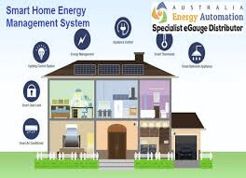
Smart Home Energy Management System
PRESENTED BY
JIYA JAIN

Slide 2
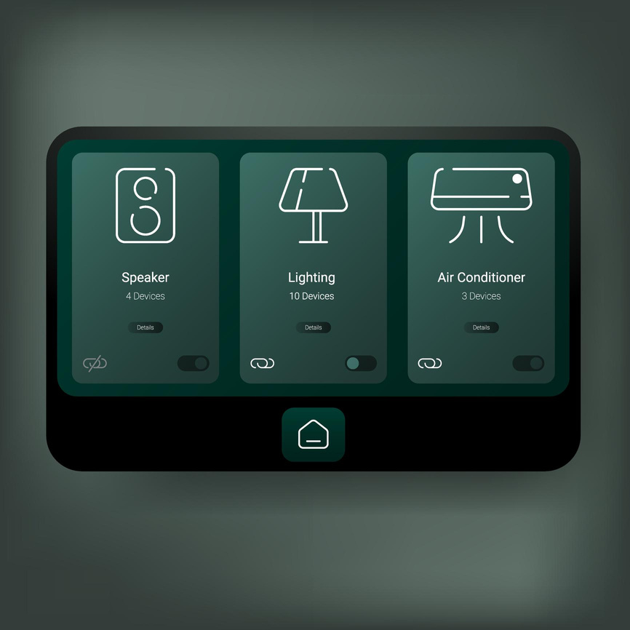
Intelligent Energy Monitoring &
Cost Optimization Platform
🔹 Overview
Java-based web platform for managing household energy usage
Centralized monitoring and control system
🔹 Key Features
Real-time electricity consumption tracking
Peak usage detection
Cost estimation and usage prediction
Interactive dashboard with live analytics

Slide 3
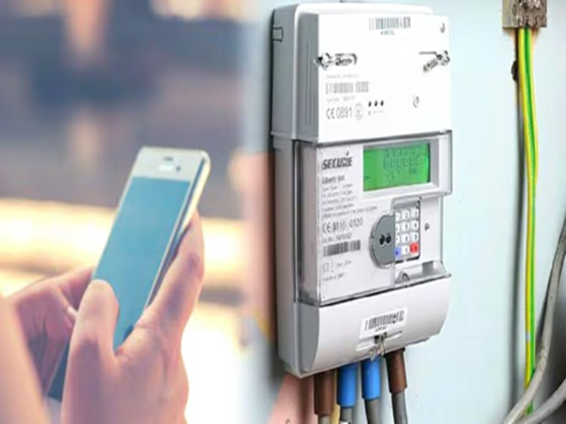
Problem
High electricity wastage due to unattended appliances
No real-time monitoring of energy usage
Increasing electricity bills
No alert system for abnormal power spikes
Poor awareness of daily and monthly consumption trends
2

Slide 4
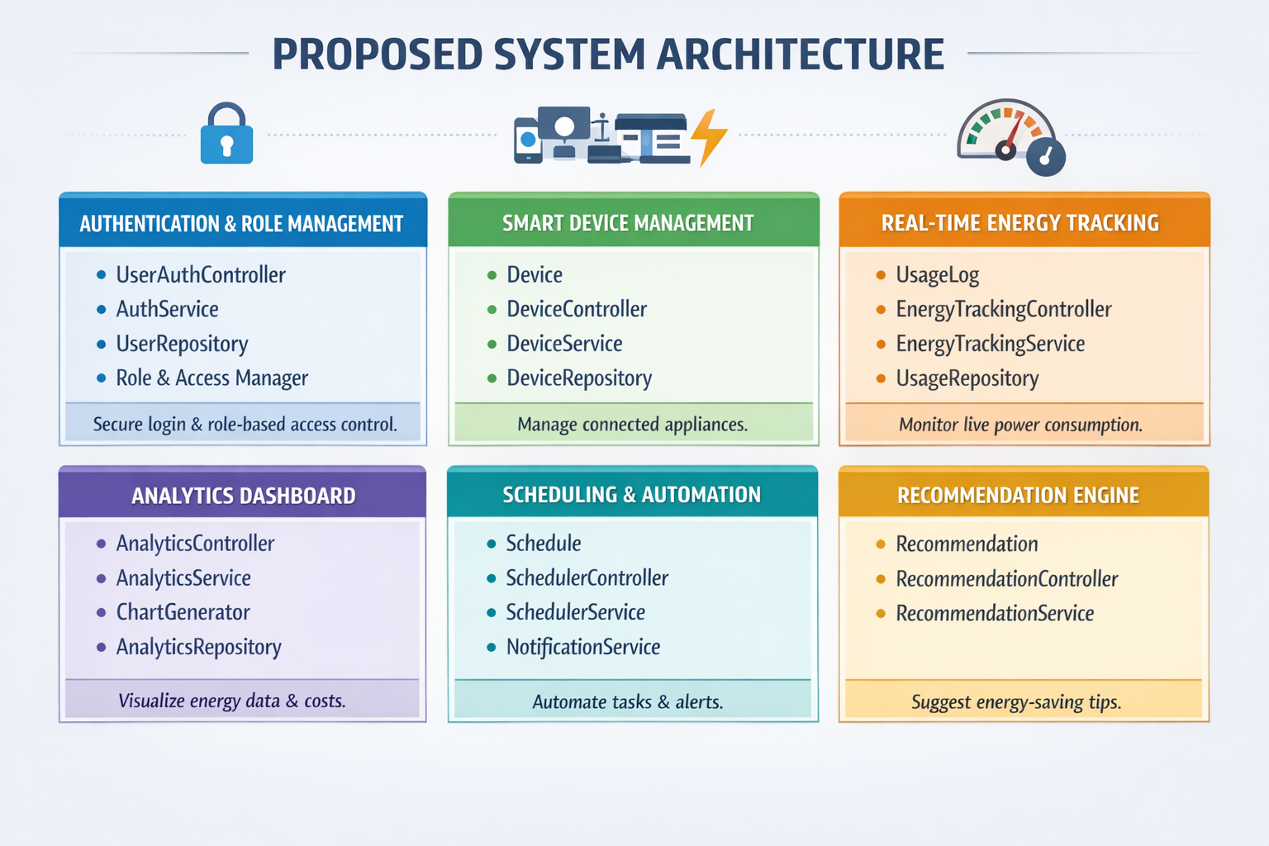

Slide 5

SYSTEM ARCHITECTURE (Technology Stack Overview
Front-End: HTML, CSS, Bootstrap, Thymeleaf (UI & user interaction)
Back-End: Java 17/21 with Spring Boot & Spring MVC (business logic)
Security: Spring Security (authentication & authorization)
REST API: Spring Boot REST Controllers (JSON communication)
Persistence: Hibernate / JPA (ORM & database operations)
Database: MySQL / PostgreSQL (data storage)
Deployment: Docker (containerized application environment)

Slide 6
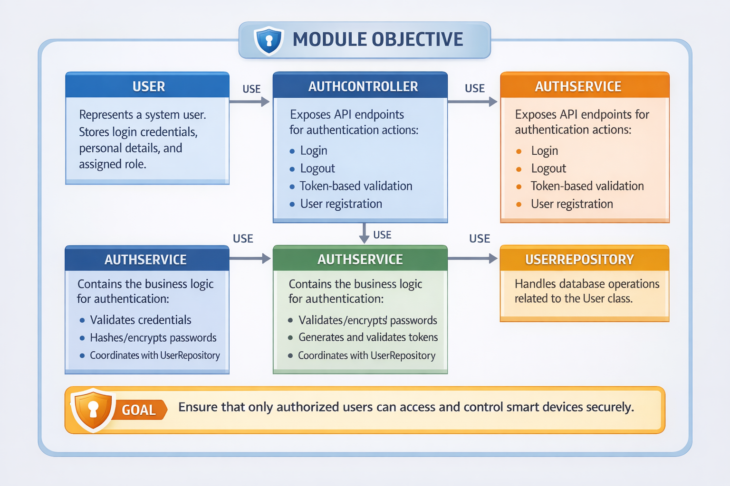

Slide 7
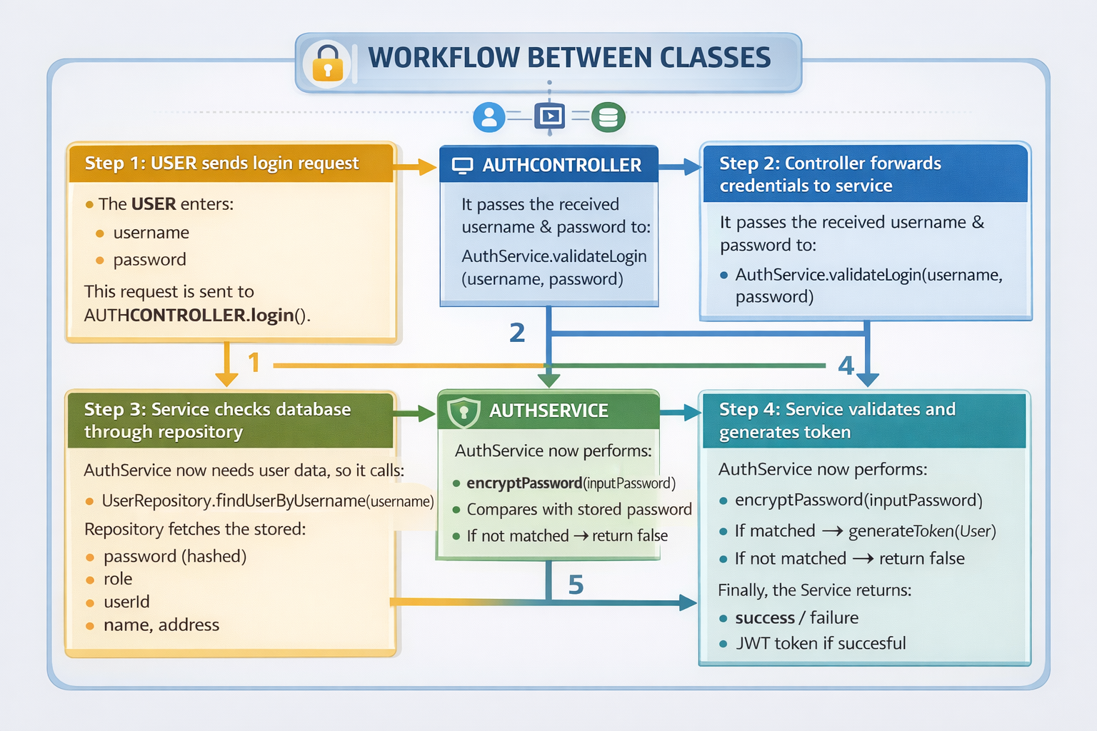

Slide 8
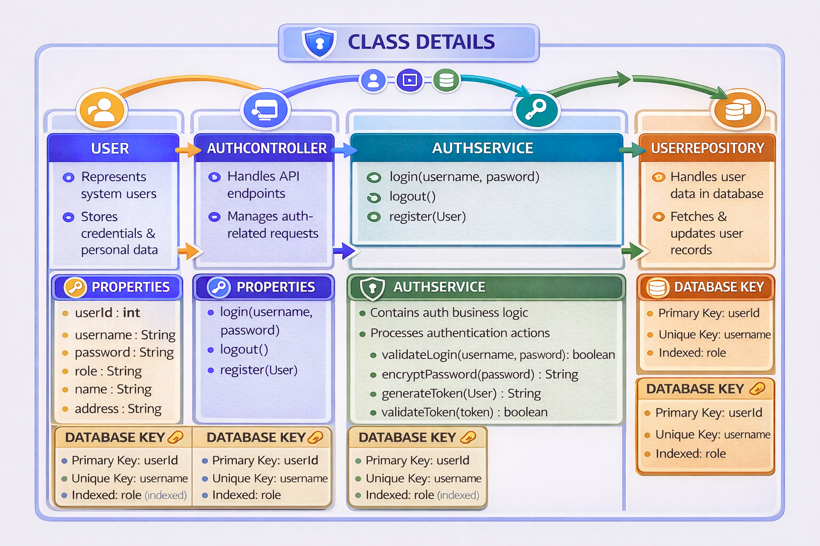

Slide 9
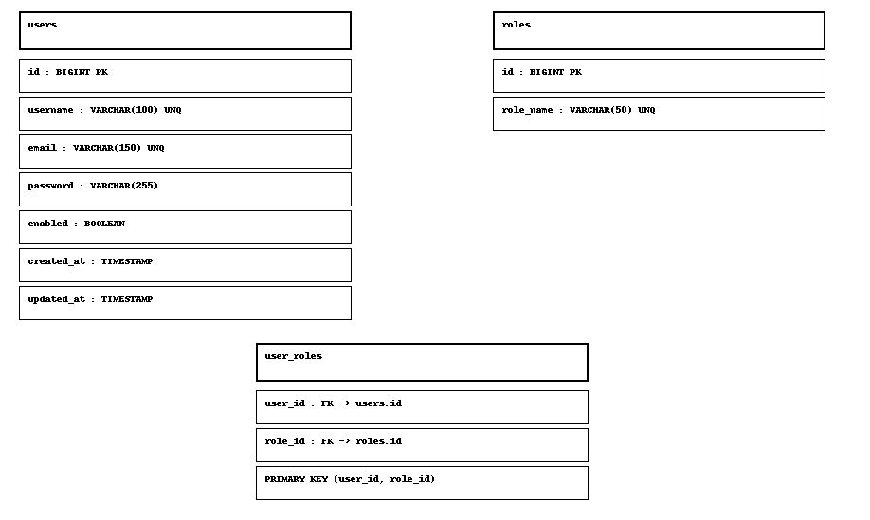
DATABASE SCHEMA

Slide 10
The End

