Slide 1
PID Control
Jackson Isenberg

Slide 2
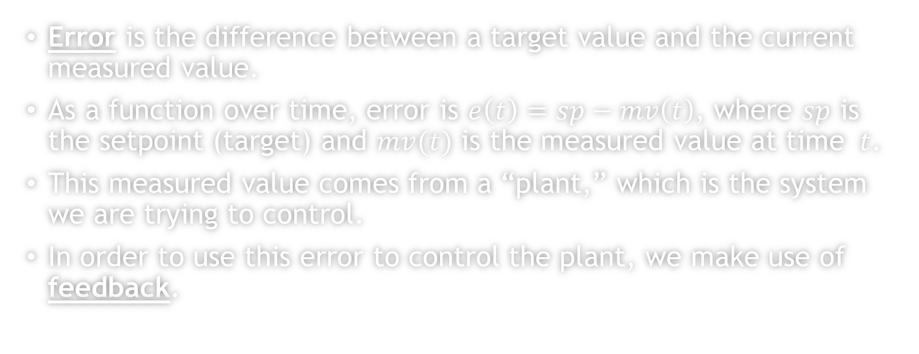
What is Error?
Error is the difference between a target value and the current measured value.
As a function over time, error is $e\left(t\right)=sp−mv\left(t\right)$, where $sp$ is the setpoint (target) and $mv(t)$ is the measured value at time $t$.
This measured value comes from a “plant,” which is the system we are trying to control.
In order to use this error to control the plant, we make use of feedback.

Slide 3

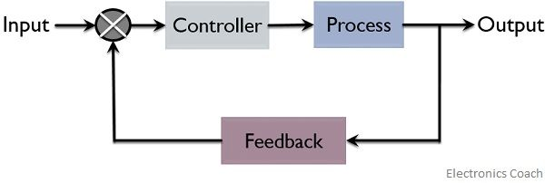
What is Feedback?
A feedback loop takes an input, performs some mutation on the input, and then feeds the output back into what produced the original input.
The system then produces a new value that is fed in as the new input to the loop and the process continues.

Slide 4
Proportion Term
Imagine you want to move the hand of a clock to a certain position, but the clock hand is very sensitive and eagerly moveable.
You start off by pushing it far past the goal point; to fix it, you push it back the other way but with a bit less force than last time.
You repeat this process until the clock hand reaches the goal position.
This is an example of proportional control…

Slide 5
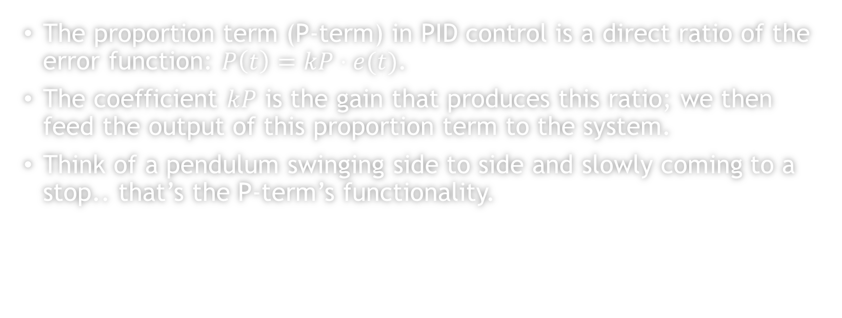
Proportion Term
The proportion term (P-term) in PID control is a direct ratio of the error function: $P\left(t\right)=kP⋅e(t)$.
The coefficient $kP$ is the gain that produces this ratio; we then feed the output of this proportion term to the system.
Think of a pendulum swinging side to side and slowly coming to a stop.. that’s the P-term’s functionality.

Slide 6
Derivative Term
The P-term, however, produces a lot of oscillations as we saw with the clock hand.
We can try to minimize the oscillations by decreasing the speed of the force we apply over time to the clock hand as we near the goal position.
As the clock hand gets closer to the goal, we slow down our pushing force.

Slide 7
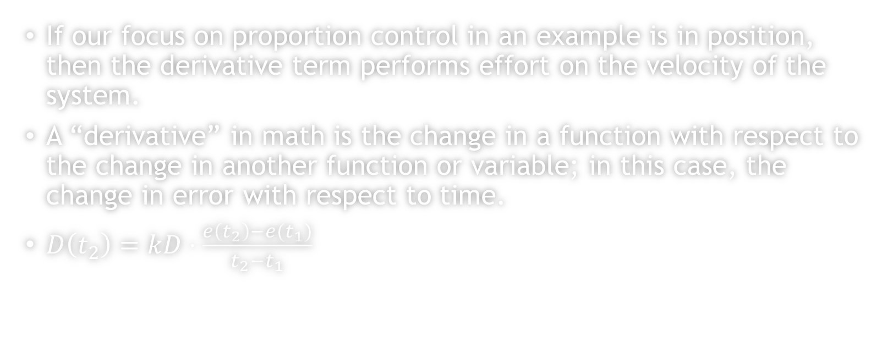
Derivative Term
If our focus on proportion control in an example is in position, then the derivative term performs effort on the velocity of the system.
A “derivative” in math is the change in a function with respect to the change in another function or variable; in this case, the change in error with respect to time.
$D\left(t_{2}\right)=kD⋅\frac{e\left(t_{2}\right)−e(t_{1})}{t_{2}−t_{1}}$

Slide 8
Integral Term
Now we’re having issues with missing the target position as we slow down our speed and move positions.
To fix this, we just apply a tad bit more force than we normally would as time passes.
The more time that passes, the slightly more force we apply onto the clock hand.

Slide 9
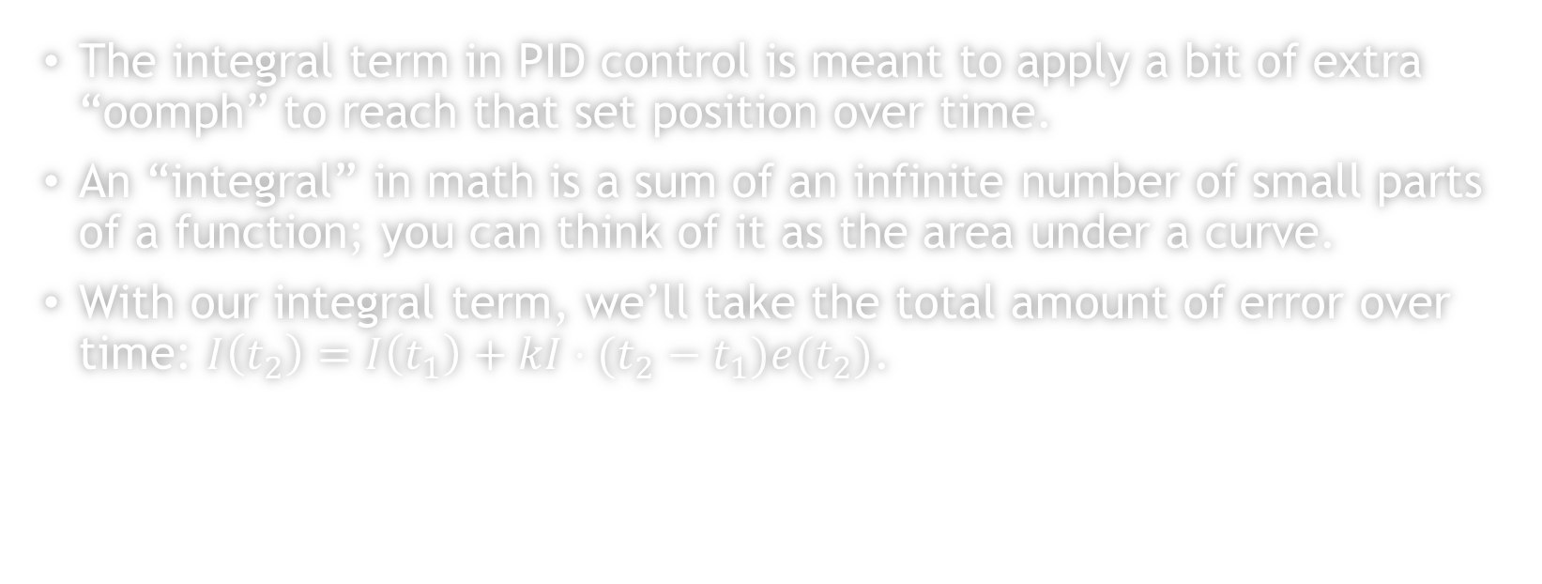
Integral Term
The integral term in PID control is meant to apply a bit of extra “oomph” to reach that set position over time.
An “integral” in math is a sum of an infinite number of small parts of a function; you can think of it as the area under a curve.
With our integral term, we’ll take the total amount of error over time: $I\left(t_{2}\right)=I\left(t_{1}\right)+kI⋅(t_{2}−t_{1})e(t_{2})$.

Slide 10
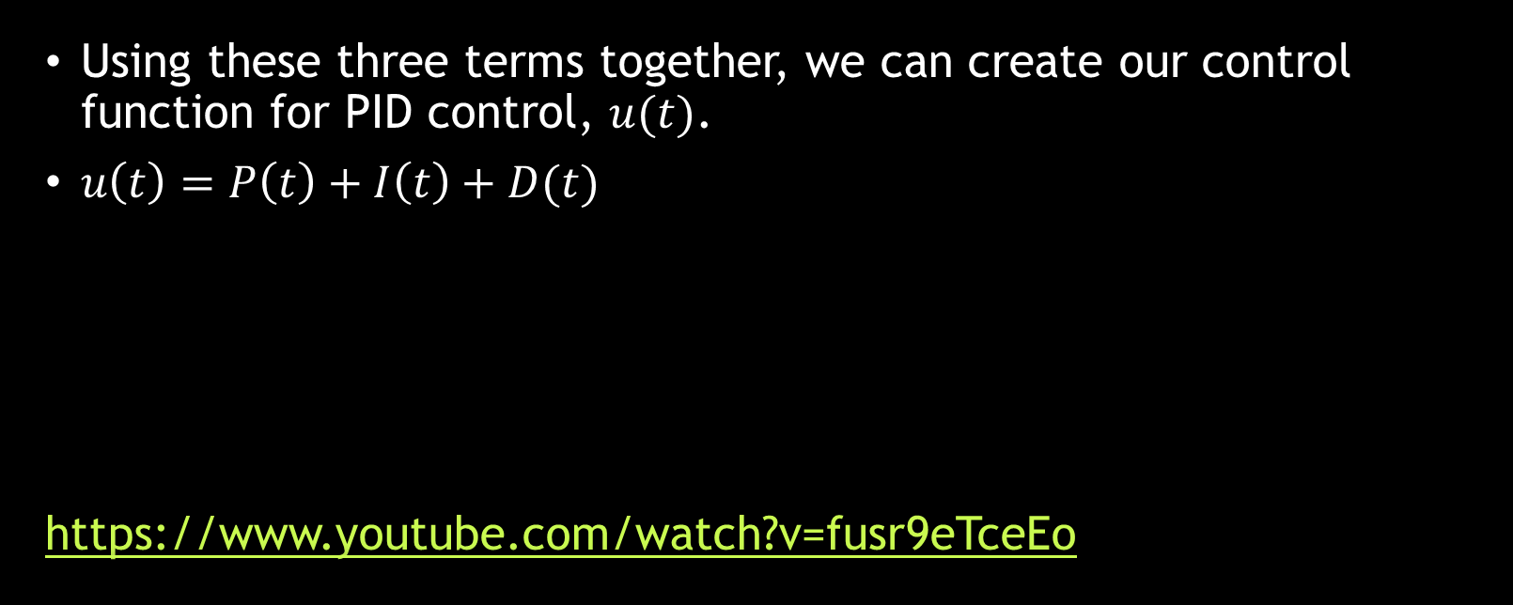
Control Function
Using these three terms together, we can create our control function for PID control, $u(t)$.
$u\left(t\right)=P\left(t\right)+I\left(t\right)+D(t)$
https://www.youtube.com/watch?v=fusr9eTceEo

