Slide 1
Application Development for the Android platform using the Android SDK
Introductory Stuff

Slide 2
Introduction
What is the Android platform?
Why should you care?
A little about the course.
Notes:
How presentation will benefit audience: Adult learners are more interested in a subject if they know how or why it is important to them.
Presenter’s level of expertise in the subject: Briefly state your credentials in this area, or explain why participants should listen to you.

Slide 3
Android Platform Architecture
Click on this link to go to the image for Architecture(internet connection required)
Click here to go to the Android Developers documentation page(internet connection required)
Notes:
Lesson descriptions should be brief.

Slide 4
Android Application Components(Main)
Activity: Manage the UI and direct user interaction. It is a single screen.
Service: Does background tasks. No UI. Push your heavy lifting here(Multithreading?).
Broadcast Receiver: Manages “screams” from the OS or other apps.
Content Provider: Supplies data from one application to another upon request. (How does WhatsApp access the user’s contact list?)
Notes:
Example objectives
At the end of this lesson, you will be able to:
Save files to the team Web server.
Move files to different locations on the team Web server.
Share files on the team Web server.

Slide 5
The AndroidManifext.xml
As the name suggest, it’s kind of like a manifest of the app which is required by the build tools, the Android OS and Play Store for various important information about the app.
Contents
The app’s package name
The main components’ declaration(activities, services, etc.) and their basic properties.
Permission to access protected parts of the system or other apps. Example: internet usage by your app must be stated here.
The hardware and software features the app requires, which affects which devices can install the app from Google Play.

Slide 6
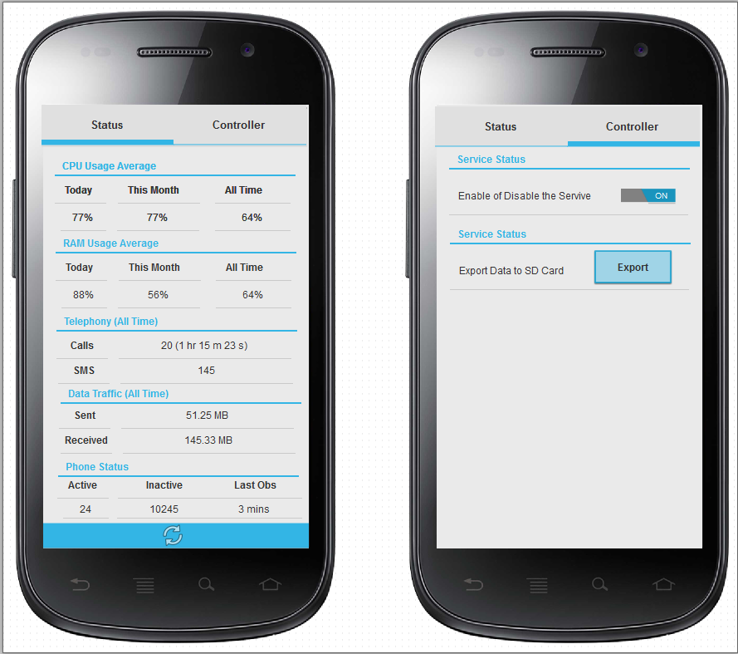
Activities
The entry point of the user’s interaction with the app. It is a fundamental component. You may also call an activity as “screen”(non-technical term).
Activities within an app have almost “zero” “”dependencies”” among each other.
Handling of all user interaction actions are performed here.
Has lifecycle callback methods that is used to perform tasks `(Google main method vs. lifecycle methods). (Example: onCreate(), onResume(), onDestroy(), etc.)

Slide 7
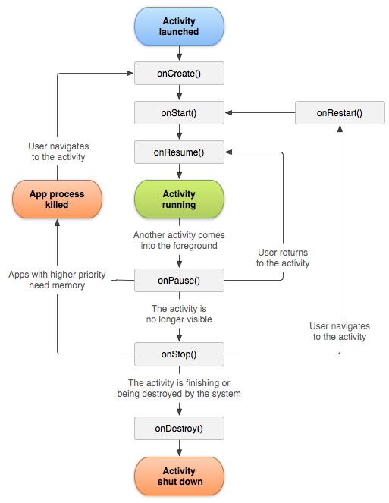
Activity Lifecycle
onCreate()
onStart()
onResume()
onPause()
onStop()
onDestroy()

Slide 8
Switching between Activities
There are 2 standard ways in which we can switch between activities.
The most standard way is to use the method startActivity(Intent). The intent parameter is an Intent instance that can be initialized via a constructor taking the present activity and the target activity as the parameters (like this: Intent i = new Intent(source.class,dest.class);).
Another way is to use startActivityForResult(Intent,int). This is used when you want to get some result back after the ending of an activity. We will skip this for now.

Slide 9
Lifecycle method order during Activity switch
Lets that that we have 2 Activities A and B. When we transition from Activity A to Activity B, the following events take place in sequence:
Activity A's onPause() method executes.
Activity B's onCreate(), onStart(), and onResume() methods execute in sequence. (Activity B now has user focus.)
Then, if Activity A is no longer visible on screen, its onStop() method executes.
This predictable sequence allows for management of transition of information from one activity to another.

Slide 10
Passing Information from one Activity to another
Intents at play here as well.
Intents contain a method known as putExtra(String, ______). The first parameter is the key which is of type String and the second parameter can be primitives, String instance, instance of class that implements the interface java.io.Serializable or instance of class that implements the interface android.os.Parcelable.
In the target Activity, create an android.os.Bundle instance and call getIntent().getExtras() chain of methods. Using the bundle instance you can obtain the data passed from the source Activity by using getter methods for the bundle instance(like get(Object), getInt(String).

Slide 11
Exercise:
Create an app that takes in two numbers entered in TextFields, adds them and displays their sum in the TextField of another Activity.
Implement a mechanism to travel back and forth between the two activities in the about mentioned exercise.

Slide 12
Further Reading
More on Intents and Intent-Filters.
More on Activity State Changes.
Advanced Task
Make a simple calculator and not-so-simple converter app. On opening the app, the user gets to choose between using the simple calculator or the not-so-simple calculator. If the user chooses the simple calculator then direct the user to the simple calculator(full implementation. Number input, calculation and result output) and if the uses chooses other, then direct them to the not-so-simple calculator(implement trigonometric functions and factorials here).
This app should contain a minimum of 3 Activities.

