Slide 1




Domain Charge Transfer Analysis Feature Development
Julia Szczuczko

Slide 2
From computational backend to user interaction
pybest-ct CLI script
Core Utility
Domain definition GUI
CTProperty
Notes:
Existing pain points: no simple domain-resolved CT visualization.
Project goals:
- Unified property structure.
- Intuitive GUI/CLI integration.
- Support for automated domain selection and future interactivity.
Input → Computation → Analysis → Visualization.
Mention integration with checkpoints and reuse of molecular data.

Slide 3

Core Utility & Domain Logic
Computational backend
How the core charge-transfer logic works
DomainSpec, CT matrix, analysis principles

Slide 4
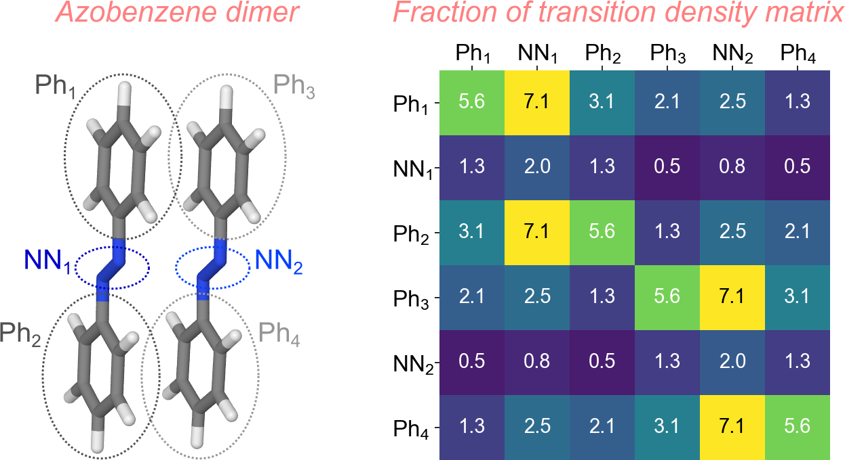
Charge Transfer Analysis
What CT Analysis is?
Quantifies how much electronic charge moves between predefined molecular domains.
Essential for studying excitation character, donor–acceptor systems, and intermolecular charge flow.
Represents results as a Charge Transfer matrix where each element CT(A→B) measures transfer from domain A to domain B.
Titov, Evgenii. "On the low-lying electronically excited states of azobenzene dimers: Transition density matrix analysis." Molecules 26.14 (2021): 4245.
Notes:
CT analysis partitions a molecule into domains (Ph₁–Ph₄, NN₁–NN₂).
Each element of the CT matrix quantifies how much electronic density is transferred from domain A to B.
Computed via AO→MO projections and summed per domain pair.
Highlights donor–acceptor interactions and intra- vs inter-domain character of transitions.

Slide 5




Backend Utility Logic
User-defined domains (DomainSpec)
Input defined by user via GUI or .xyz file
AO $→$ MO projection
AO → MO projection
Domain-weight computation
CT Matrix
Aggregated inter-domain charge flow
Each atom is assigned to a domain
Transformation of atomic orbitals into molecular orbitals
$C_{ij}$ coefficients describe orbital composition
The CT analysis combines orbital data with user-defined domains.
For each molecular orbital, atomic-orbital coefficients are summed within each domain.
The resulting weights are then aggregated into the CT matrix, quantifying how charge redistributes between fragments.
$$ψ_{j}=\sum_{i}{C_{ij}φ_{i}}$$
$${CT}_{A→B}=\sum_{i∈A}{\sum_{j∈B}{{\left|C_{ij}\right|}^{2}}}$$
$$w_{jB}=\sum_{i∈B}{{\left|C_{ij}\right|}^{2}}$$
Sum of squared
coefficients per domain
domain yields relative
contribution
Notes:
Domains are defined by the user and passed as DomainSpec.
AO→MO coefficients describe how atomic orbitals contribute to each molecular orbital.
These coefficients are grouped per domain and squared to yield domain weights.
Summing over orbitals produces the CT matrix, representing charge flow between domains.
The process begins with user-defined domains (A, B, …), provided through the GUI or file input. Next, molecular orbitals are expressed as linear combinations of atomic orbitals — that’s the AO→MO projection. We then compute domain weights for each orbital by summing squared coefficients within each domain. Finally, these weights are aggregated into the charge transfer matrix, which quantifies how much charge moves from one domain to another.

Slide 6

Implementation Highlights
CT Matrix Computation
Core numerical layers
DomainSpec
Structural + atom grouping
Interfaces
Property/CLI
Access layers
Key Principles
Modular design → reusable both in CLI/GUI and Property contexts.
Independent of PyBEST core → can be tested or executed standalone.
DomainSpec → manages atom-to-domain mapping, validation, and color assignments.
Design Advantages
Ensures reproducibility and clear separation of responsibility.
Simplifies integration and future extension (e.g., GUI, scripting).
Enables consistent results regardless of user interface.
CT Analysis Utility /utility/ct_analysis.py

Slide 7
PyBEST integration (CTProperty)
How the CT feature communicates with PyBEST’s internal framework
Unified lifecycle for setup, execution, and data export
Enables reuse across workflows and automated testing

Slide 8
PyBEST Property Workflow
Properties are modular analysis or computation units that operate on finished molecular calculations.
Each property inherits from PropertyBase and follows a standardized execution sequence (__call__ pipeline).
Results are stored in a unified checkpoint (IOData) for reuse or serialization.
Enables reproducible analyses, automation, and consistent testing across PyBest.
MOLECULE/ CALCULATION
PROPERTY INITIALIZATION
UNMASK & READ INPUT
PREPARE INTERMEDIATES
PROPERTY COMPUTATION
RESULTS
Input wavefunction, basis, and orbital data from a PyBEST computation.
unmask_args() &
read_input() process property-specific options.
get_property() performs the actual analysis.
A property is instantiated and linked to molecular data and the checkpoint.
Temporary tensors or integrals are built
print_results() outputs summaries; results stored in checkpoint and optionally exported.
Notes:
Every PyBest property—from energy computations to our CT analysis—follows the same standardized lifecycle defined in PropertyBase. It starts by unpacking molecular data, prepares intermediate tensors, performs the actual computation, and finally stores the results in a shared checkpoint file. This unified design is what lets new properties like CTProperty integrate seamlessly into the PyBest framework.”

Slide 9
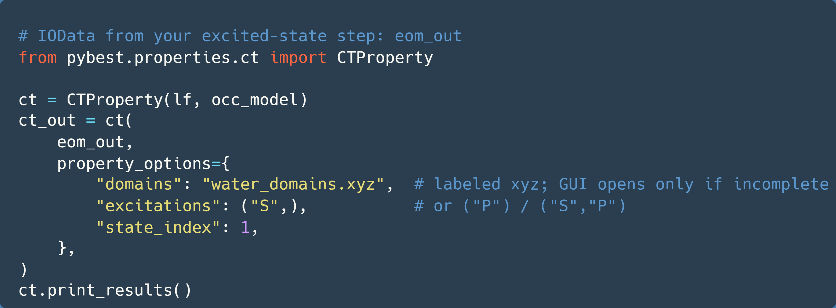
CTProperty – Integration of Charge-Transfer Analysis
INPUTS
iodata: must contain excited-state vectors civ_ee; overlaps/orbitals are auto-seeded into the checkpoint
domains: path to labeled .xyz or a DomainSpec. If labels in the xyz are incomplete, the GUI picker is launched
INTEGRATION
prepare_intermediates: orthogonalizes orbitals, computes MO→domain weights, assigns MOs to domains (stores arrays under ct/*)
get_property: aggregates CI contributions into the domain→domain CT matrix and writes it to the checkpoint (ct/matrix).
options: state_index, excitations, major_thresh, tie_break, strict
Notes:
On the previous slide we saw the generic PropertyBase pipeline.
CTProperty plugs straight into that: it seeds the checkpoint from IOData, computes MO→domain weights, then aggregates CI into the final CT matrix.
Yinstantiate and call it with IOData plus domains; if the xyz isn’t fully labeled, the GUI completes it.

Slide 10
CLI Interface (pybest-ct script)
User-level interface
Simple command-line entry point for CT analysis
Runs automatically from checkpoints or opens GUI if needed
Designed for quick usage with pre-calculated results and reproducible workflows

Slide 11
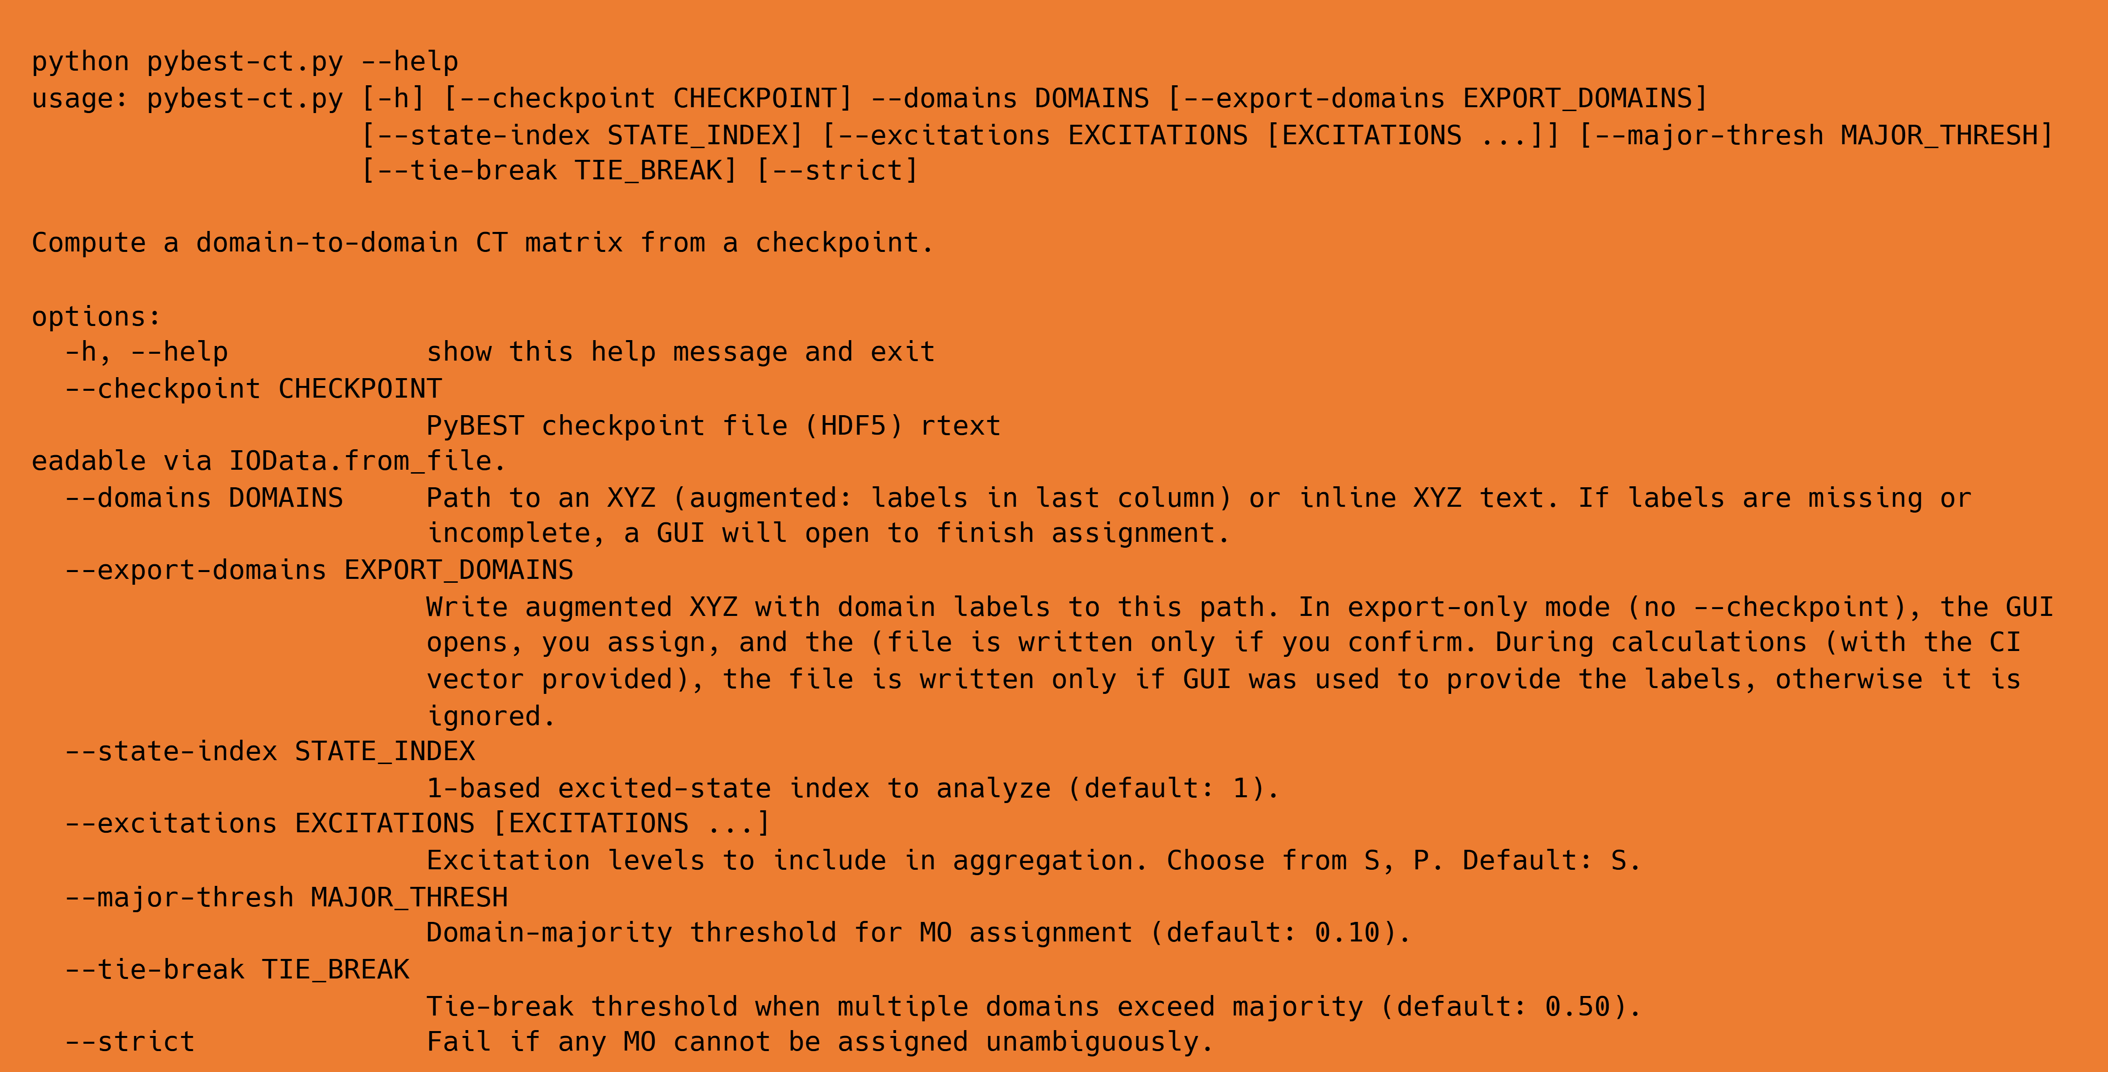
pybest-ct Command-Line Tool
Standalone entry point for running Charge Transfer analysis.
Notes:
This CLI wraps our CTProperty into a simple standalone tool. You can run it fully headless if your .xyz already contains domain labels, or use it as a lightweight GUI launcher to create labeled inputs. It’s perfect for batch runs or quick visualization tests

Slide 12
GUI – Domain Definition Interface
Interactive atom selection and domain assignment
Real-time color feedback and live assignment tracking
Built on Qt + 3Dmol.js for cross-platform visualization

Slide 13
CT Analysis GUI - Interactive Domain Definition
Loads structures directly from XYZ.
Assigns, recolors, and validates domain definitions.
Exports labeled geometry automatically.
Lightweight — no external dependencies or web connections.
Visual tool for assigning atoms to labeled domains directly in 3D
Launches automatically when domain labels in .xyz are missing or incomplete.
Uses Qt WebEngine + 3Dmol.js for visualization and atom picking.
Communicates with Python via Qt WebChannel and updates the DomainSpec mapping in real time.
Returns the completed mapping to CTProperty or the CLI for CT computation.
KEY FEATURES
DATA FLOW
Notes:
Provides a visual way to assign atoms to user-defined domains.
Automatically opens when domain labels in the .xyz are missing or incomplete.
Designed to ensure consistency between GUI actions and backend DomainSpec data.
Shares the same CT computation backend — only the interaction layer changes.
Export option.
Qt + 3Dmol.js integration via QtWebEngine.
WebChannel bridge enables real-time communication between Python and JavaScript.
Atom picking → sends index to Python → recolored in JS viewer.
Live counter shows “Assigned X / N” until all domains are defined.
Same DomainSpec is serialized and reused by CTProperty or the CLI.
This GUI uses a WebChannel bridge between 3Dmol.js and PySide6. When a user clicks an atom in the viewer, JavaScript sends the atom index to Python, which assigns it to the active domain and immediately recolors it back in the viewer. Once all atoms are assigned, the resulting domain map is passed to the CTProperty backend for charge-transfer computation. It’s one of our first truly interactive PyBest components

Slide 14
Future Development
Additional GUI & CLI functionalities
GUI compatibility
Testing & refinement

Slide 15
Planned features
Atom deselection
Multi-atom group selection
Direct geometry loading from checkpoint
GUI MacOS compatibility
Tests
Additional sanity checks
Notes:
This CLI wraps our CTProperty into a simple standalone tool. You can run it fully headless if your .xyz already contains domain labels, or use it as a lightweight GUI launcher to create labeled inputs. It’s perfect for batch runs or quick visualization tests

Slide 16
THANK YOU

