Slide 1
Heuristics in the Longest Simple Path Problem
Justin Xie
Mentors: Bart Massey and Cassaundra Smith

Slide 2
Agenda
Longest Simple Path Problem
Our Heuristics
  Greedy Heuristics
  Graph Pruning Heuristics
Comparison Results
Conclusions

Slide 3
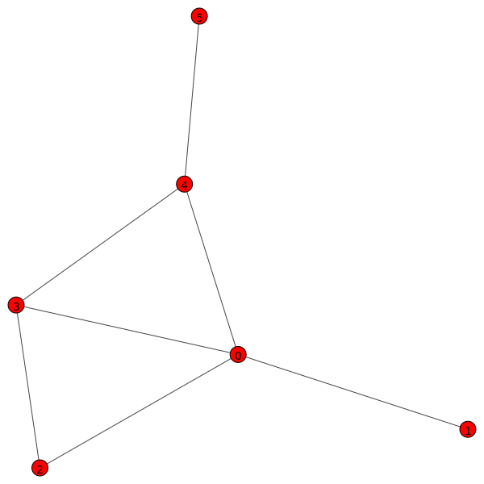
Longest Simple Path: The longest path in a graph that does not repeat vertices

Slide 4
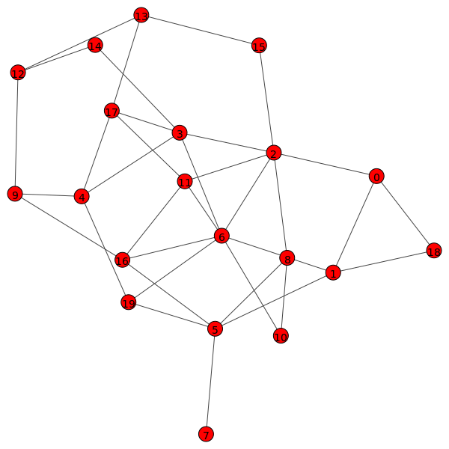

Slide 5
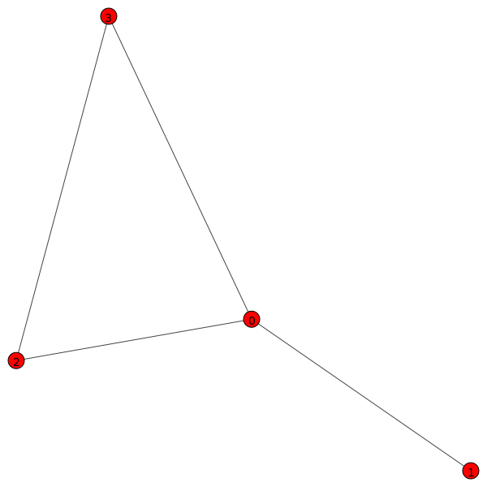
The Brute-Force Solution
Find all simple paths
Find the longest of those simple paths

Slide 6
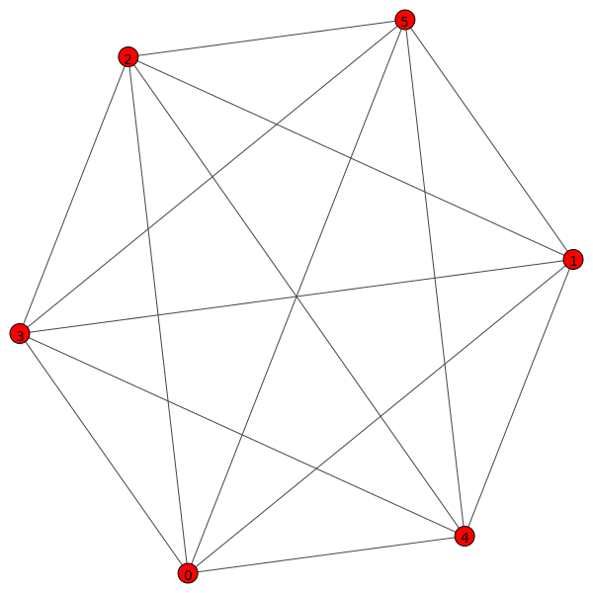
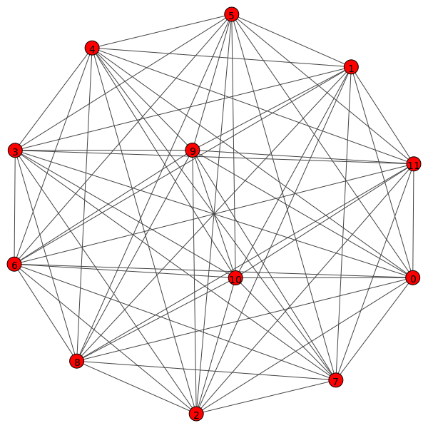
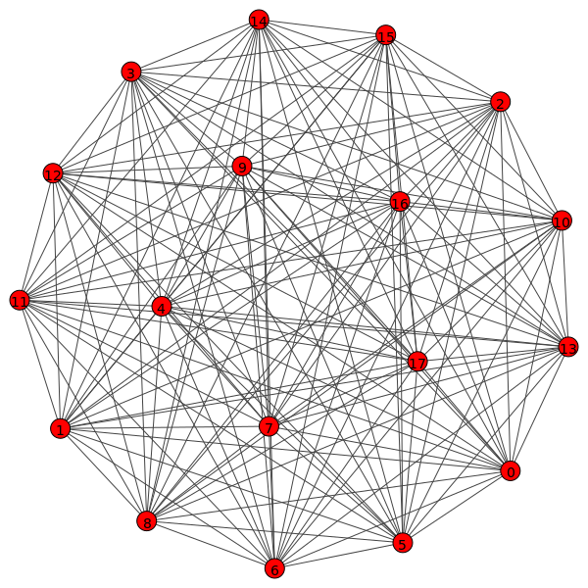
120 Simple Paths
479,001,600 Simple Paths
Over 6.4 Quintillion
Simple Paths
Number of paths increases in exponential behavior.
The Longest Simple Path Problem is NP-Hard.

Slide 7
Heuristics
Shortcuts for speeds
Trade-offs for accuracy

Slide 8
Agenda
Longest Simple Path Problem
Our Heuristics
  Greedy Heuristics
  Graph Pruning Heuristics
Performance Comparison
Conclusions

Slide 9
The Greedy Heuristics
Best choice in the moment
Doesn’t look at bigger picture

Slide 10
Basic Greedy Heuristic
Starts at each vertex
Chooses neighbor with least next options
Knocks out vertices with least options first

Slide 11
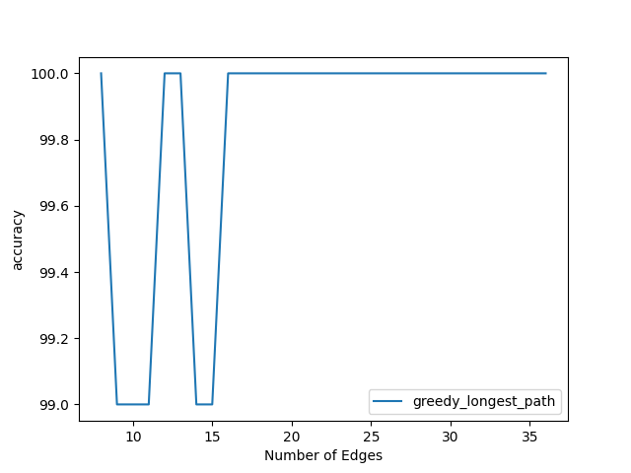

Slide 12
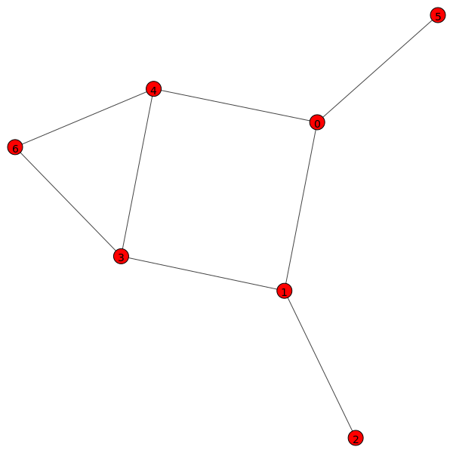
Greedy heuristic takes path:
2, 1, 0, 4, 6, 3

Slide 13
Depth-First Search Greedy Heuristic
Basic greedy heuristic sometimes has ties between neighbors
DFS added to tie-break
Compares trees created by DFS and calculates internal path length (IPL)
  Highest IPL is next vertex

Slide 14
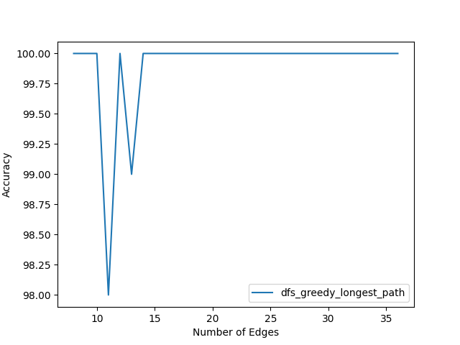

Slide 15
Agenda
Longest Simple Path Problem
Our Heuristics
  Greedy Heuristics
  Graph Pruning Heuristics
Performance Comparison
Conclusions

Slide 16
Graph Pruning and Stretching Heuristics
Cut graphs into a trees in order to use Dijkstra’s Dangle Algorithm

Slide 17
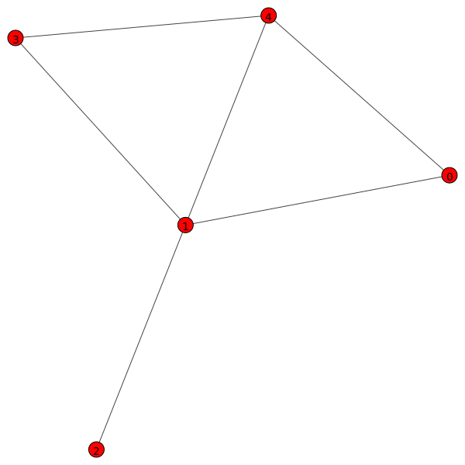
Graph and Vertex Characteristics
Given a vertex V
Vertex Periphery: Longest shortest path from V to any other vertex
Total Vertex Periphery (TVP): Total of shortest paths from V to all other vertices
Lower periphery = More central
Graph Periphery: Sum of TVP of all vertices

Slide 18
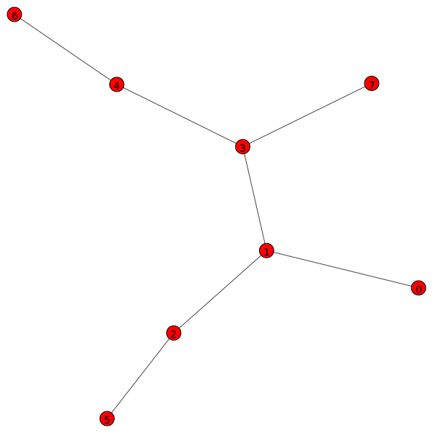
Dijkstra’s Dangle Algorithm
A tree with n vertices always has n-1 edges
Find “extremes” of the tree and the length of path between them to get longest path in a tree

Slide 19
Pruning Most Central Edges
Chooses two vertices with lowest Total Vertex Periphery
  Remove edge between them if it exists and can be removed without discontinuity

Slide 20
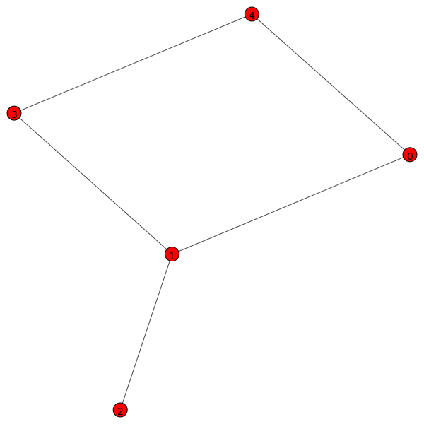
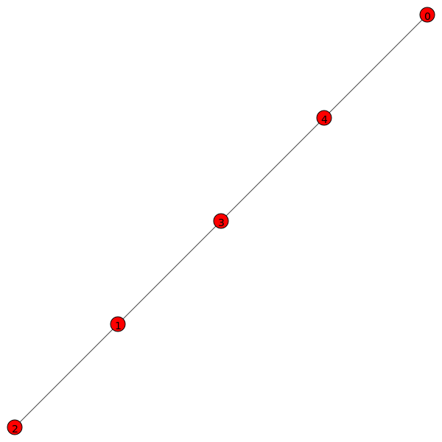

Slide 21
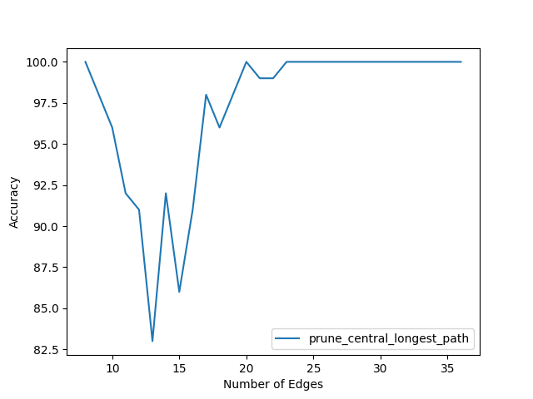

Slide 22
Stretch Vertex With Lowest Total Periphery
Selects vertex with lowest Total Vertex Periphery
Removes edge to maximize the TVP of that vertex

Slide 23
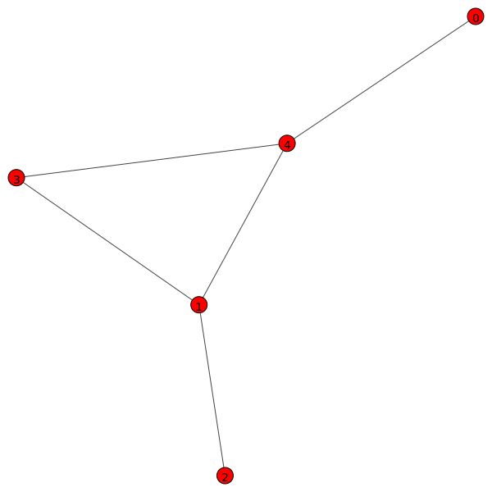

Slide 24
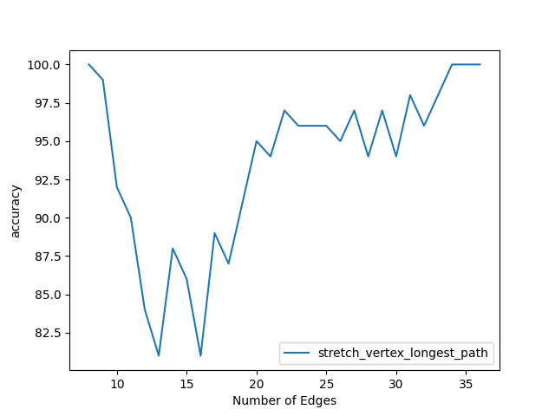

Slide 25
Stretching Graph Periphery
Removes edge in graph that will maximize the graph periphery

Slide 27
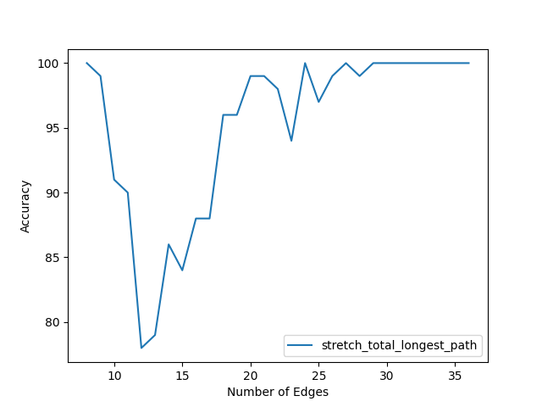

Slide 28
Agenda
Longest Simple Path Problem
Our Heuristics
  Greedy Heuristics
  Graph Pruning Heuristics
Performance Comparison
Conclusions

Slide 29
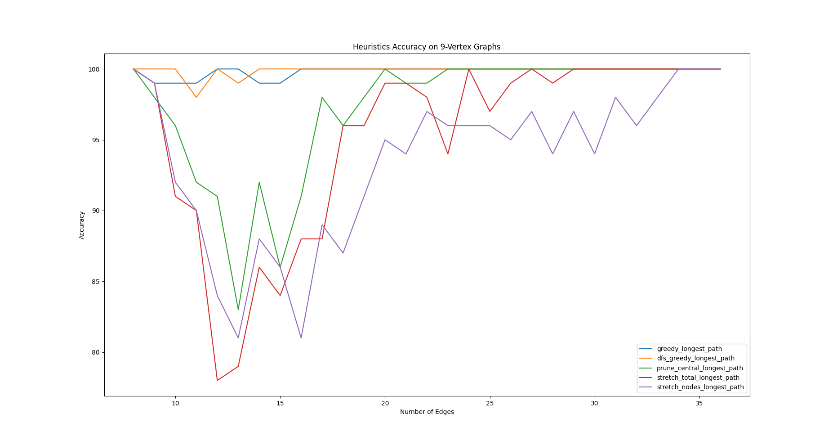

Slide 30
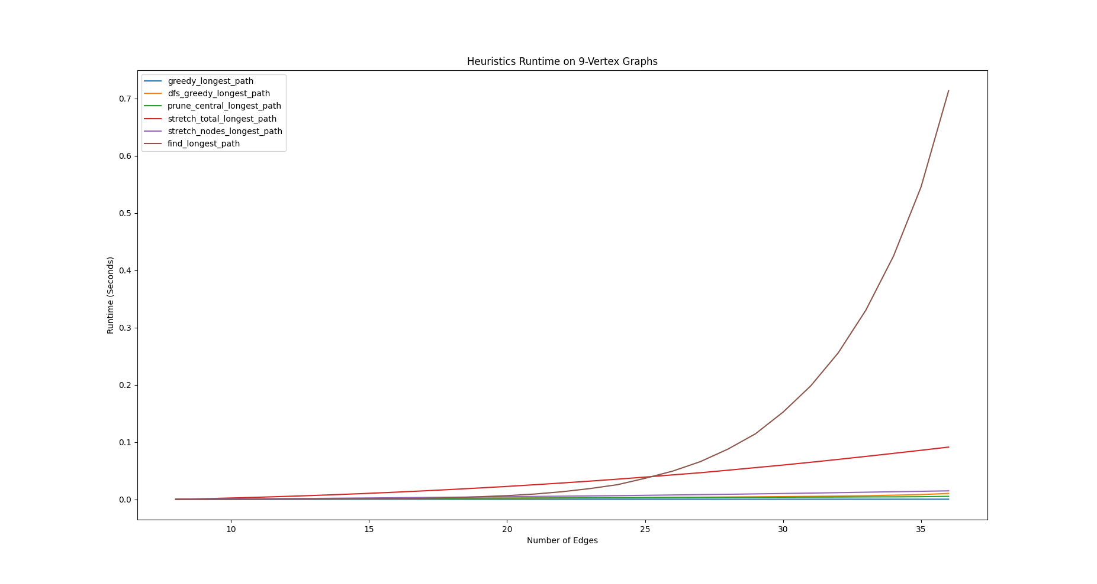

Slide 31
Conclusions
The Longest Simple Path Problem is NP-Hard
We implemented 5 heuristics as alternative methods
Heuristics are faster, but less accurate
Greedy heuristics are capable on dense graphs
  DFS did not improve greedy heuristic too much
Pruning heuristics show promise for use with other well-known search heuristics like A* and local-search
Sparse graphs are the most difficult to solve

