Slide 1
InternetMusicSoundtrackatron

Slide 2
Team Members

Slide 3
Member Assignment
Alex
AJAX calls to api’s
Jose
UI
Founder and GIT Overlord
James
Login
Persistence Layer
Firebasing it up

Slide 4
Concept

Slide 5
InternetMovieSoundtrackatron
Concept
Have a song from a favorite movie or tv show but not sure what it was?
Now you can find those songs and play them in a customized playlist!

Slide 6
Design

Slide 7
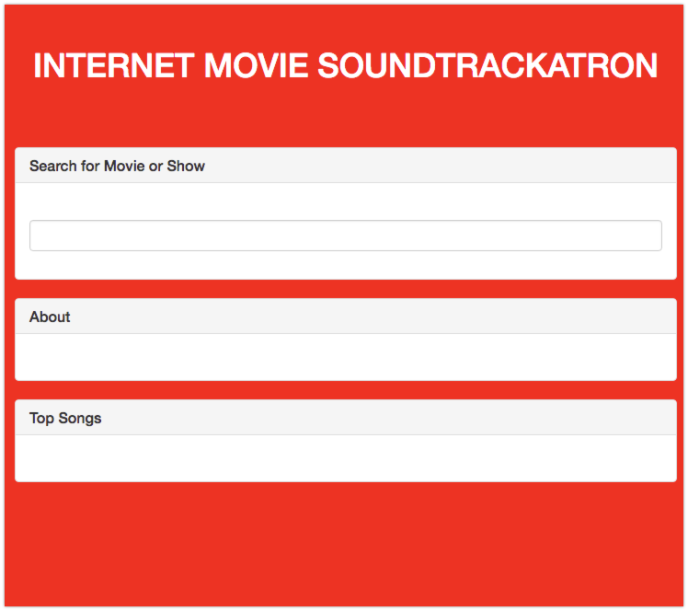
InternetMovieSoundtrackatron
Design
Mobile-First – Bootstrap 3.3

Slide 8
Functionality

Slide 9
InternetMovieSoundtrackatron
Functionality
Utilizes the following API’s
Spotify
IMDB
Frameworks Utilized
Jquery/Ajax
Firebase
Bootstrap
New Library or Technology
Undecided

Slide 10
Collaboration

Slide 11
InternetMovieSoundtrackatron
Collaboration
Github – Organization - JJASoundTrackatron

