Slide 1

Singapore Bubble Tea Market Share Analysis
Presentation on the Singapore Bubble Tea Market Share Analysis

Slide 2

Introduction
An overview of Singapore's bubble tea market
The importance of market share analysis
Presentation objectives

Slide 3

Market Overview
Trends in the bubble tea industry
Major players in Singapore's bubble tea market
Consumer preferences and demographic insights

Slide 4
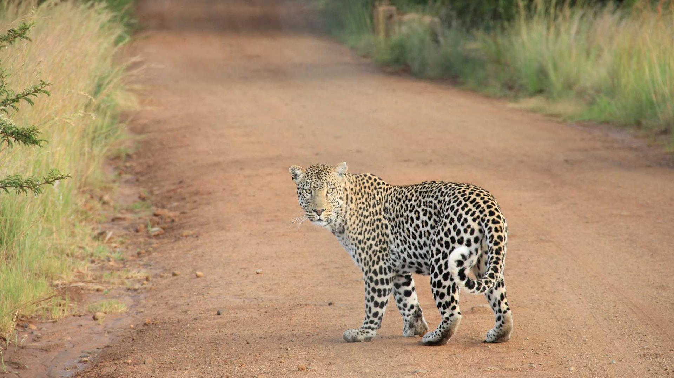
Methodology
Data sources: Market reports, surveys, and social media analytics
Data selection criteria: Relevance, currency, and reliability
Analytical tools: SPSS for statistical analysis and Tableau for data visualization

Slide 5

Market Share Analysis
Analysis of the market share held by top bubble tea brands in Singapore
Trend analysis over recent years
Market share comparison using line charts and tables

Slide 6

Implications
Influence on business strategies for bubble tea companies
Opportunities for growth and investment
Challenges and opportunities within the market

Slide 7

Conclusion and Recommendations
Summary of the key findings
Strategic recommendations for stakeholders
Future outlook for Singapore's bubble tea market

Slide 8
Key Takeaway | Insight
Market Dominance | Brand A commands the largest market share at 35%, showcasing strong brand loyalty and effective marketing.
Rapid Growth | The bubble tea market has expanded by 20% year-on-year, reflecting Singapore's growing demand for bubble tea.
Consumer Preference | Preferences for flavored pearls and premium tea bases highlight opportunities for product innovation.
Competitive Landscape | The top three brands make up 70% of the market, indicating a high concentration and significant entry barriers.

