Slide 1
[Untitled] Pizza Online
By Nathan Wemmer
Jacob Hanchett
Joseph Cochran

Slide 2
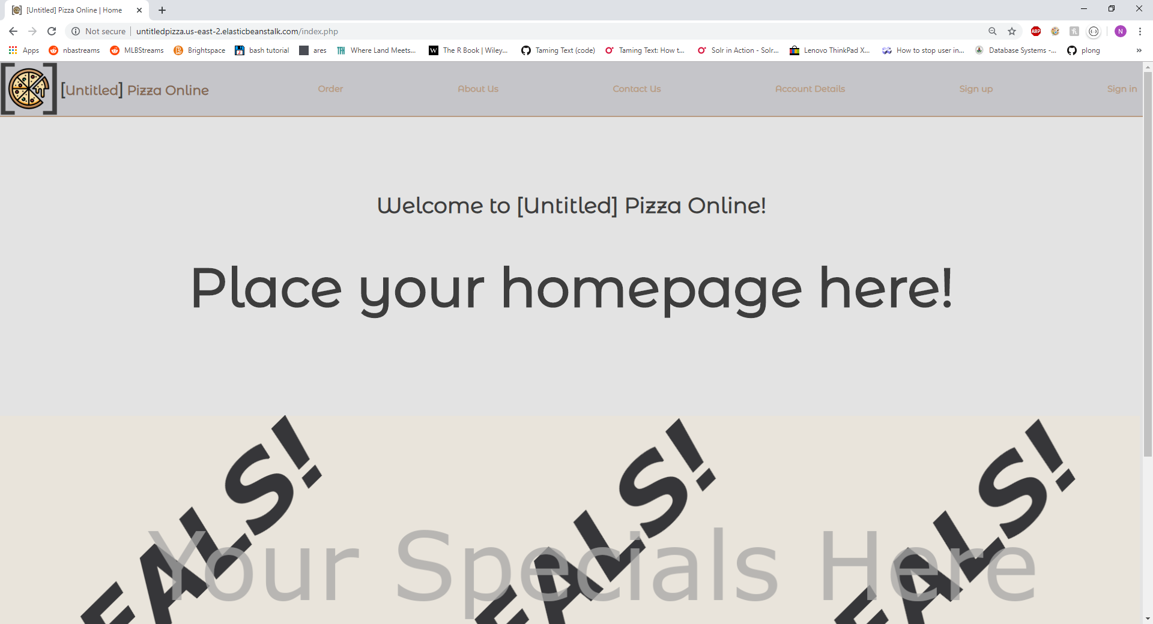
Homepage

Slide 3
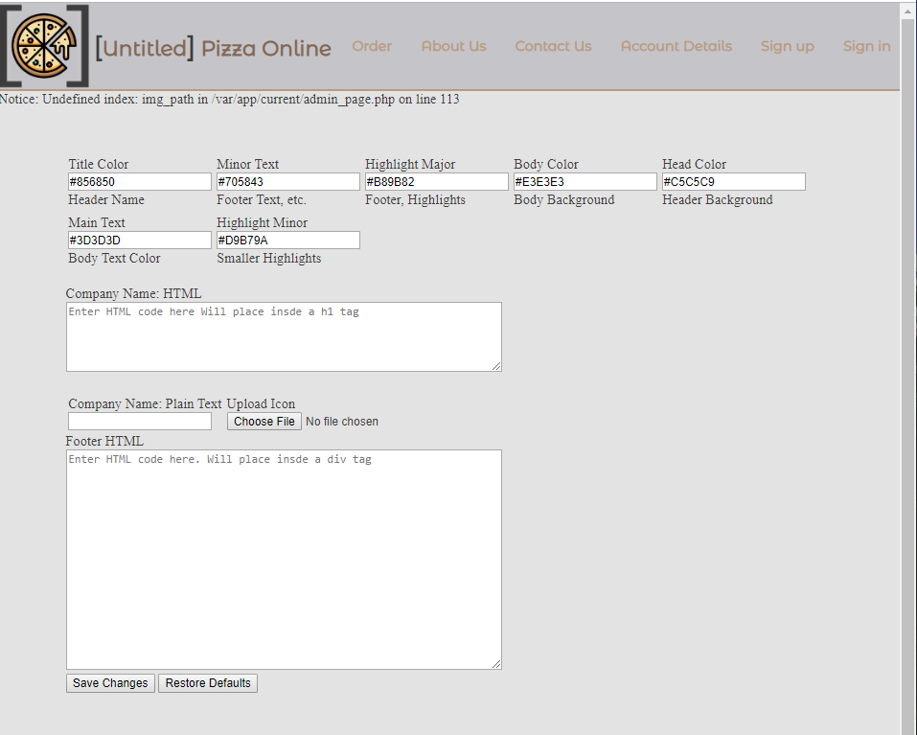
Admin order page

Slide 4
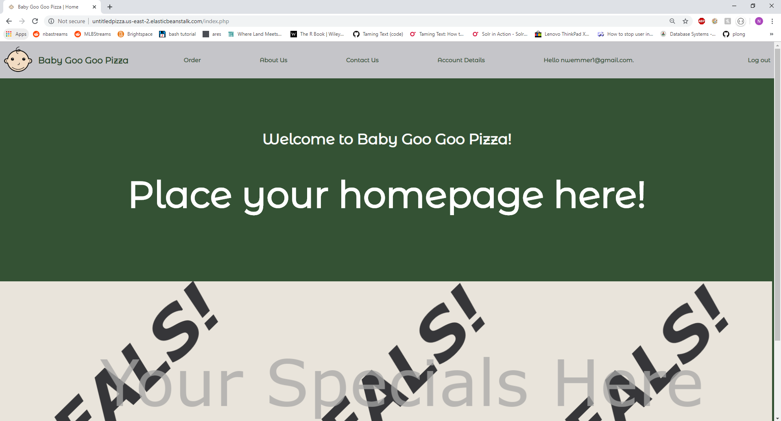
Software as a Service (SaaS)

Slide 5
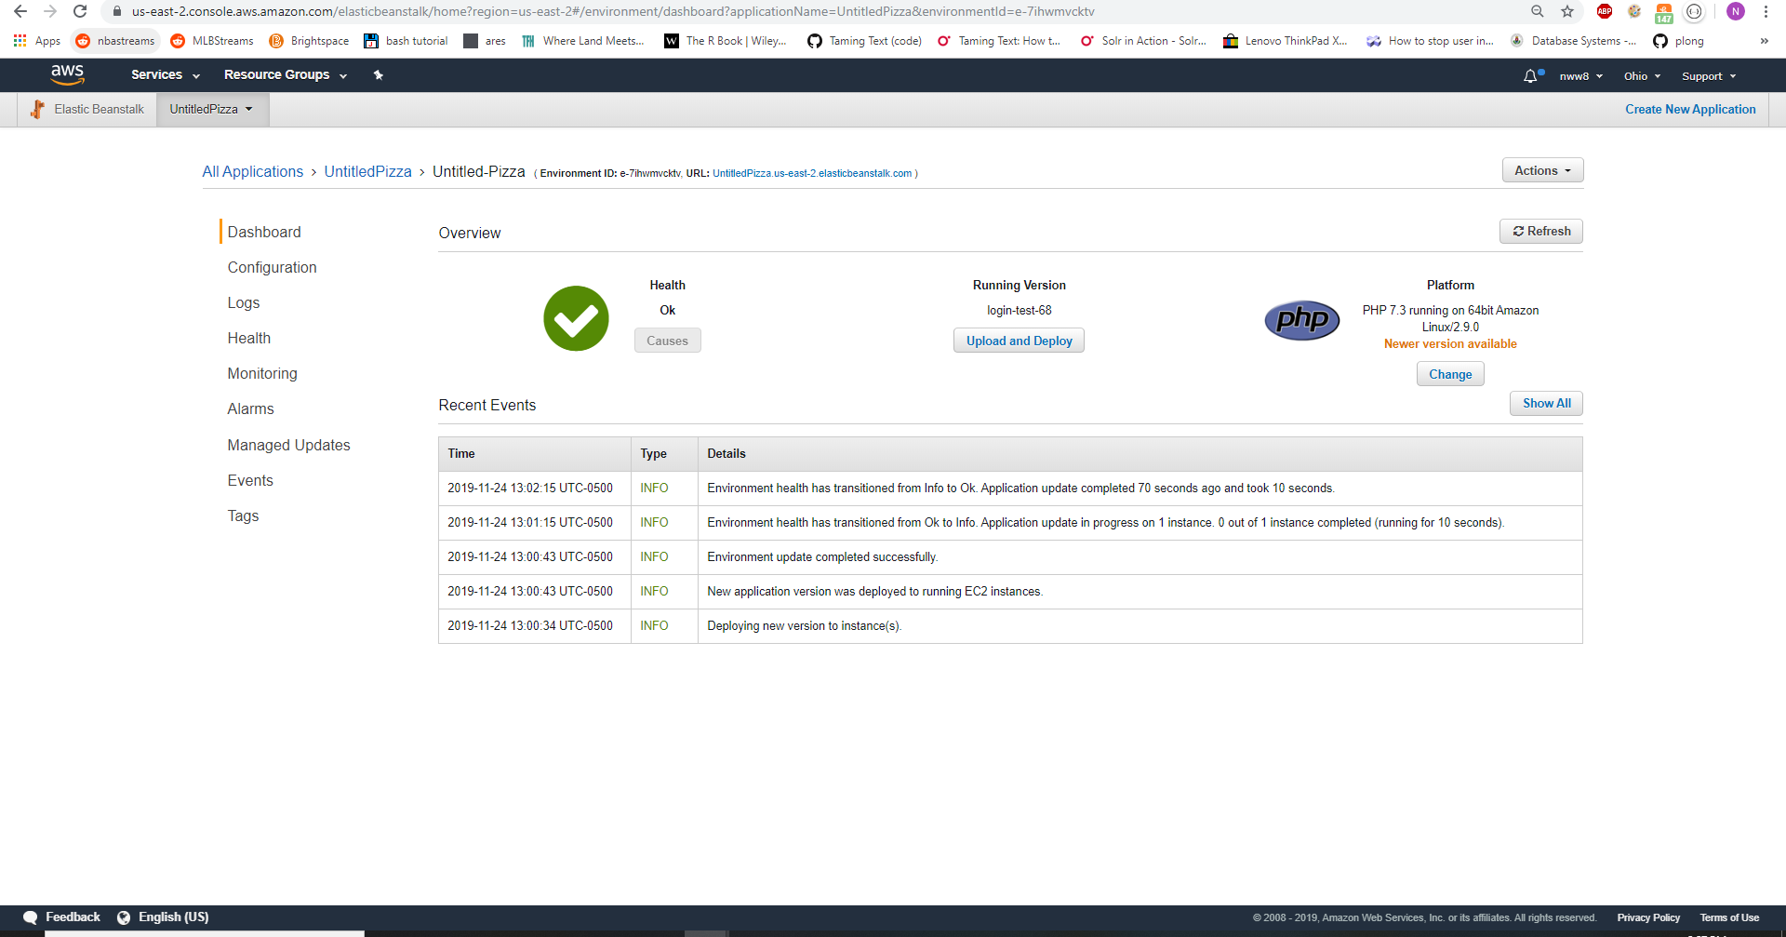
Amazon Web Services (AWS)
AWS Management Console
Where you deploy new versions of the application
Where you establish a connection to your database over the server
Restart environment (host system)/ Shutdown or Terminate Environment

Slide 6
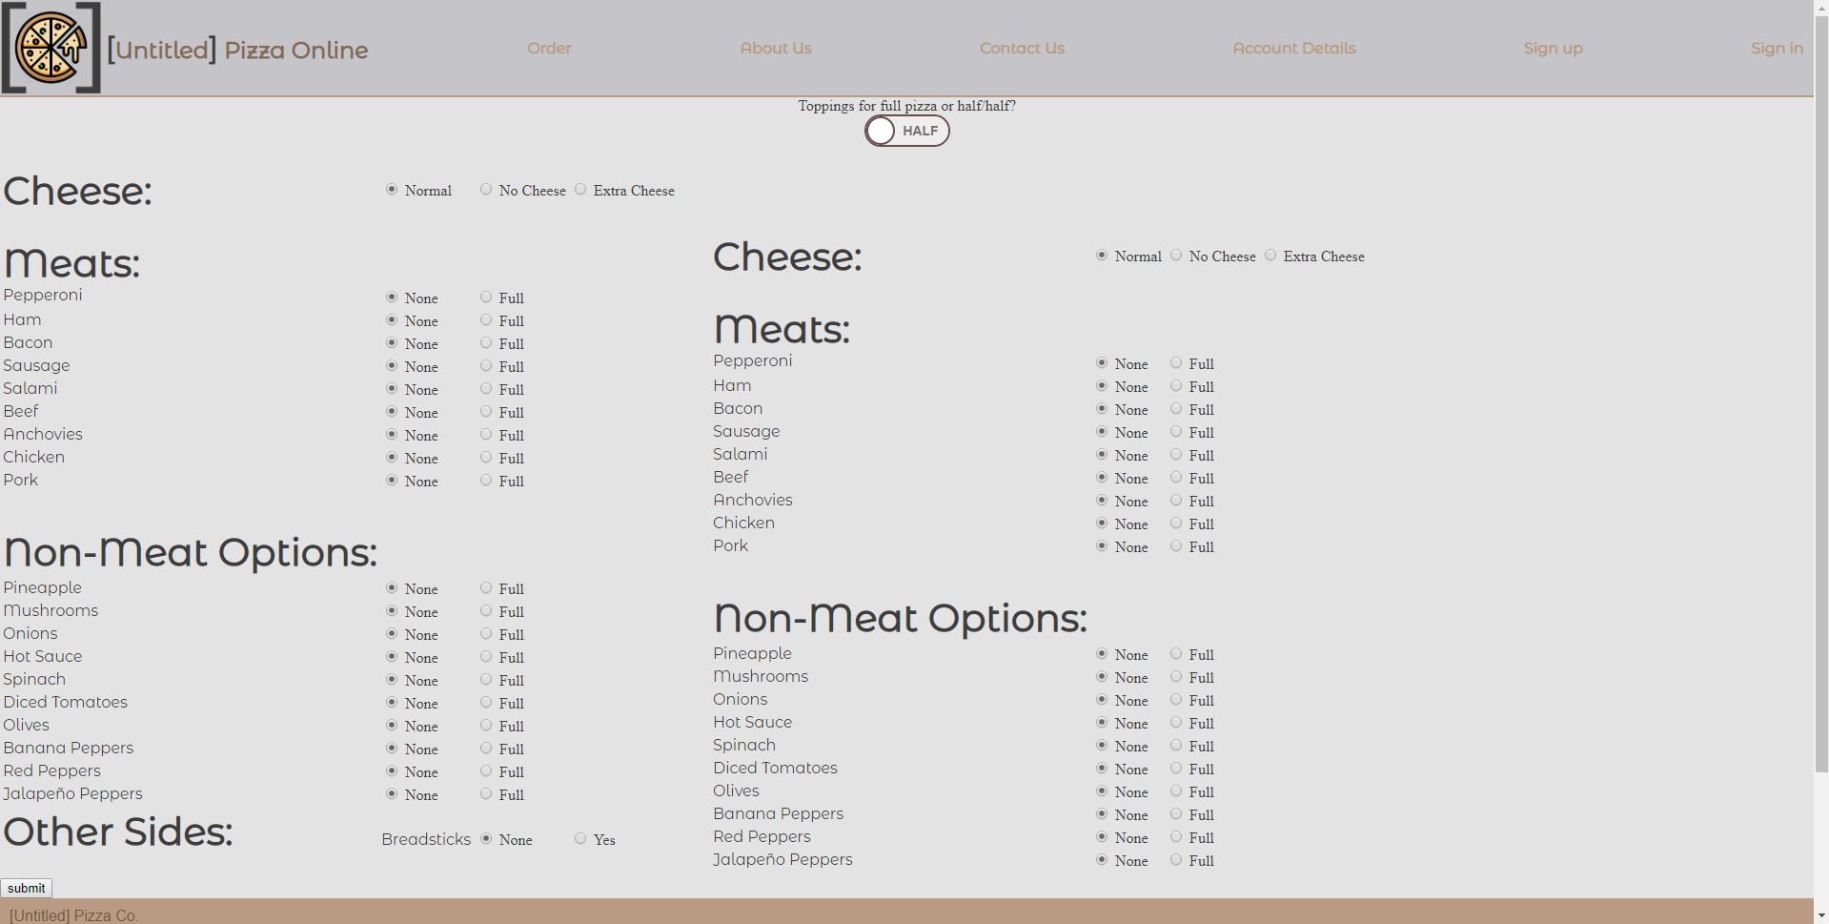
Order page

Slide 7
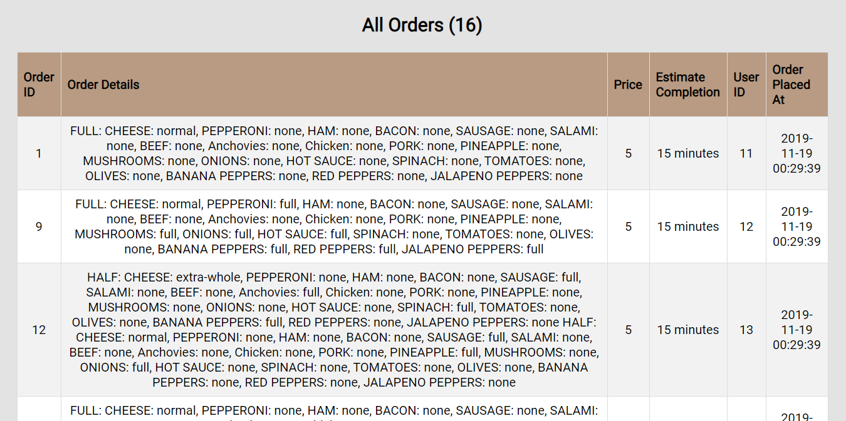
Employee page

Slide 8
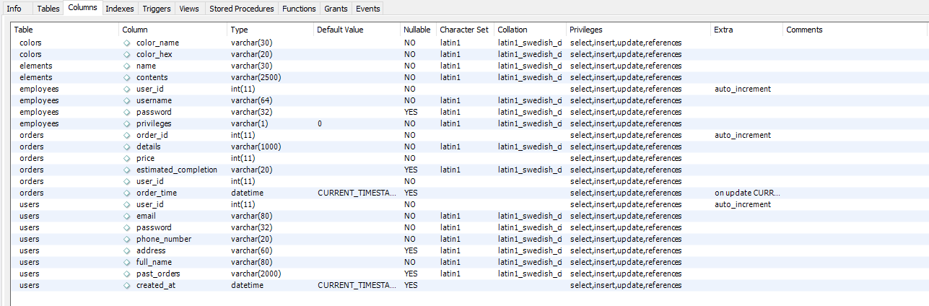
Database setup

Slide 9
Possible future work..
Add more elements to the admin page (ex. ‘Contact Us’ page)
Make the order page more user friendly
Learn more about AWS

Slide 10
Conclusion
Learning how to use AWS and all its features are a skill all in itself
PHP can be used in every aspect of the webpage
CSS can change the complete feel of the website

