Slide 1
CSED226 Introduction to Data Analysis Competition: Classification & Regression

Slide 2
Overview
The goal is to improve your model's performance as much as possible.
You can improve your model's performance through data preprocessing, model selection, and hyperparameter tuning.
You can submit your model's results to Kaggle and view your scores in real-time on the leaderboards. (you can only submit a maximum of 20 per day, we recommend that you run the model sufficiently on your PC before uploading.)

Slide 3
Rules
In this competition, you can use all the models learned in class (e.g. Ensembles, SVM, ...)
For the library, you can use the library used in the previous HW (seaborn, matplotlib, pandas, numpy) and the scikit-learn library. (Other libraries are not allowed.)
The rules for models changed that you should not use the k-nearest neighbor method.
You must participate as an individual team in this competition.

Slide 4
Evaluation (Classification)
Accuracy
Accuracy = Correct classifications (True) / All classifications
 |  | Predicted class
 |  | Class0 | Class1 | Class2
Actual class | Class0 | True
 | Class1 |  | True
 | Class2 |  |  | True

Slide 5

Evaluation (Regression)
RMSE
$\sqrt{\sum_{i=1}^{N}{\frac{{\left(Predicted_{i}−{Actual}_{i}\right)}^{2}}{N}}}$
N =Total number

Slide 6
Datasets (Classification)
① Plant species
You will use information from the plant's habitat (location, elevation, etc.) to classify that plant species.
The last column ("Plant_species") of the training set is the label to be classified, and there is no label column in the test set.
Summary
Training set: 20000
Test set: 20000
Classes: 5

Slide 7
Datasets (Regression)
② Fruit juice's taste score
You will make a model to predict Fruit juice's taste score by using the ingredient information.
The last column("score") of the training set is the target value to be predicted, and there is no target value column in the test set.
Summary
Training set: 2000
Test set: 2000
Score range: 0 ~ 100

Slide 8
Competition
You will enter the competition individually through Kaggle.
Kaggle-site: https://www.kaggle.com/
Plant species
https://www.kaggle.com/t/7ba9b1ae75624d089ac3541eb939dc3a
Fruit juice's taste score
https://www.kaggle.com/t/3fc68f542dd9456c943186fd68a73a18

Slide 9
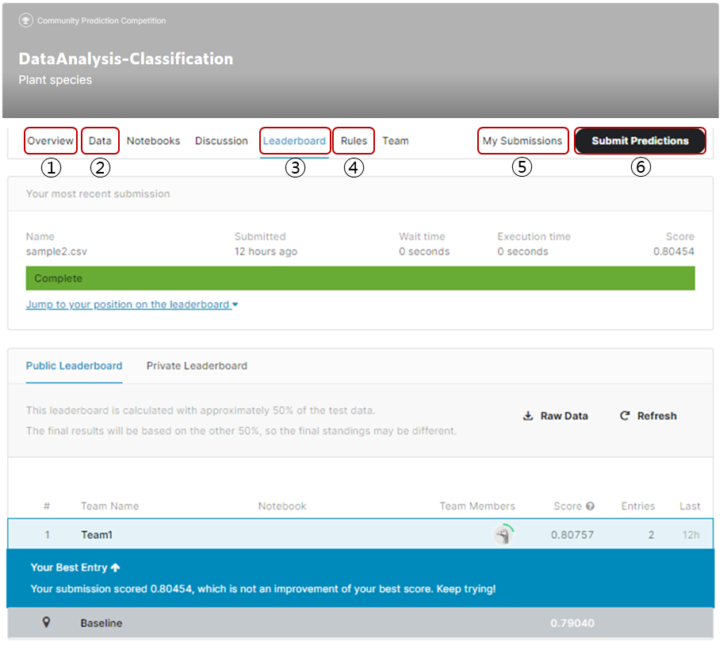
Competition
Kaggle-site
① Overview: Description of the task
② Data: Files to be used in the competition
③ Leaderboard: Current score updated in real time
④ Rules: What you must follow in the competition
⑤ My submissions: Files you submitted
⑥ Submit Predictions: Submission

