Slide 1

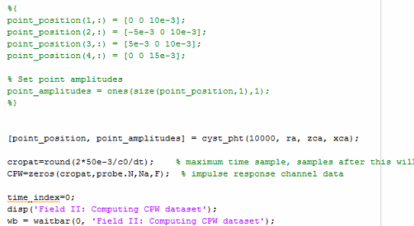
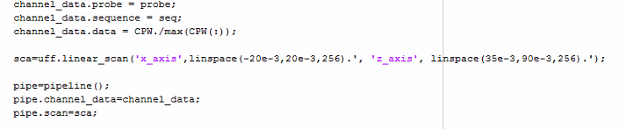
CPWC Ultrasound Simulation with DAS Beamforming
1. Use the field II CPWC example in the USTB folder.
2. Download cyst_pht.m and add it to the Field II path
Download Field II libraries and USTB (Ultrasound Tool-box) online.
Install USTB.
Add all the Matlab files to the field II path.
Use Field II to generate CPWC imaging channel data.
Create new phantoms based on the phantom of the Field II Cyst example.
Use USTB to implement Delay-and-sum beamforming plus Ultrasound coherent compounding.
e
3. Comment out the original phantom points and add the
phantom function cyst_pht to the CPWC script.
e
4. Modify the scan region dimension to properly scan and show the image.
ee

Slide 2
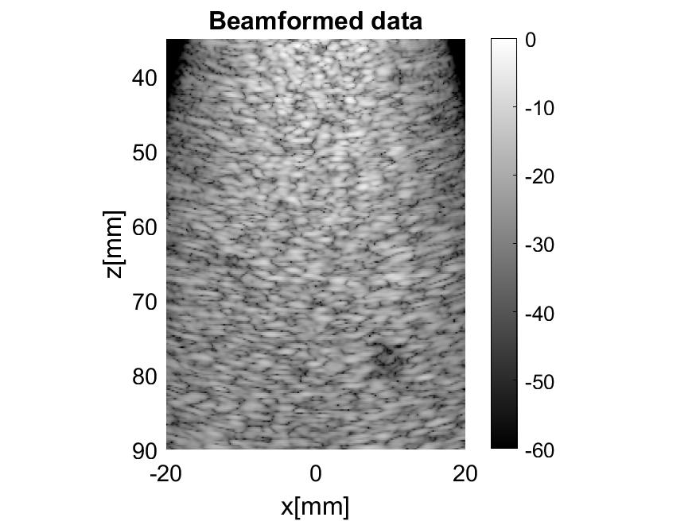
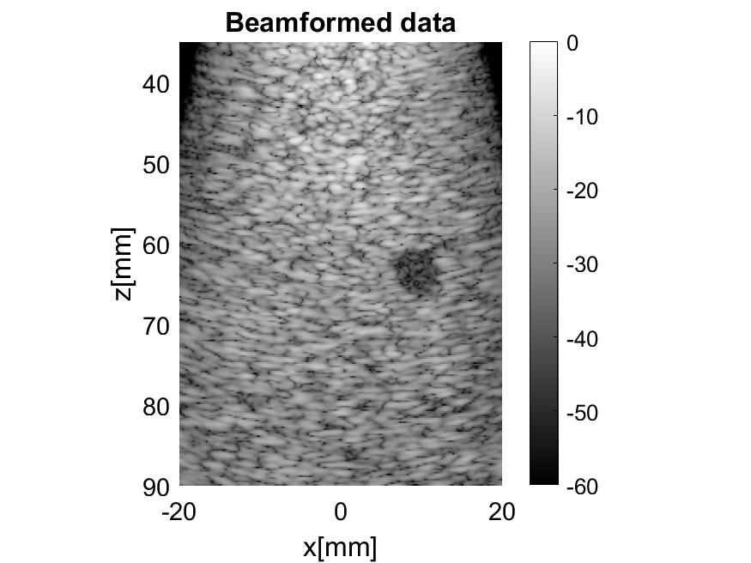
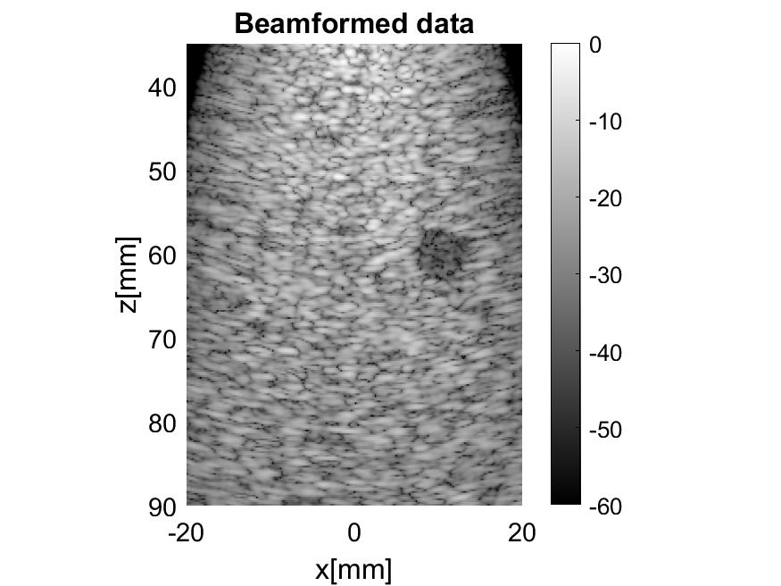
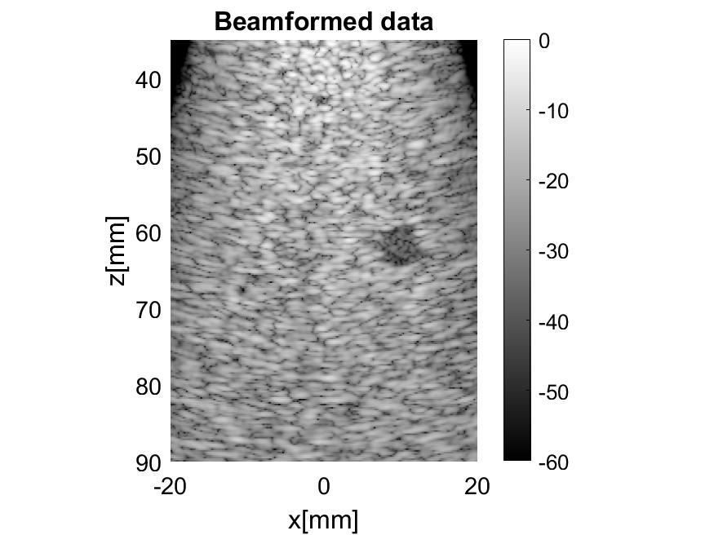
Simulation Data
500 simulation data
10000 scatterers
Random amplitude and position.
Image size:
535 pixels ×356 pixels.
40 mm × 55 mm
1 dark target (similar to nerve hole)
Shape: circular.
Radius: 5mm to 7mm.
Position:
X axis: 9mm-11mm.
Z axis: 30 mm– 50mm.
CPWC: 8-16 angles and -26.5° to 26.5°.

Slide 3
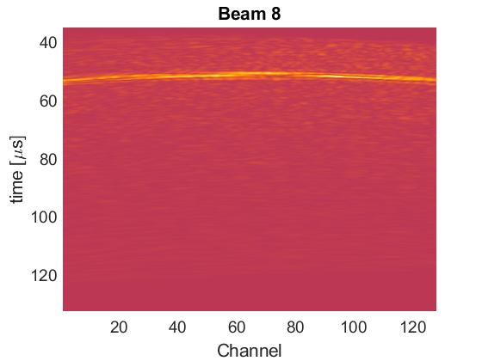
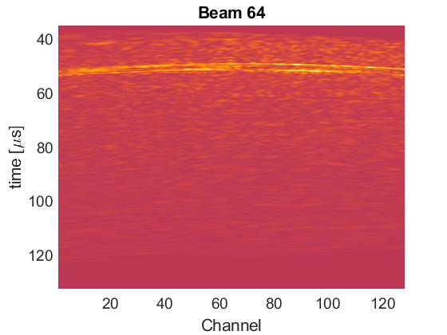
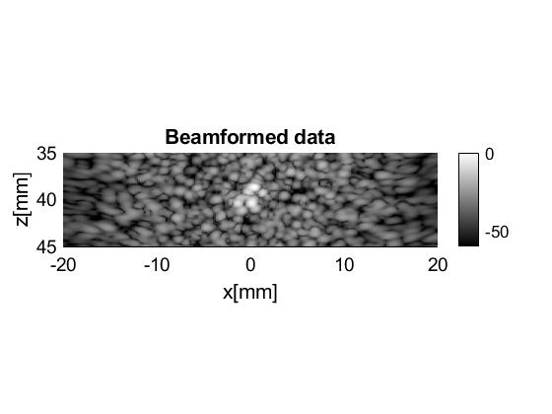

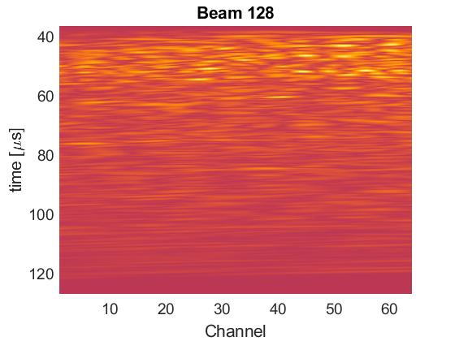
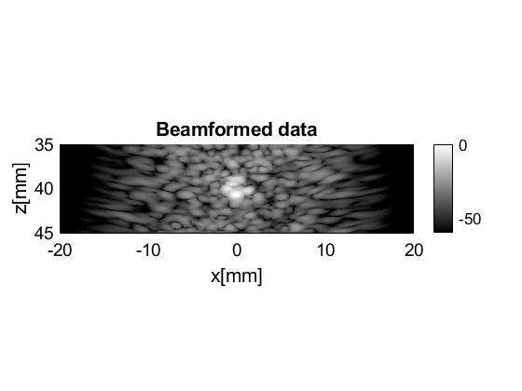
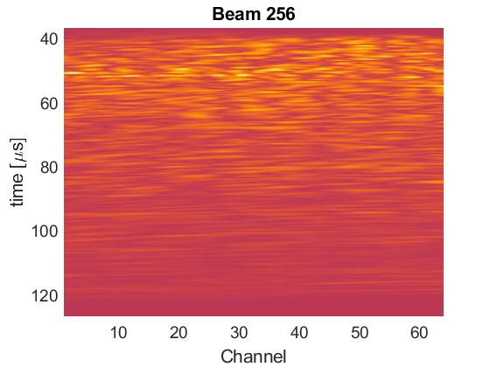
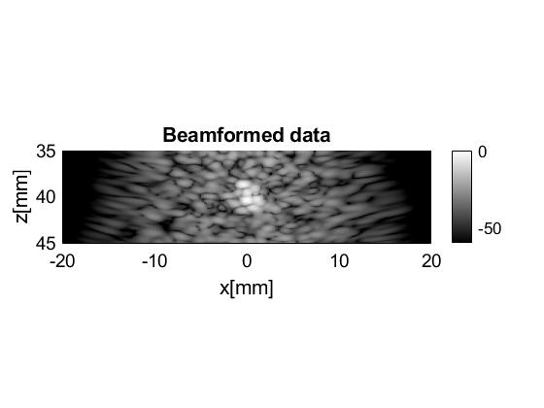
Channel Data (64 elements and 128 elements)
128 Elements (can detect the target signal: an arch)
64 Elements (cannot detect the target signal)

Slide 4
Diagnostic Ultrasound Imaging: Inside Out
Please read the chapters below to understand Ultrasound imaging.
Chapter 6 Beamforming 6.1-6.6
Chapter 7 Array Beamforming 7.1-7.4
Chapter 8 Wave Scattering and Imaging. (especially 8.4)
Chapter 10.12.2 Plane-wave Compounding 411

