Slide 1
J2EE

Slide 2
Contents
Database(RDBMS / *NoSQL*) – SQL, PLSQL
JDBC
JSP
Front-End technologies
Git and Github
CICD

Slide 3
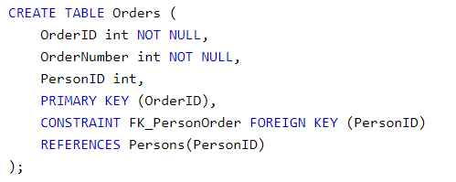
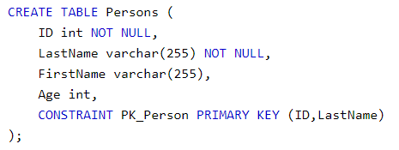


Database
Primary Key, Foreign Key, Unique Key
Interview Question: difference between them

Slide 4
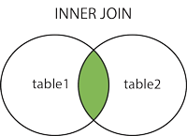
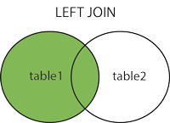
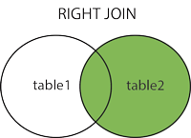
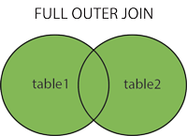
Database
Type of Joins (inner join, left join, right join, full outer join)
Notes:
SQL:: https://www.w3schools.com/sql/default.asp
PL/SQL:: https://www.tutorialspoint.com/plsql/index.htm

Slide 5
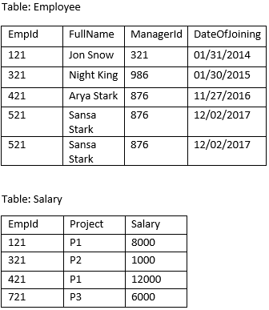
Database
Use MySQL to build employee and salary table and solve the followings:
1. fetch the count of employees working in project 'P1'.
2. fetch employee names having salary greater than or equal to 5000 and less than or equal 10000.
3. fetch project-wise count of employees sorted by project's count in descending order.
4. fetch projects that include more than 1 employees
5. fetch employee names and salary, if employee does not have salary, show salary as 0.
6. fetch all employees whose managers are also in the employee table
7. fetch duplicate employee name in the employee table
8. fetch employees who do not have salary
9. fetch current date and current timestamp
10.fetch employee who joined in year 2016
11.fetch employees and their salary who joined in "January"

Slide 6
Database
Clob vs Blob
Truncate vs Delete vs Drop
View vs Materialized View vs Table
Normalization vs De-Normalization
index
Query: Distinct, Group by, isnull/nvl, join on, Having

Slide 7
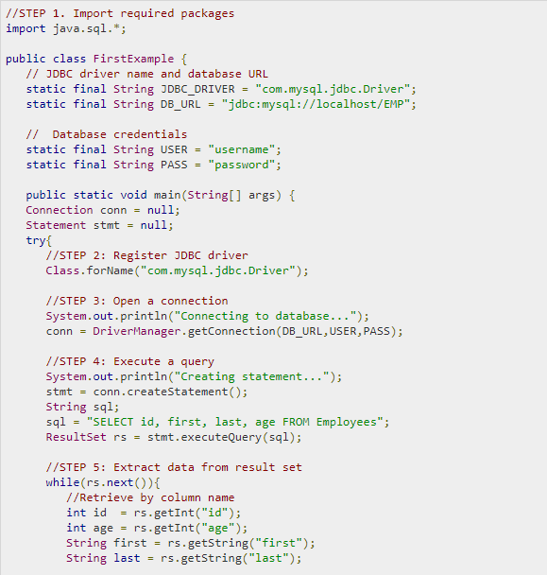
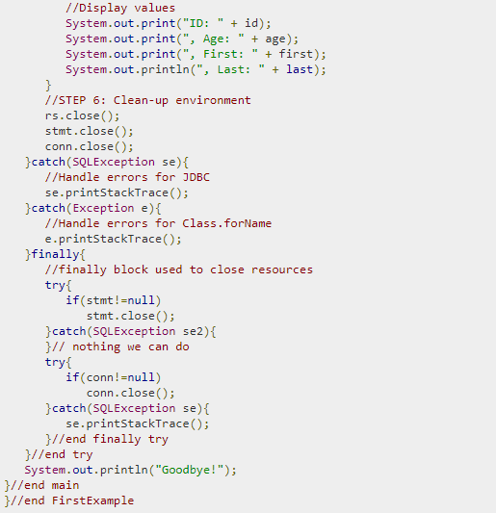
JDBC

Slide 8
RDBMS vs NoSQL
Relational Database | NoSQL Database
Structure Data (table based) | Unstructured Data (document, column based)
Supports Transactions | Does not support Transactions
Store Medium to Large Data | Store Huge Amount of Data
Relative Fixed Query Language (SQL) | Different Query languages
Performance Low | Performance High
Design Principle: ACID | Design Principle: CAP
Example: MySQL, Oracle, SQL Server | Example: MongoDB, Cassandra, Reddis
Question: Which one to choose?

Slide 9
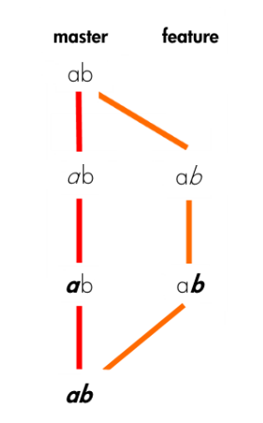
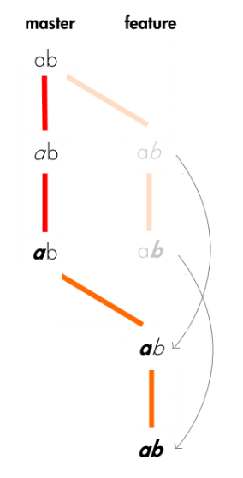
Git rebase vs merge
Git init, clone, pull, branch, checkout, add, commit, push, log, fork, pull request, remote
Git rebase, merge
merge
rebase

Slide 10
Maven
Maven – Dependency Management
Local vs Remote repository
Snapshot
Maven Clean, Build, Package, Test, Install

Slide 11
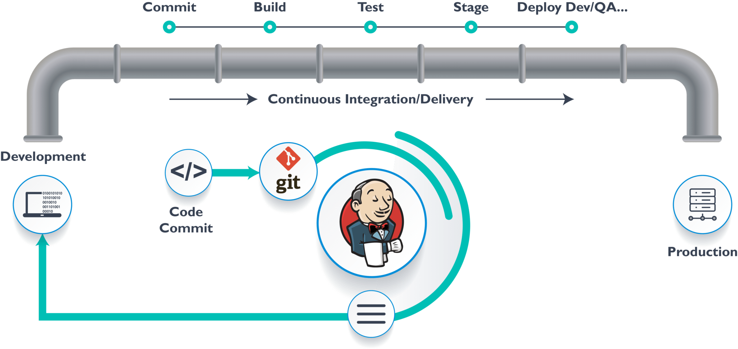
CICD

Slide 12
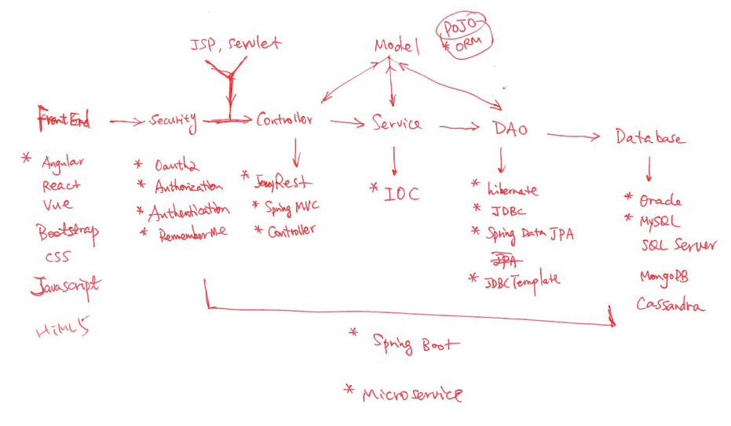
Architecture Review

