Slide 1

The Conventions of Engineering Reports
An Introduction to ENGI 2304

Slide 2
An overview of today’s presentation
The importance of writing
Engineering vs. literary writing
Engineering report conventions
Advantages of presentations

Slide 3
Time Engineers Spend Communicating
Other
Work
56%
Writing
28%
Oral Pres
16%
source: Survey of 300+ Cornell engr grads, 1950-1992
source: instruct1.cit.cornell.edu/courses/aep264/LectureOneFeb02.ppt
Notes:
In 1994, the Engineering Communications Program surveyed 1100 engineers who graduated from Cornell between 1950 and 1992; over 300 respnded. We discovered that these engineers spent an average of 28% of their time writing. They spent 16% of their time giving oral presentations. All their other engineering work took just 56% of their time.

Slide 4
Audiences for Engineers’ Writing
(% who write primarily to each audience)
Non-
Technical
Technical
48%
12%
Mixed
Tech/Non-
Tech
40%
source: instruct1.cit.cornell.edu/courses/aep264/LectureOneFeb02.ppt
Notes:
Who do you think you’ll write for? Do you think you’ll mostly write and give presentations to other engineers? What about people in other departments? Clients? The general public?
In the 1994 survey, we asked Cornell engineering grads what their primary work audience was. Did they write mostly for engineers and other technical people? About half of them did. The other half, however, wrote for a mix of engineers and non-technical audiences, or for people without a technical background. In other words—learning to write for non specialists is important, and learning to write for a variety of audiences is important.
When you write your lab reports, you’ll notice that you’re asked to summarize information, and to be very careful about placing the right information in the right section. That’s because a lab report is often read by different audiences. Some people want to get the summary, so they’ll read the memo of transmittal. Some people will go straight to the recommendations. And some people want to know every last detail; they’ll read the whole report, then they’ll read the appendices. Write for all of your audiences, and make it easy for them to move between sections—to see the relationship between the appendices and the main report, for instance. The Chem E 432 Lab Report Manual gives instructions on how to make the report easy for readers to navigate.

Slide 5
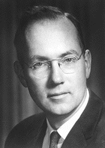
The story of the laser
Charles H. Townes—professor of physics at Columbia University
Sketched the maser (using microwaves) in 1951
Discussed and detailed a plan to build the “optical maser” (which would become the laser) in September 1957.

Slide 6
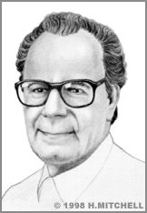
The story of the laser
Gordon Gould—graduate student in physics at Columbia University
Inspired by the maser, sketched his own idea about an optical maser
Coined the word “laser”
Took his notes to a candy store owner who notarized them

Slide 7
The story of the laser
Whose name is associated with the laser?
Charles H. Townes

Slide 8

The laboratory notebook
Sir William Hershel (1738-1822) discovered Uranus in 1781.
Pierre LeMonnier (1715-1799) had noted the motions of Uranus in 1769.
parts of his notes were written on a paper bag
the notebook was in disorder
Sir William Hershel is credited with the discovery.

Slide 9

What is “literary” writing?
Read the following paragraph from Charles Dickens’ A Tale of Two Cities:
IT WAS the best of times, it was the worst of times, it was the age of wisdom, it was the age of foolishness, it was the epoch of belief, it was the epoch of incredulity, it was the season of Light, it was the season of Darkness, it was the spring of hope, it was the winter of despair, we had everything before us, we had nothing before us, we were all going direct to Heaven, we were all going direct the other way- in short, the period was so far like the present period, that some of its noisiest authorities insisted on its being received, for good or for evil, in the superlative degree of comparison only.
What are the elements of this passage?

Slide 10

How is engineering writing different?
Read this paragraph from Ghaly et al, “Compression and Deformation Performance of Concrete Containing Postconsumer Plastics” in the Journal of Materials in Civil Engineering:
Particles of postconsumer plastics were used in lieu of a portion of the coarse aggregates. These grains were produced by chopping up larger pieces to reduce their size. No specific type of plastic was dominant. The particle size and shape of plastics varied widely. Some particles were long and stringlike, and others resembled small rocks. Using a random sample, a sieve analysis was completed on the gradation of the plastics. They were found to be poorly graded…
What are the elements of this passage?

Slide 11
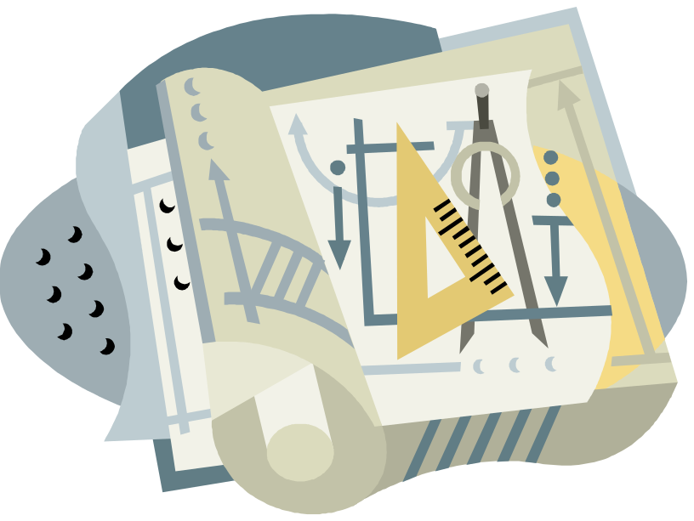
Engineering writing is based on convention.

Slide 12
Readers expect documents to answer their questions in certain places
Beginning of a document
    What exactly is the work?
    Why is the work important?
    What is needed to understand the work?
    How will the work be presented?
Middle of a document
    What happened and how it happened
    State and explain results
End of a document
    Analysis of key results presented in the middle
    Future perspective on the work

Slide 13

There are many different kinds of engineering documents
Proposals
Progress Reports
Technical/Research Reports
Lab Reports
Recommendation Reports
Process Descriptions
Instructions
Extended Abstracts

Slide 14

Let’s look at the technical report
Letter of Transmittal
Title Page
Abstract
Table of Contents
List of Figures and Tables
List of Abbreviations and Symbols
Body of the Report
References
Supporting Details
Front Matter
Body
Appendices or Back Matter

Slide 15
Other reports follow a similar format
Proposals
Introduction
Purpose
Background
Scope
Discussion
Approach
Results
Statement of Work
Resources
Personnel
Facilities/equipment
Costs
Fiscal
Time
Conclusion
Summary
Contact
Technical Reports
Introduction
Purpose
Problem
Scope
Background
Theory
Research
Test and Evaluation
Apparatus
Procedure
Findings
Data
Interpretation
Conclusion
Assessment
Recommendations
Progress Reports
Introduction
Purpose
Background
Scope
Status
Tasks completed
Tasks remaining
Statement of Work
Conclusion
Summary
Evaluation
Forecast
Contact

Slide 16
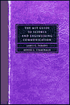
The technical or engineering report
“In science and engineering literature, the term report describes a document that tells what happened.”
--The MIT Guide to Science and
Engineering Communication
by James Paradis
and Muriel Zimmerman

Slide 17
Consider the differences between types of engineering writing
--describes what will happen
Proposal
--describes what has been happening and what is expected to happen next
Progress Report

Slide 18

Consider the differences between types of engineering writing
Technical or Engineering Report
--describes what happened

Slide 19
Presentations in engineering
Advantages of presentations
Can make the presentation come alive
Can revise the presentation on the spot
Can use films, slides, and color
Disadvantages of presentations
Have only one chance to say something correctly
Audience has one chance to catch the material
Time constraints
Often have to communicate to multiple audiences
From Michael Alley’s The Craft of Scientific Writing

Slide 20


To be effective, organize your writing
Use appropriate headings
Use short paragraphs—less than 12 lines long
Use lists effectively—know when to use different kinds
Use parallel constructions, even in lists
Use an easy-to-read format
Questions

