Slide 1
Learning Abstraction Selection for Bayesian Program Analysis
Yifan Zhang, Yuanfeng Shi, Xin Zhang
Peking University, China
Notes:
Hello, everyone. I am Yifan Zhang from Peking University. I am going to talk about our recent work on Learning Abstraction Selection for Bayesian Program Analysis. This is the joint work of Yuanfeng Shi and Xin Zhang.

Slide 2

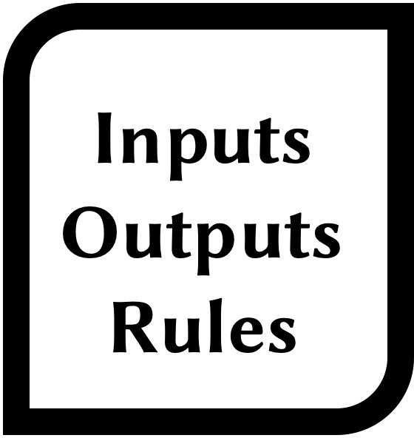



Bayesian Program Analysis [Mangal et al. 2015]
Conventional
False positives
Unable to learn and adapt
Program to be analyzed
Static analyzer
Alarms
Over-approximation
User feedback
Older version code
Test runs
Bayesian
Probability distribution of alarms
Learning and adaptation
Posterior information
Probabilistic models
Ranked alarms
Notes:
We begin with an introduction to Bayesian program analysis. Bayesian program analysis is a new paradigm to address problems existing in conventional program analysis. In conventional analysis, the analyzer will generate alarms based on logic rules and hand them to the user. However, there are many false positives due to the over-approximation. The analyzer also cannot learn and adapt to the users’ needs because the logic rules are fixed. To address these problems, Bayesian analysis converts the conventional analyses into Bayesian models. As a result, the analysis can learn from posterior information, such as user feedback, older version code, and test runs. The analysis can also generate the probabilities of alarms to rank them. Therefore, compared to conventional analysis, Bayesian analysis can significantly improve users 'experience.

Slide 3
Abstraction Selection
Conventional
Logic rules
Trade-offs
Parametric
flow | context | object | ...
-sensitive analysis
Precision
Abstract domains
Cost
A long line of works
Bayesian
Example
Analysis derivation
Model structure
Generalization ability
How to model objects in the pointer analysis?
The ability to produce good alarm rankings with a given amount of posterior information
a = new A()
f()..g()..h()..a = new A()
How to select adequate abstractions?
Our work is the first to research this problem
Notes:
Next, let’s focus on another key component of program analysis: abstraction selection. Conventional program analysis is based on logic rules and selected abstract domains. The selection is crucial for conventional analysis. For example, How to model objects in the pointer analysis? One way is to model all objects allocated by the same line as one abstract object. This method is fast but coarse. Another way is to add a constraint on the last k call-sites. This method is more precise but slower when k is large. This is a well-known trade-off between precision and cost, and there is a lone line of works on how to select well-balanced abstractions for conventional analysis. Since the Bayesian analysis is a systematic approach for transforming analysis derivation into Bayesian models, and the analysis derivation varies significantly with selected abstract domains, thus the selection of abstraction is also curial for Bayesian analysis. Specifically, the selection of abstraction will affect its generalization ability, which is the ability to produce good alarm rankings with a given amount of posterior information. So how to select adequate abstractions for Bayesian analysis? Our work is the first to research this problem. We will use a motivating example to show the challenges of this problem.
Bayesian 基于 抽象语义，所以抽象影响 Bayesian，实际上是对分析的一个聚类，所以会出现精确抽象不一定好
贝叶斯程序分析依赖于derivation

Slide 4
A Motivating Example
B[10] = {0}
f(){
x = input1() // 1 < x < 5
x1 = x
x2 = x1
B[h(x2)] = 1 // A1 false
}
g1(){
y = input2() // y < 0
y1 = y
B[g(y1)] = 2 // A2 true
}
g2(){
z = input3() // z < 0
B[g(z)] = 3 // A3 true
}
g(i){ return h(i) }
h(j){ return j }
0-CFA
Taint(v): Variable v is tainted
Alarm(A): Alarm A is true
Taint(x)
Taint(y)
Taint(z)
0.8
0.8
Taint(x1)
Taint(y1)
0.8
0.8
Derivation graph
Derived tuples
Taint(x2)
Taint(i)
0.8
0.8
Taint(j)
0.8
0.8
0.8
Alarm(A1)
Alarm(A2)
Alarm(A3)
Bayesian network
Bernoulli variables
Prob. | Alarm
0.699 | A1
0.699 | A2
0.699 | A3
… | …
… | …
Prob. | Alarm
… | …
0.465 | A2
0.465 | A3
… | …
0 | A1
Bayesian inference on each variable based on given posterior information
Notes:
Here, we illustrate a code fragment. We will show how the clone depth in context-sensitivity affect the analysis result. There are 3 functions f, g1, and g2. In each function, there will be a variable from input and eventually used as the index of the array B. We want to use a taint analysis to detect potential out-of-bounds bugs in these statements. We assume the analysis doesn't know the specifications of the inputs and conservatively assumes the values from inputs are tainted, which can lead to false alarms. So we can derive tuples taint(x), taint(y) and taint(z). We first use the context-insensitivity, or we called 0-CFA on all functions. Let’s first focus on function f: There is value flows from x to x1, x1 to x2, and x2 to j in function h. Since j is returned and being an array index, the alarm on A1 is derived. However, since the specification of x makes it a valid array index, A1 is a false alarm. We then focus on function g1: The value flow is from y to y1, y1 to i in function g, and since we use 0-CFA, the value flow is merged to j in function h, and then derive the alarm A2, which is a true alarm. This is similar for function g2, variables z, i, j and alarm A3. We refer this directed graph as the derivation graph, and each vertex represents a derived tuple. Next, we can attach a probability 0.8 to each derivation to quantify their degrees of approximation. Then the whole graph is transformed to a Bayesian network, and each tuple becomes a Bernoulli variable. We can do Bayesian inference on each variable based on given posterior information. For example, We can first calculate the probability of Alarm A1, A2, and A3. They all have the same probability and we assume they are the highest. The user checks A1 giving negative feedback. Then, we can calculate the conditional probability under this feedback. The probabilities of A2 and A3 are decreased since they are connected through the path we showed in the network. This is not good for the user since A2 and A3 are true alarms. We will show what will happen when we use a more precise abstraction.
加 path
f() {
x= input()
index = h(x, 0)
Z[index] = 1 // A1
}

Slide 5
A Motivating Example
B[10] = {0}
f(){
x = input1() // 1 < x < 5
x1 = x
x2 = x1
B[h(x2)] = 1 // A1 false
}
g1(){
y = input2() // y < 0
y1 = y
B[g(y1)] = 2 // A2 true
}
g2(){
z = input3() // z < 0
B[g(z)] = 3 // A3 true
}
g(i){ return h(i) }
h(j){ return j }
0-CFA
1-CFA
Taint(x)
Taint(y)
Taint(z)
Taint(x)
Taint(y)
Taint(z)
Taint(x1)
Taint(y1)
Taint(x1)
Taint(y1)
Taint(x2)
Taint(i)
Taint(x2)
Taint(i_{g1})
Taint(i_{g2})
Taint(j)
Taint(j_{f})
Taint(j_{g})
Alarm(A1)
Alarm(A2)
Alarm(A3)
Alarm(A1)
Alarm(A2)
Alarm(A3)
Prob. | Alarm
0.699 | A1
0.699 | A2
0.699 | A3
… | …
… | …
Prob. | Alarm
… | …
0.465 | A2
0.465 | A3
… | …
0 | A1
Prob. | Alarm
0.659 | A2
0.659 | A3
… | …
0.410 | A1
… | …
Prob. | Alarm
1.0 | A2
0.8 | A3
… | …
0.410 | A1
… | …
Notes:
We then use the context-sensitivity with clone depth of 1, or we called 1-CFA. The change is that the value flow from x2 to j will be separated from other two flows. The flow from function g1 and g2 will finally be merged in function h since only the last call-site is considered in 1-CFA. Then, the alarms with highest probability are now A2 and A3. We assume the user check A2, then the probability of A3 will increase since they are connected, and the probability of A1 will not increase since they are separated in the network. This is better for user since A2 is a true alarm and A1 is a false alarm.

Slide 6
A Motivating Example
B[10] = {0}
f(){
x = input1() // 1 < x < 5
x1 = x
x2 = x1
B[h(x2)] = 1 // A1 false
}
g1(){
y = input2() // y < 0
y1 = y
B[g(y1)] = 2 // A2 true
}
g2(){
z = input3() // z < 0
B[g(z)] = 3 // A3 true
}
g(i){ return h(i) }
h(j){ return j }
0-CFA
1-CFA
Taint(x)
Taint(y)
Too coarse
Taint(z)
Taint(x)
Taint(y)
Taint(z)
Taint(x1)
Taint(y1)
Taint(x1)
Taint(y1)
Cause posterior information to propagate to irrelevant analysis results falsely:
Under-fitting
Taint(x2)
Taint(i)
Taint(x2)
Taint(i_{g1})
Taint(i_{g2})
Taint(j)
Taint(j_{f})
Taint(j_{g})
Alarm(A1)
Alarm(A2)
Alarm(A3)
Alarm(A1)
Alarm(A2)
Alarm(A3)
Prob. | Alarm
0.699 | A1
0.699 | A2
0.699 | A3
… | …
… | …
Prob. | Alarm
… | …
0.465 | A2
0.465 | A3
… | …
0 | A1
Prob. | Alarm
0.659 | A2
0.659 | A3
… | …
0.410 | A1
… | …
Prob. | Alarm
1.0 | A2
0.8 | A3
… | …
0.410 | A1
… | …
Notes:
We can conclude that if an abstraction is too coarse, then it may cause posterior information to propagate to irrelevant analysis results falsely, just like from A1 to A2 and A3, and this is the under-fitting in machine learning.

Slide 7
A Motivating Example
B[10] = {0}
f(){
x = input1() // 1 < x < 5
x1 = x
x2 = x1
B[h(x2)] = 1 // A1 false
}
g1(){
y = input2() // y < 0
y1 = y
B[g(y1)] = 2 // A2 true
}
g2(){
z = input3() // z < 0
B[g(z)] = 3 // A3 true
}
g(i){ return h(i) }
h(j){ return j }
2-CFA
1-CFA
Taint(x)
Taint(y)
Taint(z)
Taint(x)
Taint(y)
Taint(z)
Taint(x1)
Taint(y1)
Taint(x1)
Taint(y1)
Taint(x2)
Taint(i_{g1})
Taint(i_{g2})
Taint(x2)
Taint(i_{g1})
Taint(i_{g2})
Taint(j_{f})
Taint(j_{g1, g})
Taint(j_{g2, g})
Taint(j_{f})
Taint(j_{g})
Alarm(A1)
Alarm(A2)
Alarm(A3)
Alarm(A1)
Alarm(A2)
Alarm(A3)
Prob. | Alarm
0.512 | A3
… | …
0.410 | A1
0.410 | A2
… | …
Prob. | Alarm
1.0 | A3
… | …
0.410 | A1
0.410 | A2
… | …
Prob. | Alarm
0.659 | A2
0.659 | A3
… | …
0.410 | A1
… | …
Prob. | Alarm
1.0 | A2
0.8 | A3
… | …
0.410 | A1
… | …
Notes:
However, if we use a more precise abstraction than 1-CFA, the context-sensitivity with clone depth of 2, or we called 2-CFA, what will happen? The change is that all value flows will be separated since the length of call-chains is no more than 2. Now, the alarm A3 has the highest probability. The user will check it and give positive feedback. Due to the separation, the probability of A1 and A2 will not increase. This is not good for user, since A2 is also a true alarm but A2 have a lower probability.

Slide 8
A Motivating Example
B[10] = {0}
f(){
x = input1() // 1 < x < 5
x1 = x
x2 = x1
B[h(x2)] = 1 // A1 false
}
g1(){
y = input2() // y < 0
y1 = y
B[g(y1)] = 2 // A2 true
}
g2(){
z = input3() // z < 0
B[g(z)] = 3 // A3 true
}
g(i){ return h(i) }
h(j){ return j }
2-CFA
1-CFA
Taint(x)
Taint(y)
Too precise
Taint(z)
Taint(x)
Taint(y)
Taint(z)
Taint(x1)
Taint(y1)
Taint(x1)
Taint(y1)
Prevent posterior information from propagating to relevant analysis results effectively: Over-fitting
Taint(x2)
Taint(i_{g1})
Taint(i_{g2})
Taint(x2)
Taint(i_{g1})
Taint(i_{g2})
Taint(j_{f})
Taint(j_{g1, g})
Taint(j_{g2, g})
Taint(j_{f})
Taint(j_{g})
Alarm(A1)
Alarm(A2)
Alarm(A3)
Alarm(A1)
Alarm(A2)
Alarm(A3)
Prob. | Alarm
0.512 | A3
… | …
0.410 | A1
0.410 | A2
… | …
Prob. | Alarm
1.0 | A3
… | …
0.410 | A1
0.410 | A2
… | …
Prob. | Alarm
0.659 | A2
0.659 | A3
… | …
0.410 | A1
… | …
Prob. | Alarm
1.0 | A2
0.8 | A3
… | …
0.410 | A1
… | …
Notes:
We can conclude that if an abstraction is too precise, then it may prevent posterior information from propagating to relevant analysis results effectively, just like from A3 to A2, and this is the over-fitting in machine learning.

Slide 9

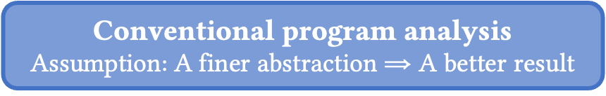

Challenges
Effectiveness
Conventional program analysis
Assumption: A finer abstraction $⇒$ A better result
Bayesian program analysis
A finer abstraction $⇏$ A better result
Conventional approaches
Ineffective
Generality
Pointer analysis
Interval analysis
Taint analysis
Datarace analysis
x = input1()
// 1 < x < 5
Specific
approaches
Probabilistic models
Analysis-agnostic approaches
Notes:
From the motivating example, we can conclude two challenges. The first one is effectiveness. There is an assumption in conventional analysis: a finer abstraction will lead to a better result. All previous selection approaches are based on this assumption. However, in our example, we showed that a modest abstraction may have a better generalization ability than a more precise or a coarser one, so this assumption is break in Bayesian analysis, and we need a new technique to handle this problem. The second one is generality. Since Bayesian analysis is not based on a specific analysis, designing a specific approach is not ideal. For example, we can use the range of x to determine which type of context-sensitivity to use, but this only works on specific analyses. We want to design an analysis-agnostic approach based on the probabilistic model itself.

Slide 10
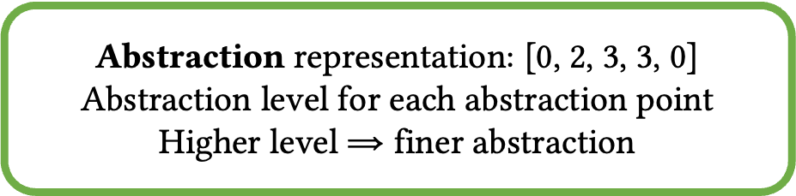
Our learning-based approach: BinGraph
Abstraction 1
[0, 0, 0, 0, 0]
Abstraction 2
[0, 1, 0, 1, 0]
Abstraction 3
[0, 2, 1, 1, 0]
Final abstraction
[0, 2, 3, 3, 0]
Example
Abstraction representation: [0, 2, 3, 3, 0]
Abstraction level for each abstraction point
Higher level $⇒$ finer abstraction
The clone depth (abstraction level) for each function (abstraction point) in the parametric k-CFA analysis
Notes:
Since conventional approaches are unable to address these two huge challenges, we propose a learning-based approach: BinGraph. Our approach starts from the coarsest abstraction, iteratively refines the abstraction in several rounds. The final abstraction is the selected abstraction of our approach. Here, we use an integer vector to represent an abstraction. Each element represents the abstraction level for each abstraction point. A higher level represents a finer abstraction in conventional analysis. For example, the abstraction level and the abstraction point correspond to the clone depth and the function in the parametric k-CFA analysis.
说一下多阶段

Slide 11
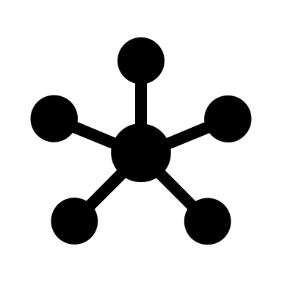



Our learning-based approach: BinGraph
Feature calculation
Offline learning
Refining
Calculation from two derivations
Graph-based feature
Learned
strategy
Training
programs
Abstraction 1
[0, 0, 0, 0, 0]
Abstraction 2
[0, 1, 0, 1, 0]
Abstraction 3
[0, 2, 1, 1, 0]
Final abstraction
[0, 2, 3, 3, 0]
Example
Abstraction representation: [0, 2, 3, 3, 0]
Abstraction level for each abstraction point
Higher level $⇒$ finer abstraction
The clone depth (abstraction level) for each function (abstraction point) in the parametric k-CFA analysis
Notes:
In each round, our approach will calculate features based on the analysis derivation, and refines it based on our offline learned strategy.
说一下多阶段

Slide 12
Our learning-based approach: BinGraph
Feature calculation
Offline learning
Refining
Calculation from two derivations
Graph-based feature
Learned
strategy
Training
programs
Abstraction 1
[0, 0, 0, 0, 0]
Abstraction 2
[0, 1, 0, 1, 0]
Abstraction 3
[0, 2, 1, 1, 0]
Final abstraction
[0, 2, 3, 3, 0]
Feature design for generality
Example
As long as we can extract derivation graphs of a given analysis, BinGraph can apply
Abstraction representation: [0, 2, 3, 3, 0]
Abstraction level for each abstraction point
Higher level $⇒$ finer abstraction
The clone depth (abstraction level) for each function (abstraction point) in the parametric k-CFA analysis
Notes:
Here, our feature is designed to be derivation-graph-based to obtain generality. In other words, as long as we can extract derivation graphs of a given analysis, BinGraph can apply. We will demonstrate the detailed property types later.

Slide 13
Our learning-based approach: BinGraph
Feature calculation
Offline learning
Refining
Calculation from two derivations
Graph-based feature
Learned
strategy
Training
programs
Abstraction 1
[0, 0, 0, 0, 0]
Abstraction 2
[0, 1, 0, 1, 0]
Abstraction 3
[0, 2, 1, 1, 0]
Final abstraction
[0, 2, 3, 3, 0]
Example
Abstraction representation: [0, 2, 3, 3, 0]
Abstraction level for each abstraction point
Higher level $⇒$ finer abstraction
The clone depth (abstraction level) for each function (abstraction point) in the parametric k-CFA analysis
Notes:
Moreover, we will not only use one derivation graph.

Slide 14
Our learning-based approach: BinGraph
Feature calculation
Offline learning
Refining
Calculation from two derivations
Graph-based feature
Learned
strategy
Training
programs
Abstraction 1
[0, 0, 0, 0, 0]
Abstraction 2
[0, 1, 0, 1, 0]
Abstraction 3
[0, 2, 1, 1, 0]
Final abstraction
[0, 2, 3, 3, 0]
Feature design for effectiveness
Example
Precise computation of the impact of the refinement on generalization ability
Abstraction representation: [0, 2, 3, 3, 0]
Abstraction level for each abstraction point
Higher level $⇒$ finer abstraction
The clone depth (abstraction level) for each function (abstraction point) in the parametric k-CFA analysis
Notes:
We will use the original derivation graph and the derivation graph after the refinement. This is because we can do a more precise computation of the impact of the refinement on generalization ability, which can lead to a more effective approach.

Slide 15
Our learning-based approach: BinGraph
Feature calculation
Offline learning
Refining
Calculation from two derivations
Graph-based feature
Learned
strategy
Training
programs
Abstraction 1
[0, 0, 0, 0, 0]
Abstraction 2
[0, 1, 0, 1, 0]
Abstraction 3
[0, 2, 1, 1, 0]
Final abstraction
[0, 2, 3, 3, 0]
Example
Abstraction representation: [0, 2, 3, 3, 0]
Abstraction level for each abstraction point
Higher level $⇒$ finer abstraction
The clone depth (abstraction level) for each function (abstraction point) in the parametric k-CFA analysis
Notes:
Finally, the abstraction we selected will be transformed into a Bayesian network,

Slide 16

Our learning-based approach: BinGraph
Feature calculation
Offline learning
Refining
Calculation from two derivations
Graph-based feature
Learned
strategy
Training
programs
Abstraction 1
[0, 0, 0, 0, 0]
Abstraction 2
[0, 1, 0, 1, 0]
Abstraction 3
[0, 2, 1, 1, 0]
Final abstraction
[0, 2, 3, 3, 0]
Bayesian program analysis
Ranked alarms
User
Feedback
Bayesian network
Notes:
Finally, the abstraction we selected will be transformed into a Bayesian network, and it can calculate ranked alarms and hand them to the user. The user will inspect the alarm with the highest probability, feed it back, and continue this interaction. We will then focus on the core feature calculation part of BinGraph.
尝试放到例子上
解释一下数字
优化offline leaning

Slide 17
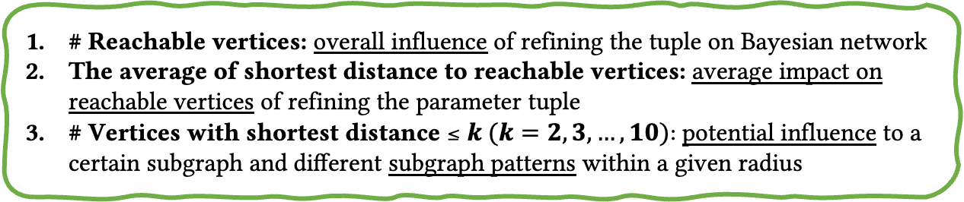
Feature Calculation
B[10] = {0}
f(){
x = input1() // 1 < x < 5
x1 = x
x2 = x1
B[h(x2)] = 1 // A1 false
}
g1(){
y = input2() // y < 0
y1 = y
B[g(y1)] = 2 // A2 true
}
g2(){
z = input3() // z < 0
B[g(z)] = 3 // A3 true
}
g(i){ return h(i) }
h(j){ return j }
0-CFA
1-CFA
Taint(x)
Taint(y)
Taint(z)
Taint(x)
Taint(y)
Taint(z)
Taint(x1)
Taint(y1)
Taint(x1)
Taint(y1)
Taint(x2)
Taint(i)
Taint(x2)
Taint(i_{g1})
Taint(i_{g2})
Taint(j)
Taint(j_{f})
Taint(j_{g})
Alarm(A1)
Alarm(A2)
Alarm(A3)
Alarm(A1)
Alarm(A2)
Alarm(A3)
CS(g, 0)
CS(g, 1)
# Reachable vertices: overall influence of refining the tuple on Bayesian network
The average of shortest distance to reachable vertices: average impact on reachable vertices of refining the parameter tuple
# Vertices with shortest distance$≤k (k=2,3,…,10):$potential influence to a certain subgraph and diﬀerent subgraph patterns within a given radius
17
Notes:
We use the previous example to show the feature calculation part. Assume we are in the first iteration and we start from 0-CFA and try to determine whether to use 1-CFA on function g. For each abstraction point, there will be a corresponding parametric tuple to generate the derivation graph. We use CS(g,0) to represent 0-CFA on g and CS(g,1) for 1-CFA on g. We will calculate the properties of each parametric tuple in two derivations graphs. We use three property types: the first one is the count of reachable vertices, which reflects the overall influence of refining the tuple on the Bayesian network. The second one is the average of shortest distance to reachable vertices, it reflects the average impact on reachable vertices of refining the parameter tuple. The third one is the count of vertices with the shortest distance of no more than k, which reflects potential influence to a certain subgraph and diﬀerent subgraph patterns within a given radius.

Slide 18
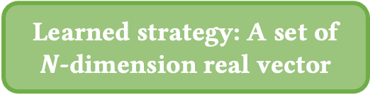
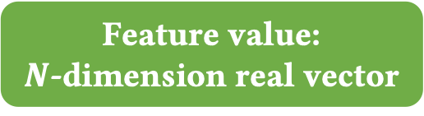
Feature Calculation
0-CFA
1-CFA
Refine if contained
Taint(x)
Taint(y)
Taint(z)
Taint(x)
Taint(y)
Taint(z)
Taint(x1)
Taint(y1)
Taint(x1)
Taint(y1)
Learned strategy: A set of $N$-dimension real vector
Taint(x2)
Taint(i)
Taint(x2)
Taint(i_{g1})
Taint(i_{g2})
Taint(j)
Taint(j_{f})
Taint(j_{g})
Alarm(A1)
Alarm(A2)
Alarm(A3)
Alarm(A1)
Alarm(A2)
Alarm(A3)
Feature value:
$N$-dimension real vector
CS(g, 0)
CS(g, 1)
# Reachable vertices: overall influence of refining the tuple on Bayesian network
The average of shortest distance to reachable vertices: average impact on reachable vertices of refining the parameter tuple
# Vertices with shortest distance$≤k (k=2,3,…,10):$potential influence to a certain subgraph and diﬀerent subgraph patterns within a given radius
Ratio
18
Notes:
The ratio of features calculated in the two graphs consists of a N-dimension real vector. Our learned strategy is a set of n-dimension real vectors. If this set contains this feature value, then the corresponding part of this parametric tuple in the abstraction will be refined, otherwise, it will not be.

Slide 19
Experiments
Instance analyses: A datarace analysis [Naik et al. 2006] and a thread-escape analysis [Naik et al. 2012].
Benchmarks: 13 Java benchmarks from the DaCapo suite [Blackburn et al. 2006] and from past works.
Baselines: The coarsest abstraction Base-C, the most precise abstraction Base-P, and the abstraction with random parameters Base-R.
Metrics: Inversion count (the number of pairs of a false alarm inspected by the user before a true alarm) of simulated interaction.
Feedback
0011000110
Bayesian network
Simulated user
Inversion count
Ranked alarms
Notes:
In order to evaluate the efficiency of our approach, we conducted experiments on it. We use two instance analyses, a datarace analysis, and a thread-escape analysis. Our benchmark consists of 13 Java programs from the DaCapo suite and from past works. Our baselines are the coarsest abstraction, the most precise abstraction, and the abstraction with random parameters. Our major evaluation metric is the inversion count of simulated interaction. Here, we previously obtained true bugs in benchmarks and simulated the whole interaction. The inversion count is the number of pairs of a false alarm inspected by the user before a true alarm. Lower inversion count represents a better user experience during the overall interaction.

Slide 20
Eﬀectiveness
Average 45.36%, 23.38%, and 45.64% lower inversion count
Similar improvements in the other two metrics [Raghothaman et al. 2018]
Notes:
We first researched how effective is BinGraph? Our results show that there are average 40% lower inversion count compared to baselines, and there are also similar improvements in the other two metrics used in the previous work. In summary, BinGraph is indeed eﬀective.

Slide 21
Necessity to Use Two Derivations
An ablation experiment that only uses the abstraction before overall refinement to characterize each abstraction point: BinGraph_{A}
The variation of BinGraph_{A} is completely diﬀerent from BinGraph, and even worse than baselines in most metrics.
Notes:
We then researched whether it is necessary to use two derivation graphs. Since the derivation graph after refinement usually has a high computational cost. We do an ablation experiment that only uses one derivation. The result shows that it is extremely worse than the original setup, and even worse than baselines in most metrics. We can conclude that it is necessary to use two derivation graphs.

Slide 22
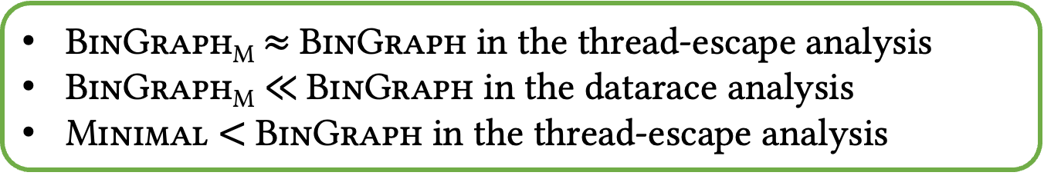
Ineﬀectiveness of Conventional Approaches
The minimal abstraction (Minimal): the cheapest abstraction among all the abstractions that produce the least false positives
Training from the minimal abstraction: BinGraph_{M}
BinGraph_{M}$≈$BinGraph in the thread-escape analysis
BinGraph_{M} $≪$BinGraph in the datarace analysis
Minimal $<$BinGraph in the thread-escape analysis
Notes:
Last, we researched whether conventional approaches can replace BinGraph? In other words, does a well-balanced abstraction in conventional analysis happen to be one with good generalization ability in Bayesian analysis? We compared our approach with the cheapest abstraction among all the abstractions that produce the least false positives. The result shows that conventional approaches cannot reliably find abstractions with good generalization ability for Bayesian analysis.

Slide 23
Conclusion
We are the first to research the abstraction selection problem of Bayesian program analysis.
We propose a framework BinGraph for learning abstraction selection for Bayesian program analysis.
BinGraph has a direct optimization eﬀect on the generalization ability and is general to apply to Bayesian program analyses with diﬀerent logical rules.
We show the eﬀectiveness of BinGraph on diverse analyses applied to a suite of real-world programs.
Thanks for listening!
Notes:
Finally, I will give the conclusion of our work. We are the first to research the abstraction selection problem of Bayesian program analysis. Then, we propose a framework BinGraph for learning abstraction selection for Bayesian program analysis. Next, BinGraph has a direct optimization eﬀect on the generalization ability and is general to apply to Bayesian program analyses with diﬀerent logical rules. Last, We show the eﬀectiveness of BinGraph on diverse analyses applied to a suite of real-world programs. That’s all, thanks for listening!

Slide 24
Eﬀectiveness
Another metric AUC is the normalized area under the
ROC curve, also used in previous work [Raghothaman et al. 2018]
A visual illustration of the powerful generalization ability of abstractions selected by BinGraph
Notes:
We also demonstrate another metric AUC, the normalized area under the ROC curve. The larger area under the curve represents a stronger generalization ability. This is a visual illustration of the effective of BinGraph.

Slide 25
RQ2. Sensitivity
The leave-one-out cross-validation on the thread-escape analysis: BinGraph_{C}
Only minor changes in all metrics between BinGraph and BinGraph_{C}. BinGraph is not sensitive to the selection of training benchmarks.
Notes:
The second research question is how sensitive is BinGraph to training benchmarks, we do the leave-one-out cross-validation on the thread-escape analysis. The results show only minor changes so we can conclude that BinGraph is not sensitive to training benchmarks.
删了第一个

Slide 26
RQ4. Scalability
An evaluation of Bayesian inference cost of abstractions selected by BinGraph in the datarace analysis
Under the existing framework of Bayesian program analysis, the scalability of BinGraph is acceptable compared to other approaches
Notes:
The fourth research question is the scalability of BinGraph. We mainly evaluated the Bayesian inference cost in the datarace analysis. The conclusion is that the scalability of BinGraph is acceptable compared to other approaches under the existing framework.

Slide 27
A Motivating Example
B[10] = {0}
f(){
x = input1() // x < 0
x1 = x
x2 = x1
B[h(x2)] = 1 // A1
}
g1(){
y = input2() // 1 < y < 5
B[g(y)] = 2 // A2
}
g2(){
z = input3() // 2 < z < 6
B[g(z)] = 3 // A3
}
g(i){ return h(i) }
h(j){ return j }
Context-insensitive
Taint(v): Variable v is tainted
Alarm(A): Alarm A is true
Taint(x)
Taint(y)
Taint(i)
Derivation graph
Derived tuples
Taint(a)
Taint(b)
0.8
Alarm(A1)
Taint(c)
Bayesian network
Bernoulli variables
0.8
Alarm(A2)
Prob. | Alarm
0.614 | A1
… | …
0.492 | A2
… | …
Prob. | Alarm
1.0 | A1
0.512 | A2
… | …
… | …
Bayesian inference on each variable based on given posterior information
Notes:
Here, we illustrate a code fragment. We will show how to use a taint analysis to find these two out-of-bounds bugs A1 and A2. We assume the values from external calls are tainted. So we can derive tuples taint(x) and taint(y). There is a value flow from x to i, and y to i. We first use the context-insensitive on function h. Then, the two value flows will be merged. Next, there is value flow from i to a. Since a is being an array index, the alarm on A1 is derived. This is similar for variables b, c, and alarm A2. We refer this directed graph as the derivation graph, and each vertex represents a derived tuple. Next, we can attach a probability 0.8 to each derivation to quantify their degrees of approximation. Then the whole graph is transformed to a Bayesian network, and each tuple becomes a Bernoulli variable. We can do Bayesian inference on each variable based on given posterior information. For example, We can first calculate the probability of Alarm A1 and A2. We assume A1 is the highest one and the user checks it giving positive feedback. Then, we can calculate the conditional probability under this feedback. The probability of A2 is increased since A1 and A2 are connected through the path we showed in the network.
加 path
f() {
x= input()
index = h(x, 0)
Z[index] = 1 // A1
}

Slide 28
Our learning-based approach: BinGraph
Online selection
Offline learning
Matching
Calculation from two derivations
Graph-based feature
Learned strategy
Training programs
Abstraction 1
[0, 0, 0, 0, 0]
Abstraction 2
[0, 1, 0, 1, 0]
Abstraction 3
[0, 2, 1, 1, 0]
Final abstraction
[0, 2, 3, 3, 0]
Example
Abstraction representation: [0, 2, 3, 3, 0]
Abstraction level for each abstraction point
Higher level $⇒$ finer abstraction
The clone depth (abstraction level) for each object allocation site (abstraction point) in a parametric k-object-selective analysis
Notes:
先说abstraction level是结果，强调learning是关键，为了通用性和有效性，我们的feature设置为了xxx。这里放一个整体流程图，类似paper中的那种

Slide 29
Our learning-based approach: BinGraph
Online selection
Offline learning
Matching
Calculation from two derivations
Graph-based feature
Learned strategy
Training programs
Abstraction 1
[0, 0, 0, 0, 0]
Abstraction 2
[0, 1, 0, 1, 0]
Abstraction 3
[0, 2, 1, 1, 0]
Final abstraction
[0, 2, 3, 3, 0]
Bayesian program analysis
Ranked alarms
User
Feedback
Bayesian network
Notes:
先说abstraction level是结果，强调learning是关键，为了通用性和有效性，我们的feature设置为了xxx。这里放一个整体流程图，类似paper中的那种

Slide 30
Learning design for effectiveness
Online selection
Offline learning
Matching
Calculation from two derivations
Graph-based feature
Learned strategy
Training programs
Abstraction 1
[0, 0, 0, 0, 0]
Abstraction 2
[0, 1, 0, 1, 0]
Abstraction 3
[0, 2, 1, 1, 0]
Final abstraction
[0, 2, 3, 3, 0]
Bayesian program analysis
Ranked alarms
User
Feedback
Bayesian network
Notes:
先说abstraction level是结果，强调learning是关键，为了通用性和有效性，我们的feature设置为了xxx。这里放一个整体流程图，类似paper中的那种

Slide 31
Learning design for effectiveness
Online selection
Offline learning
Leveraging two derivation graphs
Matching
Precise computation of the impact of the refinement on generalization ability
Calculation from two derivations
Graph-based feature
Learned strategy
Training programs
Abstraction 1
[0, 0, 0, 0, 0]
Abstraction 2
[0, 1, 0, 1, 0]
Abstraction 3
[0, 2, 1, 1, 0]
Final abstraction
[0, 2, 3, 3, 0]
Multi-round refining
Bayesian program analysis
Ranked alarms
Guide the change of abstraction towards a strong generalization ability
User
Feedback
Bayesian network
Notes:
先说abstraction level是结果，强调learning是关键，为了通用性和有效性，我们的feature设置为了xxx。这里放一个整体流程图，类似paper中的那种

Slide 32
Learning design for generality
Online selection
Offline learning
Matching
Calculation from two derivations
Graph-based feature
Learned strategy
Training programs
Abstraction 1
[0, 0, 0, 0, 0]
Abstraction 2
[0, 1, 0, 1, 0]
Abstraction 3
[0, 2, 1, 1, 0]
Final abstraction
[0, 2, 3, 3, 0]
Bayesian program analysis
Ranked alarms
User
Feedback
Bayesian network
Notes:
先说abstraction level是结果，强调learning是关键，为了通用性和有效性，我们的feature设置为了xxx。这里放一个整体流程图，类似paper中的那种

Slide 33
Learning design for generality
Online selection
Offline learning
Matching
Calculation from two derivations
Graph-based feature
Learned strategy
Training programs
Abstraction 1
[0, 0, 0, 0, 0]
Abstraction 2
[0, 1, 0, 1, 0]
Abstraction 3
[0, 2, 1, 1, 0]
Final abstraction
[0, 2, 3, 3, 0]
Graph-based properties
As long as we can extract derivations graphs of a given analysis, BinGraph can apply
Bayesian program analysis
Ranked alarms
User
Feedback
Bayesian network
Notes:
先说abstraction level是结果，强调learning是关键，为了通用性和有效性，我们的feature设置为了xxx。这里放一个整体流程图，类似paper中的那种

Slide 34
Our learning-based approach: BinGraph
Online selection
Offline learning
Matching
Calculation from two derivations
Graph-based feature
Learned strategy
Training programs
Abstraction 1
[0, 0, 0, 0, 0]
Abstraction 2
[0, 1, 0, 1, 0]
Abstraction 3
[0, 2, 1, 1, 0]
Final abstraction
[0, 2, 3, 3, 0]
Bayesian program analysis
Ranked alarms
User
Feedback
Bayesian network
Notes:
先说abstraction level是结果，强调learning是关键，为了通用性和有效性，我们的feature设置为了xxx。这里放一个整体流程图，类似paper中的那种

Slide 35
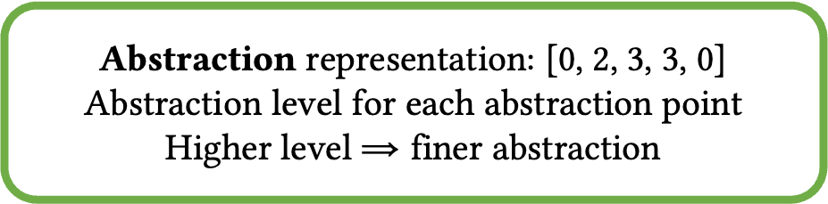
Our approach: BinGraph
Example
Abstraction representation: [0, 2, 3, 3, 0]
Abstraction level for each abstraction point
Higher level $⇒$ finer abstraction
The clone depth (abstraction level) for each object allocation site (abstraction point) in a parametric k-object-selective analysis
Abstraction 1
[0, 0, 0, 0, 0]
Abstraction 2
[0, 1, 0, 1, 0]
Abstraction 3
[0, 2, 1, 1, 0]
Final abstraction
[0, 2, 3, 3, 0]
Online selection
Offline learning
Matching
Calculation from two derivations
Graph-based feature
Learned strategy
Training programs
Notes:
先说abstraction level是结果，强调learning是关键，为了通用性和有效性，我们的feature设置为了xxx。这里放一个整体流程图，类似paper中的那种

Slide 36
Our approach: BinGraph
Example
Abstraction representation: [0, 2, 3, 3, 0]
Abstraction level for each abstraction point
Higher level $⇒$ finer abstraction
The clone depth (abstraction level) for each object allocation site (abstraction point) in a parametric k-object-selective analysis
Abstraction 1
[0, 0, 0, 0, 0]
Abstraction 2
[0, 1, 0, 1, 0]
Abstraction 3
[0, 2, 1, 1, 0]
Final abstraction
[0, 2, 3, 3, 0]
Multi-round refining
Online selection
Offline learning
Guide the change of abstraction towards a strong generalization ability
Matching
Calculation from two derivations
Graph-based feature
Learned strategy
Training programs

Slide 37
Online Selection
Original abstraction
[0, 0, 0, 0, 0]
Abstraction after overall refinement
[1, 1, 1, 1, 1]
Abstraction 1
[0, 0, 0, 0, 0]
Abstraction 2
[0/1, 0/1, 0/1, 0/1, 0/1]
Should raise abstraction level for each abstraction point?
Calculate properties of parametric tuples in two derivations graphs

Slide 38
Online Selection
Original abstraction
[0, 0, 0, 0, 0]
Abstraction after overall refinement
[1, 1, 1, 1, 1]
Abstraction 1
[0, 0, 0, 0, 0]
Leveraging two derivation graphs
Abstraction 2
[0/1, 0/1, 0/1, 0/1, 0/1]
Should raise abstraction level for each abstraction point?
Precise computation of the impact of the refinement on generalization ability
Calculate properties of parametric tuples in two derivations graphs

Slide 39
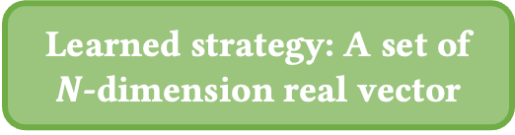
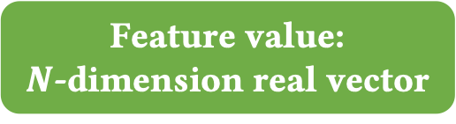
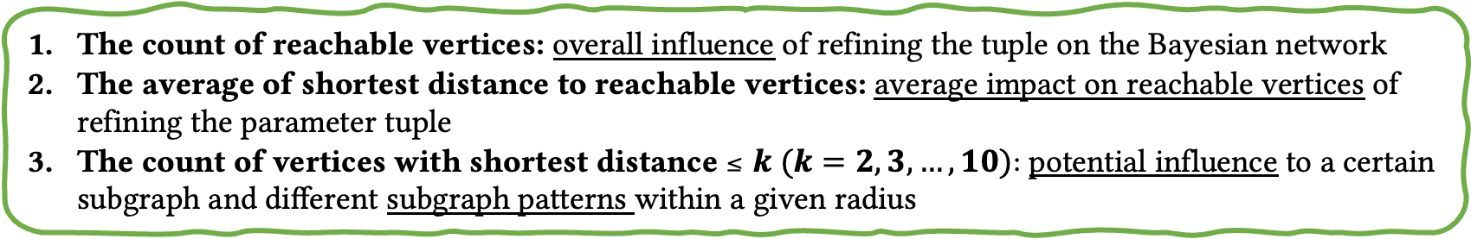
Feature Calculation
Refine if contained
Original abstraction
[0, 0, 0, 0, 0]
Abstraction after refinement
[1, 1, 1, 1, 1]
Learned strategy: A set of $N$-dimension real vector
Feature value:
$N$-dimension real vector
Ratio
The count of reachable vertices: overall influence of refining the tuple on the Bayesian network
The average of shortest distance to reachable vertices: average impact on reachable vertices of refining the parameter tuple
The count of vertices with shortest distance$≤k (k=2,3,…,10):$potential influence to a certain subgraph and diﬀerent subgraph patterns within a given radius
Notes:
To calculate the feature of an abstraction, we will calculate the properties of each parametric tuple in two derivations graphs, one is the original abstraction, and the other one is the abstraction after refinement. We use three property types: the first one is the count of reachable vertices, which reflects the overall influence of refining the tuple on the Bayesian network. The second one is the average of shortest distance to reachable vertices, it reflects the average impact on reachable vertices of refining the parameter tuple. The third one is the count of vertices with the shortest distance of no more than k, which reflects potential influence to a certain subgraph and diﬀerent subgraph patterns within a given radius. The ratio of features calculated in the two graphs consists of a N-dimension real vector. Our learned strategy is a set of n-dimension real vectors. If this set contains this feature value, then the corresponding part of this parametric tuple in the abstraction will be refined, otherwise, it will be not.

Slide 40
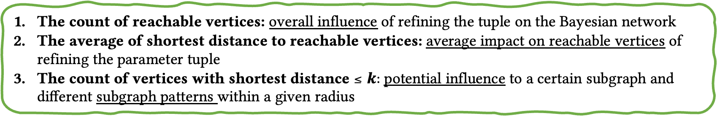

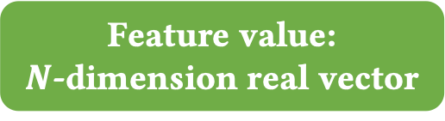
Online Selection
Raise abstraction level if contained
Original abstraction
[0, 0, 0, 0, 0]
Abstraction after overall refinement
[1, 1, 1, 1, 1]
Graph-based properties
Learned strategy: A set of $N$-dimension real vector
As long as we can extract derivations graphs of a given analysis, BinGraph can apply
Feature value:
$N$-dimension real vector
Ratio
The count of reachable vertices: overall influence of refining the tuple on the Bayesian network
The average of shortest distance to reachable vertices: average impact on reachable vertices of refining the parameter tuple
The count of vertices with shortest distance$≤k:$potential influence to a certain subgraph and diﬀerent subgraph patterns within a given radius

Slide 41




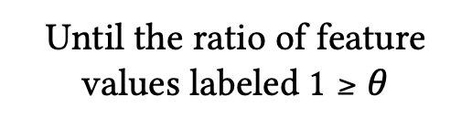
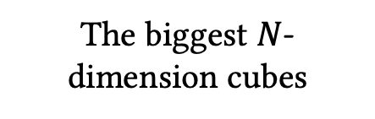
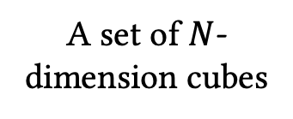
Offline Learning
Labeling
Abstraction 1
[0, 0, 0, 0, 0]
Abstraction 2
[0, 1, 0, 1, 0]
Abstraction 3
[0, 2, 1, 1, 0]
Final abstraction
[0, 2, 3, 3, 0]
Feature values for each abstraction point
Label 1 if raises level
Else label 0
Simulated-annealing
Supervised learning
Remove covered feature values and run again
The biggest $N$-dimension cubes
Until the ratio of feature values labeled 1 $≥θ$
A set of $N$-dimension cubes
Size reduction

Slide 42
A Motivating Example
B[10] = {0}
f(){
x = input1() // 1 < x < 5
x1 = x
x2 = x1
B[h(x2)] = 1 // A1 false
}
g1(){
y = input2() // y < 0
y1 = y
B[g(y1)] = 2 // A2 true
}
g2(){
z = input3() // z < 0
B[g(z)] = 3 // A3 true
}
g(i){ return h(i) }
h(j){ return j }
2-CFA
1-CFA
Taint(x)
Taint(y)
Taint(z)
Taint(x)
Taint(y)
Taint(z)
Taint(x1)
Taint(y1)
Taint(x1)
Taint(y1)
Taint(x2)
Taint(i_{g1})
Taint(i_{g2})
Taint(x2)
Taint(i_{g1})
Taint(i_{g2})
Taint(j_{f})
Taint(j_{g1,g})
Taint(j_{f})
Taint(j_{g})
Alarm(A1)
Alarm(A2)
Alarm(A3)
Alarm(A1)
Alarm(A2)
Alarm(A3)
Prob. | Alarm
0.614 | A1
0.492 | A2
0.492 | A3
… | …
… | …
Prob. | Alarm
… | …
0.492 | A2
0.492 | A3
… | …
0 | A1
Prob. | Alarm
0.614 | A1
0.492 | A2
0.492 | A3
… | …
… | …
Prob. | Alarm
… | …
0.492 | A2
0.492 | A3
… | …
0 | A1
Notes:
Here, we illustrate a code fragment. We will show how to use a taint analysis to find these two out-of-bounds bugs A1 and A2. We assume the values from external calls are tainted. So we can derive tuples taint(x) and taint(y). There is a value flow from x to i, and y to i. We first use the context-insensitive on function h. Then, the two value flows will be merged. Next, there is value flow from i to a. Since a is being an array index, the alarm on A1 is derived. This is similar for variables b, c, and alarm A2. We refer this directed graph as the derivation graph, and each vertex represents a derived tuple. Next, we can attach a probability 0.8 to each derivation to quantify their degrees of approximation. Then the whole graph is transformed to a Bayesian network, and each tuple becomes a Bernoulli variable. We can do Bayesian inference on each variable based on given posterior information. For example, We can first calculate the probability of Alarm A1 and A2. We assume A1 is the highest one and the user checks it giving positive feedback. Then, we can calculate the conditional probability under this feedback. The probability of A2 is increased since A1 and A2 are connected through the path we showed in the network.
加 path
f() {
x= input()
index = h(x, 0)
Z[index] = 1 // A1
}

Slide 43

A Motivating Example
f(){
x = input1() // x < 0
h(x, 0)
}
g(){
y = input2() // y < 0
h(y, 1)
}
h(i, j){
Z[10] = {0}
if(j == 0){
a = i
Z[a] = 1 // A1
}else{
b = i
c = b
Z[c] = 2 // A2
}
}
Context-insensitive on h
Context-sensitive on h
Taint(x)
Taint(y)
Taint(x)
Taint(y)
Taint(i)
Taint(i_{f})
Taint(i_{g})
Taint(a)
Taint(b)
Taint(a_{f})
Taint(b_{g})
Alarm(A1)
Taint(c)
Alarm(A1)
Taint(c_{g})
Alarm(A2)
Alarm(A2)
Prob. | Alarm
0.614 | A1
… | …
0.492 | A2
… | …
Prob. | Alarm
1.0 | A1
0.512 | A2
… | …
… | …
Prob. | Alarm
0.512 | A1
… | …
0.410 | A2
… | …
Prob. | Alarm
1.0 | A1
… | …
0.410 | A2
… | …
Notes:
However, if we use context-sensitive on h, then the value flow from x to i and from y to i will be separated. Then, the feedback of A1 will not affect A2. This is not good for the user since A2 is also a true alarm. This is mainly because that the abstraction can only affect the structure of the Bayesian model instead of the final result. Since the range of x and y are same, merging them will lead to a better result. This insight can only be captured by context-insensitive.
Over-fitting，抽象是一种形容，不一定越精确越好。聚类
改名字，避免歧义。
克隆了两个h，只能泛化到自己

Slide 44
A Motivating Example
f(){
x = input1() // x < 0
h(x, 0)
}
g(){
y = input2() // y < 0
h(y, 1)
}
h(i, j){
Z[10] = {0}
if(j == 0){
a = i
Z[a] = 1 // A1
}else{
b = i
c = b
Z[c] = 2 // A2
}
}
Context-insensitive on h
Context-sensitive on h
Taint(x)
Taint(y)
Taint(x)
Taint(y)
Too precise
Taint(i)
Taint(i_{f})
Taint(i_{g})
Prevent posterior information from propagating to relevant analysis results effectively: Over-fitting
Taint(a)
Taint(b)
Taint(a_{f})
Taint(b_{g})
Alarm(A1)
Taint(c)
Alarm(A1)
Taint(c_{g})
Alarm(A2)
Alarm(A2)
Prob. | Alarm
0.614 | A1
… | …
0.492 | A2
… | …
Prob. | Alarm
1.0 | A1
0.512 | A2
… | …
… | …
Prob. | Alarm
0.512 | A1
… | …
0.410 | A2
… | …
Prob. | Alarm
1.0 | A1
… | …
0.410 | A2
… | …
Notes:
From this example, we can conclude that if an abstraction is too precise, then it may prevent posterior information from propagating to relevant analysis results effectively, just like from A1 to A2, and this is the over-fitting in machine learning.

Slide 45

A Motivating Example
f(){
x = input1() // x < 0
h(x, 0)
}
g(){
y = input3() // 1 < y < 5
h(y, 1)
}
h(i, j){
Z[10] = {0}
if(j == 0){
a = i
Z[a] = 1 // A1
}else{
b = i
c = b
Z[c] = 2 // A2
}
}
Context-insensitive on h
Context-sensitive on h
Taint(x)
Taint(y)
Taint(x)
Taint(y)
Taint(i)
Taint(i_{f})
Taint(i_{g})
Taint(a)
Taint(b)
Taint(a_{f})
Taint(b_{g})
Alarm(A1)
Taint(c)
Alarm(A1)
Taint(c_{g})
Alarm(A2)
Alarm(A2)
Prob. | Alarm
0.614 | A1
… | …
0.492 | A2
… | …
Prob. | Alarm
1.0 | A1
0.512 | A2
… | …
… | …
Prob. | Alarm
0.512 | A1
… | …
0.410 | A2
… | …
Prob. | Alarm
1.0 | A1
… | …
0.410 | A2
… | …
False positive
Notes:
On the other hand, if we change the code fragment on the taint source of y, we let y be an input in the range from 1 to 5. Then the alarm A2 now becomes a false alarm since c is a valid array index. In this situation, context-insensitive will perform worse since the feedback of A1 will increase the probability of A2, but A2 is not true. Conversely, context-sensitive will not have this issue.
输入数据，不确定性。具体情况，取决于数据

Slide 46
A Motivating Example
f(){
x = input1() // x < 0
h(x, 0)
}
g(){
y = input3() // 1 < y < 5
h(y, 1)
}
h(i, j){
Z[10] = {0}
if(j == 0){
a = i
Z[a] = 1 // A1
}else{
b = i
c = b
Z[c] = 2 // A2
}
}
Context-insensitive on h
Context-sensitive on h
Taint(x)
Taint(y)
Taint(x)
Taint(y)
Too coarse
Taint(i)
Taint(i_{f})
Taint(i_{g})
Cause posterior information to propagate to irrelevant analysis results falsely:
Under-fitting
Taint(a)
Taint(b)
Taint(a_{f})
Taint(b_{g})
Alarm(A1)
Taint(c)
Alarm(A1)
Taint(c_{g})
Alarm(A2)
Alarm(A2)
Prob. | Alarm
0.614 | A1
… | …
0.492 | A2
… | …
Prob. | Alarm
1.0 | A1
0.512 | A2
… | …
… | …
Prob. | Alarm
0.512 | A1
… | …
0.410 | A2
… | …
Prob. | Alarm
1.0 | A1
… | …
0.410 | A2
… | …
False positive
Notes:
Therefore, we can conclude that if an abstraction is too coarse, then it may cause posterior information to propagate to irrelevant analysis results falsely, and this is the under-fitting in machine learning.

Slide 47
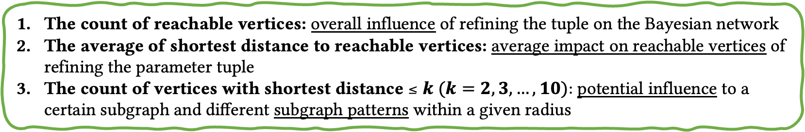
Feature Calculation
Context-insensitive on h
Context-sensitive on h
Refine if contained
Taint(x)
Taint(y)
Taint(x)
CS(h)
Taint(y)
CI(h)
Taint(i)
Taint(i_{f})
Taint(i_{g})
Learned strategy: A set of $N$-dimension real vector
Taint(a)
Taint(b)
Taint(a_{f})
Taint(b_{g})
Alarm(A1)
Taint(c)
Alarm(A1)
Taint(c_{g})
Feature value:
$N$-dimension real vector
Alarm(A2)
Alarm(A2)
Ratio
The count of reachable vertices: overall influence of refining the tuple on the Bayesian network
The average of shortest distance to reachable vertices: average impact on reachable vertices of refining the parameter tuple
The count of vertices with shortest distance$≤k (k=2,3,…,10):$potential influence to a certain subgraph and diﬀerent subgraph patterns within a given radius
Notes:
We use the previous example to show the feature calculation part. For each abstraction point, there will be a corresponding parametric tuple to generate the derivation graph. We assume the function h is an abstraction point. We use CI(h) for context-insensitive and CS(h) for context-sensitive. We will calculate the properties of each parametric tuple in two derivations graphs. We use three property types: the first one is the count of reachable vertices, which reflects the overall influence of refining the tuple on the Bayesian network. The second one is the average of shortest distance to reachable vertices, it reflects the average impact on reachable vertices of refining the parameter tuple. The third one is the count of vertices with the shortest distance of no more than k, which reflects potential influence to a certain subgraph and diﬀerent subgraph patterns within a given radius. The ratio of features calculated in the two graphs consists of a N-dimension real vector. Our learned strategy is a set of n-dimension real vectors. If this set contains this feature value, then the corresponding part of this parametric tuple in the abstraction will be refined, otherwise, it will be not.

Slide 48
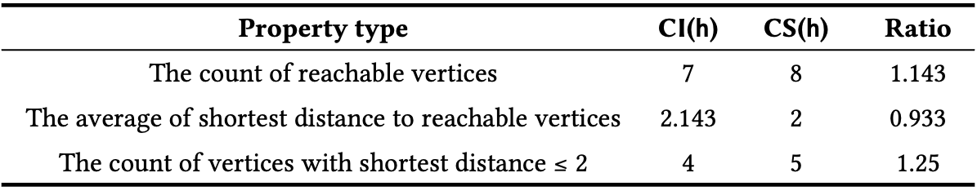
Feature Calculation
Context-insensitive on h
Context-sensitive on h
Refine if contained
Taint(x)
Taint(y)
Taint(x)
CS(h)
Taint(y)
CI(h)
Taint(i)
Taint(i_{f})
Taint(i_{g})
Learned strategy: A set of $N$-dimension real vector
Taint(a)
Taint(b)
Taint(a_{f})
Taint(b_{g})
Alarm(A1)
Taint(c)
Alarm(A1)
Taint(c_{g})
Feature value:
$N$-dimension real vector
Alarm(A2)
Alarm(A2)
Property type | CI(h) | CS(h) | Ratio
The count of reachable vertices | 7 | 8 | 1.143
The average of shortest distance to reachable vertices | 2.143 | 2 | 0.933
The count of vertices with shortest distance$≤2$ | 4 | 5 | 1.25
More property types used in experiments and in practical
Notes:
In our example, We use three property types. We can calculate the count of reachable vertices, the average of shortest distance to reachable vertices, and the count of vertices with shortest distance no more than 2 of these two parametric tuples. The ratio of this two value consists of a 3-dimension real vector, our learned strategy will determine whether to refine to it. In the experiments, we used more property types, and the property types can be arbitrarily set in practical use.

Slide 49
Research Questions
RQ1. How eﬀective is BinGraph at optimization for generalization ability of Bayesian program analysis?
RQ2. How sensitive is BinGraph to the hyper-parameter and training benchmarks?
RQ3. Is it necessary to calculate the derivation graph after an overall refinement to characterize abstraction points?
RQ4. How scalable is Bayesian program analysis using the abstraction selected by BinGraph?
RQ5. Can an existing abstraction selection approach for conventional program analyses replace our approach? Does an abstraction with a good balance of precision/scalability in a conventional analysis happen to be one with good generalization in its Bayesian counterpart?

