Slide 1
Fuzzing Guided by
Bayesian Program Analysis
Yifan Zhang, Xin Zhang
Peking University, China
Notes:
Hello, everyone. I am Yifan Zhang from Peking University. Today, I am going to talk about our recent work on Fuzzing Guided by Bayesian Program Analysis. This is joint work with my advisor, Xin Zhang.

Slide 2








Large-Scale Target-Guided Greybox Fuzzing (LTGF)
Large-scale target-guided greybox fuzzing
Exploration
Exploitation
Existing approaches
Program under test and a large target set
Coverage-guided mutation
Directed mutation
Prioritize targets sequentially,
one at a time
Ad-hoc
Stronger capability
to detect bugs
Target prioritization
Coarse-grained
New bugs
Notes:
Our work is based on Large-Scale Target-Guided Greybox Fuzzing, or LTGF for short. (click) Given a program under test and a large set of targets — usually coming from static analysis alarms — (click) LTGF aims to trigger as many potential new bugs at these targets as possible. (click) LTGF operates in two alternating stages: exploration and exploitation. In the exploration stage, (click) LTGF performs coverage-guided mutation to accumulate more seeds, (click) which enhances its capability to detect bugs during the exploitation stage. In the exploitation stage, (click) LTGF first conducts target prioritization. For those high-priority targets, (click) LTGF carries out directed mutation to trigger the potential bugs associated with them.
However, existing approaches for target prioritization lack a systematic design. (click) For instance, they prioritize targets one by one in sequence. (click) This strategy is not only ad hoc but also coarse-grained, causing LTGF to waste a significant amount of time on targets that are unlikely to contain bugs.

Slide 3


Limitation of LTGF
e = 0, a = 0
B[2000]
e = input() % 3
a = input()
if(e == 0){
B[a % 100 - 1] = 0 // A1
}else if(e == 1){
b = a == 100 ? 0 : 1
B[b - 1] = 0 // A2
}else{
c = a * 2 + 1
B[c % 2 - 1] = 0 // A3
}
... // A4
... // A5
... // A6
Exploration
e = 0, a = 0
e = 1, a = 0
e = 2, a = 0
Exploitation on A1
e = 0, a = 0
Mutate 1000 times
waste of time
Exploitation on A2
e = 1, a = 0
Mutate 1000 times
Exploitation on A3
e = 2, a = 0
Mutate 1000 times
Notes:
Let me use a simple example to show the limitation of existing LTGF. (click)
In this program, we run taint analysis to find potential out-of-bounds bugs. The variable e comes from the input, and depending on its value, the running goes into one of three branches. The variable a is also input-controlled, so it’s tainted, and any variable derived from a is tainted as well, including b and c. Since a, b, and c are all used as array indices, the analysis raises three alarms: A1, A2, and A3. We also assume there are other alarms from the analysis, such as A4, A5, and A6.
(click) Now suppose we start with just one seed: e = 0, a = 0. (click) Existing LTGF first runs an exploration stage, where the goal is to maximize coverage. Let’s assume this stage successfully covers all three branches for e = 0, 1, 2. For each coverage pattern, the fuzzer only keeps one seed. (click) So at this point, our seed set is:
(e = 0, a = 0)
(e = 1, a = 0)
(e = 2, a = 0)
Next, LTGF runs exploitation fuzzing for each target, one by one. (click) For A1, LTGF picks the seed that is “closest” to that target, say (e = 0, a = 0), and mutates it for a given time – assume 1000 mutations in this time budget. The bug behind A1 is triggered whenever a % 100 == 0, (click) so it’s quite likely that one of these 1000 mutations will hit such a value and expose the bug.
(click) Then LTGF moves on to A2. This bug only occurs when a is exactly 100. With 1000 random mutations, the chance of hitting exactly 100 is extremely low, (click) so it’s very unlikely we’ll trigger this bug.
(click) For A3, the situation is even worse. Here, c is always odd, so c % 2 is always 1. This means the corresponding alarm is actually a false positive: (click) no matter how we mutate the seed, we can never trigger a real bug there.
(click) So the time spent fuzzing for A2 and A3 is basically wasted: the fuzzer has almost no chance of finding a bug, yet A2 and A3 receive the same time budget as A1. This example shows why we need a more systematic way to allocate fuzzing time—so that we invest more in valuable targets like A1, instead of treating all targets as equally promising.

Slide 4
Contributions
We systematically define the reachable fuzzing targets problem.
We redefine Bayesian program analysis semantics to enable accurate prediction of this problem and fuzzer feedback generalization.
We propose Bayzzer, a framework that leverages Bayesian program analysis to provide semantics-aware, fine-grained, and adaptive fuzzing guidance.
We demonstrate the effectiveness of Bayzzer on real-world programs, showing superior bug detection performance compared to baselines.
Notes:
We make the following contributions to address this problem. (click)
First, we systematically formulate it as the reachable fuzzing targets problem.
(click)To solve this problem, we then redefine the semantics of Bayesian program analysis to enable accurate prediction of target reachability and effective generalization from fuzzer feedback.
(click)Building on this foundation, we propose Bayzzer, a framework that leverages Bayesian program analysis to provide semantics-aware, fine-grained, and adaptive fuzzing guidance.
(click)Finally, we demonstrate the effectiveness of Bayzzer on real-world programs, showing superior bug-detection performance compared with baseline approaches.
Next, We first introduce the reachable fuzzing targets problem, then present how our redefined-semantics Bayesian program analysis enables semantics-aware, fine-grained, and adaptive guidance for LTGF, and finally describe our experimental evaluation.

Slide 5


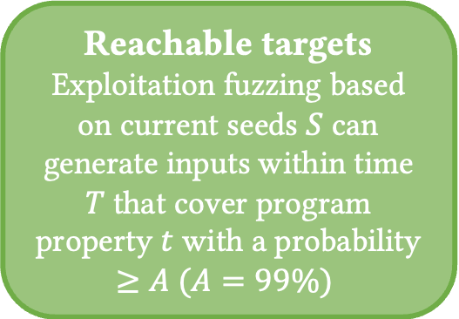



Reachable Fuzzing Targets Problem
Large-scale target-guided greybox fuzzing
Target
prioritization
Current seeds $S$
Exploitation fuzzing
Target $t_{1}$
Reachable targets
Exploitation fuzzing based on current seeds $S$ can generate inputs within time $T$that cover program property $t$ with a probability $≥A (A=99\%)$
Exploitation fuzzing
Target $t_{2}$
Exploration
fuzzing
Exploitation fuzzing
Target $t_{n}$
Predict the probability that each target $t$ is reachable
Notes:
We first define the Reachable Fuzzing Targets Problem. (click) The entire LTGF process can be formalized as the following loop: (click) first, exploration fuzzing is performed to continually expand coverage and obtain the current seed set S. (click) Then, several rounds of exploitation fuzzing are conducted based on S. (click) In each round, target prioritization is used to select a target t, and exploitation fuzzing is performed with the goal of triggering bugs at target t. (click) After several rounds, the process returns to exploration fuzzing.
(click) We define a target t as reachable if and only if, in a single round of exploitation fuzzing within a given time budget, based on the current seed set S, there is a probability of at least A of generating an input that triggers t.
In practice, we set A to 99%. (click) Therefore, our problem becomes predicting, for each target t, the probability that t is reachable.

Slide 6
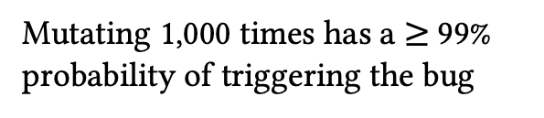
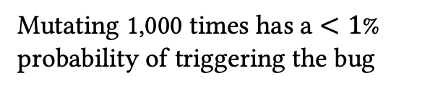
Example of Reachable Fuzzing Targets Problem
B[2000]
e = input() % 3
a = input()
if(e == 0){
B[a % 100 - 1] = 0 // A1
}else if(e == 1){
b = a == 100 ? 0 : 1
B[b - 1] = 0 // A2
}else{
c = a * 2 + 1
B[c % 2 - 1] = 0 // A3
}
... // A4
... // A5
... // A6
Current seeds
e = 0, a = 0
e = 1, a = 0
e = 2, a = 0
A1 is reachable
Mutating 1,000 times has a $≥$99% probability of triggering the bug
A2 is unreachable
Mutating 1,000 times has a $<1$% probability of triggering the bug
A3 is unreachable
Mutating 1,000 times has a 0% probability of triggering the bug
Notes:
(click) Taking the above example, suppose our current seed set is (e = 0, a = 0), (e = 1, a = 0), (e = 2, a = 0). For the three targets A1, A2, and A3:
(click) A1 is a reachable target, because within the given time budget (1000 mutations), the probability of triggering the bug is at least 99%.
(click) A2 is not a reachable target, because the probability of triggering the bug within 1000 mutations is below 1%.
(click) A3 is also not a reachable target, because the bug can never be triggered, regardless of how we mutate the seeds.
Thus, we successfully reduce the problem to predicting, for each target, whether it is reachable. By prioritizing those targets that are reachable, we can effectively address the limitations of existing LTGF and improve its efficiency.

Slide 7









Our Approach: Bayzzer
Target
prioritization
Large-scale target-guided greybox fuzzing
Negative feedback elimination
Bayesian network with redefined semantics
Current seeds $S$
Exploitation fuzzing
Target $t_{1}$
whether $t_{1}$ is reachable
Exploitation fuzzing
Target $t_{2}$
The probability each target is reachable by exploitation fuzzing based on seed set $S$
whether $t_{2}$ is reachable
Exploration
fuzzing
Exploitation fuzzing
Target $t_{n}$
Notes:
We propose a framework called Bayzzer, which uses Bayesian program analysis with redefined semantics to predict the reachable fuzzing targets problem, thereby guiding LTGF. Its workflow is as follows.
Building on the LTGF workflow, (click) we use the redefined Bayesian network semantics to compute, for each target, the probability that it is reachable by exploitation fuzzing given the current seed set S. We then perform exploitation fuzzing on the target with the highest predicted reachability probability. (click) The result of this exploitation fuzzing is fed back into the Bayesian network: if the target bug is successfully triggered, we provide positive feedback; otherwise, we provide negative feedback.
(click) Finally, as each round of exploration fuzzing completes and the seed set expands, some targets that were previously unreachable may become reachable. Therefore, we clear all accumulated negative feedback after each exploration stage to ensure more accurate probability estimation.

Slide 8
Bayesian Program Analysis
Taint(v): Variable v is tainted
Alarm(A): Alarm A is true
Taint(a)
0.8
Derivation graph
Derived tuples
Taint(b)
0.8
0.8
B[2000]
a = input()
b = a + 1
c = b + 2, d = b + 3
B[c % 100 - 1] = 0 // A1
B[d % 200 - 1] = 0 // A2
Taint(c)
Taint(d)
0.8
0.8
Bayesian network
Bernoulli variables
represent whether or not it is hold under any possible input
Alarm(A1)
Alarm(A2)
Prob. | Alarm
0.512 | A1
0.512 | A2
… | …
… | …
Prob. | Alarm
1.0 | A1
0.640 | A2
… | …
… | …
The fuzzer can only generate a subset of all possible inputs
Bayesian inference on each variable based on given posterior information
Notes:
We first illustrate the original-semantics Bayesian Program Analysis with an example. In the code fragment, variable a is read from external input, variable b is derived from a, and variables c and d are derived from b. Finally, c and d are used as array indices. We apply taint analysis to detect potential out-of-bounds bugs in these statements. (click) We use taint(v) to denote that variable v is tainted by external input, and alarm(A) to denote that alarm A holds.
(click) Initially, we have taint(a). According to taint-propagation rules, (click) we can derive taint(b), (click) and further taint(c) together with alarm(A1) when c is used as an array index. (click) Similarly, we obtain taint(d) and alarm(A2). (click) We call this directed graph a derivation graph; each derived tuple represents a program property produced by the static analysis. We then transform this derivation graph into a Bayesian network.
(click) Each derived tuple is modeled as a Bernoulli variable indicating whether there exists some input under which the corresponding program property holds. Conditional probabilities between variables are defined according to the graph structure; for brevity, we set each such probability to 0.8. (click) Using this Bayesian network, we can compute the probability distribution of each variable given posterior information. (click) For example, we obtain that both A1 and A2 have a reachability probability of 0.512. Suppose there are other alarm statements in other parts of the program, but with lower probabilities.
(click) If the user inspects A1 and confirms that it is a real bug, we can treat this positive feedback as posterior evidence and recompute the probabilities. Since alarm(A2) is connected to alarm(A1) in the Bayesian network, the probability of A2 increases.
(click) However, the semantics of existing Bayesian program analysis is defined over all possible program inputs, whereas the inputs that a fuzzer can actually generate form only a subset of these. Therefore, we need to redefine the semantics to adapt Bayesian program analysis to the fuzzing setting.

Slide 9
Redefining Semantics
Taint(v): Variable v is tainted
Alarm(A): Alarm A is true
Taint(a)
0.8
Derivation graph
Derived tuples
Taint(b)
0.8
0.8
B[2000]
a = input()
b = a + 1
c = b + 2, d = b + 3
B[c % 100 - 1] = 0 // A1
B[d % 200 - 1] = 0 // A2
Taint(c)
Taint(d)
0.8
0.8
Bayesian network
Bernoulli variables
represent whether or not it is hold under any possible input
Alarm(A1)
Alarm(A2)
Fuzzer feedback
Redefining
The results of exploitation fuzzing can be used to provide feedback on whether it is reachable
represent whether or not it is reachable by exploitation fuzzing
Bayesian inference on each variable based on given posterior information
Notes:
We redefine the semantics of each Bernoulli variable to express (click) whether or not it is reachable by exploitation fuzzing. Under this new semantics, the Bayesian network computes, for each alarm, the probability that it is reachable, which can be directly used to predict the reachable fuzzing targets problem.
(click) Furthermore, the outcome of each exploitation fuzzing attempt precisely indicates whether a given target is reachable under the current setting, so we can treat this fuzzer feedback as posterior evidence and recompute more accurate probability estimates.

Slide 10
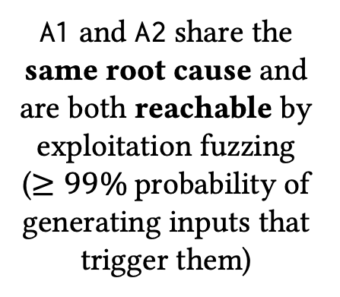
Semantics-aware and Fine-grained Guidance
Taint(a)
Insight
0.8
Taint(b)
0.8
0.8
A1 and A2 share the same root cause and are both reachable by exploitation fuzzing
($≥99\%$probability of generating inputs that trigger them)
B[2000]
a = input()
b = a + 1
c = b + 2, d = b + 3
B[c % 100 - 1] = 0 // A1
B[d % 200 - 1] = 0 // A2
Taint(c)
Taint(d)
0.8
0.8
Alarm(A1)
Alarm(A2)
Our approach achieves precise prioritization of alarms with the same root cause through positive fuzzer feedback
Notes:
Next, we show how Bayesian program analysis with the redefined semantics can provide semantics-aware and fine-grained guidance for LTGF.
(click) In this example, the key insight is that A1 and A2 share the same root cause and are both reachable by exploitation fuzzing, that is there is at least a 99% probability of generating inputs that trigger them. (click) We use the positive feedback obtained from exploitation fuzzing on A1 to increase the reachability probability of A2, thereby achieving precise prioritization of alarms that share the same root cause.

Slide 11
Semantics-aware and Fine-grained Guidance
Exploitation fuzzing on A1
Taint(a)
0.8
Triggering of A1 after several mutation
Taint(b)
0.8
0.8
B[2000]
a = input()
b = a + 1
c = b + 2, d = b + 3
B[c % 100 - 1] = 0 // A1
B[d % 200 - 1] = 0 // A2
Taint(c)
Taint(d)
0.8
0.8
Positive feedback
Alarm(A1)
Alarm(A2)
Exploitation fuzzing on A2
Prob. | Alarm
0.512 | A1
0.512 | A2
… | …
… | …
Prob. | Alarm
1.0 | A1
0.640 | A2
… | …
… | …
Triggering of A2 after several mutation
Notes:
We’ll now show how our approach works.
(click) The fuzzer will first select A1, which has the highest ranking, as the next target. According to the triggering condition, the probability is around 1/100, (click) so the fuzzer can quickly trigger this bug through repeated mutations and (click) provide positive feedback to the Bayesian network. Based on this posterior information, (click) a new probability distribution is recalculated. Since Alarm(A2) is connected to Alarm(A1) in the network, its probability increases, (click) making A2 the next target. The triggering probability for A2 is approximately 1/200, (click) so the fuzzer can also quickly trigger A2 through multiple mutations.

Slide 12
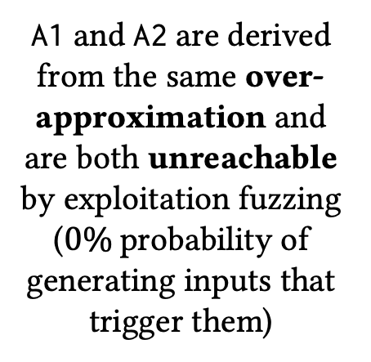
Semantics-aware and Fine-grained Guidance
Taint(a)
Insight
0.8
Taint(b)
A1 and A2 are derived from the same over-approximation and are both unreachable by exploitation fuzzing
($0\%$probability of generating inputs that trigger them)
B[2000]
a = input()
b = a + 1
if(b % 2 == 0) continue
c = b * 3, d = b * 5
B[c % 4 - 1] = 0 // A1
B[d % 8 - 1] = 0 // A2
0.8
0.8
Taint(c)
Taint(d)
0.8
0.8
Alarm(A1)
Alarm(A2)
Our approach leverages negative fuzzer feedback to accurately lower the prioritization of alarms arising from the same over-approximation.
Notes:
We present a second example. For easier understanding, we make a small modification to the first one: now variable b must be an odd number, so c and d are also always odd. As a result, A1 and A2 can never be triggered, since both c mod 4 and d mod 8 will always be greater than 0. The taint analysis produces a derivation graph with the same structure as in the previous example. However, because it does not consider precise value ranges, it over-approximates and incorrectly reports the false alarms A1 and A2.
(click) The key insight is that A1 and A2 are derived from the same over-approximation and are both unreachable by exploitation fuzzing, that is there is a 0% probability of generating inputs that trigger them. (click) We use the negative feedback obtained from exploitation fuzzing on A1 to decrease the reachability probability of A2, thereby accurately lowering the prioritization of alarms arising from the same over-approximation.

Slide 13
Semantics-aware and Fine-grained Guidance
Exploitation fuzzing on A1
Taint(a)
0.8
No triggering of A1 after several mutation
Taint(b)
B[2000]
a = input()
b = a + 1
if(b % 2 == 0) continue
c = b * 3, d = b * 5
B[c % 4 - 1] = 0 // A1
B[d % 8 - 1] = 0 // A2
0.8
0.8
Taint(c)
Taint(d)
0.8
0.8
Negative feedback
Alarm(A1)
Alarm(A2)
Other targets
Prob. | Alarm
0.512 | A1
0.512 | A2
… | …
… | …
Prob. | Alarm
… | …
0.378 | A2
… | …
0 | A1
Avoid focusing on false alarms
Notes:
We’ll now show how our approach works.
(click) The fuzzer will target A1 first because it has the highest probability. (click) After some time mutating inputs, the fuzzer realizes the bug cannot be triggered and (click) provides negative feedback. (click) Since Alarm(A2) is connected to Alarm(A1) in the network, the probability for A2 also decreases. (click) This allows the fuzzer to skip this false alarm and focus on other potentially triggerable targets, (click) effectively avoiding wasted time.

Slide 14
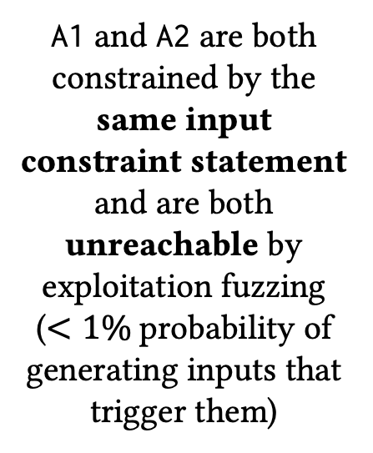
Adaptive Guidance
No seeds with e = 1
Taint(a)
B[2000]
e = 0
if(input() % 1000 == 0) e = 1
a = abs(input())
b = a + 1
if(e == 0){
if(b == 100) c = -1
else c = 0
if(b == 200) d = -1
else d = 0
}else{
c = b % 100 – 1
d = b % 200 - 1
}
B[c] = 0 // A1
B[d] = 0 // A2
0.8
Insight
Taint(b)
0.8
0.8
A1 and A2 are both constrained by the same input constraint statement and are both unreachable by exploitation fuzzing
($<1\%$probability of generating inputs that trigger them)
Taint(c)
Taint(d)
0.8
0.8
Alarm(A1)
Alarm(A2)
By using negative feedback to de-prioritize targets that are unreachable under the current seed set
Notes:
Next, we look at a third example. Building on the previous two, this one introduces a new variable e. The value of e is set to 1 only when the external input is a multiple of 1000; otherwise, it’s 0.
(click) If e is 0, then c and d become 0 only when b hits an exact magic value, such as 100 or 200. In that case, they may trigger the bugs at A1 and A2. (click) But if e is 1, we don’t need an exact magic value anymore: it’s enough for b to be a multiple of 100 or 200 to trigger A1 or A2.
(click) The derivation graph from taint analysis again has the same structure as in the previous examples. Here, we show how our approach uses adaptive guidance to help the fuzzer make better decisions at different stages.
(click) At the beginning, the fuzzer has no seeds with e = 1. At this point, the probability of triggering the bugs at A1 and A2 by random mutation is extremely low, because it would require mutating b to an exact magic value.
(click) The key insight is that A1 and A2 are both constrained by the same input condition, and under the current seed set, they’re both essentially unreachable by exploitation fuzzing—that is, the probability of generating inputs that trigger them is below 1%. (click) We use the negative feedback from exploitation fuzzing on A1 to de-prioritize such targets that are unreachable under the current seeds.

Slide 15
Adaptive Guidance
Exploitation fuzzing on A1
No seeds with e = 1
Taint(a)
B[2000]
e = 0
if(input() % 1000 == 0) e = 1
a = abs(input())
b = a + 1
if(e == 0){
if(b == 100) c = -1
else c = 0
if(b == 200) d = -1
else d = 0
}else{
c = b % 100 – 1
d = b % 200 - 1
}
B[c] = 0 // A1
B[d] = 0 // A2
0.8
No triggering of A1 after several mutation
Taint(b)
0.8
0.8
Taint(c)
Taint(d)
0.8
0.8
Negative feedback
Alarm(A1)
Alarm(A2)
Other targets
Prob. | Alarm
0.512 | A1
0.512 | A2
… | …
… | …
Prob. | Alarm
… | …
0.378 | A2
… | …
0 | A1
Avoid focusing on unreachable alarms
Notes:
We’ll now show how our approach works.
(click) The fuzzer will first target A1; (click) after attempting mutations for a while and failing to trigger the bug, (click) it gives negative feedback to the Bayesian network. (click) Since Alarm(A2) is connected to Alarm(A1) in the network, the probability for A2 also decreases. (click) Thus, the fuzzer can skip this currently unreachable alarm (A2) and (click) focus on other potentially reachable targets, avoiding wasted time.

Slide 16
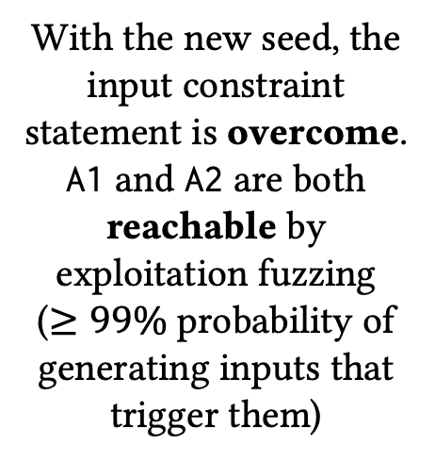
Adaptive Guidance
Seeds with e = 1
Taint(a)
B[2000]
e = 0
if(input() % 1000 == 0) e = 1
a = abs(input())
b = a + 1
if(e == 0){
if(b == 100) c = -1
else c = 0
if(b == 200) d = -1
else d = 0
}else{
c = b % 100 – 1
d = b % 200 - 1
}
B[c] = 0 // A1
B[d] = 0 // A2
0.8
Insight
Taint(b)
0.8
0.8
With the new seed, the input constraint statement is overcome.
A1 and A2 are both reachable by exploitation fuzzing
($≥99\%$ probability of generating inputs that trigger them)
Taint(c)
Taint(d)
0.8
0.8
Alarm(A1)
Alarm(A2)
By using negative feedback elimination together with positive feedback to prioritize targets that become reachable again.
Notes:
After another round of exploration fuzzing, (click) the fuzzer has accumulated more seeds and now has seeds where e=1. At this point, we clear all previous negative feedback. (click) The insight is that, with the new seed, the input constraint statement is overcome, and both A1 and A2 become reachable by exploitation fuzzing ,that is there is at least a 99% probability of generating inputs that trigger them. (click) By applying negative feedback elimination, and using the updated result of exploitation fuzzing on A1, we prioritize targets that become reachable again.

Slide 17
Adaptive Guidance
Exploitation fuzzing on A1
Seeds with e = 1
Taint(a)
B[2000]
e = 0
if(input() % 1000 == 0) e = 1
a = abs(input())
b = a + 1
if(e == 0){
if(b == 100) c = -1
else c = 0
if(b == 200) d = -1
else d = 0
}else{
c = b % 100 – 1
d = b % 200 - 1
}
B[c] = 0 // A1
B[d] = 0 // A2
0.8
Triggering of A1 after several mutation
Taint(b)
0.8
0.8
Taint(c)
Taint(d)
0.8
0.8
Positive feedback
Alarm(A1)
Alarm(A2)
Exploitation fuzzing on A2
Prob. | Alarm
0.512 | A1
0.512 | A2
… | …
… | …
Prob. | Alarm
1.0 | A1
0.640 | A2
… | …
… | …
Triggering of A2 after several mutation
Notes:
We’ll now show how our approach works.
(click) The alarm with the highest probability is still A1. The fuzzer will again target A1; according to the new triggering condition, the probability is about 1/100, (click) so the bug can be triggered through mutation in a short time. (click) The fuzzer then gives positive feedback to the Bayesian network. (click) Since Alarm(A2) is connected to Alarm(A1) in the network, its probability increases, (click) making A2 the next target. (click) The triggering probability for A2 is approximately 1/200, so it can also be triggered in a short amount of time.

Slide 18
Experiments
Analyses and fuzzers: We build Bayzzer upon FishFuzz and use a taint analysis based on SVF.
Baselines: (1) Prospector, SOTA of large-scale target-guided greybox fuzzing , (2) FishFuzz, (3) FunFuzz, SOTA of coverage-guided greybox fuzzing using non-Bayesian light-weight static analysis, (4) AFL++.
Benchmarks: Consistent with Prospector, we evaluate on 24 real-world programs with various input formats, including images, audios, videos, texts, binaries and networks.
Metrics: Consistent with Prospector, we use the median time-to-exposure (TTE) across 10 repeated executions, with a time limit of 60 hours. Our total experimental time is approximately 9.86 CPU-years.
Notes:
We conducted experiments to evaluate the effectiveness of our approach. (click) We build Bayzzer on top of the LTGF tool FishFuzz and use a taint analysis based on SVF. (click) We compare our approach with the following baselines: (1) Prospector, the SOTA in LTGF; (2) FishFuzz, the foundational fuzzer for our approach; (3) FunFuzz, the SOTA of coverage-guided greybox fuzzing based on non-Bayesian lightweight static analysis. We include FunFuzz to demonstrate that Bayesian program analysis provides stronger guidance for fuzzing than conventional static analysis. (4) AFL++, the foundational fuzzer for all three baselines as well as our approach. (click) We use the same benchmarks as Prospector, including 24 real-world programs with various input formats. (click) We also use the same metrics as Prospector: we measure the median time-to-exposure (or TTE for short) across 10 repeated runs. TTE represents the time required to trigger a bug for the first time. Our time limit is 60 hours, and the total experimental time amounts to approximately 9.86 CPU-years.

Slide 19
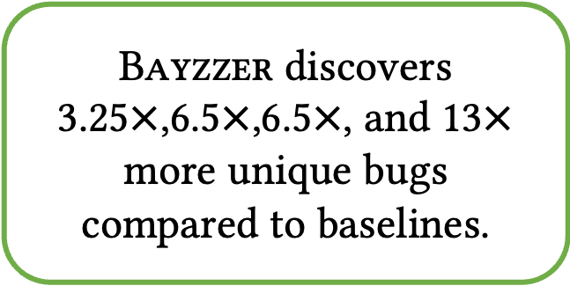
Effectiveness
Bayzzer discovers 3.25$×$,6.5$×$,6.5$×$, and 13$×$ more unique bugs compared to baselines.
Notes:
We use a Venn diagram to illustrate the bugs discovered by different fuzzers. Compared to other baselines, Bayzzer is able to find 3.25 to 13 times more unique bugs, which clearly demonstrates its significantly stronger bug-finding capability.

Slide 20
Effectiveness
In the final 20 hours, Bayzzer significantly outperforms other baselines by discovering substantially more bugs through sufficient feedback accumulation.
Notes:
We further use bug discovery curves over time to provide a more direct visualization. As shown, Bayzzer does not have a leading advantage in the first 40 hours; however, as a large amount of feedback accumulates, its strong guidance ability becomes apparent in the final 20 hours, clearly surpassing the other baselines. This further demonstrates the effectiveness of Bayesian program analysis in guiding fuzzing.

Slide 21
Bayesian Inference Overhead
The time overhead of Bayesian inference in Bayzzer accounts for an average of 0.31%.
Notes:
We measured the computational overhead of Bayesian inference. On average, the time spent on Bayesian inference accounts for approximately 0.31% of the total running time. Therefore, the overhead introduced by Bayesian program analysis is tiny and fully acceptable in practice.

Slide 22
Necessity to Remove Negative Feedback
Without removing negative feedback, Bayzzer would miss 16 targets that are ultimately reachable.
Notes:
We conducted ablation experiments to verify the necessity of removing negative feedback. As time progresses, many bugs become reachable, and if negative feedback is given prematurely, we may lose the opportunity to trigger them. In fact, the configuration without removing negative feedback discovers 16 fewer bugs in the end. Therefore, removing negative feedback can significantly enhance bug-finding capability and is highly necessary.

Slide 23
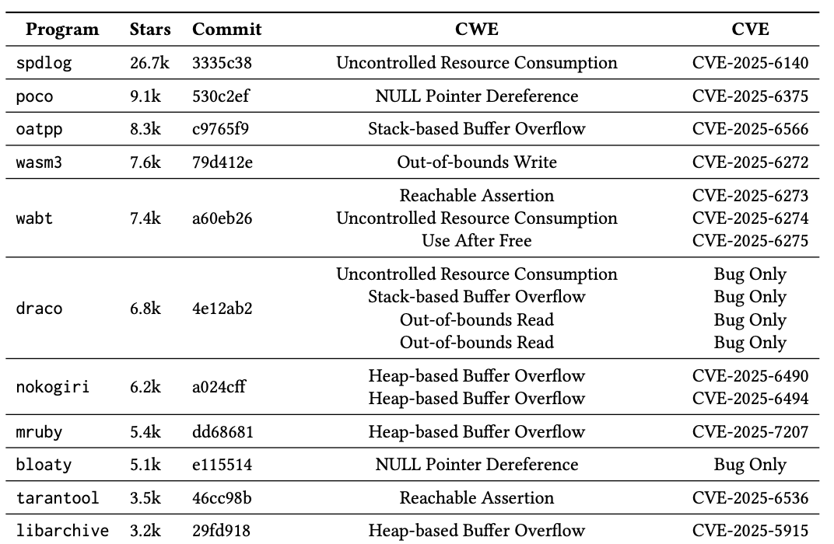
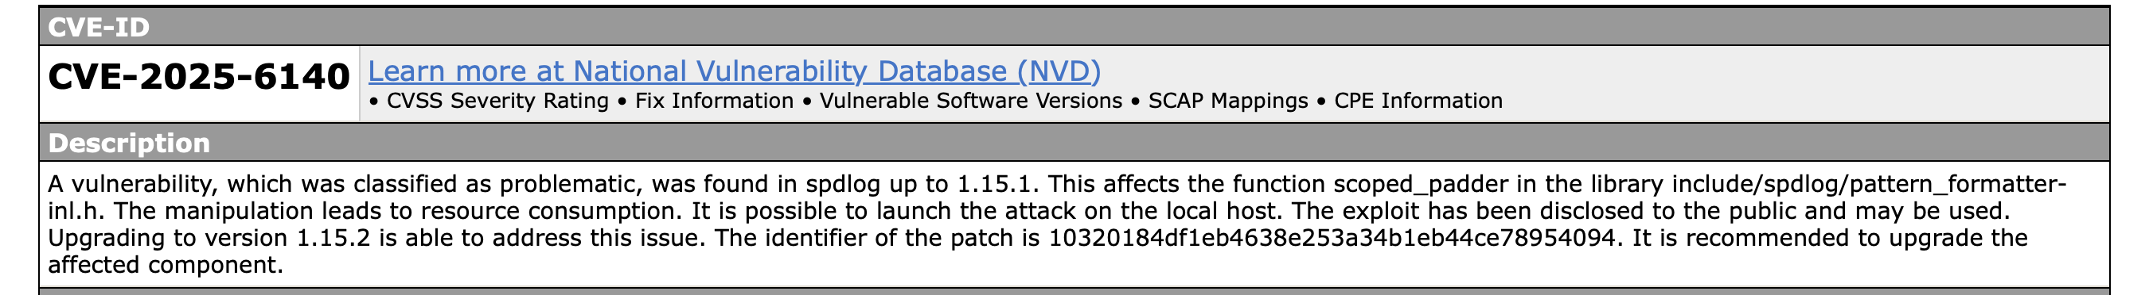
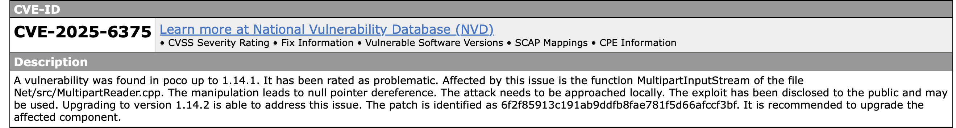
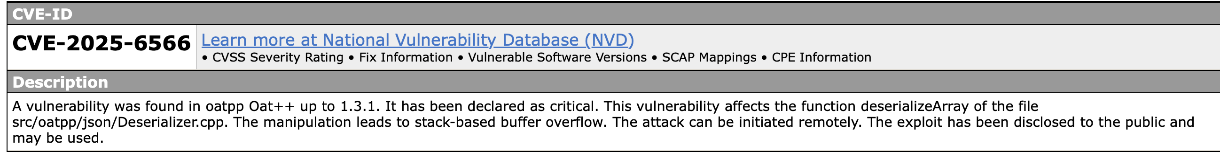
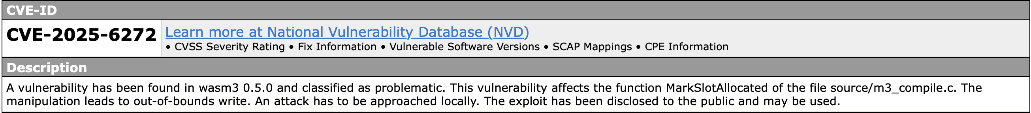
New Bugs
We use our approach to test:
The latest commit of benchmarks in control experiments
Popular projects with high number of stars in OSS-Fuzz
We found 39 new bugs and submitted it to the developers
30 bugs have been received CVEs
Notes:
(click) Finally, we use Bayzzer to test the latest versions of software, (click) including the most recent commits of the 24 programs used in our controlled experiments, (click) as well as popular projects with a high number of stars in OSS-Fuzz. Both groups of software have been extensively fuzzed twenty-four by seven, yet we are still able to discover a large number of important new bugs. (click) In total, we found 39 bugs, (click) 30 of which were assigned CVEs.
We present some of the bugs we discovered: (click) on the left, we show the four most influential bugs, whose GitHub repositories have between 7.6k and 26.7k stars. (click) On the right, we show several other high-impact bugs. Overall, our approach demonstrates strong practical value in real-world software engineering.

Slide 24
Conclusion
We systematically define the reachable fuzzing targets problem and redefine Bayesian program analysis semantics to enable accurate prediction of this problem and fuzzer feedback generalization.
We propose Bayzzer, a framework that leverages Bayesian program analysis to provide semantics-aware, fine-grained, and adaptive fuzzing guidance.
We extend Bayesian program analysis beyond static alarm ranking to automated fuzzing guidance for bug discovery.
We demonstrate the effectiveness of Bayzzer on real-world programs, showing superior bug detection performance compared to baselines.
Thanks for listening!
Notes:
Finally, I will give the conclusion of our work. (click) First, We systematically define the reachable fuzzing targets problem and redefine Bayesian program analysis semantics to enable accurate prediction of this problem and fuzzer feedback generalization. (click) Next, We propose Bayzzer, a framework that leverages Bayesian program analysis to provide semantics-aware, fine-grained, and adaptive fuzzing guidance. (click) Then, We extend Bayesian program analysis beyond static alarm ranking to automated fuzzing guidance for bug discovery. (click) Last, We demonstrate the effectiveness of Bayzzer on real-world programs, showing superior bug detection performance compared to baselines. (click) That’s all, thanks for listening!

Slide 25




Bayesian Program Analysis
Conventional
False positives
Unable to learn and adapt
Program to be analyzed
Static analyzer
Alarms
Over-approximation
User feedback
Older version code
Test runs
Bayesian
Probability distribution of alarms
Learning and adaptation
Posterior information
Bayesian models
Ranked alarms
Notes:
We leverage Bayesian program analysis to address this prediction problem. We give a brief introduction to Bayesian program analysis. Bayesian program analysis is a new paradigm to address problems existing in conventional program analysis. In conventional analysis, the analyzer will generate alarms based on logic rules and hand them to the user. However, there are many false positives due to the over-approximation. The analyzer also cannot learn and adapt to the users’ needs because the logic rules are fixed. To address these problems, Bayesian analysis converts the conventional analyses into Bayesian models. As a result, the analysis can learn from posterior information, such as user feedback, older version code, and test runs. The analysis can also generate the probabilities of alarms to rank them. Therefore, compared to conventional analysis, Bayesian analysis can significantly improve users 'experience.

Slide 26


Redefining Semantics of Bayesian Program Analysis
The probability that inputs exist satisfying each program property
Program to be analyzed
Previous Bayesian network
Ranked alarms
The probability each program property is reachable by exploitation fuzzing
Fuzzing feedback
Our
Bayesian network
Ranking by reachability probability
Notes:
Existing Bayesian program analysis considers all possible inputs, while fuzzers can only generate a subset of inputs. Therefore, we redefine the semantics of Bayesian program analysis to address the reachable fuzzing targets problem. In previous work on Bayesian program analysis, each random variable in the Bayesian network represents whether there exists an input that satisfies the corresponding program property, and the final computed probabilities are used for alarm ranking in manual inspection.
In our approach, we redefine each random variable to represent whether the corresponding program property can be reached by exploitation fuzzing. This allows us to compute the reachability probability for each target, which can be used for target prioritization. Moreover, we can use the outcome of exploitation fuzzing as fuzzer feedback, feeding it back into the Bayesian network to update the probabilities for more accurate calculation.

Slide 27




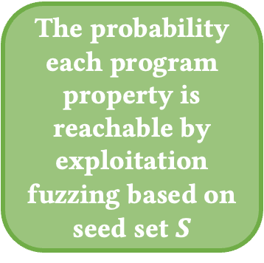
Our Approach: Bayzzer
Target
Prioritization
Large-scale target-guided greybox fuzzing
Negative feedback elimination
Bayesian network
Current seeds $S$
Exploitation fuzzing
Target $t_{1}$
Semantics-aware
and
Fine-grained
whether $t_{1}$ is reached
Exploitation fuzzing
Target $t_{2}$
The probability each program property is reachable by exploitation fuzzing based on seed set $S$
whether $t_{2}$ is reached
Exploration
fuzzing
Exploitation fuzzing
Target $t_{n}$
Notes:
Our approach is semantics-aware and fine-grained. This is because the Bayesian network is constructed based on static analysis semantics, and by redefining the semantics of Bayesian program analysis, the probabilities we compute precisely correspond to the reachable fuzzing targets problem that we have defined.

Slide 28
Our Approach: Bayzzer
Target
Prioritization
Large-scale target-guided greybox fuzzing
Negative feedback elimination
Bayesian network
Current seeds $S$
Exploitation fuzzing
Target $t_{1}$
Semantics-aware
and
Fine-grained
Adaptive
whether $t_{1}$ is reached
Exploitation fuzzing
Target $t_{2}$
The probability each program property is reachable by exploitation fuzzing based on seed set $S$
whether $t_{2}$ is reached
Exploration
fuzzing
Exploitation fuzzing
Target $t_{n}$
Notes:
Our approach is also adaptive. This is because the redefined Bayesian program analysis semantics can continuously adapt to the fuzzer's capabilities at different stages. As the number of seeds increases, the ability of the fuzzer becomes stronger, and our method can provide adaptive guidance based on the current capability, allowing the fuzzer to focus on the targets that match its current capability as much as possible. Next, we will use several motivating examples to demonstrate that Bayzzer is semantics-aware, fine-grained, and adaptive.

