Slide 1
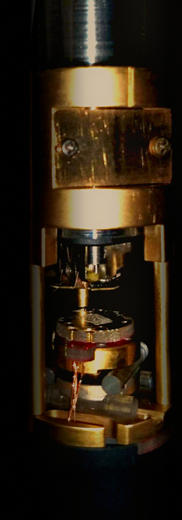
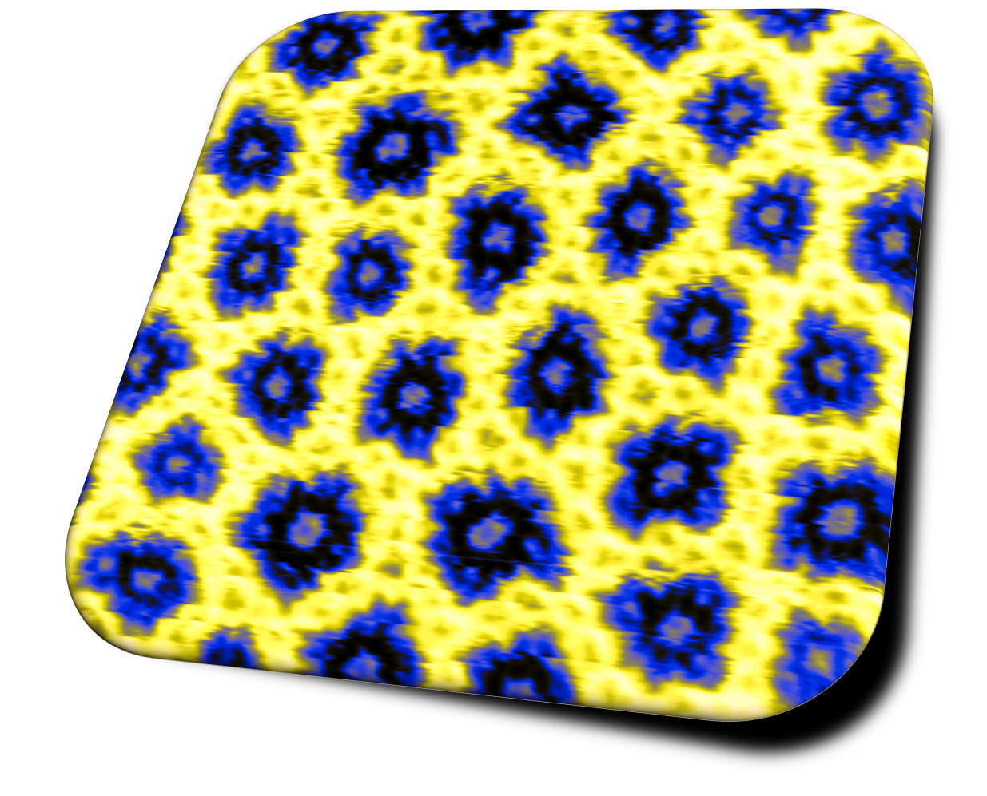
AFM&MFM

Slide 2

CrGeTe₃
µ₀M
H_{z}
T =22K; Lift height= 150nm
phase shift
FULL RANGE: 96deg
2.0kOe
0.2 kOe
0 Oe
-0.2kOe
-0.4kOe
-0.5kOe
-0.55kOe
-0.6kOe
-0.55kOe
3
5
6
7
8
10
11
12
11
µ₀M
-0.45kOe
9
0.55kOe
-2.0kOe
-0.2 kOe
0 Oe
0.2kOe
0.4kOe
0.5kOe
0.55kOe
0.6kOe
0.45kOe
H_{z}
25
17
19
20
21
22
24
25
26
23
Notes:
As in the previous case you can see that as field magnitude changes, the fractal pattern is more and more complex.
If you focus on this branch, how the branch increases as the field decreases
The same pattern seems to appear from 0 to 600Oe, applying an increasing field in the same direction.
In order to gain some insight regarding this behaviour we carried out an analysis of images trying to characterise them
Here I have collected some of the images and represent them just normalised for a these applied field values from 0 Oersted to -600 Oe

Slide 3
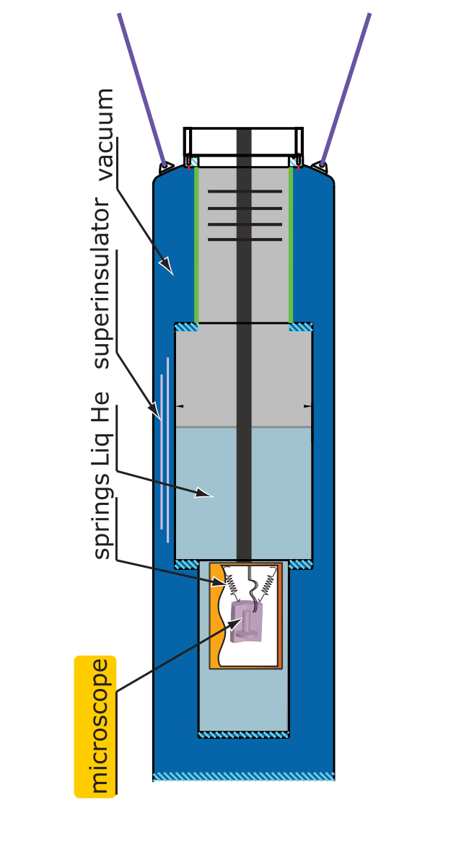
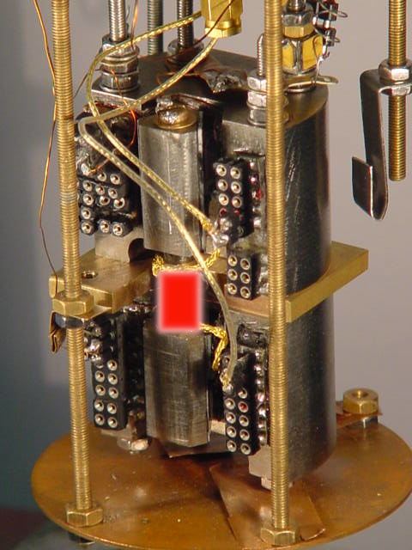
Self-alignment configuration

Slide 4
k = 75N/m
T=4.2 K, f₀=4312.60 Hz, Q=9003

