Slide 1
BlingBank
2023/24 SIRS Project
99180 - André Caseiro
99085 - Ivan Fortes
99258 - Jorge Santos

Slide 2
Index
Infrastructure
Secure Documents
Security challenge

Slide 3
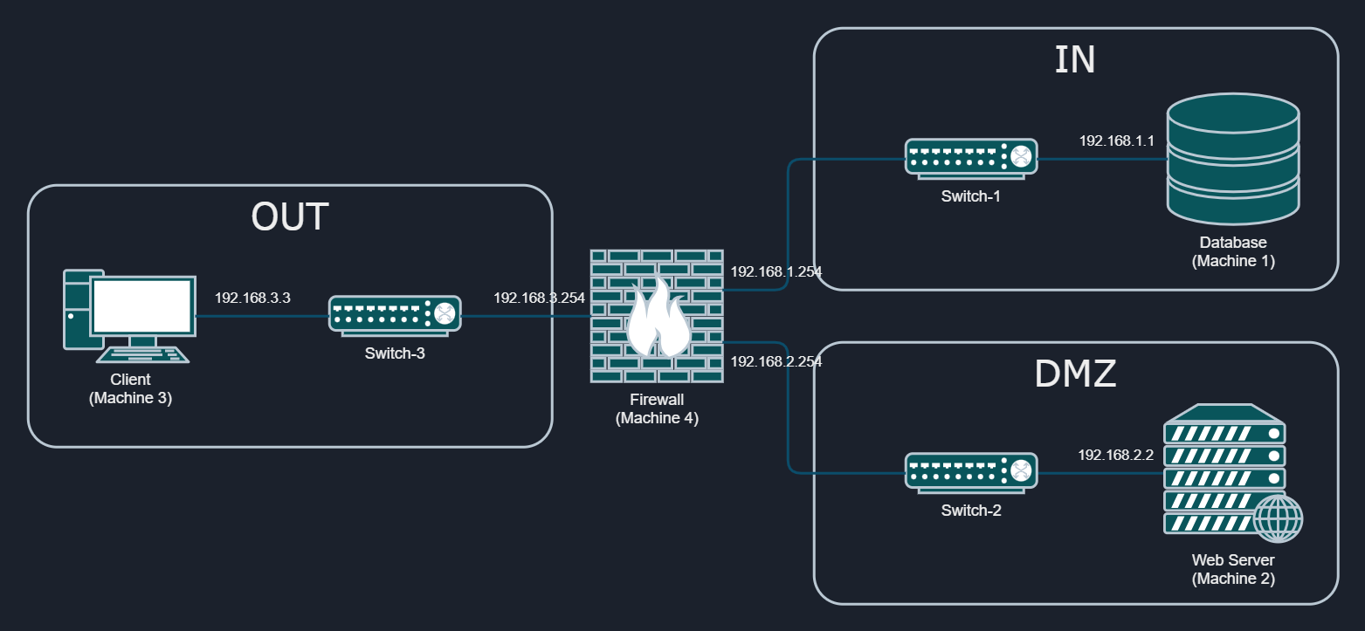
Infrastructure
Notes:
Ivan

Slide 4
Advantages
Adds an additional layer of security to the internal subnet
Exposes the services in a more controlled manner
Minimizes the resource utilization

Slide 5
Disadvantages
Single point of failure
Single filter for all packets in the network

Slide 6
Secure channels
Https (Client <-> Server)
Certification authority (CA)
Shares certificate with client
Signs server certificate
Server level database encryption
Notes:
Caseiro
To ensure a secure communication, we employ https between the client and server, on top of the secure document format.
For that purpose, we created:
a CA, whose certificate is shared with the client
a certificate for the server, signed by the CA
Furthermore, we also employed database encryption on the server side, and used TLS between the server and the database.

Slide 7
Security challenge
New secure document format
Robust freshness measure
Dynamic system for key distribution
Ensure non repudiation of transfers from accounts with multiple owners
Notes:
Jorge

Slide 8
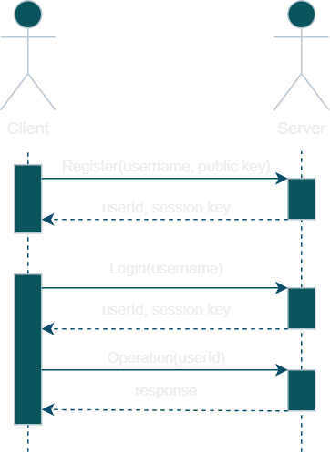
Key distribution
Notes:
Jorge

Slide 9
Secure document format - Server
Authenticity
Confidentiality
{
"value":"+VLbgNxDARq4dOzumnaUMqrlavBr9k0bPqIfNmK+JfEI1IDhxuBol+sNp5RQQNNGNAKEjJPo4=",
"timestamp":1703171053131,
"mac":"8eFFcDszX8hsUh6l3m6ltQqLKp+7Y2G+ftetG0aE1t8="
}
Notes:
Jorge

Slide 10
Secure Document format - Client
Confidentiality
Authenticity
Non-repudiation
{
"value":"aOO/XSAqJVHhNOlAx35NBMPsEKKLOkzCqr9qJuebTkGtcOxU5d6n9u9hk8A+rNJi",
"timestamp":1703259394960,
"signature":"mrgbMxsLBCfnjxvo4 […] Y4GS7hChXwycxTPKceMzFxVi+yCQ=="
}
Notes:
Jorge

Slide 11
Robust freshness measure
Request transfer
PUT users/{userId}/transfers/register
> {origin, destination, amount, description, […]}
All account holders approve by signing unique transfer Id
POST users/{userId}/transfers/confirm
> {transferId, signature, […]}
Store the list of signatures
Notes:
Caseiro
To ensure no duplicate transfer is executed, we block replay attacks by signing the transfer Id when confirming a transfer, and store a list of users who approved the transfer, with the signatures.

Slide 12
Demonstration
Recorded version at:
https://drive.google.com/file/d/1uv_uPj3JJAVMkCkK7c6KlP4ZW9jHRwB6/view
***Welcome to BlingBank!***
1 - Register
2 - Login
0 - Exit
>

Slide 13
Conclusion
With this project, we conceptualized and implemented a multi-layer infrastructure for an online banking system from the ground up. We assembled the entire infrastructure while ensuring its integrity against external attacks.
Suggestions:
Login with passwords and identity verifications
Adding a second firewall
This project provided hands-on experience in creating and protecting a system, reinforcing theoretical knowledge in a practical manner

Slide 14



Q&A
Ivan Fortes
André Caseiro
Jorge Santos

