Slide 1
d20: Chi-squared values
Dragon Dice
Flower Dice
Average roll: 10.51
Chi-squared statistic: 28.28
P-value: 0.0782
Average roll: 10.62
Chi-squared statistic: 14.15
P-value: 0.7749

Slide 2
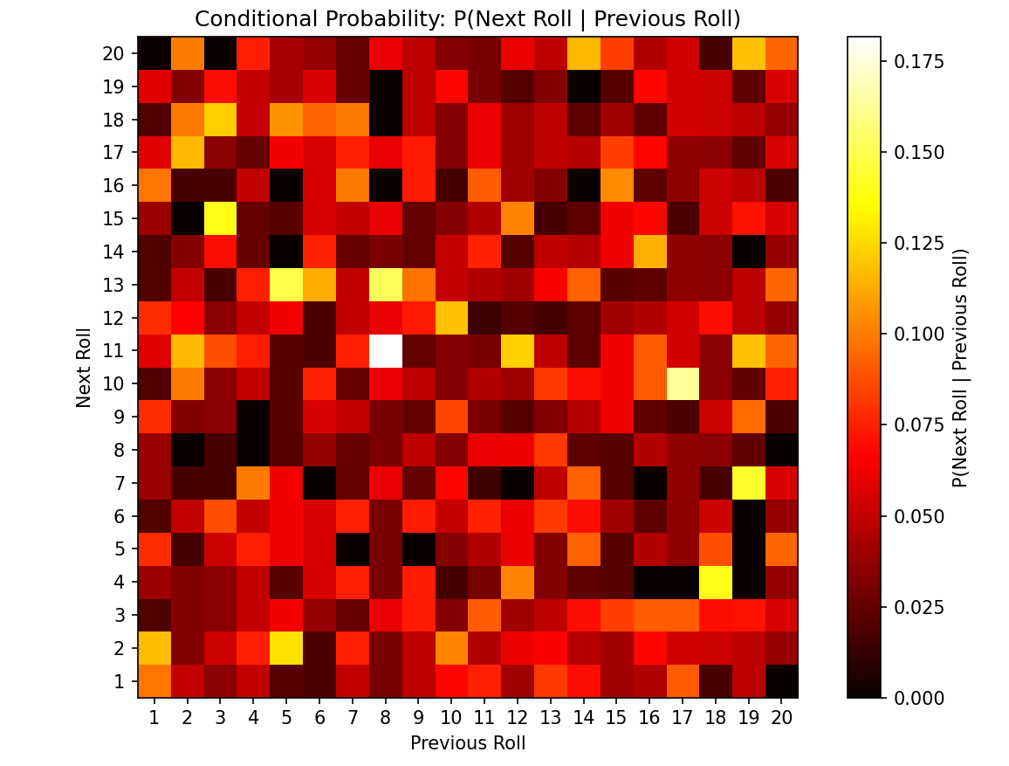
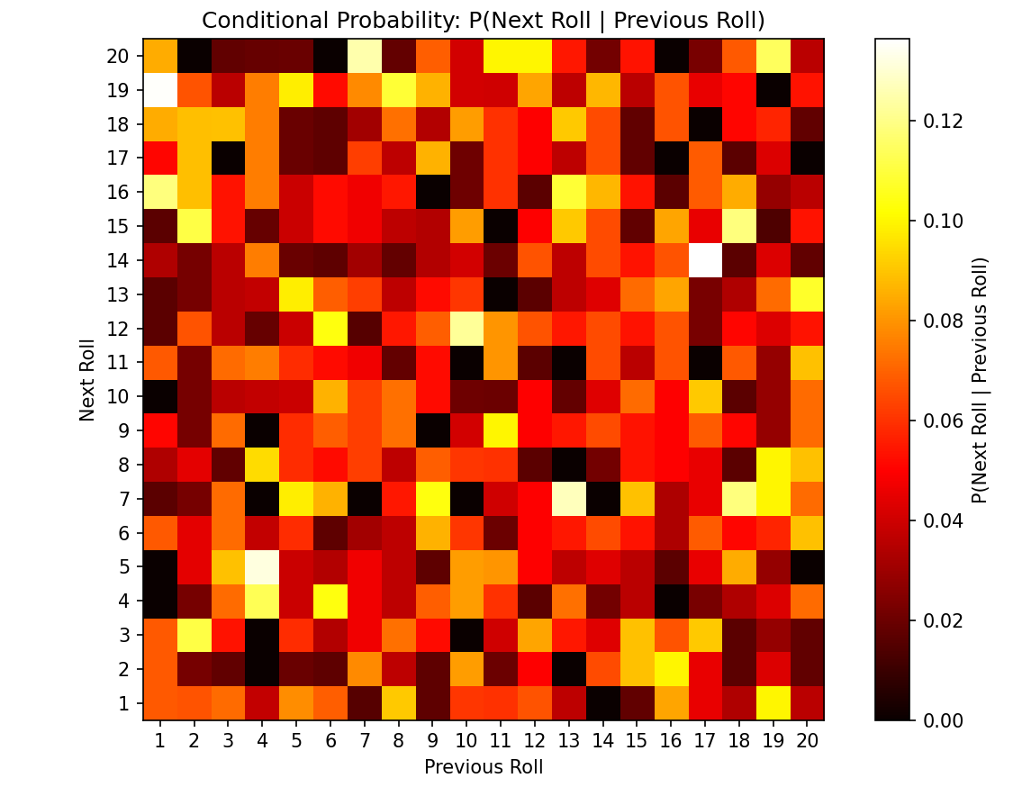
d20: heatmap of probabilities of one roll after another
Dragon Dice
Flower Dice

Slide 3
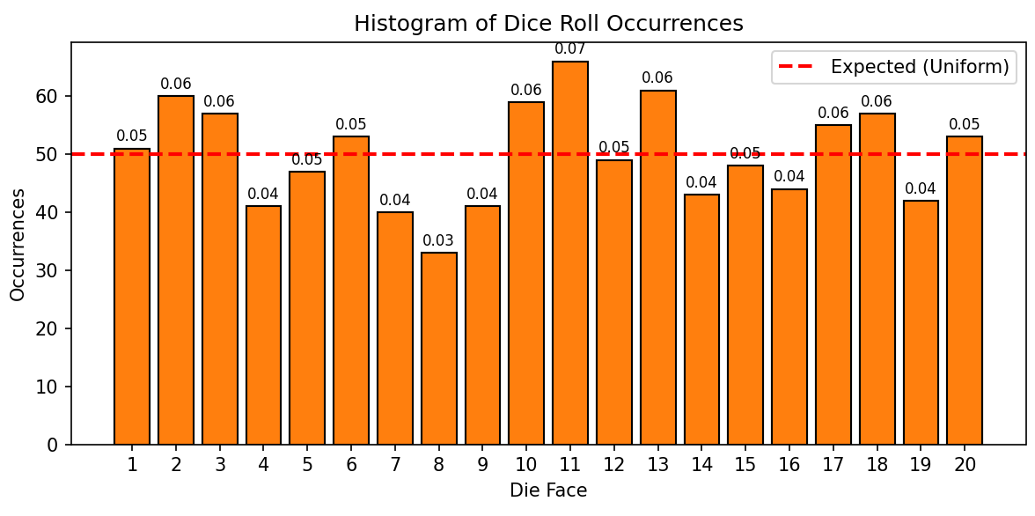
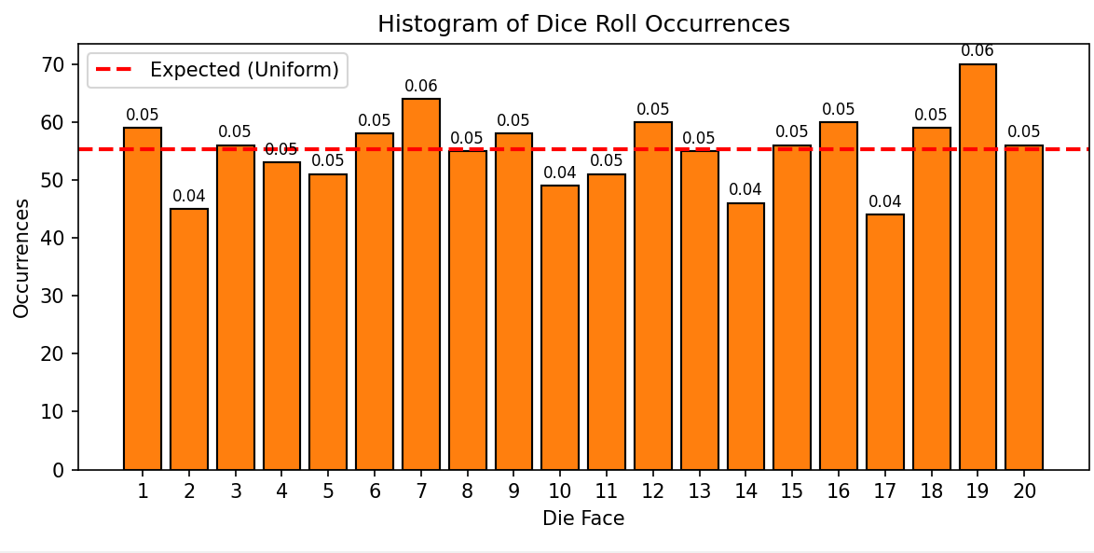
d20: graph of roll counts
Dragon Dice
Flower Dice

Slide 4
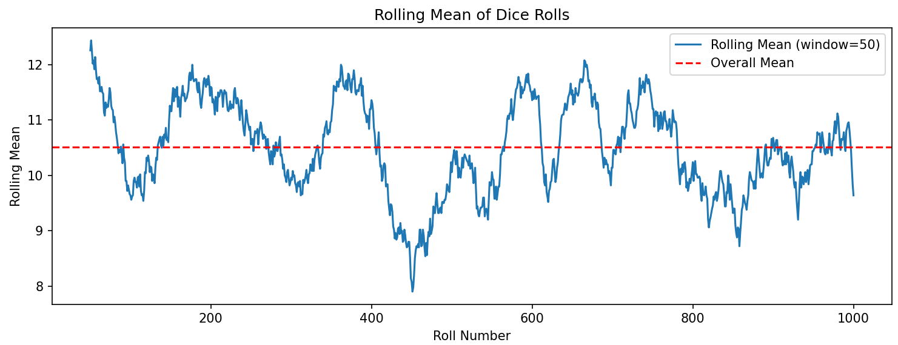
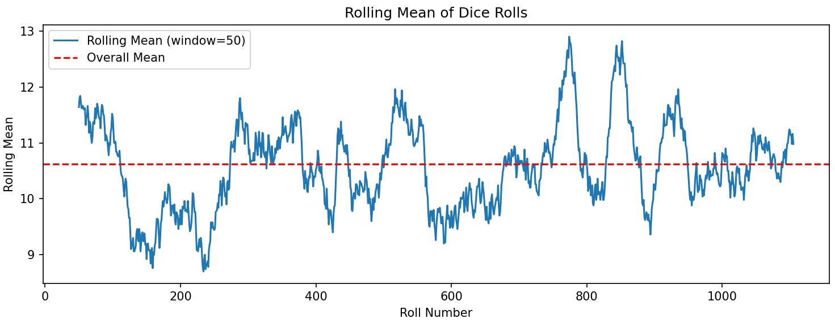
d20: graph of rolling mean
Dragon Dice
Flower Dice

