Slide 1
d20: Chi-squared values, average, total rolls
Dragon Dice
Flower Dice
Average roll: 10.51
Chi-squared statistic: 28.28
P-value: 0.0782
Total Rolls: 1000
Average roll: 10.50
Chi-squared statistic: 24.09
P-value: 0.1927
Total Rolls: 2000

Slide 2
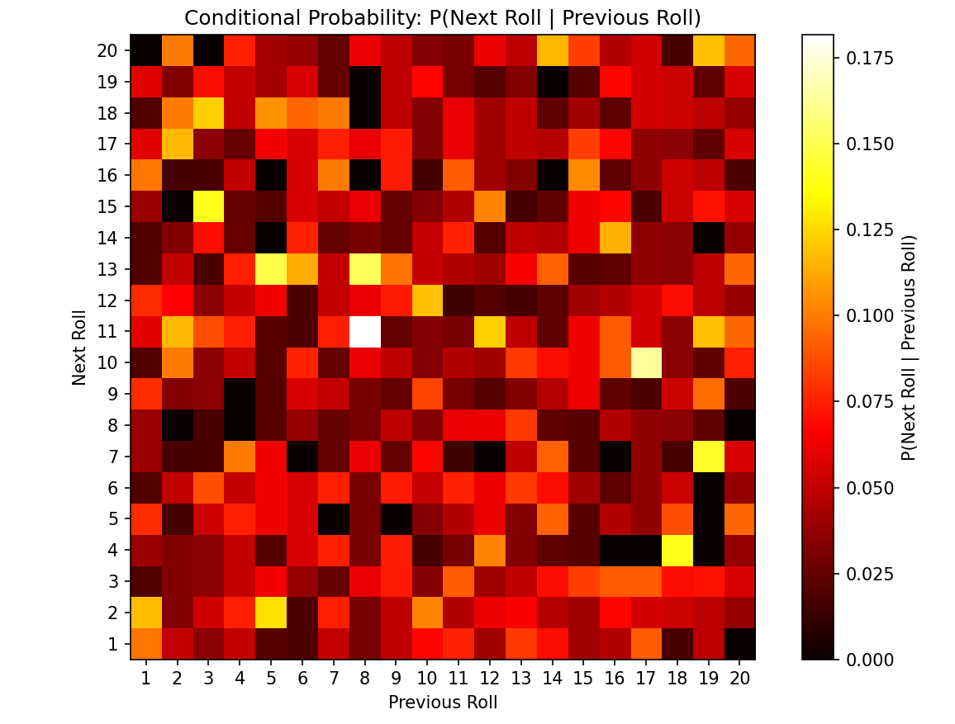
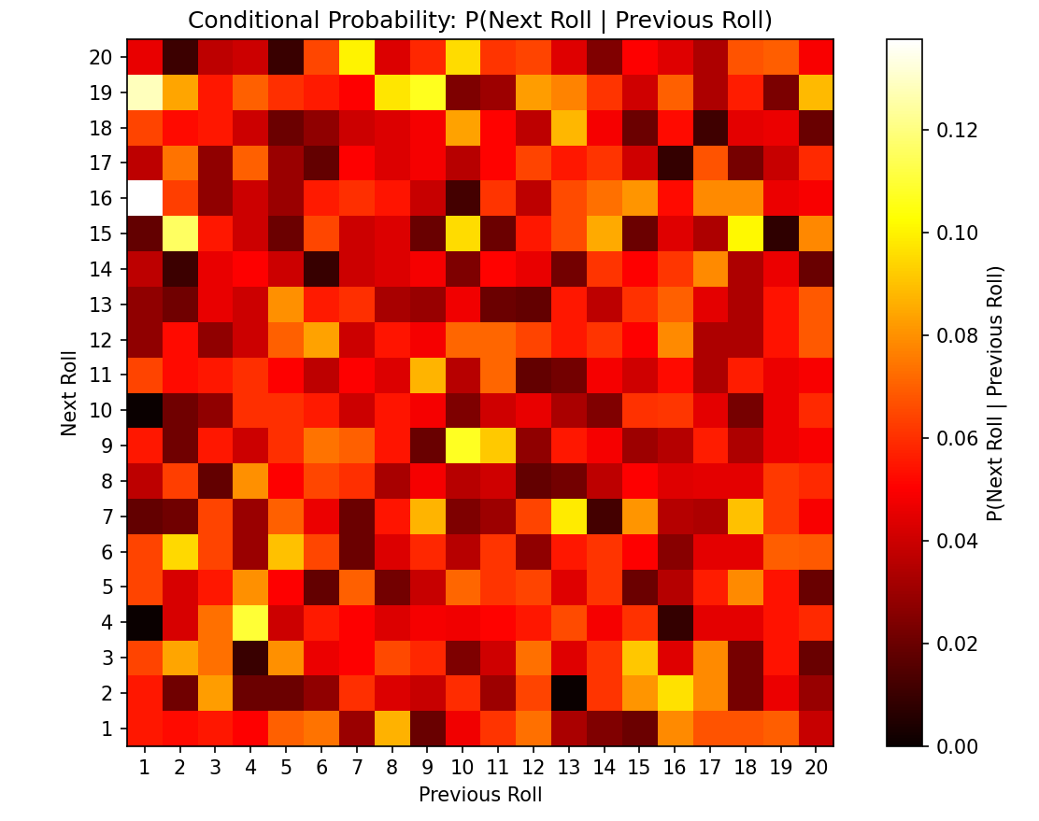
d20: heatmap of probabilities of one roll after another
Dragon Dice
Flower Dice

Slide 3
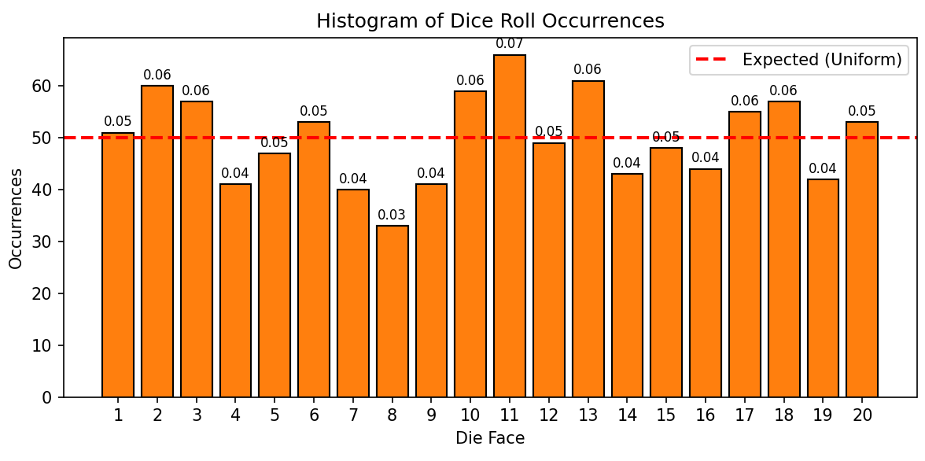
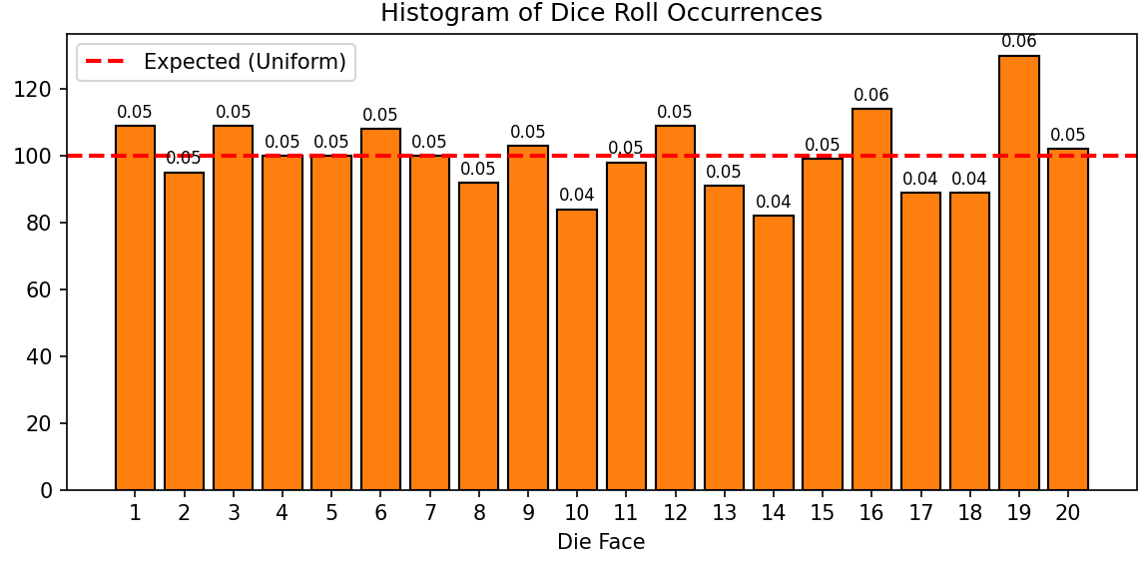
d20: graph of roll counts
Dragon Dice
Flower Dice

Slide 4
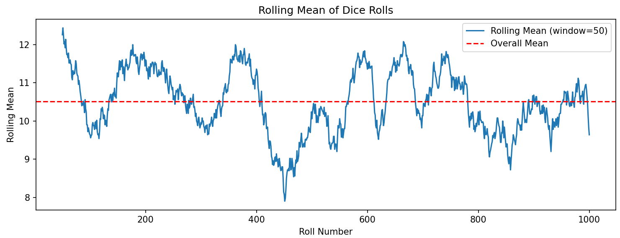
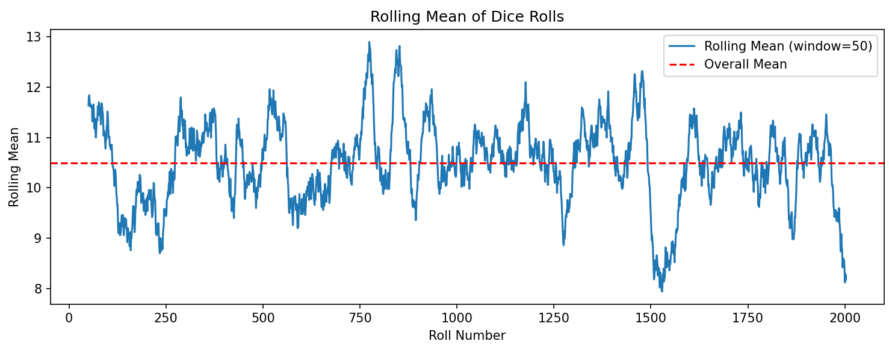
d20: graph of rolling mean
Dragon Dice
Flower Dice

