Slide 1
Selected Topics in Programming
Exam Mini-Project

Slide 2
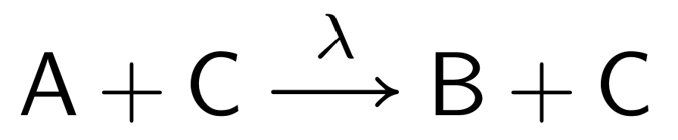
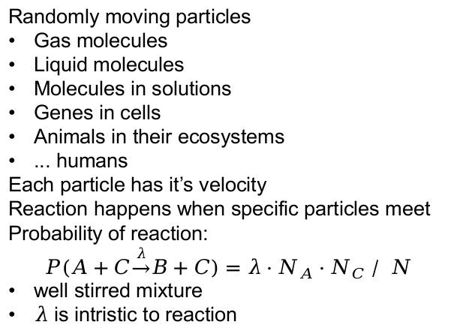
Stochastic Process
A
B
C
C
Randomly moving particles
Gas molecules
Liquid molecules
Molecules in solutions
Genes in cells
Animals in their ecosystems
... humans
Each particle has it’s velocity
Reaction happens when specific particles meet
Probability of reaction:
$$P(A+C\underset{→}{λ}B+C)=λ⋅N_{A}⋅N_{C}∕ N$$
well stirred mixture
$λ$ is intristic to reaction
A
B
C
B
A
A
B
A
B
C
B
B
A
A

Slide 3
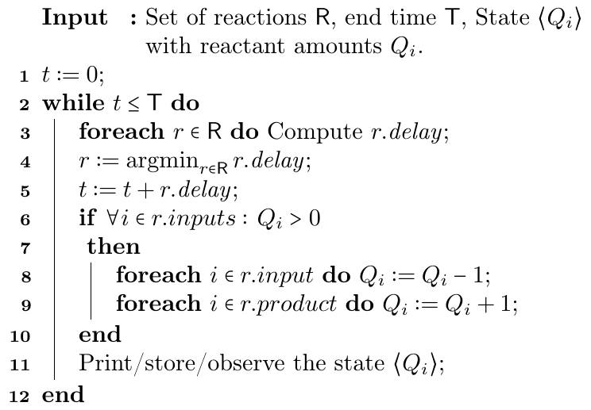

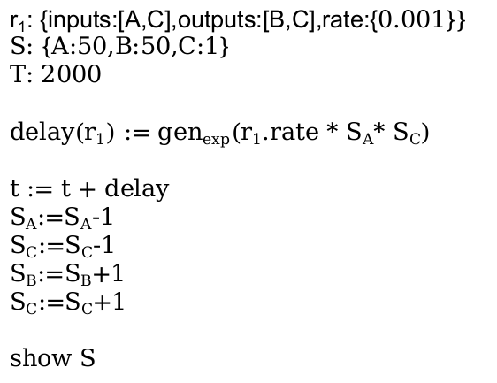
Stochastic Simulation
r₁: {inputs:[A,C],outputs:[B,C],rate:{$0.001$}}
S: {A:50,B:50,C:1}
T: 2000
delay(r₁) := gen_{exp}(r₁.rate * S_{A}* S_{C})
t := t + delay
S_{A}:=S_{A}-1
S_{C}:=S_{C}-1
S_{B}:=S_{B}+1
S_{C}:=S_{C}+1
show S

Slide 4
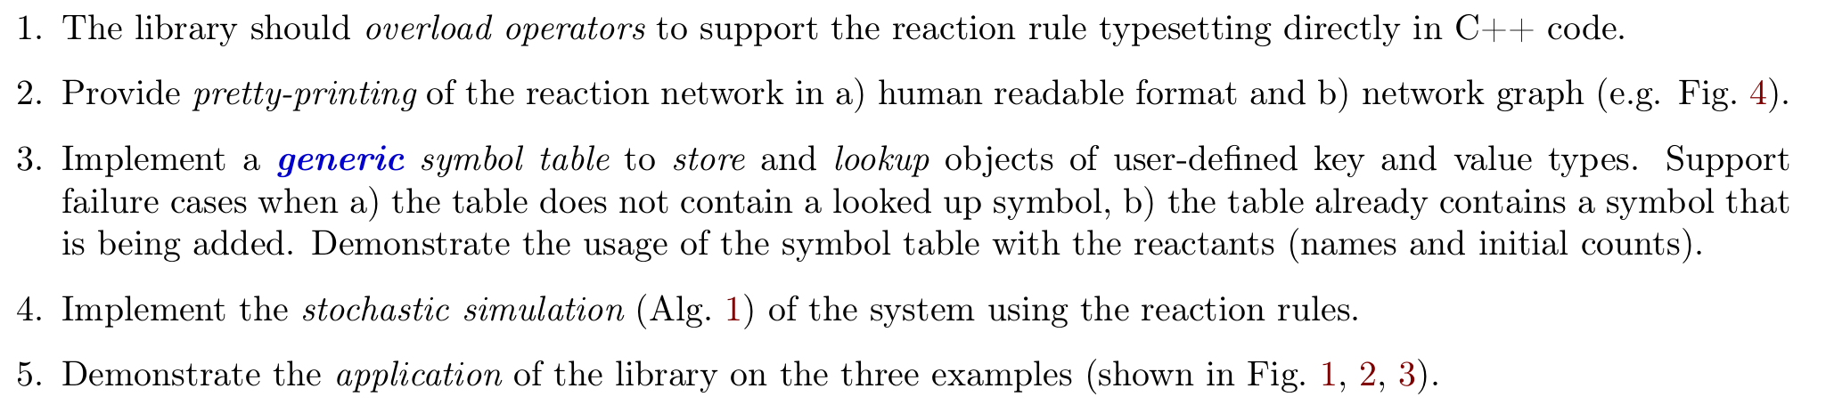
Requirements (1/2)
Symbol table:
stores names and data
issues identifiers
checks for duplicate names
looks up by name
generic: use templates

Slide 5
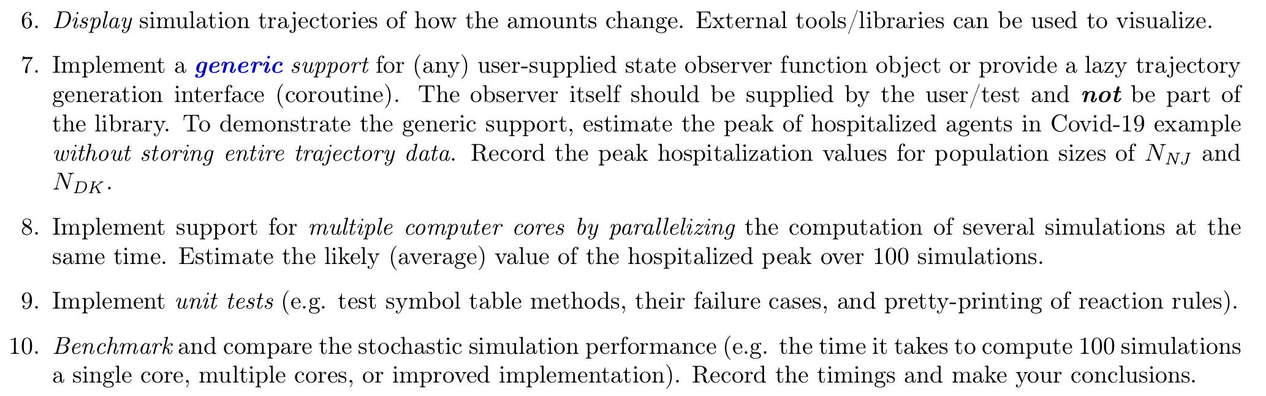
Requirements (2/2)
Trajectory visualization:
output in whatever format,
use whatever tool (spreadsheets, gnuplot - whatever)
remember to include to report
Generic observer:
Use templates (not inheritance), or
Coroutines

Slide 6
Deliverable
zip archive containing:
The source code in original form (without binary/object/debug/release files). The code is evaluated by the detailed requirements implemented and thus should be commented with references to them.
The source code listing in PDF report. The report should start with student name and a short documentation about what compiler, C++ standard and compilation options are used to build the probject. A brief command line, a Makefile or a CMakeLists.txt is enough.
Include experiment data into the report: tables, plots, figures, screenshots and conclusions!
The latex-code.sh script (on the course page) can be used to scan current directory for text/C/C++/Makefile/CMake files and link them into a listing.tex which can be compiled into PDF using LaTeX.
An example listing.tex is also available on the course page, which can be adopted manually (add your files by editing the corresponding listing lines).

Slide 7
Exam Structrure
~1min student presents their study card.
~5min student presents the submitted code in the form of the included PDF report (see the Exam assignment at the top of this page) on the projector, where student requests to scroll to relevant parts. The presentation does not have to be exhaustive to cover everything: instead, the student should pick parts that are particularly interesting.
~5min interactive discussion with questions and answers based on the submitted code. Without submission, lecturer's own solution will be discussed.
~5min evaluation: finding the grade and giving the feedback based on the student performance.

