Slide 1
Optimization of tree maintenance
Prepared by: Dr. Jyoti

Slide 2
AGENDA
OBJECTIVE
METHODOLOGY
EDA (EXPLORATORY DATA ANALYSIS)
OBSERVATIONS
UNIVARIATE STATISTICAL ANALYSIS
VISUALIZATIONS
INFERENCE

Slide 3
OBJECTIVE
To optimize tree maintainence in Paris

Slide 4
METHODOLOGY
Tree maintainence can be optimized if we concentrate on the growth of trees i.e. the development_stage of trees. Young trees need maximum care, Young adults like adoloscents need to be shaped .Trees in Adult phase need no care. Mature trees need to be checked for base.The growth parameters for trees are circumference and height(used in our analysis).Increasing circumference tells us about the development stage of tree.On analysing these parameters,we can plan and optimize the number of visits for tree maintainence.
Reference: https://www.arborday.org/trees/lifestages/youth.cfm

Slide 5
EXPLORATORY Data ANALYSIS

Slide 6
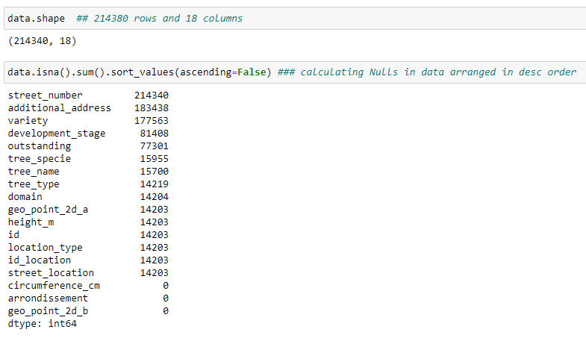
Data: Columns and Rows

Slide 7
Data
Variable | type | No. of nulls
Id | Quantitative | 14203
Location_type | Quantitative | 14203
Domain | Qualitative | 14204
Arrondissement | Qualitative | 0
Additional_address | Qualitative | 183438
Street_number | Quantitative | 214340
Street_location | Qualitative | 14203
Id_location | Number | 14203
Tree_name | Qualitative | 15700
Tree_type | Qualitative | 14219
Tree_specie | Qualitative | 15955
Variety | nulls | 177563
Circumference_cm | Quantitative | 0
Height_m | Quantitative | 14203
Development_stage | Quantitative | 81408
Outstanding | Boolean/Quantitative | 77301
Geo_point_2d_a | Quantitative | 14203
Geo_point_2d_a | Quantitative | 0

Slide 8
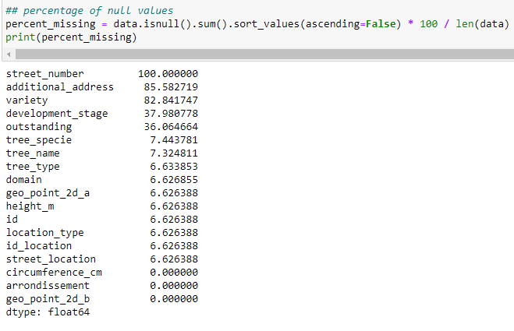
Calculating percentage of null values

Slide 9
Removal of columns:
Columns which are not relevant for further analysis are removed from dataset (additional_address, street_number, variety, ID, ID_location, outstanding,geo_point_2d_a,geo_point_2d_b)

Slide 10
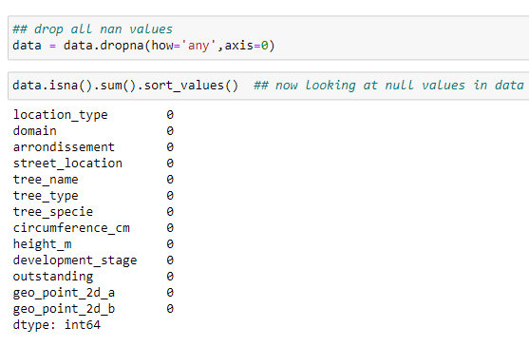
Dropping all nan values in data

Slide 11
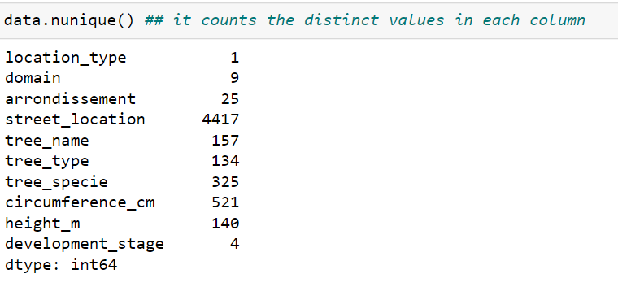
Checking distinct values in each column

Slide 12
Observations
Looking at the most useful variables for our analysis:
There are 9 domains:
Garden,alignment,DJS,DFPE,Cemetry,DASCO,DAC,Ringroad,DASES
Development_stage are 4 in given dataset :
J- young trees-Stage_1 -need more care ,
JA-young_adult- Stage_2 -Teenagers(need shape/care),
A-Adult- Stage_3 Fully_grown- require no care ,
M-Mature- Stage-4 - base needs to be checked .
Arrondissement are 25: These are the locations/regions of Paris.

Slide 13
UNIVARIATE STATISTICAL Analysis

Slide 14
Some descriptive statistical measures
Mean : The mean (also know as average), is obtained by dividing the sum of observed values by the number of observations.
Median: Midpoint between the lowest and highest value of the set (median). The median is the middle value of a set of data containing an odd number of values, or the average of the two middle values of a set of data with an even number of values.
Mode : Most frequently occurring value in dataset.
Standard Deviation: Data sets with a small standard deviation have tightly grouped, precise data. Data sets with large standard deviations have data spread out over a wide range of values. How much each measurement deviates from the mean is standard deviation of the mean.
Skewness : Skewness value should be within the range of -1 to 1 for a normal distribution, Any major changes from this value indicates the presence of extreme value or outlier.

Slide 15
Some descriptive statistical measures
KURTOSIS:
To check the peakedness of data ,we use kurtosis
TYPE OF KURTOSIS
If kurtosis=0: Mesokurtic, the distribution has the same degree of peakedness (or flatness) as the normal distribution.
If kurtosis>0:Leptokurtic, the distribution is more peaked (less flat) than the normal distribution: the observations are more densely concentrated around mean.(i.e., sharply peaked with heavy tails).
If kurtosis<0 :Platykurtic,the distribution less peaked (flatter) than the normal distribution: the observations are less densely concentrated around mean.(i.e., the curve has a flat peak and has more dispersed scores with lighter tails).

Slide 16
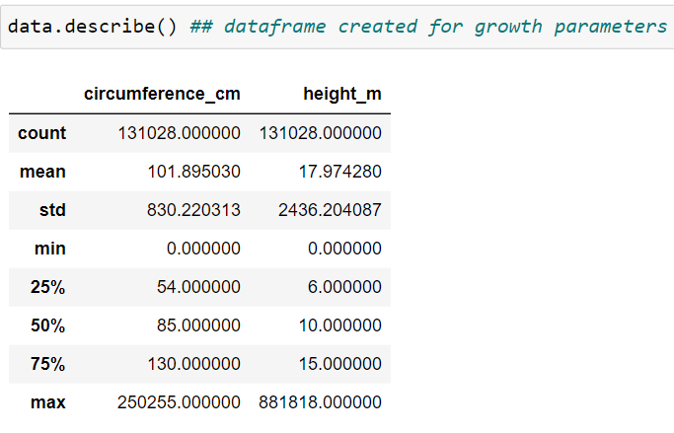
Checking data for outliers

Slide 17
Observations
As the Minimum and Maximum values in circumference and height show a huge difference ,we need to check for outliers in data.
Standard deviation,deviation of values from mean values is large, which means very large values are included in dataset.
It was found that maximum circumference can‘t be more than 1500cm and max height can‘t be more than 150 m .
Reference: https://www.monumentaltrees.com/en/records/fra/

Slide 18
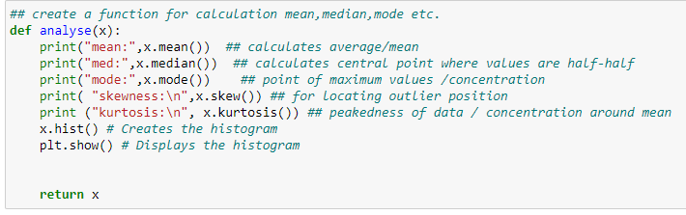
Function for univariate statistical analysis

Slide 19
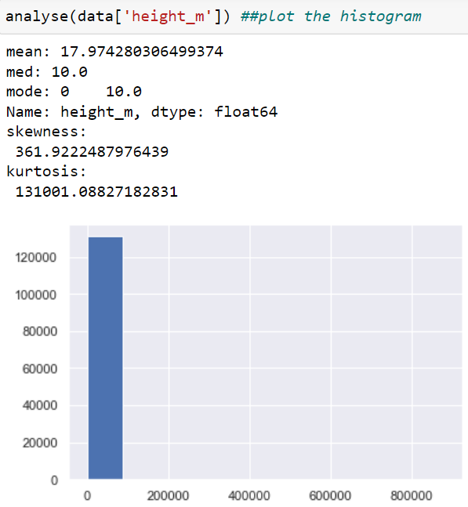
Analysis of height_m

Slide 20
Observations for height_m:
mean>median=mode : 17.97>10 =10, distribution is skewed right (or is positively skewed).
Skewness value: 361.9 (very high) ,shows presence of outliers.
As we have obtained large values for kurtosis 131001 which means Leptokurtic, which means observations are densely concentrated around mean. This exceptionally high value shows presence of outliers.

Slide 21
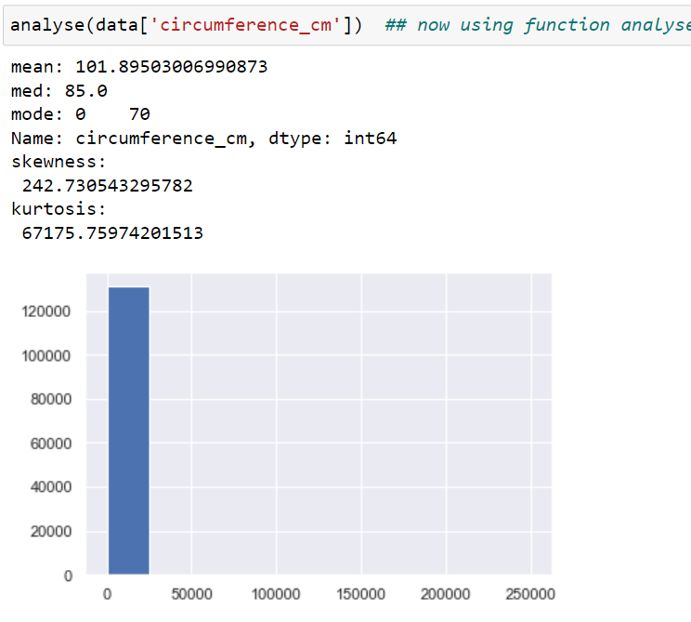
Analysis of circumference_cm

Slide 22
Observations for circumference_cm:
mean>median>mode : 101 >85>70 , distribution is skewed right (or is positively skewed) means outliers are in right side of mean.
Skewness value : 242.7 (very high) ,shows presence of outliers.
As we have obtained large values for kurtosis 67175 which means Leptokurtic which means observations are densely concentrated around mean. This exceptionally high value shows presence of outliers.

Slide 23
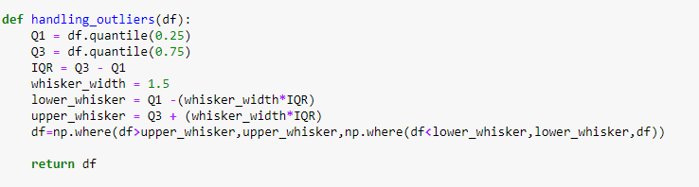
Handling Outliers
Flooring And Capping:(Min-Max)
This quantile-based technique, we will do the flooring(e.g 25th percentile) for the lower values and capping(e.g for the 75th percentile) for the higher values. These percentile values will be used for the quantile-based flooring and capping.

Slide 24
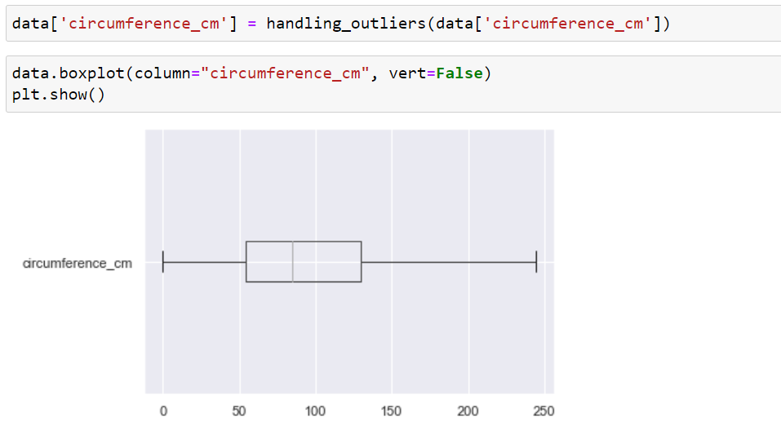
Boxplot for circumference_cm after handling outliers

Slide 25
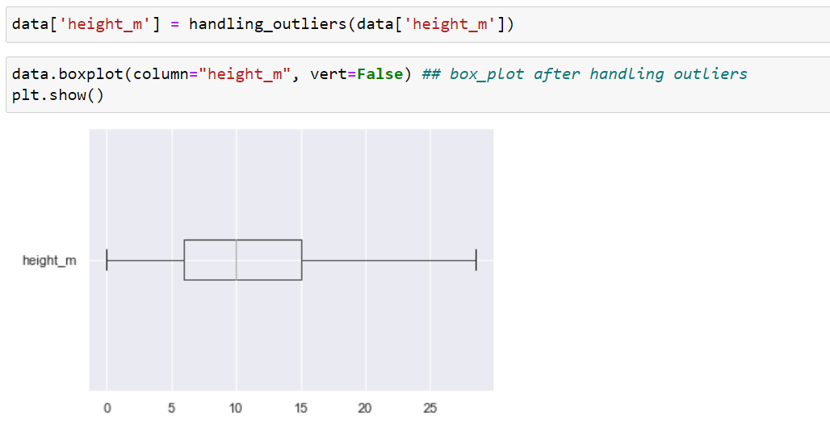
Boxplot for height_m after handling outliers

Slide 26
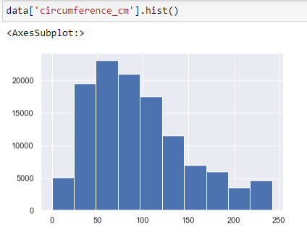
Feature Circumference_cm after handling outliers

Slide 27
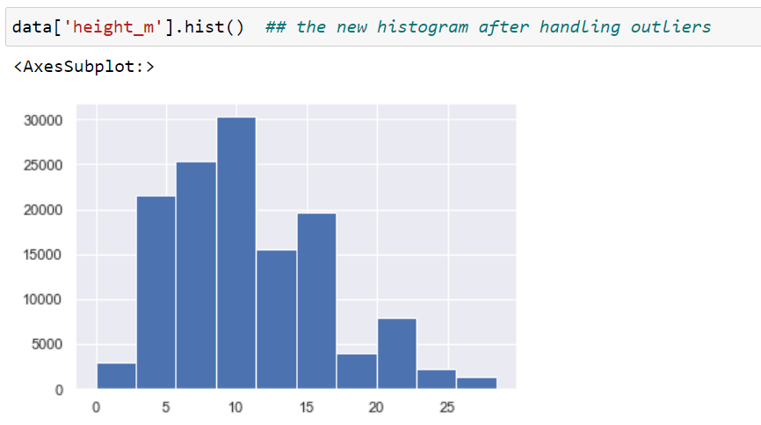
Feature height_m after handling outliers

Slide 28
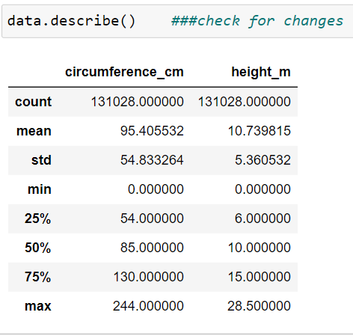
Descriptive analysis after handling outliers

Slide 29
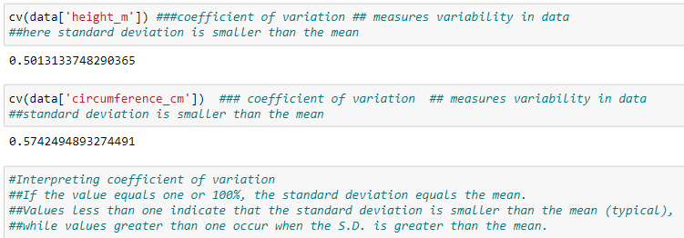
Coefficient of variation
Coefficient of variation measures extent of variability in relation to the mean of the population. After removing outliers coefficient of variation is less than one.

Slide 30
VISUALIZATIONS

Slide 31
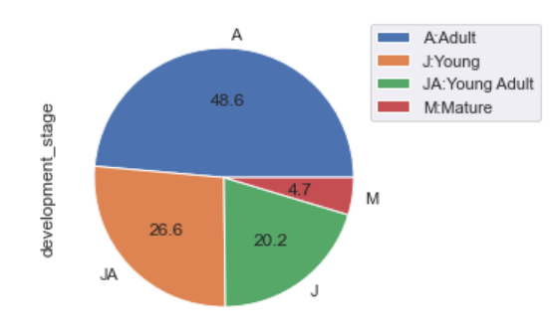
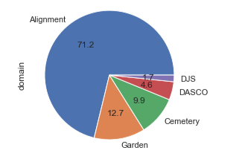
Pie chart for Domain & Development_stage
These pie charts show that maximum number of trees are Adults and maximum trees are in domain Alignment.In first pie chart 48.6% of trees are adult,26.6% trees are JA(young adults ) and 20.2% are Young trees. In second pie chart 71.2% trees are in domain Alignment,12.7% in domain Garden ,9.9% in cemetry and 4.6% in Dasco.

Slide 32
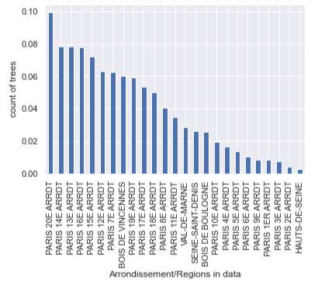
Region/Arrondissement with max number of trees

Slide 33
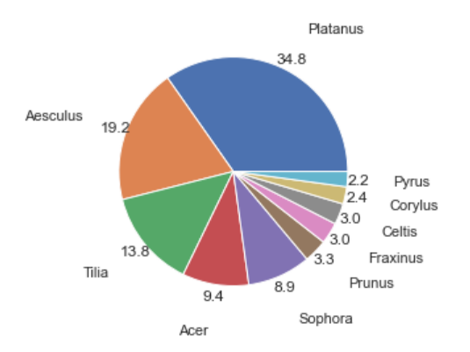
Top 10 tree_type in data
In this Piechart , we can see the 10 most prominent tree_type in Paris. Here 34.8% are Platanus,19.2% are Aesculus,13.8% of total trees are Tilia,9.4% are Acer and so on.

Slide 34
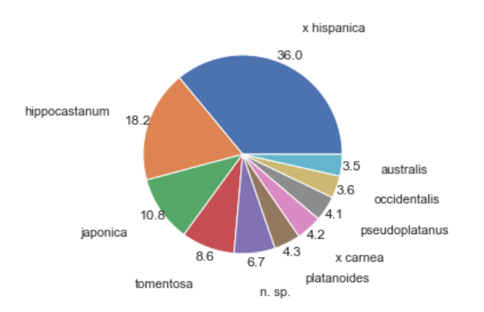
Top 10 tree_species in data
In this piechart,the 10 prominent tree species in dataset are shown. The species x_hispanica has 36% of trees,Hippocastanum has 18.2% of trees among the first 10 prominent species and so on.

Slide 35

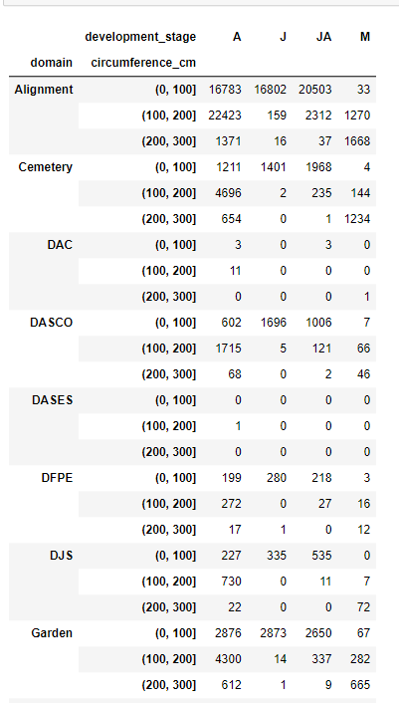
Binning the data in three bins for circumference_cm

Slide 36
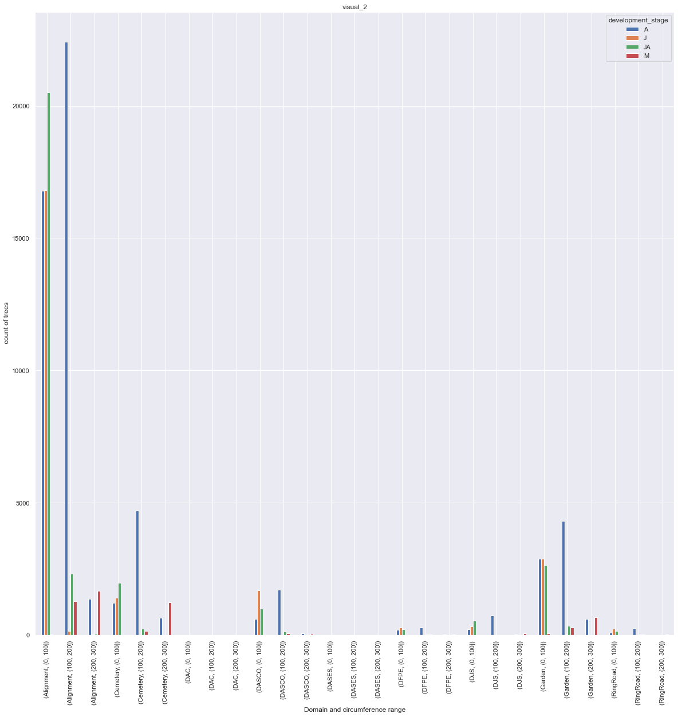
Plot for trees in each domain acc. to circumference bins

Slide 37
Observation
As alignment is the domain with maximum number of trees and the info about trees in other domains is not readable in the visualization ,therefore we remove it in next visualization.

Slide 38
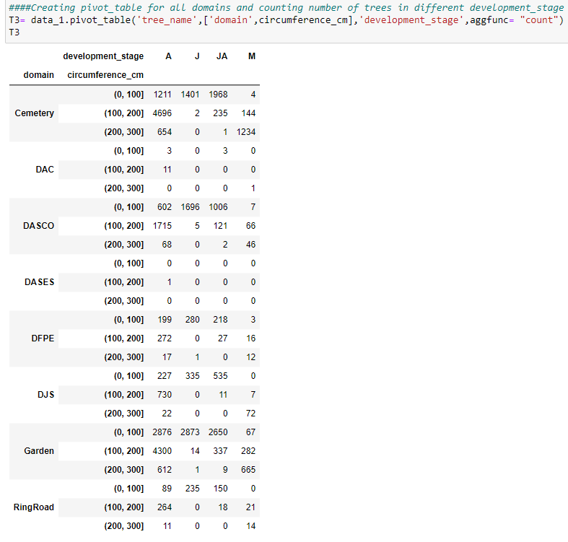
For all 8 domains (leaving Alignment)

Slide 39
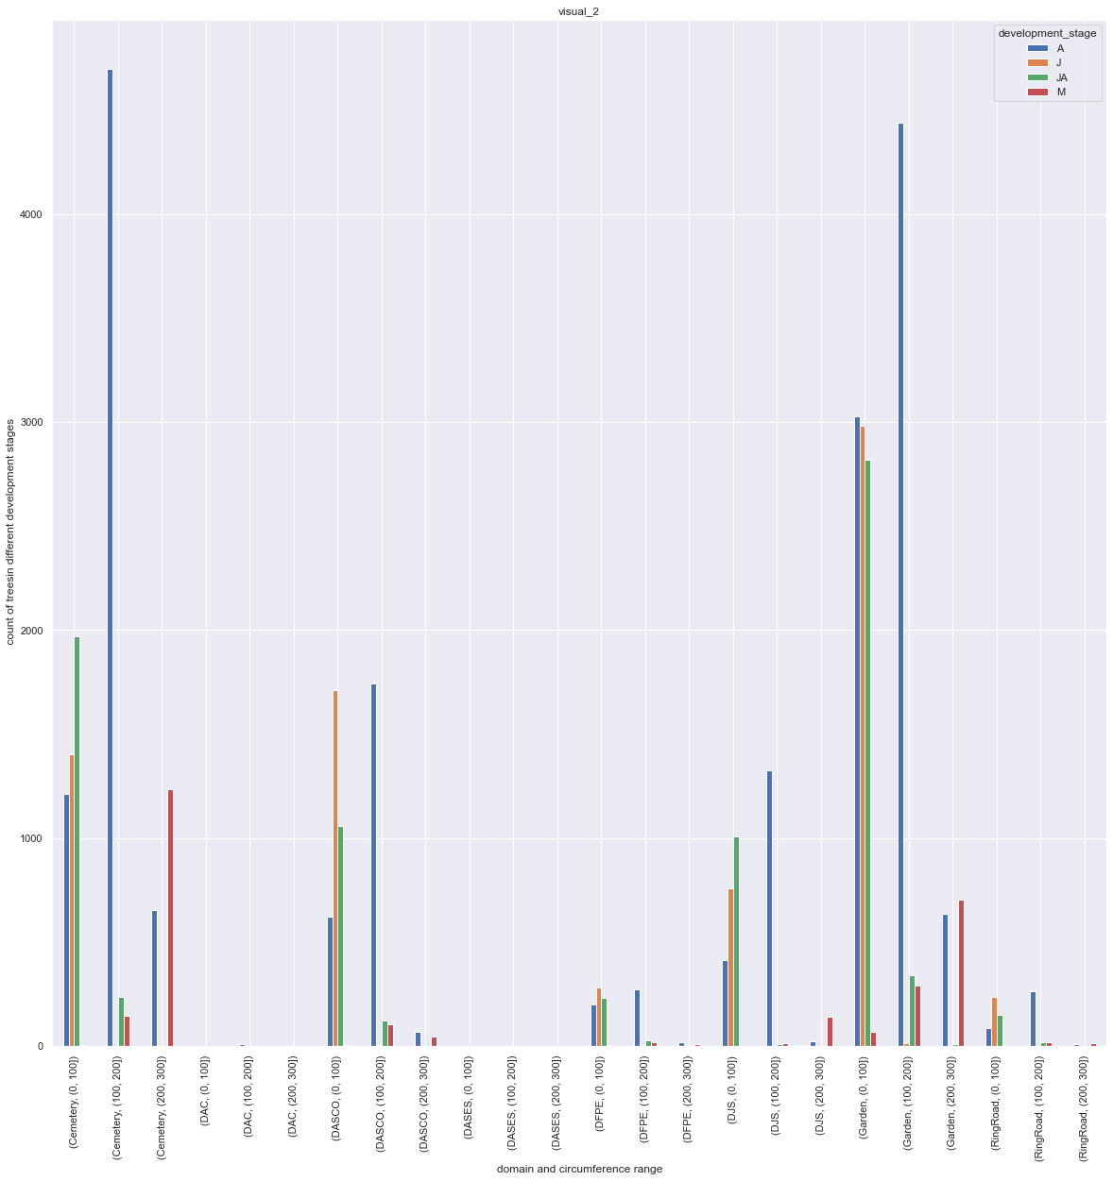
Obtaining the plot for 8 domains(leaving Alignment)

Slide 40
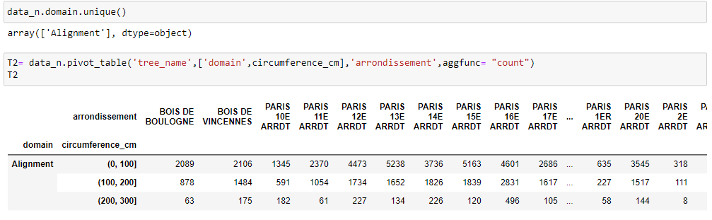
Domain Alignment:

Slide 41
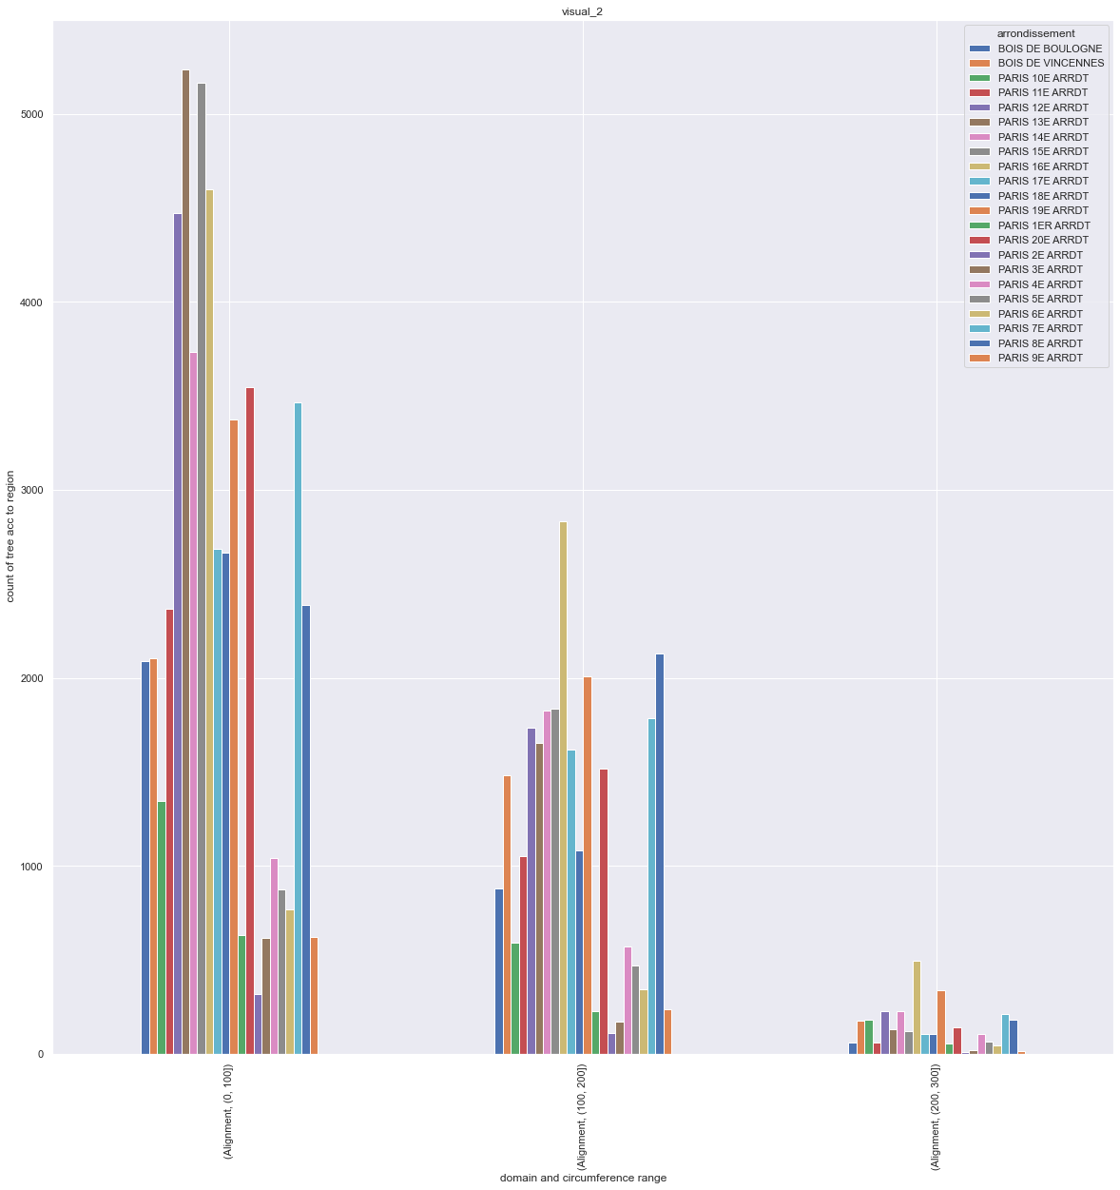
Plotting data for domain Alignment & circumference bins
Arrondissements

Slide 42
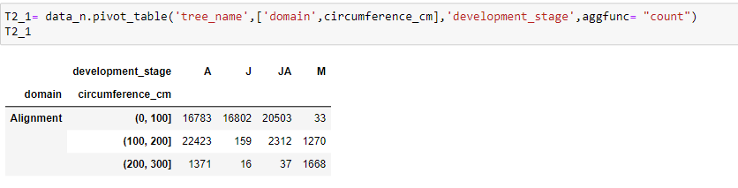
For domain Alignment: counting trees according to development_stage

Slide 43
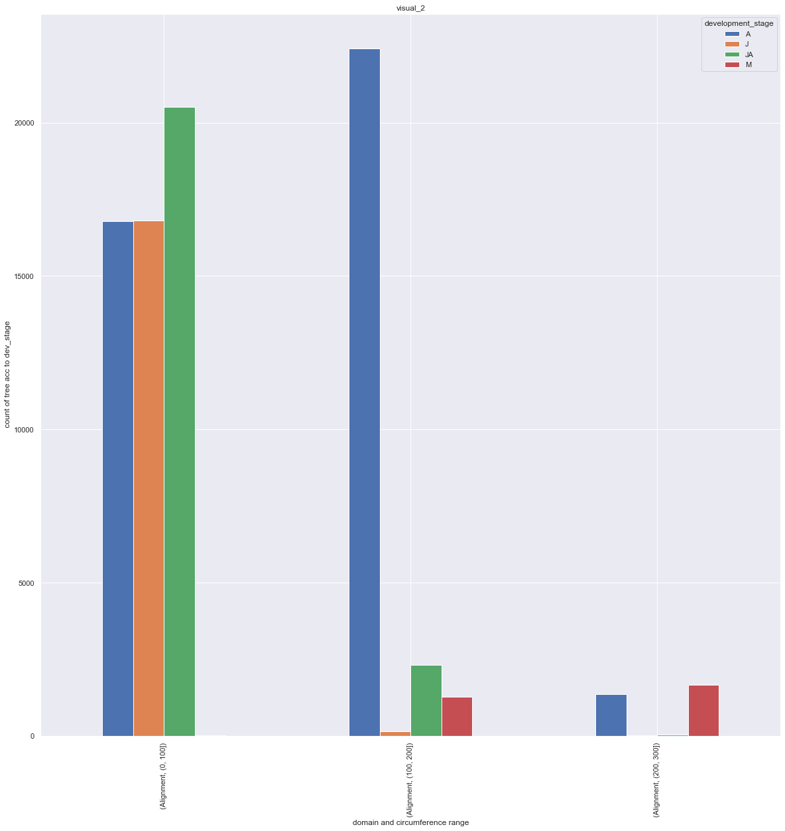
For domain Alignment:Plot according to development_stage

Slide 44
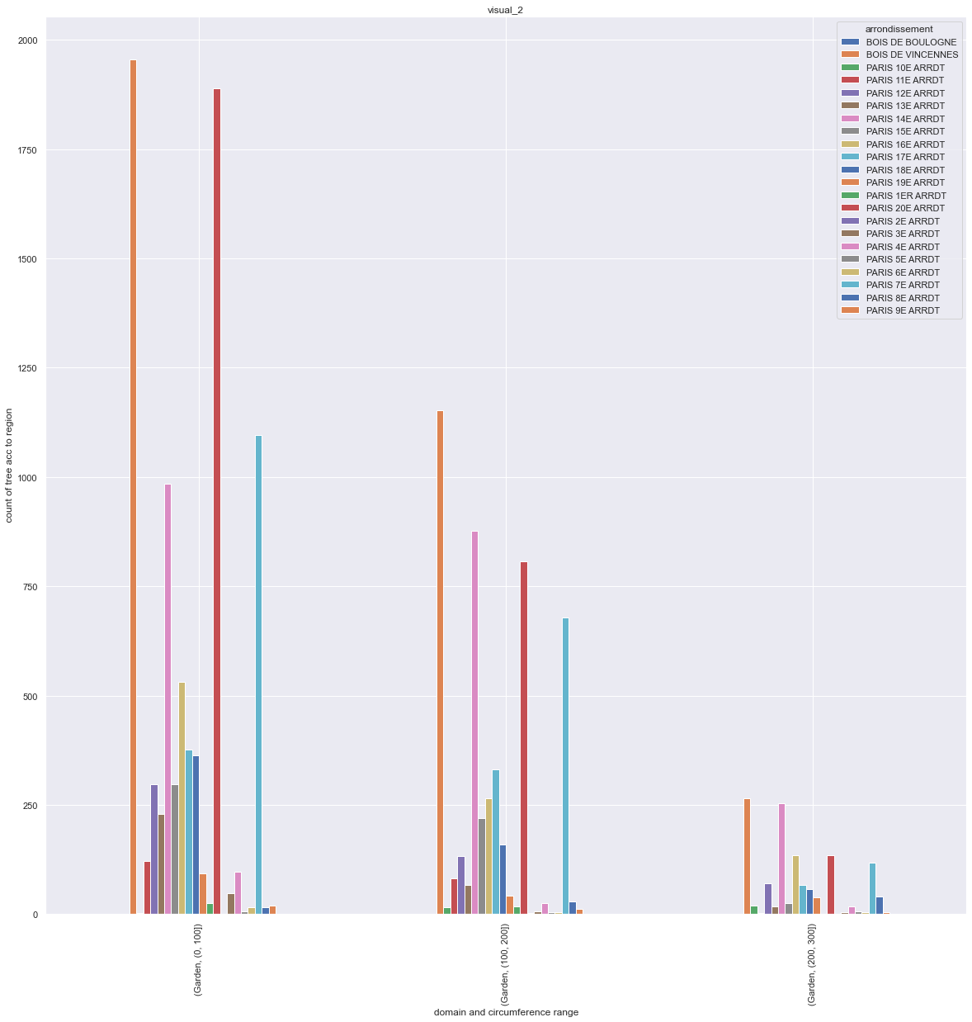
For domain Garden(trees according to arrondissement)

Slide 45
Analysis based on tree_type
As Platanus was in majority in data set. We tried to get exact number of these trees in each domain .
This analysis is useful if we want to take care of particular type of tree in a particular month. The number of visits can be planned according to number of trees in a particular domain.

Slide 46
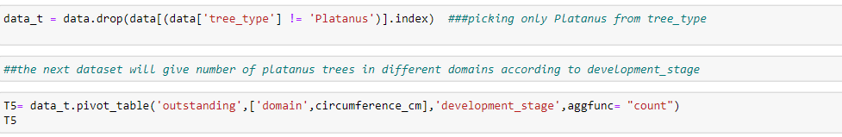
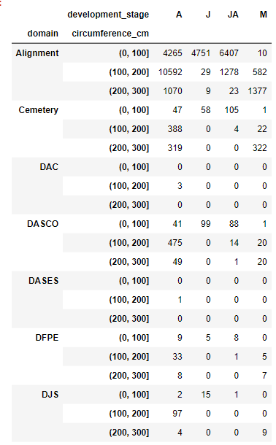
Analysis of tree type Platanus

Slide 47
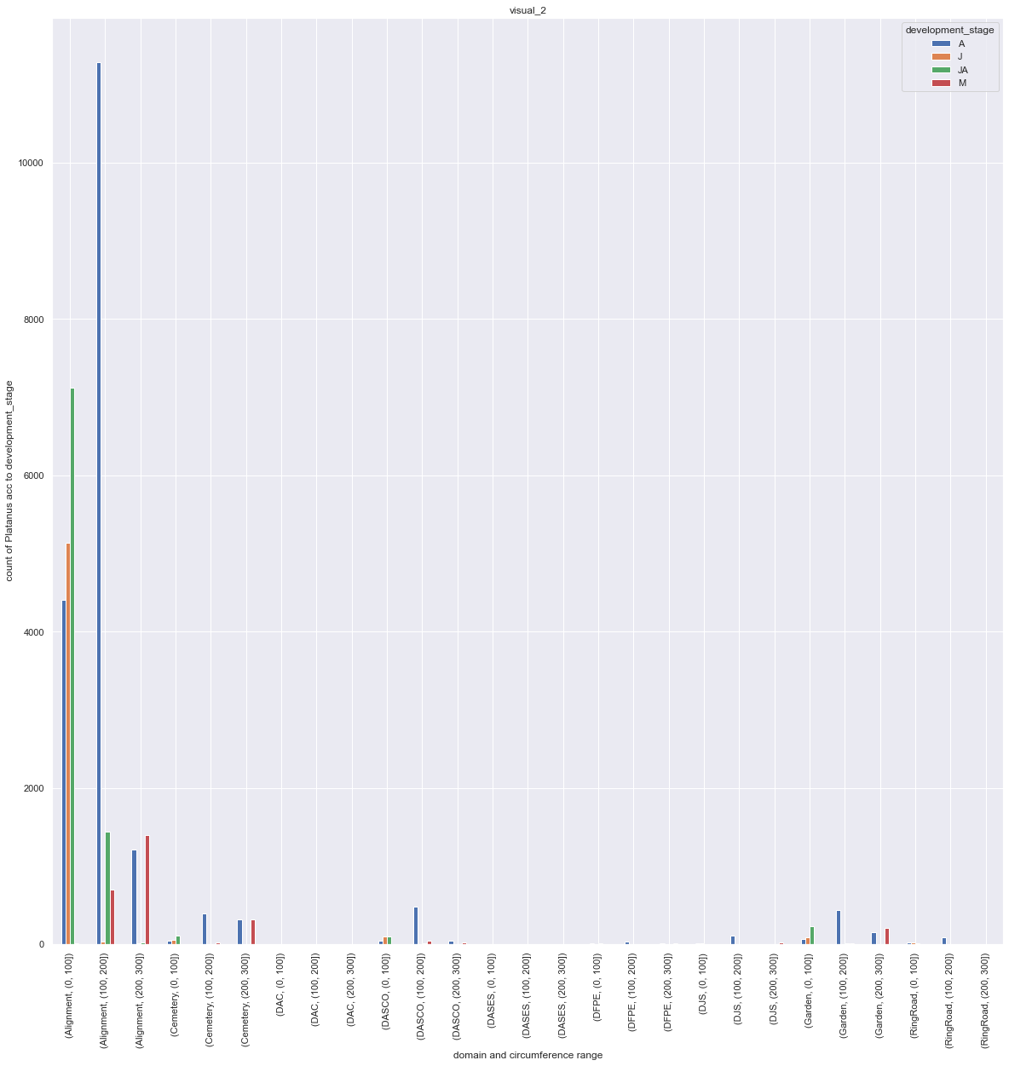
Distribution of tree_type Platanus as per development_stage

Slide 48
INFERENCE

Slide 49
Propositions to Optimize City Tree Maintenance
Analysis helps in planning the visits in specific domains by tree count according to the development stages(J,JA,A,M) e.g. domain alignment has 16802 trees in J and 20503 trees in JA. So visits and staff can be planned accordingly for care of these young trees.(slide 41,42)
For optimizing visits for a particular tree_type , analysis of exact number of trees in different domains can be used .e.g. 4751 Platanus trees in J development stage are present in domain alignment and 6407 Platanus are in JA development stage.These values can be effectively used for planning visits.(slide 45,46)

Slide 50
THANKS

