Slide 1
Chapter 4 Homework

Slide 2
Q4-1: A group of N stations share a 56-kbps pure ALOHA channel. Each station outputs a 1000-bit frame on average once every 100 sec, even if the previous one has not yet been sent (e.g., the stations can buffer outgoing frames). What is the maximum value of N?
With pure ALOHA, the usable bandwidth is
0.184×56 kbps = 10.3 kbps.
Each station requires 10 bps, so
N = 10300/10 = 1030 stations.

Slide 3
Q4-2: Measurements of a slotted ALOHA channel with an infinite number of users show that 10% of the slots are idle.
(a) What is the channel load, G?
(b) What is the throughput?
(c) Is the channel underloaded or overloaded?
(a) P = e^{-G} = 10%.
G = -lnP = -ln0.1 = 2.3.
(b) S = GP = 2.3 * e^{-2.3} = 0.23.
(c) G = 2.3 > 1, overloaded.

Slide 4
Q4-3: What is the baud rate of classic 10-Mbps Ethernet?
Classic Ethernet uses Manchester encoding, which means it has two signal periods per bit sent. The data rate is 10 Mbps, so the baud rate is twice that, or 20 megabaud.

Slide 5
Q4-4: Sketch the Manchester encoding on a classic Ethernet for the bit stream 0001110101.
The signal is a square wave with two values, high (H) and low (L). The pattern is LHLHLHHLHLHLLHHLLHHL.
0
0
0
1
1
1
0
1
0
1

Slide 6
Q4-5: A 1-km-long, 10-Mbps CSMA/CD LAN (not 802.3) has a propagation speed of 200m/u sec. Repeaters are not allowed in this system. Data frames are 256 bits long, including 32 bits of header, checksum, and other overhead. The first bit slot after a successful transmission is reserved for the receiver to capture the channel in order to send a 32-bit acknowledgement frame. What is the effective data rate, excluding overhead, assuming that there are no collisions?
The round-trip propagation time of the cable is 10 usec. A complete transmission has six phases:
1. Transmitter seizes cable (10 usec)
2. Transmit data (25. 6 usec)
3. Delay for last bit to get to the end (5. 0 usec)
4. Receiver seizes cable (10 usec)
5. Acknowledgement sent (3. 2 usec)
6. Delay for last bit to get to the end (5. 0 usec)
The sum of these is 58. 8 usec. In this period, 224 data bits are sent, for a rate of about 3.8 Mbps.

Slide 7
Q4-6: Consider building a CSMA/CD network running at 1 Gbps over a 1-km cable with no repeaters. The signal speed in the cable is 200,000 km/sec. What is the minimum frame size?
For a 1-km cable, the one-way propagation time is 5 µsec, so 2τ=10 µsec. To make CSMA/CD work, it must be impossible to transmit an entire frame in this interval. At 1 Gbps, all frames shorter than 10,000 bits can be completely transmitted in under 10 µsec, so the minimum frame is 10,000 bits or 1250 bytes
L/B ≥ 2D
L/1Gbps ≥ 2*1km/200000 km/s
L = 10000 bit

Slide 8
Q4-7: Ethernet frames must be at least 64 bytes long to ensure that the transmitter is still going in the event of a collision at the far end of the cable. Fast Ethernet has the same 64-byte minimum frame size but can get the bits out ten times faster. How is it possible to maintain the same minimum frame size?
The maximum wire delay in fast Ethernet is 1/10 as long as in Ethernet.

Slide 9
Q4-8: Suppose that an 11-Mbps 802.11b LAN is transmitting 64-byte frames back-to-back over a radio channel with a bit error rate of 10⁻⁷. How many frames per second will be damaged on average?
64byte = 512 bit
Probability of correct arrival of each frame:
p1 = (1 – p)⁵¹² = (1 – 10⁻⁷) ⁵¹²= 0.9999488
Probability of frame be damaged:
p2 = 1 – p1 = 5 * 10⁻⁵
The number of frames sent per second is:
( 11 * 10⁶ ) / 512 = 21484 frame/sec
21484 * 5 * 10⁻⁵ = 1
One damaged frame per second.

Slide 10
Q4-9: A switch designed for use with fast Ethernet has a backplane that can move 10 Gbps. How many frames/sec can it handle in the worst case?
The worst case (most demanding workload for the switch) is an endless stream of 64-byte (512-bit) frames.
If the backplane can handle 10 * 10⁹ = 10¹⁰bps,
the number of frames it can handle is
10¹⁰ /512 = 19,531,250 frames/sec.

Slide 11
Q4-10: Store-and-forward switches have an advantage over cut-through switches with respect to damaged frames. Explain what it is.
A store-and-forward switch stores each incoming frame in its entirety, then examines it and forwards it.
A cut-through switch starts to forward incoming frames before they have arrived completely. As soon as the destination address is in, the forwarding can begin.

Slide 12
Chapter 4 Exercise

Slide 13
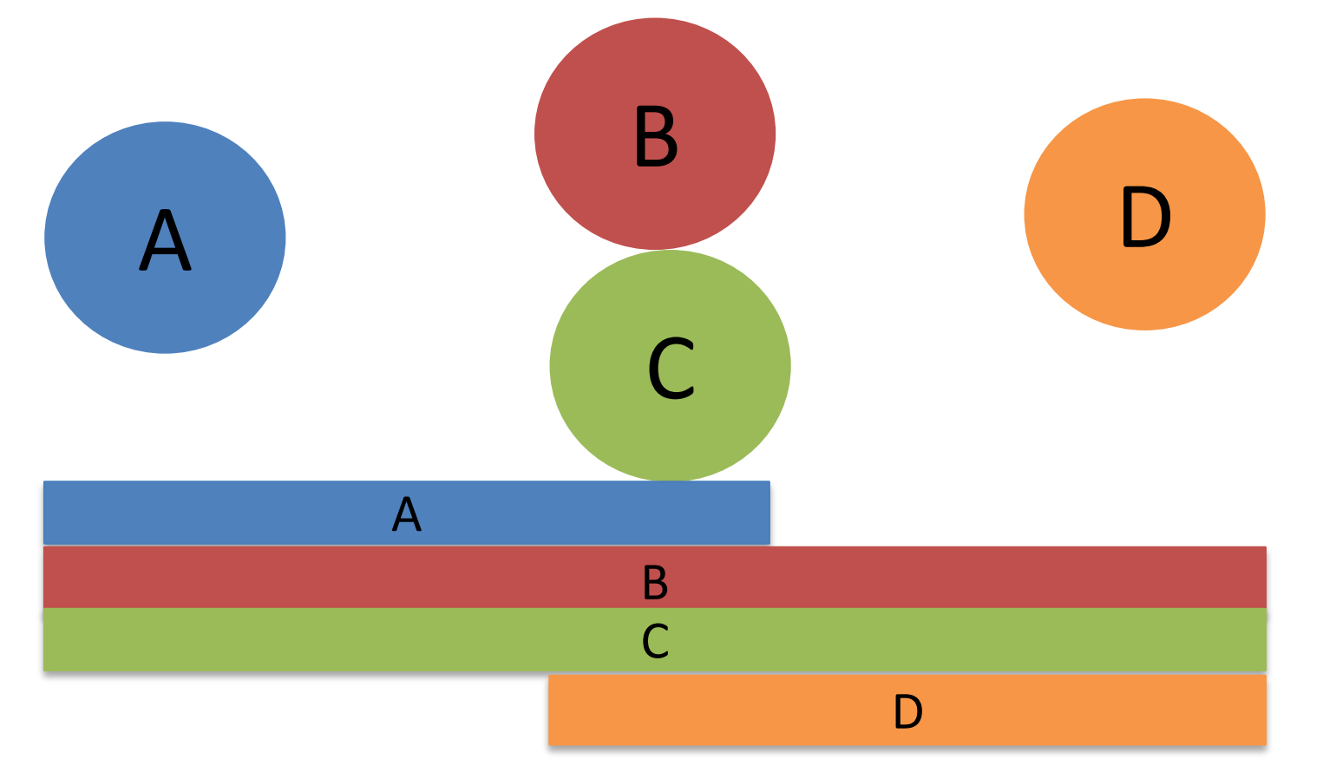
1.考虑以下无线通信场景，B和 C 可以听到 A，但 D 听不到；B 和 C 可以听到 D，但 A 听不到；每个节点都能听到 B 和 C 的声音。水平条表示这些范围。
假设 A 和 B 正在使用 MACA (Multiple Access with Collision Avoidance)，且 A 正在向 B 发送多个数据包（但 B 不需要发送回确认）。C希望将数据传输给 D（同样，D 不需要发送回确认）。
a）C 可以通过忽略 A 和 B 之间交换的 CTS 消息提高其性能吗？请解释原因（此处"忽略"意味着当C听到 CTS 消息时，不采取应该采取的操作）。
D 听不到 A 发送的消息，因此 C 可以自由发送给 D。
即使 C 本地将发生与 A 发送的消息冲突，D 仍将成功接收 C 的消息。
因此，C 可以通过一直传输来显著提高其性能。

Slide 14
b） 现在考虑B将数据发送给 A。D可以通过忽略 A 和 B 之间交换的 CTS 消息提高其性能吗？请解释原因。
每当 B 发送到 A 时，C 都会听到它，在这些时候由于冲突D都无法将数据有效地传输到 C。因此D 无法提高其性能。

Slide 15
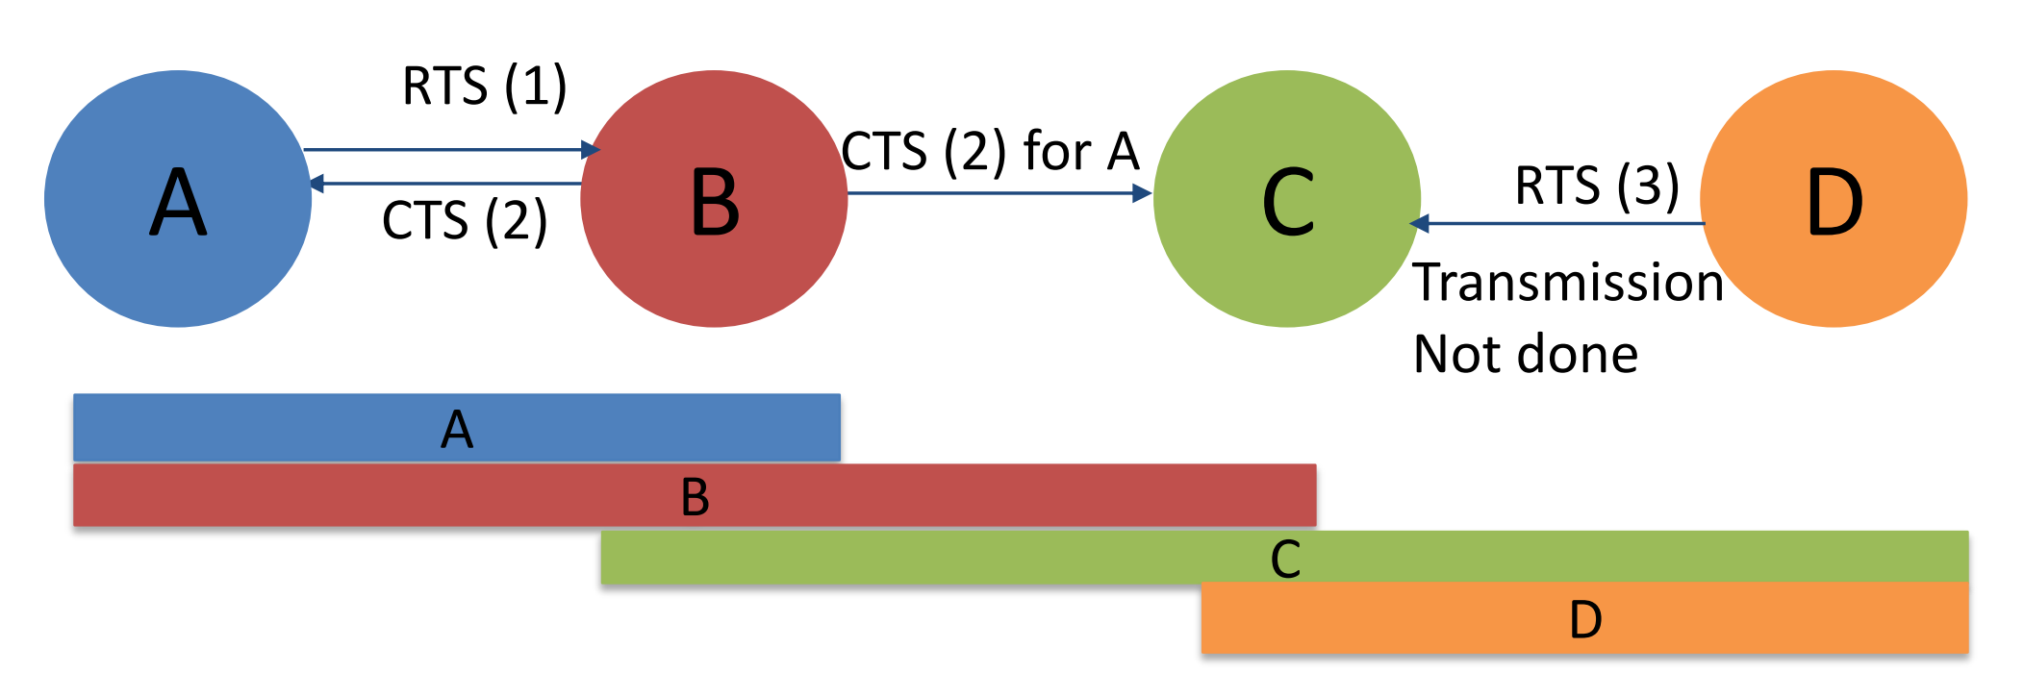
2.考虑以下场景，A 想要发送到 B ，D 想要发送到 C。如果 A 和 B 成功进行了 RTS/CTS 交换，D 能否发送到 C？画出 RTS/CTS 数据包的顺序。
不能。A 将 RTS 发送到 B，B 将 CTS 发送到 A 和 C。C侦听到该消息，当 D 的 RTS 出现时，它不会发送 CTS回来，传输无法完成。请注意，此传输是安全的，但 RTS/CTS 排除了它。

Slide 16
Chapter 5 Homework

Slide 17
Q5-1: Consider the network of Fig.5-7, but ignore the weights on the lines. Suppose that it uses flooding as the routing algorithm. If a packet sent by A to D has a maximum hop count of 3, list all the routes it will take. Also tell how many hops worth of bandwidth it consumes.
B
C
ABCD, ABCF, ABEF, ABEG, AGHD, AGHF, AGEB, AGEF,
所以总跳数为 14.
A
E
F
D
G
H

Slide 18
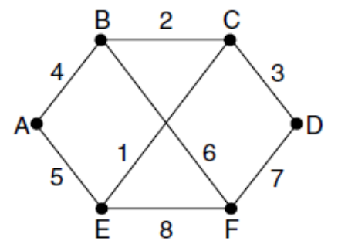
Q5-2: Consider the network of Fig. 5-12(a). Distance vector routing is used, and the following vectors have just come in to router C: from B: (5, 0, 8, 12, 6, 2); from D: (16, 12, 6, 0, 9, 10); and from E: (7, 6, 3, 9, 0, 4). The cost of the links from C to B, D, and E, are 6, 3, and 5, respectively. What is C’s new routing table? Give both the outgoing line to use and the cost.
Going via B gives(11, 6, 14, 18, 12, 8).
Going via D gives(19, 15, 9, 3, 12, 13).
Going via E gives(12, 11, 8, 14, 5, 9).
Taking the minimum for each destination except C gives(11, 6, 0, 3, 5, 8).
The outgoing lines are (B, B,– , D, E, B).

Slide 19
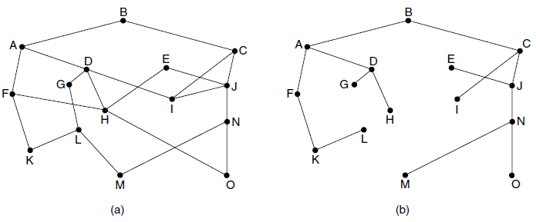
Q5-3: Looking at the network of Fig. 5-6, how many packets are generated by a broadcast from B, using
(a) Reverse path forwarding?
(b) The sink tree?

Slide 20
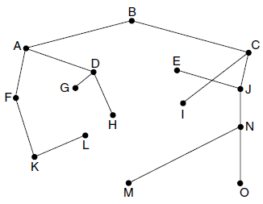
(a) The reverse path forwarding algorithm takes five rounds to finish. The packets sent on these rounds, where * denotes a recipient that received the broadcast along the sink tree and will broadcast in the next round, are:
Round 1: B sends to A*C* .
Round 2: A sends to D*F *, and C sends to I * J * .
Round 3: D to G * H * I, F to HK *, I to DJ, and J to E * IN *.
Round 4: G to L, H to EFO, K to L *, E to H, and N to M * O *.
Round 5: L to GM, M to L, and O to H.
There is a total of 28 packets across the rounds.
(b) The sink tree is shown in the figure. It needs four rounds and 14 packets.

Slide 21
Q5-4: Suppose that host A is connected to a router R 1, R 1 is connected to another router, R 2, and R 2 is connected to host B. Suppose that a TCP message that contains 900 bytes of data and 20 bytes of TCP header is passed to the IP code at host A for delivery to B. Show the Total length, Identification, DF, MF, and Fragment offset fields of the IP header in each packet transmitted over the three links. Assume that link A-R1 can support a maximum frame size of 1024 bytes including a 14-byte frame header, link R1-R2 can support a maximum frame size of 512 bytes, including an 8-byte frame header, and link R2-B can support a maximum frame size of 512 bytes including a 12-byte frame header.
Host A
Router 1
Router 2
Host B

Slide 22
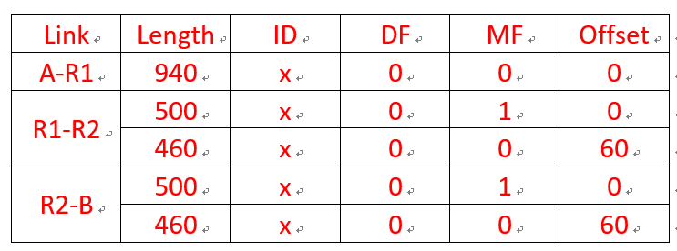
A----R1----R2----B
IP Packet(20B+920B)
A----R1: 940<1010, no fragmentation
R1----R2: 940 > 504, 504-20(IP Header) = 484/8=60..4
IP Packet 1
IP Packet 2
R2----B: 500 = 500, no fragmentation
IP Packet 1
IP Packet 2

Slide 23
Q5-5: A router is blasting out IP packets whose total length (data plus header) is 1024 bytes. Assuming that packets live for 10 sec, what is the maximum line speed the router can operate at without danger of cycling through the IP datagram ID number space?
IP header IDENTIFICATION (16 bit),
𝑥/(1024×8)×10 ≤ 2¹⁶,
x <= 2¹⁶ * 1024* 8 /10 = 2²⁹ / 10 = 54M bps.

Slide 24
Q5-6: An IP datagram using the Strict source routing option has to be fragmented. Do you think the option is copied into each fragment, or is it sufficient to just put it in the first fragment? Explain your answer.
The info is needed to route every fragment, so it must appear in all of them.

Slide 25
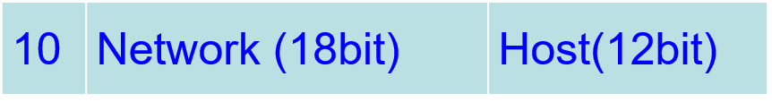
Q5-7: Suppose that instead of using 16 bits for the network part of a class B address originally, 20 bits had been used. How many class B networks would there have been?
With a 2-bit preﬁx, there would have been 18 bits left over for the network. Consequently, the number of networks would have been 2¹⁸ or 262,144. However, all 0s and all 1s are special, so only 262,142 are available.

Slide 26
Q5-8: A network on the Internet has a subnet mask of 255.255.240.0. What is the maximum number of hosts it can handle?
255.255.240.0 → 11111111 11111111 11110000 00000000
2¹² – 2 = 4094

Slide 27
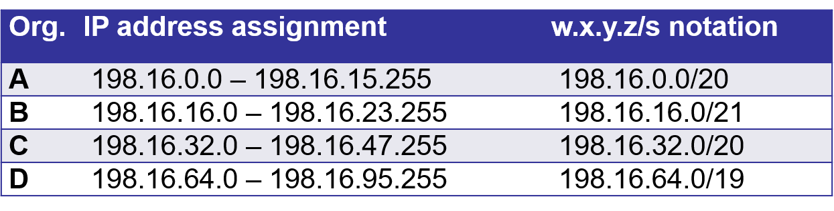
Q5-9: A large number of consecutive IP addresses are available starting at 198.16.0.0. Suppose that four organizations, A, B, C, and D, request 4000, 2000, 4000, and 8000 addresses, respectively, and in that order. For each of these, give the first IP address assigned, the last IP address assigned, and the mask in the w.x.y.z/s notation.
To start with, all the requests are rounded up to a power of two. The starting address, ending address, and mask are as follows:

Slide 28
Q5-10: A router has the following (CIDR) entries in its routing table:
Address/mask | Next hop
135.46.56.0/22 | Interface 0
135.46.60.0/22 | Interface 1
192.53.40.0/23 | Router 1
default | Router 2
For each of the following IP addresses, what does the router do if a packet with that address arrives? (a) 135.46.63.10 (b) 135.46.57.14 (c) 135.46.52.2 (d) 192.53.40.7 (e) 192.53.56.7

Slide 29
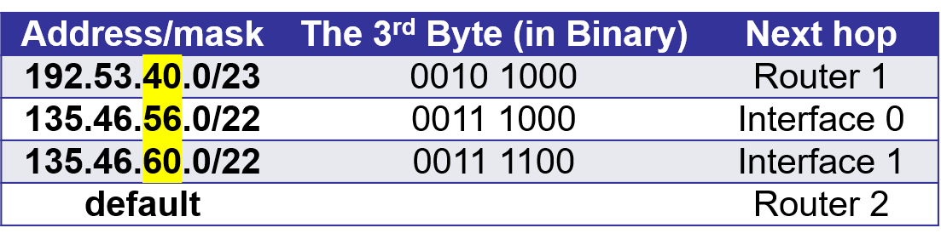
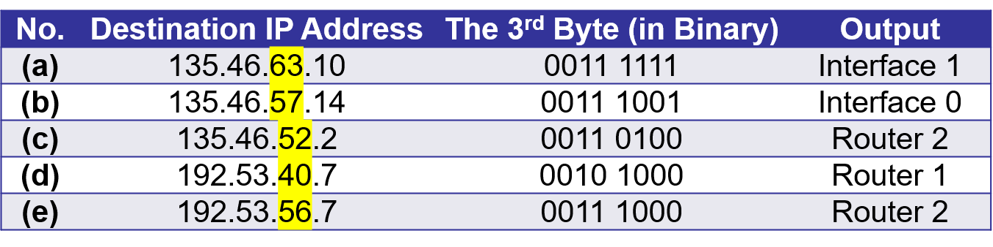

Slide 30
Chapter 5 Exercise

Slide 31
1.某大学有电子工程系、计算机系、数学系、化学系，其中化学系拥有123.100.0.0/18的地址块，数学系拥有123.100.128.0/18的地址块。假设使用CIDR寻址方案。
1）请写出数学系的子网掩码、地址范围和该地址范围中地址的个数。
子网掩码：255.255.192.0
地址范围：123.100.128.0-123.100.191.255
地址个数：2¹⁴
2）为电子工程系和计算机系预留的地址是123.100.192.0/18，请为上面两个系分配相等的地址空间，给出分配方案。
123.100.192.0/19和123.100.224.0/19

Slide 32
3）包含上面所有四个系（电子工程系、计算机系、数学系、化学系）的最长前缀是什么？
上面四个系的地址块和第三个字节的二进制形式分别如下：
化学系：123.100.0.0/18 00000000
数学系：123.100.128.0/18 10000000
电子工程和计算机系：123.100.192.0/18 11000000
前16位相同。最长前缀为123.100.0.0/16
4）假设要新设置一个系，其人数不超过50，假设为每个人分配一个地址，请给出地址分配方案。
与50最接近的2的幂次方是2⁶=64，网络前缀长度32-6=26。
前面四个系未使用的地址块为123.100.64.0/18，地址分配方案为123.100.64.0/26

Slide 33
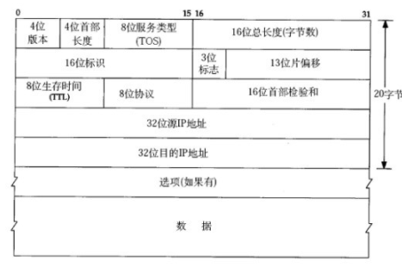
2.回答如下问题：
1）在路由器发送数据包之前必须更新哪些标头字段？
TTL， 校验和
2） 假设 IP 路由器中存在错误，因此它不再更新生存时间字段。这会引起什么问题？
如果网络的路由配置中存在环路，则此数据包将永远循环（直到不正确的路由配置更改）。
3） 假设供应商 A 设计其路由器，以便不再更新校验和。其基本原理是，端点通常计算自己的校验和无论如何。这会引起什么问题？
根据端到端原则，当端点已经计算自己的校验和时，从网络中解除校验和是一个合理的选择。但是，并非所有路由器供应商都忽略校验和，因此，如果供应商 A 路由器不在 IP 级别上更新校验和，则其他路由器可能会认为数据包已损坏，即使该数据包未损坏，也会导致大量丢弃的数据包。

Slide 34
4） 为了加速数据包转发，供应商 A 决定始终分析目标地址的标头的最后 4 个字节。这会引起什么问题？
在有选项字段时会产生问题。
5） 为什么需要 MF 标志？
数据包可能会乱序到达;MF标志告诉端主机哪个片段是最后一个片段。
6） 为什么我们不能只对分段进行编号，而是记录分段偏移量？
如何对分段的分段进行编号？（如分段经过MTU更小的网络时，分段需要进一步分段）
7） IP分段在 IPv6 中完全删除。为什么会这样？
分段和重新组装非常耗时。路由器删除超大数据包，然后向主机发送"数据包太大"错误消息的替代方法更简单，并且能够更快地转发。

Slide 35
3.下面是一个使用链路状态路由来彼此通信的路由器网络。每个链路旁边的数字表示经过该链路的成本。
（a）在所有路由器都有了网络拓扑的全局视图之后，在每个节点上运行Dijkstra算法并填写下表。
行表示每个表中的迭代，列表示目的地。每个单元格使用如下记法：（成本，前一个节点），S为已经确定好最小成本路径的节点集合。
节点A的表已填好，注意这些表不是节点的路由表，最终只有每个表的最后一行起作用。突出显示的单元格被选中添加至S。

Slide 36
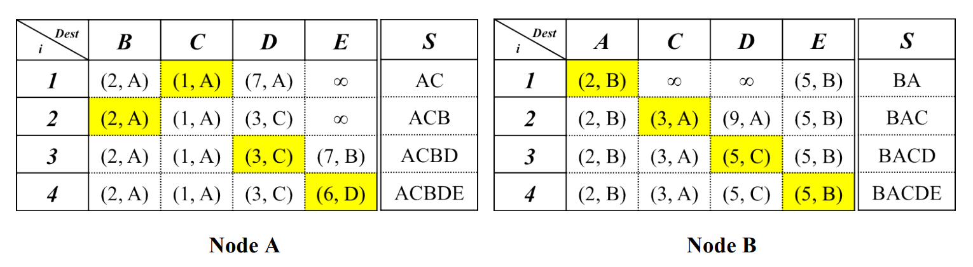
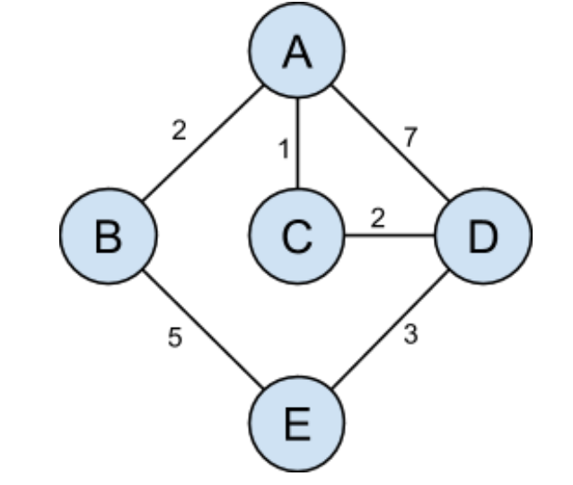
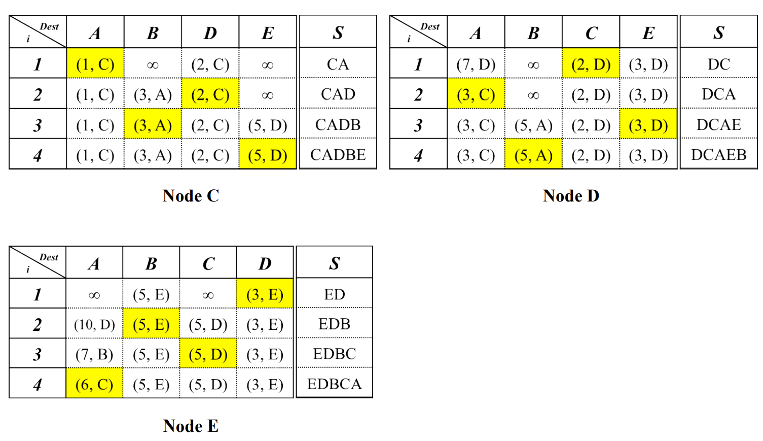
(b)节点B想要发送至节点D，分组经由哪条路径？该路径的成本是多少？
通过查看节点B的表的最后一行，可以看出分组经由的路径为 B->A->C->D ，成本为 5。

Slide 37
Chapter 6 Homework 1

Slide 38
Q6-1: In our example transport primitives of Fig. 6-2, LISTEN is a blocking call. Is this strictly necessary? If not, explain how a nonblocking primitive could be used. What advantage would this have over the scheme described in the text?
The LISTEN call could indicate a willingness to establish new connections but not block. When an attempt to connect was made, the caller could be given a signal. It would then execute, say, OK or REJECT to accept or reject the connection. In our original scheme, this flexibility is lacking.

Slide 39
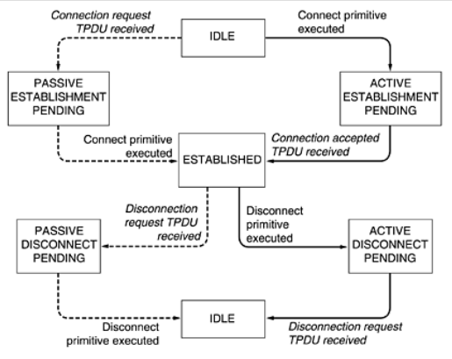
Q6-2: In the underlying model of Fig. 6-4, it is assumed that packets may be lost by the network layer and thus must be individually acknowledged. Suppose that the network layer is 100 percent reliable and never loses packets. What changes, if any, are needed to Fig. 6-4?

Slide 40
Q6-3: Why does the maximum packet lifetime, T, have to be large enough to ensure that not only the packet but also its acknowledgements have vanished?
CR(seq=x)
CR(seq=x)
CR(seq=x)
ACC(seq=x,ACK=x)
ACC(seq=x,ACK=x)
ACC(seq=x,ACK=x)
DATA(Seq=x,ACK=y
REJECT((ACK=y)
DATA(Seq=x,ACK=y
(a)
(b)
(c)

Slide 41
Q6-4: Discuss the advantages and disadvantages of credits versus sliding window protocols.
The sliding window is simpler, having only one set of parameters (the window edges) to manage. Furthermore, the problem of a window being increased and then decreased, with the segments arriving in the wrong order, does not occur.
However, the credit scheme is more ﬂexible, allowing a dynamic management of the buffering, separate from the acknowledgements.

Slide 42
Q6-5: Why does UDP exist? Would it not have been enough to just let user processes send raw IP packets?
No. IP packets contain IP addresses, which specify a destination machine. Once such a packet arrived, how would the network handler know which process to give it to?
UDP packets contain a destination port. This information is essential so they can be delivered to the correct process.

Slide 43
Q6-6: Suppose that the TCP congestion window is set to 18 KB and a timeout occurs. How big will the window be if the next four transmission bursts are all successful? Assume that the maximum segment size is 1 KB.
After a timeout, slow-start begins again with a congestion window of 1 segment and a threshold of 18 / 2 = 9 KB. The first transmission will be 1 maximum segment size, or 1 KB. After this burst, the window will be 1 KB until the acknowledgements return and cause the window to double. The subsequent bursts will be 2, 4, and 8 segments as the connection slow-starts. So after four successful bursts, the window will be 8 KB.

Slide 44
Q6-7: A TCP machine is sending full windows of 65,535 bytes over a 1-Gbps channel that has a 10-msec one-way delay. What is the maximum throughput achievable? What is the line efficiency?
One window can be sent every 20 msec. This gives 50 windows/sec, for a
maximum data rate of about 3.3 million bytes/sec. The line efficiency is then 26.4 Mbps/1000 Mbps or 2.6 percent.

Slide 45
Q6-8: In a network whose max segment is 128 bytes, max segment lifetime is 30 sec, and has 8-bit sequence numbers, what is the maximum data rate per connection?
A sender may not send more than 255 segments, i.e., 255 × 128 × 8bits, in 30 sec. The data rate is thus no more than 8.704 kbps.

Slide 46
Q6-9: A CPU executes instructions at the rate of 1000 MIPS. Data can be copied 64 bits at a time, with each word copied costing 10 instructions. If an coming packet has to be copied four times, can this system handle a 1-Gbps line? For simplicity, assume that all instructions, even those instructions that read or write memory, run at the full1 000-MIPS rate.
It takes 4 × 10 = 40 instructions to copy 8 bytes.
Forty instructions takes 40 nsec.
Thus, each byte requires 5 nsec of CPU time for copying.
The system is thus capable of handling 200 MB/sec or 1600 Mbps.
It can handle a 1-Gbps line if no other bottleneck is present.

Slide 47
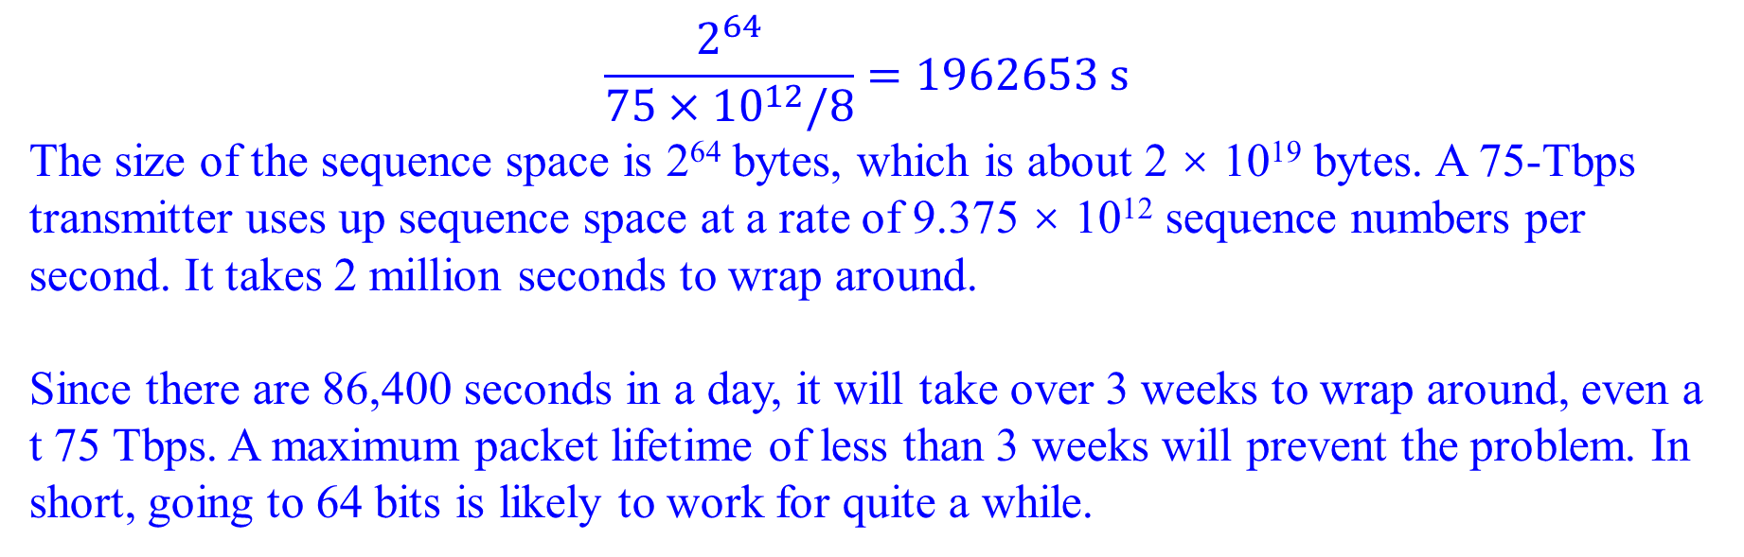
Q6-10: To get around the problem of sequence numbers wrapping around while old packets still exist, one could use 64-bit sequence numbers. However, theoretically, an optical fiber can run at 75 Tbps. What maximum packet lifetime is required to make sure that future 75-Tbps networks do not have wraparound problems even with 64-bit sequence numbers? Assume that each byte has its own sequence number, as TCP does.
$$\frac{2^{64}}{75×{10}^{12}/8}=1962653 s$$
The size of the sequence space is 2⁶⁴ bytes, which is about 2 × 10¹⁹ bytes. A 75-Tbps transmitter uses up sequence space at a rate of 9.375 × 10¹² sequence numbers per second. It takes 2 million seconds to wrap around.
Since there are 86,400 seconds in a day, it will take over 3 weeks to wrap around, even a t 75 Tbps. A maximum packet lifetime of less than 3 weeks will prevent the problem. In short, going to 64 bits is likely to work for quite a while.

Slide 48
Chapter 6 Homework 2

Slide 49
6-1. In both parts of Fig. 6-6, there is a comment that the value of SERVER PORT must be the same in both client and server. Why is this so important?
If the client sends a packet to SERVER PORT and the server is not listening to that port, the packet will not be delivered to the server.

Slide 50
6-2. In the Internet File Server example (Figure 6-6), can the connect( ) system call on the client fail for any reason other than listen queue being full on the server? Assume that the network is perfect.
The connect( ) may fail if the server hasn’t yet executed its listen( ) call.

Slide 51
6-3. One criteria for deciding whether to have a server active all the time or have it start on demand using a process server is how frequently the service provided is used. Can you think of any other criteria for making this decision?
One other criteria is how the client is affected by extra delay involved in process server technique. The server for the requested service has to be loaded and probably has to be initialized before the client request can be serviced.

Slide 52
6-3. One criteria for deciding whether to have a server active all the time or have it start on demand using a process server is how frequently the service provided is used. Can you think of any other criteria for making this decision?
One other criteria is how the client is affected by extra delay involved in process server technique. The server for the requested service has to be loaded and probably has to be initialized before the client request can be serviced.

Slide 53
6-7. A process on host 1 has been assigned port p, and a process on host 2 has been assigned port q. Is it possible for there to be two or more TCP connections between these two ports at the same time?
No. A connection is identiﬁed only by its sockets. Thus, (1, p)–(2, q) is the only possible connection between those two ports.

Slide 54
6-8. Consider the effect of using slow start on a line with a 10-msec round-trip time and no congestion. The receive window is 24 KB and the maximum segment size is 2 KB. How long does it take before the first full window can be sent?
The ﬁrst bursts contain 2K, 4K, 8K, and 16K bytes, respectively. The next one is 24 KB and occurs after 40 msec.

