Slide 1

Referral Finder
Jerry
Oct 16, 2023

Slide 2
Introduction
Full-stack web application that’s designed to help students to connect with industry alumni so that they can find referrals opportunities easily.
Three types of User:
Student Applicants
Alumni Referral Poster
Admin

Slide 3
System Design (Tech-Stack)
Frontend:
React / Material-UI / JavaScript
Backend:
Django: MVC, rest-framework
FastAPI: websocket service
Database:
PostgreSQL: saved referral posts, user profile
Redis: Token authentication & leaderboard
Other:
Celery & RabbitMQ:
async send email tasks

Slide 4

System Design (Functionalities)
User Registration and Authentication
Student & Alumni Management
Referral Post Management
Application Management
Favorite Job Management
WebSocket Push Notification Feature
Asynchronous tasks and message queuing
Leaderboard (real-time ranking) Feature

Slide 5
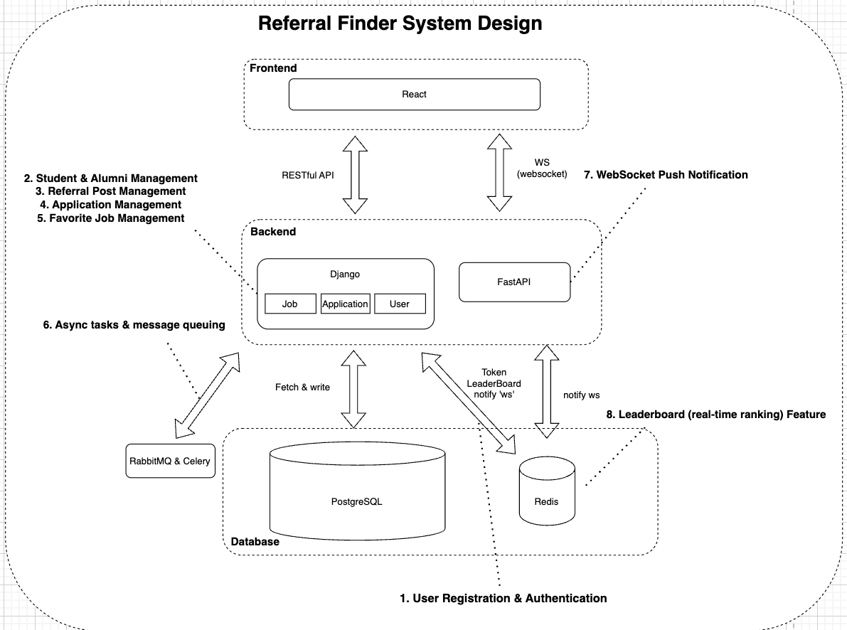
System Design Chart

Slide 6
Django
Three Django apps:
application:
a. Handle application-related models, views, and RESTful APIs
job_post:
a. Handle job-post-related models, views, and RESTful APIs
user
a. Handle student & alumni-related models, views, and RESTful APIs

Slide 7
What can Student & Alumni do?
 | Student Applicant | Alumni Poster
General/Specific View of Job Post | Yes | No
Submit application | Yes | No
Edit Application | Yes (in some condition of some fields) | Yes (But only modified the status)
Create/Edit new Referral Posts | No | Yes
Submit application | Yes | No
Save Favorite Posts | Yes | No
Authorization & Permissions

Slide 8
React
Utilized some components & styling from https://minimal-kit-react.vercel.app/
Developed responsive frontend design

Slide 9
FastAPI
Why? Better WebSocket support than Django
Implemented real-time Push Notification Feature

Slide 10
Celery & RabbitMQ
Celery workers: sending out email notifications, processing email queues, and handling other email-related operations.
RabbitMQ as a Message Broker: acts as an intermediary for communication between Django and Celery.

Slide 11
Demo Time

