Slide 1
Teaching Students to Attain Their Annual Transition Goals
Jim Martin, Jodie D. Martin
University of Oklahoma
Laura Marshall
University of Colorado, Colorado Springs
Notes:
Jodie

Slide 2
Outside Assistive Technology
When AT worked
Use
Self-determined
Parent support
When AT did not work
School
Home
Notes:
Jamie/James

Slide 3
Emergence of Goal Attainment Instruction
Adaptability Instructional Model
ChoiceMaker
Self-Determined Learning Model of Instruction
Take Action
Notes:
Martin

Slide 4
Self-determination
Definition of Self-determination
Positive impact of self-determination skills
Goal Settings
Goal attainment
Notes:
Martin

Slide 5
Goal Setting
Factor predicting engagement at transition planning meetings
Outcomes for students who attain goals
Goal setting process
Notes:
Martin

Slide 6
Goal Attainment
Missing link for students with disabilities
Plan making beyond setting goals
When to begin
Process
Notes:
Martin

Slide 7
Methods to Teach Students to Attain Goals
Utilizing support
Role Playing
Mediated Transition Goals
Notes:
Martin

Slide 8
Take Action Lesson Package
Impetus for the lesson package
Adaptability Instruction Model
Selection of the components
Development of the lesson package
Revisions to the package
Notes:
Marshall

Slide 9
Break Down Long-Term Goal

Slide 10
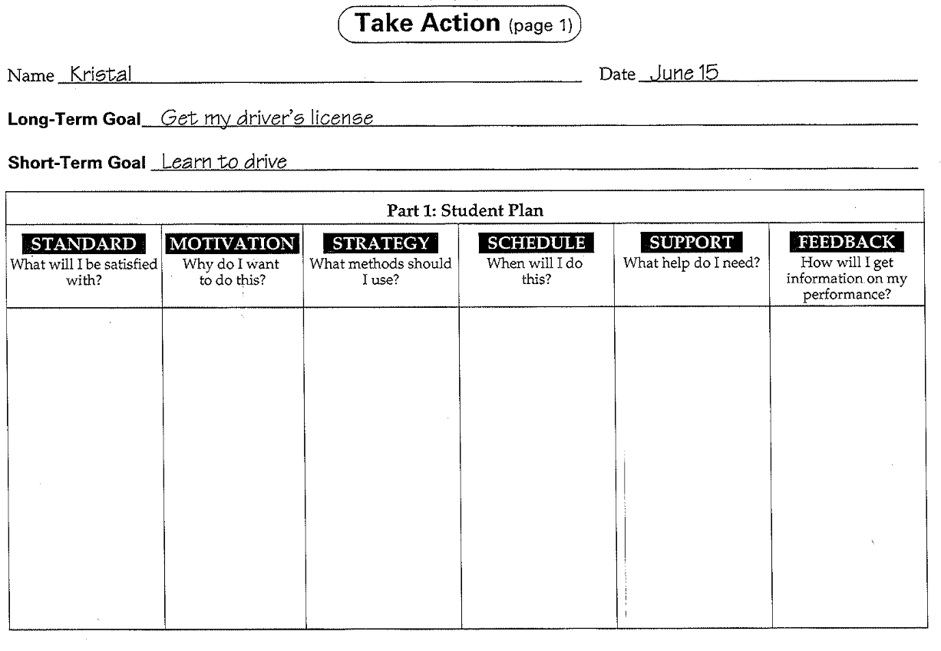
Short-Term Goal Plan

Slide 11
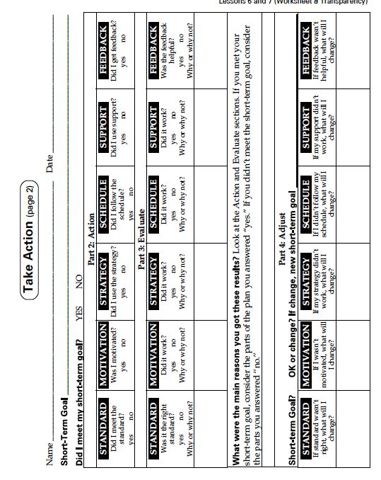
Evaluate and Adjust Plan

Slide 12
German et al., 2000 Study
Study with 6 high school students with moderate mental retardation used the modified version of Take Action to learn to attain their daily IEP goals.
Notes:
Martin

Slide 13
Walden (2002)
College Students with LD acquired and generalized goal attainment skills using Take Action, but without continued use their skills decreased over time.
The Take Action process must be used to be remembered!
Notes:
Martin

Slide 14
Students - Walden (2002)
Students in four 8th grade middle school English classes
101 students completed the study:
Number in General Ed: 81
Number in Gifted Ed: 14
Number with an IEP: 4
Number with 504 plan: 2
Notes:
Martin

Slide 15
Growth Percentage by Program, Walden (2002)
Notes:
Martin

Slide 16
Growth Percentage and Gender, Walden (2002)
Notes:
Martin

Slide 17
AT-SD Study
Self-determination instruction
Take Action
Transition goals
Procedures
Check-ins
Notes:
Jodie

Slide 18
Teacher Role
Direct student through the process
Remind student of plans that did not work
Make suggestions
Hold students accountable
Notes:
Jodie

Slide 19
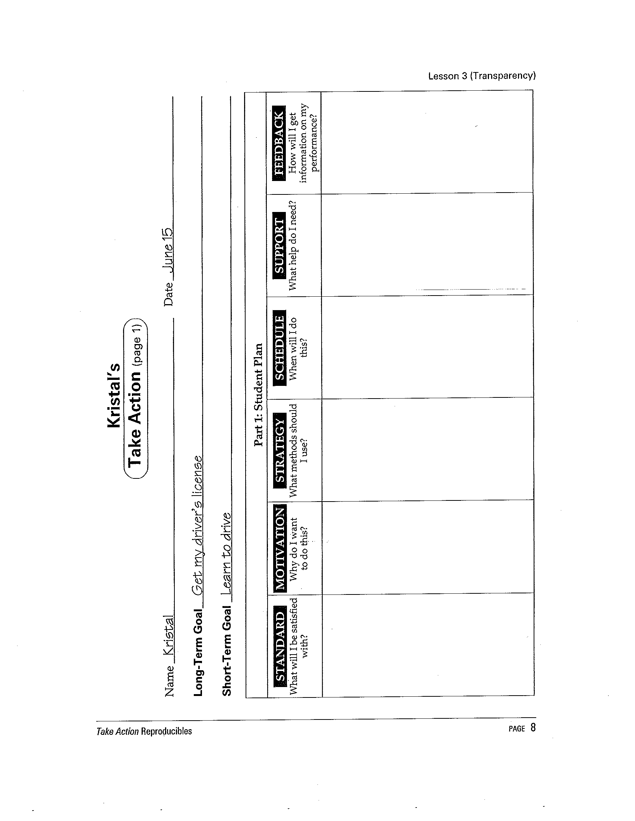
Take Action Major Steps: Plan
Establish standards
Determine how to get feedback
Identify motivation to attain goal
Select strategies, support and schedule
Get her drivers license by the time school starts
To be able to drive herself places not not be picked up by her mother and brothers
Practice driving
4:00-5:00 Wednesday and Thursday
A friend who can drive
What her passenger says about her driving
Notes:
Jodie

Slide 20
Take Action Major Steps: Action
Check each plan part for action
Get her drivers license by the time school starts
To be able to drive herself places not not be picked up by her mother and brothers
Practice driving
4:00-5:00 Wednesday and Thursday
A friend who can drive
What her passenger says about her driving
Notes:
Jodie

Slide 21
Take Action Major Steps: Evaluate
Understand why action was or was not taken
I really want my driver’s license before school starts.
I really need to practice!
I had to wait until my friend was ready.
She didn’t say anything and made me laugh.
My friend didn’t give me any!
Notes:
Jodie

Slide 22
Take Action Major Steps: Adjust
Propose changes to actions that did not work
I really want my driver’s license before school starts.
I really need to practice!
I had to wait until my friend was ready.
She didn’t say anything and made me laugh.
My friend didn’t give me any!
Keep
Keep
When my mom is off work.
My mom knows what she is talking about.
Keep
Only go with my mom!
Notes:
Jodie

Slide 23
Take Action Major Steps: Adjust
Adopt suggested plan adjustments
Keep
Keep
When my mom is off work.
My mom knows what she is talking about.
Keep
Only go with my mom!
Get her drivers license by the time school starts
To be able to drive herself places not not be picked up by her mother and brothers
Practice driving
Mom’s day off, Saturday @ 4:00
Mom and only mom!
What mom tells me.
Notes:
Jodie

Slide 24
Take Action Phase I
Percent of components adjusted
Notes:
Jodie

Slide 25
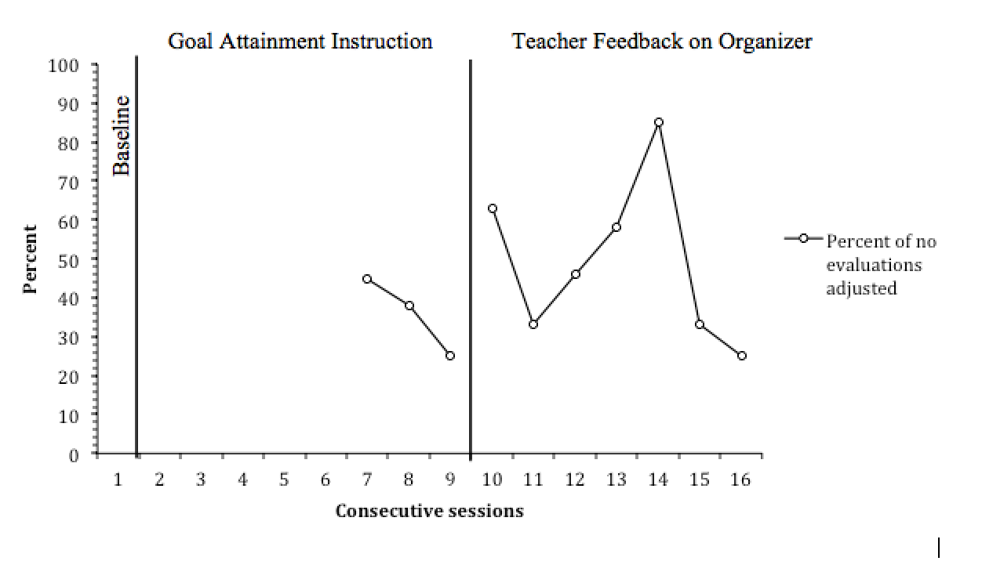
Take Action Phase I
Percent of components adjusted
Notes:
Jodie

Slide 26
Take Action Phase I
Percent of components adjusted
Motivation
Students stated they were motivated whether they did or did not attain their goals
Notes:
Jodie

Slide 27
Take Action Phase I
Percent of components adjusted
Motivation
Students stated they were motivated whether they did or did not attain their goals
Number of components used
Notes:
Jodie

Slide 28
Take Action Phase I
Number of components used
Notes:
Jodie

Slide 29
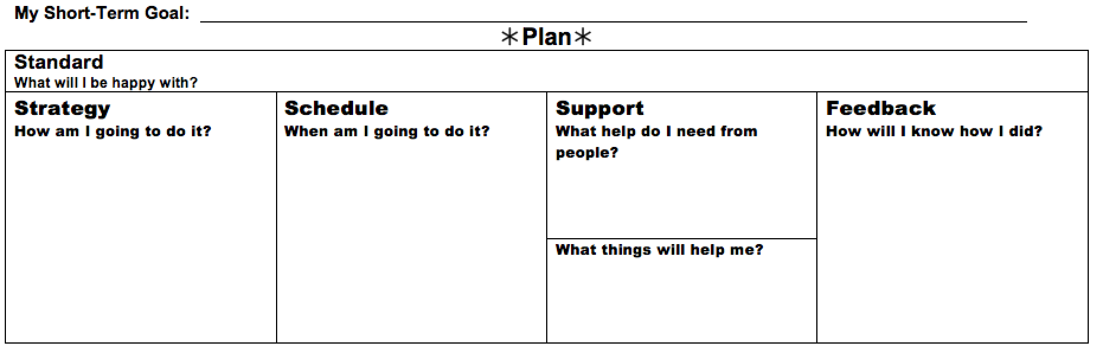
Revisions to Take Action
Operationalization of Components
What can I do in one day to get me to my goal?
How much will I do?
What will someone see me doing?
Day and time I will act.
Who/role?
What can I show someone?
What things?
Notes:
Jodie

Slide 30
Revisions to Take Action
Addition of Reminder
Reminder
How will I remember?
Notes:
Jodie

Slide 31
Revisions to Take Action
Operationalization of Components
Pick up job applications
2 applications
Tuesday @ 4:00
Ride my bike
Brother to suggest places
Bring applications to school
Reminder
How will I remember?
List of places to go
Set my iPod
Notes:
Jodie

Slide 32
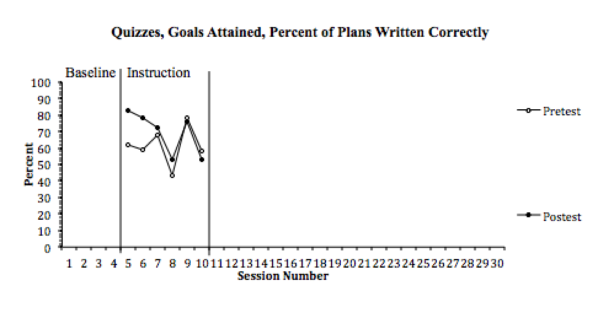
Take Action Phase II
Content Mastery
Notes:
Jodie

Slide 33
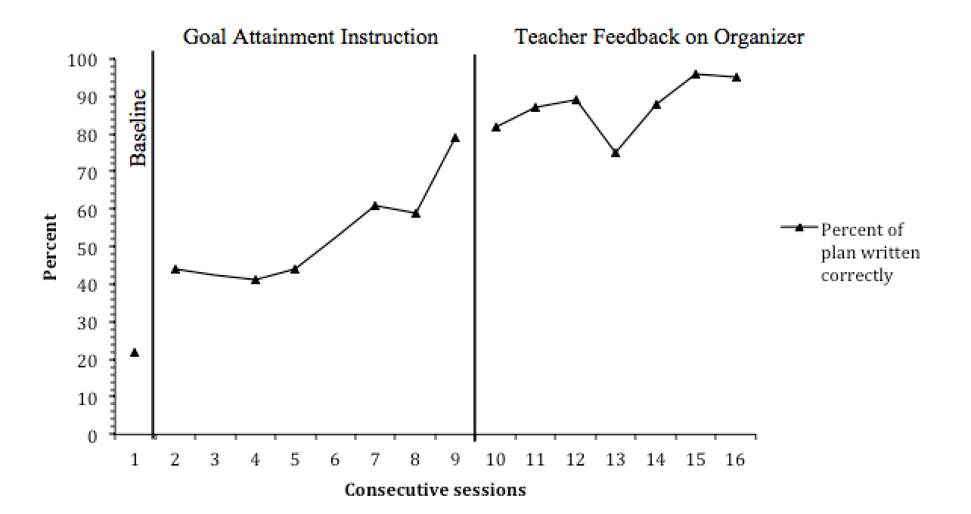
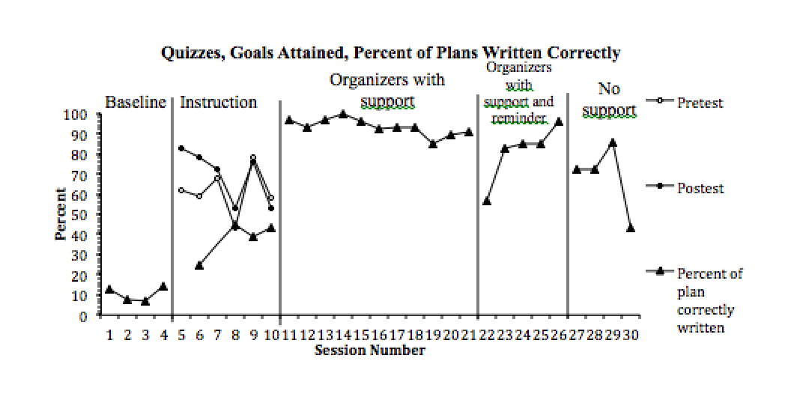
Take Action Phase II
Correctness of Plans
Phase I
Phase II
Notes:
Jodie

Slide 34
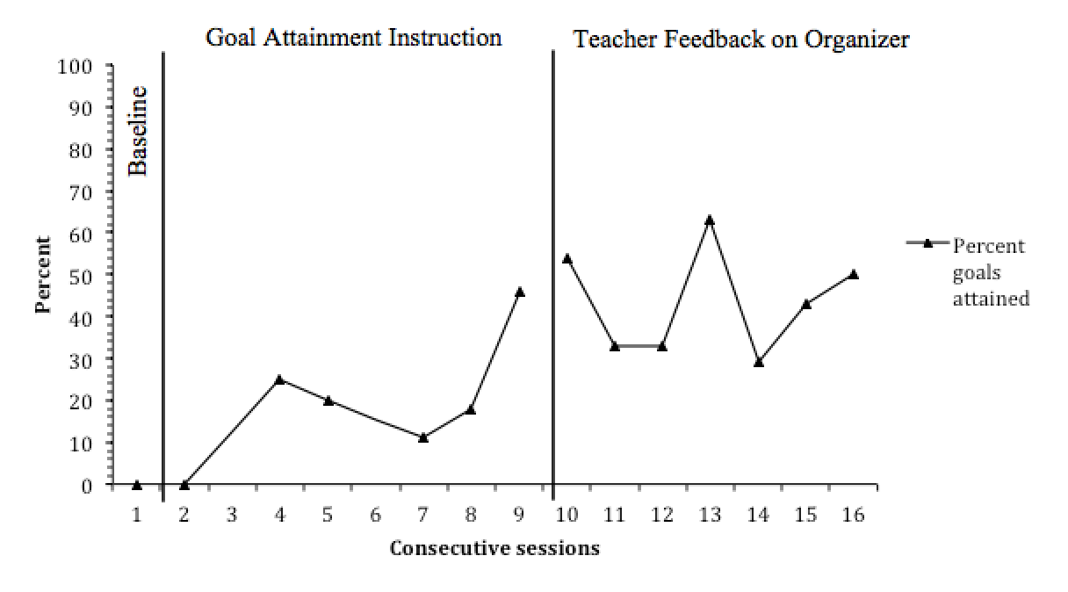
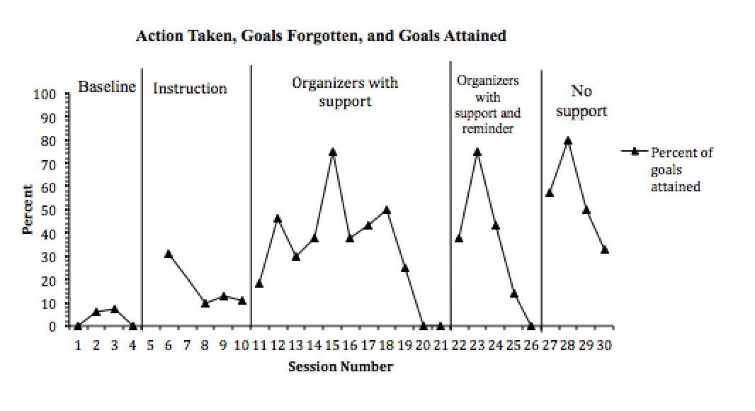
Take Action Phase II
Short-term Goals Attained
Phase I
Phase II
Notes:
Jodie

Slide 35
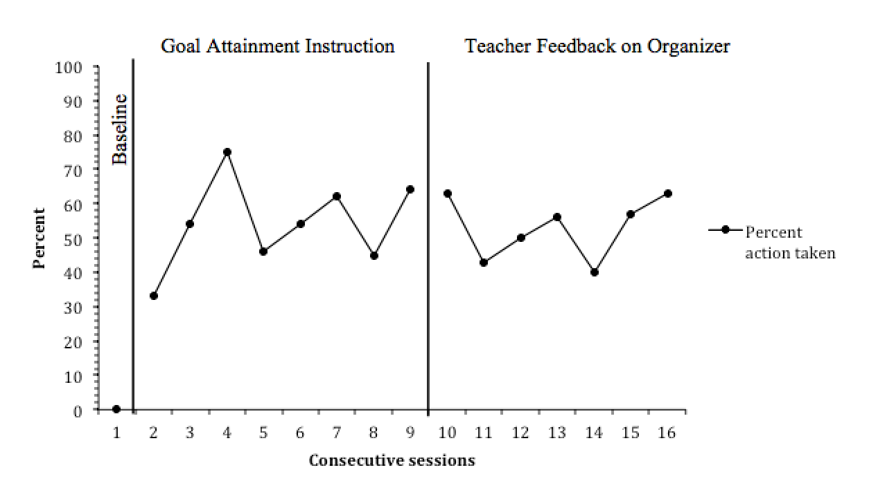
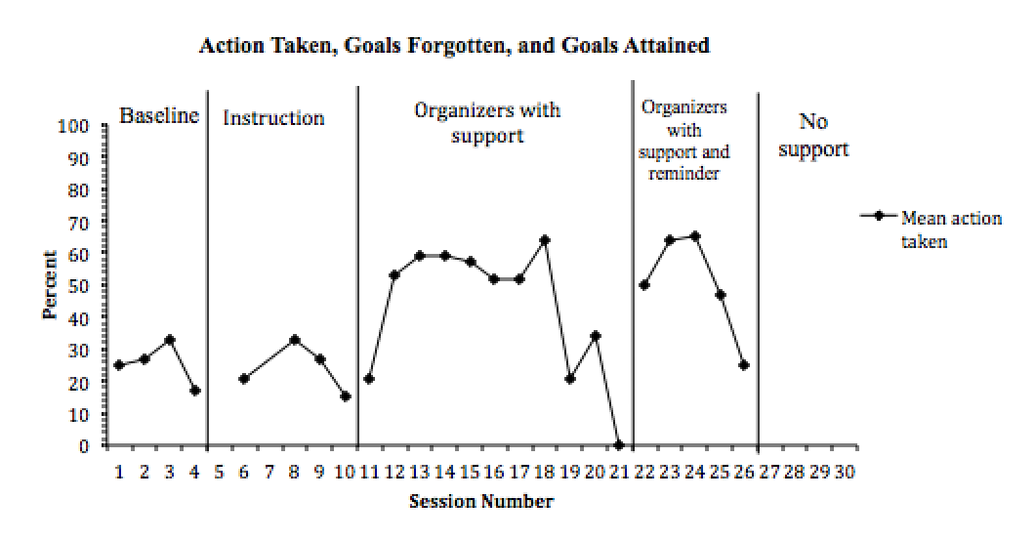
Take Action Phase II
Action Taken
Phase I
Phase II
Notes:
Jodie

Slide 36
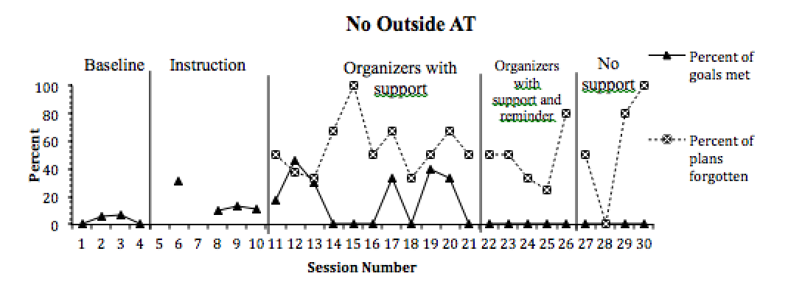
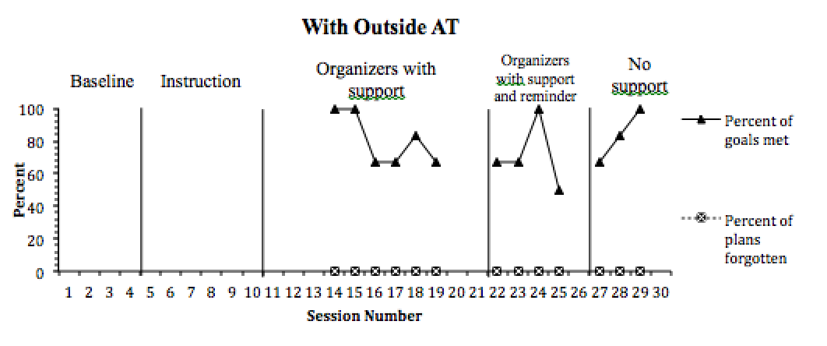
Take Action Phase II
Outside AT
Notes:
Jodie

Slide 37
Conclusion
Students want a mentor to help them make their plans
Set short-term goals often
When students had better plans, they did not need to increase their action to attain their goals
With a reminder, students will act on their goals
Notes:
Jodie

