Slide 1
Educator or Student-Directed IEP Meetings: The Choice is Yours
James Martin, Ph.D.
Zarrow Professor of Educational Psychology
University of Oklahoma
Zarrow Center
338 Cate Center Dr, Rm 190
Norman, OK 73019
405-325-8951
jemartin@ou.edu
zarrowcenter.ou.edu

Slide 2
Agenda
Transition education and student-focused planning concepts
Building the Self-Directed IEP as an effective practice
Self-Directed IEP Lessons

Slide 3
Transition-focused education Transition-focused education Transition-focused education
Transition-focused education Transition-focused education Transition-focused education
Student-focused
planning
Student
Development
Family Involvement
Interagency
Collaboration
Program
Structures

Slide 4
Seven Transition Steps
Students become involved in IEP Planning Process
Students complete a three-part transition assessment process.
Students write present level of academic achievement and functional performance
Students develop course of study
Students develop postschool linkages
Students work on attaining IEP and personal goals
Students build a Student-Directed Summary of Performance

Slide 5
Step 1: Involve Student in IEP Planning Process
Teach students to become active participants in own IEP meeting
  Learn terms and process
  Students write script of what to say and when
  Practice
  Provide opportunities for students to speak at IEP meetings
Involve and educate IEP Team in facilitating student involvement

Slide 6
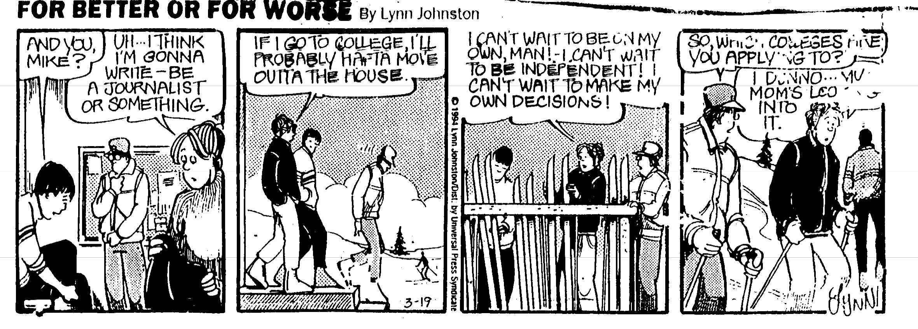
The Reason Why

Slide 7
Invitation Does Not Equal Participation
We are mandated to invite students to attend their IEP meetings when transition issues are discussed. This invitation does not guarantee meaningful student involvement in the meeting, nor does it equal meeting participation on behalf of the student.

Slide 8
Tokenism
The practice of making only a symbolic effort at something, especially in order to meet the minimum requirements of the law.
Tokenism is rampant in secondary transition planning
  Rampant: happening in an unrestrained manner
  Growing strongly or spreading uncontrollably

Slide 9

Token Member of IEP Team
Students are the token member of transition IEP teams
Invitation to be present does not provide opportunity for equal participation or decision making

Slide 10

Study of Educator-Directed IEP Meetings
3-year study of IEP meetings
Almost 1,700 IEP team members across 393 IEP meetings
389 IEP meetings over three years
    Martin, J. E., Huber Marshall, L., & Sale, P. (2004). A 3-year study of middle, junior high, and high school IEP meetings. Exceptional Children, 70, 285-297.

Slide 11
Test Your Educator-Directed IEP Knowledge
what you think you know may not be fact - but then again it may…

Slide 12
Answer This Question
What two people did not know the reason for the IEP meeting?

Slide 13
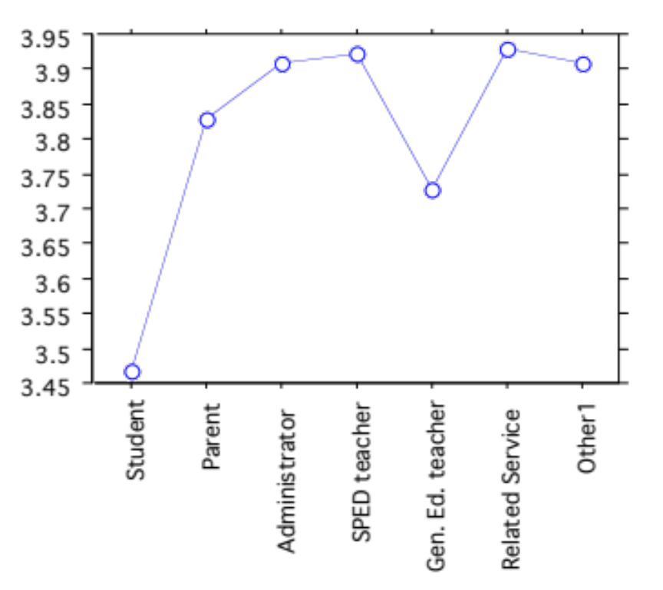
I Knew the Reason for Meeting
Students knew the reason for IEP meeting less than all other participants.
General educators knew the reasons for the meeting less than everyone except the student

Slide 14
Answer This Question
What two people did not report that they helped make decisions at the IEP meetings?

Slide 15
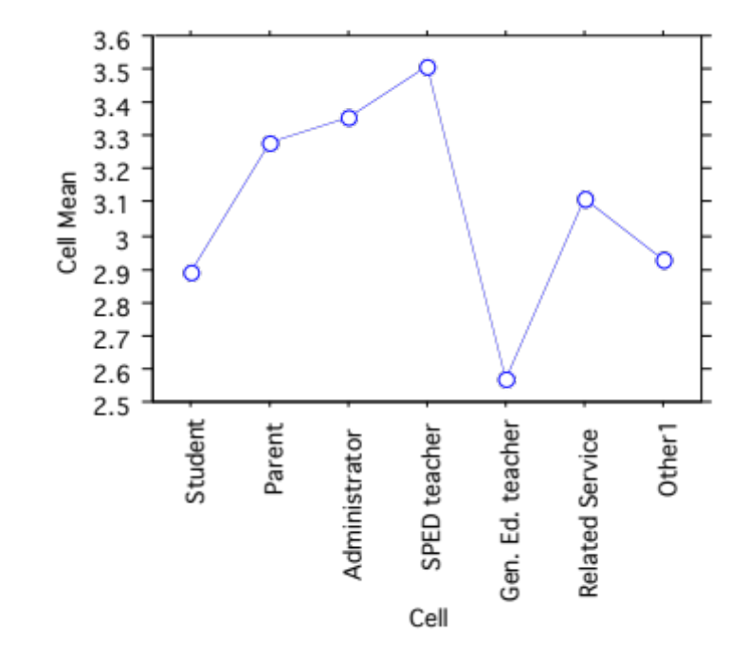
I Helped Make Decisions
Gen Education Teachers reported helping to make decisions less all other team members, followed by student.

Slide 16
More Student Findings
Students knew what to do at the meetings less than everyone else, followed by parents, and then general educators.
Students talked less than everyone & sped teachers talked the most
Students felt uncomfortable in saying what they thought more so than anyone else.
Students reported that they helped make decisions less than anyone else.
Students understood less than anyone else in what was said.
Students reported feeling less good about the meeting than anyone else.

Slide 17
When Students Attend Meeting
Parents knew the reason for the meeting and understood what was going on
Special educators talked less
Parents, gen ed, and related services felt more comfortable saying what they thought
Administrators talked more about students strengths and interests
Parents and gen ed knew more of what to do next
Gen Ed felt better when students attended

Slide 18

Field Initiated Research Grant
Year 1
  Observe meetings to determine who talks
  Survey after meetings with expanded survey
  Qualitative Study
Year 2
  Self-Directed IEP Intervention
Year 3
  Self-Directed IEP
  Team Training to facilitate student participation

Slide 19
Baseline Study Details
109 secondary IEP meetings
  50 middle school meetings (9 schools)
  59 high school meetings (7 schools)
Students attended 84 of the 109 meetings (77% of the meetings)
50.4% of meetings stand alone
  49.6% back-to-back
68% boys (n=74) and 32% girls(n=35)

Slide 20
Answer This Question
What percent of time did the following people talk?
  Sped teacher
  General ed teacher
  Administrator
  Parent
  Student

Slide 21
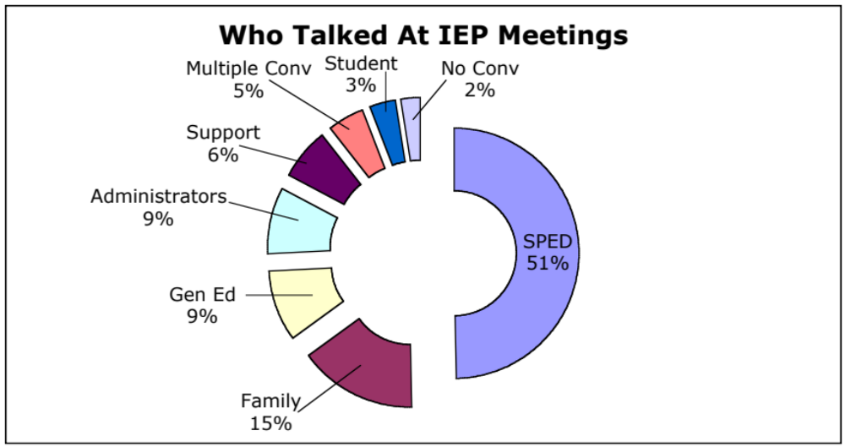
Direct Observations of IEP Meetings
    Martin, J. E., Van Dycke, J. L., Greene, B. A., Gardner, J. E., Christensen, W. R., Woods, L. L., & Lovett, D. L. (2006). Direct observation of teacher-directed IEP meetings: Establishing the need for student IEP meeting instruction. Exceptional Children, 72, 187-200.

Slide 22
Answer This Question
What percent of IEP meetings did students do these behaviors?
  Introduce everyone and self?
  State purpose of meeting?
  Review past goals?
  Express interests?

Slide 23
Teacher-Directed Meetings
Yes (%) | No (%) | Leadership Steps
3.5 | 96.5 | Student introduced self
1.2 | 98.8 | Student introduced IEP team members
0.0 | 100 | Student stated purpose of the meeting
2.4 | 97.6 | Student reviewed past goals and progress
0 | 100 | Student asked for feedback
6.0 | 94.0 | Student asked questions if didn’t understand
5.9 | 94.1 | Student dealt with differences in opinion
4.7 | 95.3 | Student stated needed support
49.4 | 50.6 | Student expressed interests
20 | 80 | Student expressed skills and limits
27.1 | 72.9 | Student expressed options and goals
0 | 100 | Student Closed meeting by thanking everyone

Slide 24
Oklahoma Self-Directed IEP Research
More Test Your Knowledge
    Martin, J. E., Van Dycke, J. L., Christensen, W. R., Greene, B. A., Gardner, J. E., & Lovett, D. L. (2006) Increasing student participation in IEP meetings: Establishing the Self-Directed IEP as an evidenced-based practice. Exceptional Children, 72, 299-316.

Slide 25
Design
Pre/post, control and intervention design with random assignment by individual
  65 students in control group & 65 in intervention
Groups did not differ in IQ & GPA
  GPA = t(45) = .27, p = .40
  IQ = t(41) = 1.08, p = .79
84% Caucasian, 9% African America, 4% Hispanic, 3% multicultural (mostly Native American)
Intervention group was taught IEP participation skills using the Self-Directed IEP
Teachers completed the ChoiceMaker Self-Determination Assessment

Slide 26
Observation Methodology
10-second momentary time sampling
  At the end of each interval recorded who talked and if talked about transition or other issues
  Total of 20,210 10-second intervals
  Percent agreement 3 checks mean 99%, with range from 88 to 100%.
Observed student engagement in IEP steps
Collected length of meeting
Who started meeting, who left & came in, type of meeting

Slide 27
Student-Directed: What Percent Did Team Members Talk?
Role | % of Time Talked
Special Ed Teacher
General Ed Teacher
Administrator
Family Members
Support Staff
Student
No Conversation
Multiple Conversations

Slide 28
Student-Directed: Percent Team Members Talked
Role | % of Time Talked
Special Ed Teacher | 53
General Ed Teacher | 7
Administrator | 6
Family Members | 8
Support Staff | 9
Student | 13
No Conversation | 3
Multiple Conversations | 2

Slide 29
Impact of the SD-IEP on Students Talking
Students and special education teachers who used the SD-IEP talked significantly more than those in the control group.
  Student control mean = 7.94
  Student intervention mean = 21.73
  SPED control mean = 71.66
  SPED intervention mean = 88.94
Eta square of .15 indicates a large effect between the SD-IEP and students talking.

Slide 30
Student-Directed Meetings: What Percent of IEP Leadership Steps Did Students Complete?
Percent Yes | Leadership Steps
 | Student introduced self
 | Student introduced IEP team members
 | Student stated purpose of the meeting
 | Student reviewed past goals and progress
 | Student asked for feedback
 | Student asked questions if didn’t understand
 | Student dealt with differences in opinion
 | Student stated needed support
 | Student expressed interests
 | Student expressed skills and limits
 | Student expressed options and goals
 | Student closed meeting by thanking everyone

Slide 31
Student-Directed Meetings: Percent of IEP Leadership Steps Students Completed
Percent Yes | Leadership Steps
70 | Student introduced self
77 | Student introduced IEP team members
70 | Student stated purpose of the meeting
53 | Student reviewed past goals and progress
22 | Student asked for feedback
35 | Student asked questions if didn’t understand
17 | Student dealt with differences in opinion
25 | Student stated needed support
72 | Student expressed interests
43 | Student expressed skills and limits
53 | Student expressed options and goals
14 | Student closed meeting by thanking everyone

Slide 32
Student-Directed IEP Meetings
Students started 28% of their own meetings.
  χ² (1, N = 221) = 70.94, p = .000
  Phi = .57 suggests a large effect between SD-IEP and starting meeting
  1 control student and 27 intervention students
Self-Directed IEP Students led 15% of their own meetings, control students did not lead any
  χ²(1, N = 230) = 27.71, p = .0
  Phi = .35 suggests a moderate effect between the SD-IEP and leading the meeting

Slide 33
Answer This Question
How much longer do Self-Directed IEP meetings last than teacher-directed meetings?

Slide 34
Length of Student-Directed vs.
Teacher-Directed Meetings
The student directed meetings are not statistically significantly longer than teacher-directed meetings.

Slide 35
Answer This Question
Who talked most about transition?

Slide 36
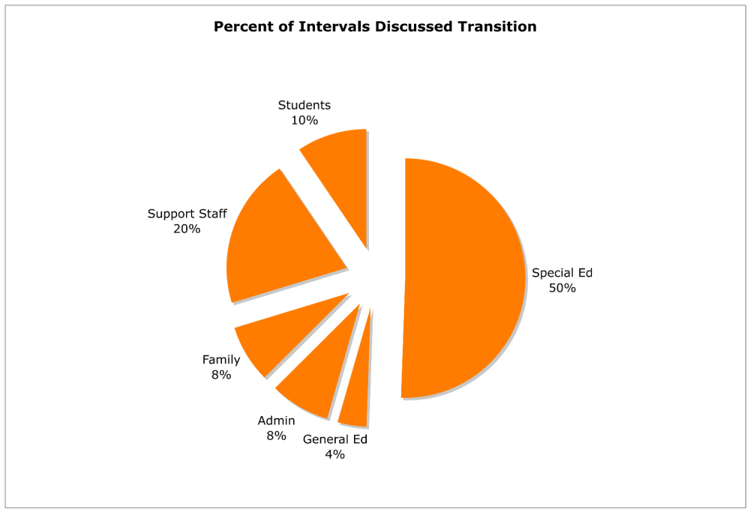

Slide 37
Teaching Students With Visual Impairments to Actively Participate in Their Secondary IEP Meetings
Pei-Fang Wu and Jim Martin
University of Oklahoma
Sharon Isbell
Oklahoma School for the Blind

Slide 38
Method
We observed 34 IEPs,14 males and 20 females.
50% with visual impairment, 32% have more than one type of disability, and 17.6% were blind.
We had 82.4% Caucasian, 8.8%African American, 5.9%Hispanic/Latino American, and 2.9% Native American

Slide 39
Participants
Students’ age range from 13 to 20 years old. 52.9% student being 17 years or younger, and 47.1% student were being 18 years or older.
58% of the participating teachers were female with average of 10 years and 7 months teaching experience. 42% of the participated teachers were male with the average of 19 years and 7 month teaching experience.

Slide 40
Research Design
We used experimental design with random assignment of student to the control and intervention groups.
All student received Self-Directed IEP instruction.
Intervention condition: Student-Directed IEP with team training
Control condition: Student-Directed IEP without team training

Slide 41
Team Training PowerPoint
Taught team members about their role in facilitating student engagement in their IEP meeting.

Slide 42
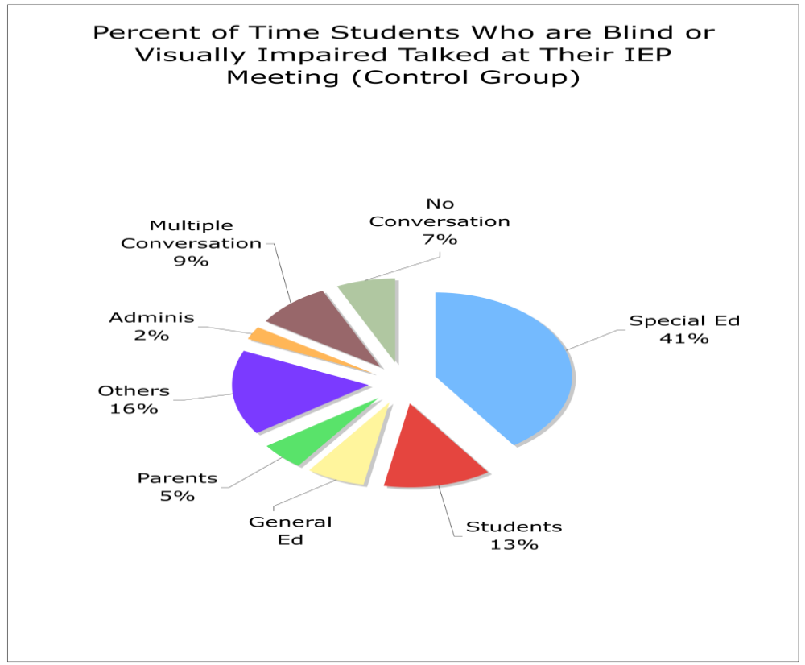

Slide 43
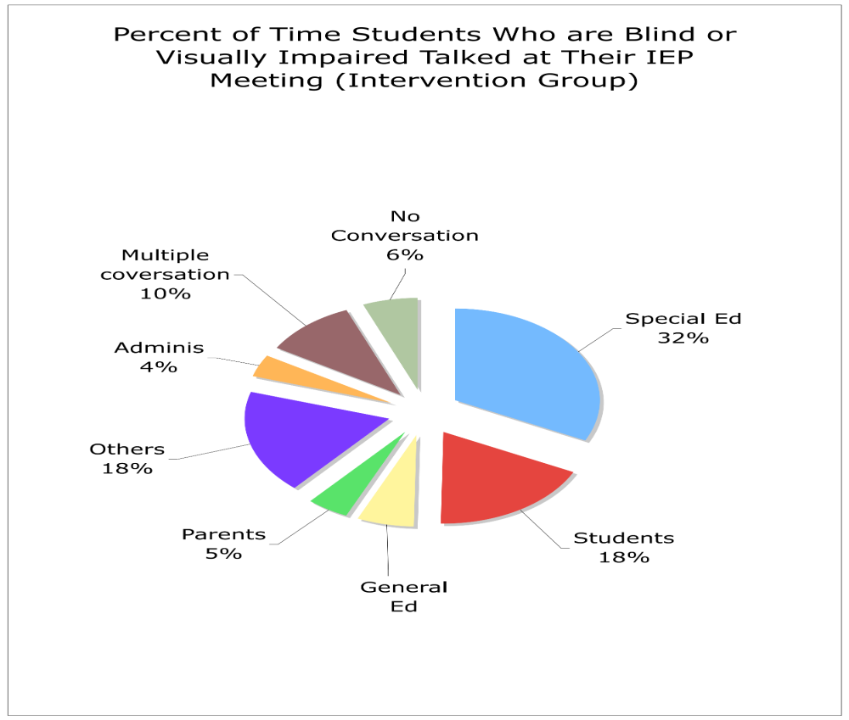

Slide 44
IEP Leadership Steps
The team training group average of
  79.44% of students did all the twelve leadership steps
  36.11% need a prompt from special education teacher.
Self-Directed IEP only group
  65.79% of the student in the control group completed 12 leadership step
  51.86% required prompt.

Slide 45
Additional Research Studies
Students learn skills to become active team members (Allen, Smith, Test, Flowers, & Wood, 2001; Snyder & Shapiro, 1997)
Students remember IEP Goals (Sweeney, M. (1996)
More students and parents attend IEP meetings ( Sweeney,1996)
Effective for students with learning disabilities, emotional problems and MR (Allen, Smith, Test, Flowers, & Wood, 2001; Snyder & Shapiro, 1997; Snyder, 2002)

Slide 46
The Sweeny Study
Control and intervention group design
Students with learning disabilities, mental retardation, and speech/language impairments
Students taught the SD-IEP learned the steps, had significantly higher levels of involvement in IEP meetings, attended more meetings, and knew significantly more of their goals after the meeting ended.
    Sweeney, M. A. (1997). The effects of self-determination training on student involvement in the IEP process. Unpublished doctoral dissertation, Florida State University, Tallahassee.

Slide 47
North Carolina Study
Allen, Smith, Test, Flowers, & Wood (2001)
Students with mental retardation led their meetings and engaged in the SD-IEP steps at their meetings after being taught the SD-IEP.
    Allen, S. K., Smith, A. C., Test, D. W., Flowers, C., & Wood, W. M. (2001). The effects of self-directed IEP on student participation in IEP meetings. Career Development for Exceptional Individuals, 24, 107-120.

Slide 48
The Snyder Studies
Snyder & Shapiro (1997) demonstrated that the SD-IEP increased IEP participation behaviors for students with emotional/behavior problems.
Snyder (2000) demonstrated that the SD-IEP increased IEP participation behaviors for students with learning disabilities.
Snyder (2002) demonstrated that the SD-IEP increased IEP participation behaviors for students dually diagnosed with mental retardation and emotional/behavior problems.
    Snyder, E. P. (2000). Examining the effects of teaching ninth grade students receiving special education
    learning supports services to conduct their own IEP meetings. Lehigh University, Bethlehem, PA.
    Snyder, E. P. (2002). Teaching students with combined behavioral disorders and mental retardation to
    lead their own IEP meetings. Behavioral Disorders, 27(4), 340-357.
    Snyder, E. P., & Shapiro, E. (1997). Teaching students with emotional/behavioral disorders the skills to
    participate in the development of their own IEPs. Behavioral Disorders, 22, 246-259.

Slide 49
Van Dycke Study
Van Dycke (2005) found that the written IEP documents of students who received SD-IEP instruction had more comprehensive postschool goal/vision statements than those who attended teacher-directed IEP meetings.
    Van Dycke, J. L. (2005). Determining the Impact of Self-Directed IEP Instruction on Secondary IEP Transition Documents. Unpublished doctoral dissertation, University of Oklahoma, Norman.

Slide 50
Self-Directed IEP
The small-n, experimental, and quasi-experimental studies demonstrate SD-IEP as an evidence-based practice.

Slide 51
Examples and Non-Examples
Teachers and parents telling team student’s interests & strengths
Teachers and parents telling team about student’s limits
Teachers and parents deciding who will attend IEP meeting
Educators being responsible for attainment of goals
Student telling team about her own interests & strengths
Student telling team about her own limits
Student inviting those who have to be there and those of her choice to the meeting.
Student attaining goals

Slide 52
IEP Participation Is a By- Product of Skills and Opportunities
Skills
Participation
Opportunity

Slide 53


Self-Directed IEP
IEP
Teaches students to become active participants of their IEP team!

Slide 54
Lesson Structure
Cumulative Review
Lesson Preview
Vocabulary Instruction
Video / Example
Sample Situations
Workbook / Written Notes
Evaluation
Relate to Personal Experience

Slide 55
Self-Directed IEP Steps
State Purpose of Meeting
Introduce Team
Review Past Goals
Ask for Feedback
State School and Transition Goals
Ask Question If Don’t Understand
Deal with Differences in Opinion
State Support Needs
Summarize Goals
Close Meeting
Work on Goals All Year

Slide 56

Stating the Purpose
STEP
Students:
Watch the Self-Directed IEP video showing the 11 steps for leading a staffing.
Discuss the purpose of a staffing.
Write the three purposes for the IEP staffing and practice stating purposes.

Slide 57
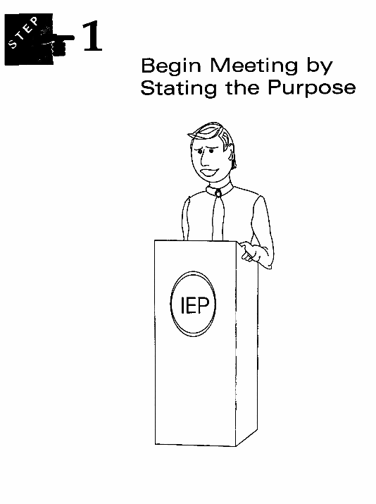
• 40 minutes
Hi, I'm Sam.
Welcome to my IEP meeting!

Slide 58

Introduce Everyone
STEP
Students:
Discuss who attended Zeke’s staffing and why they attended.
Learn who is required to attend IEP staffings.
Decide whom they will invite.
Practice introducing everyone.

Slide 59
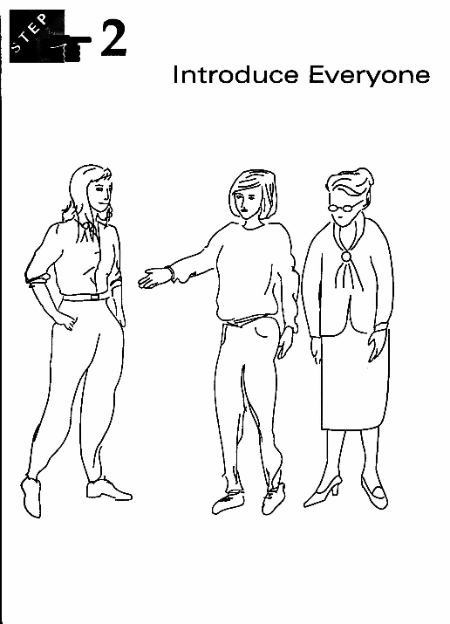
• Who comes to meeting
• Who will student invite
• Who has to be there
• Time: 30 minutes
This is my best friend Ann.

Slide 60

Review Past Goals and Performance
STEP
Students:
Review Zeke’s goals and actions.
Discuss actions they can take to accomplish two sample goals.
Review their own IEP goals.
Write actions toward each goal.
Practice saying goals and actions.

Slide 61
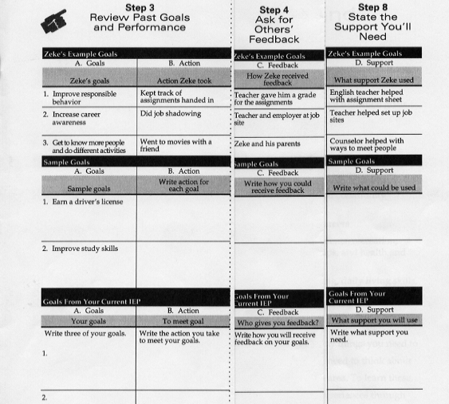

Slide 62
Develop Script
My goal is….
The action I take to meet my goal is….

Slide 63

Ask for Others’ Feedback
STEP
Students:
Discuss how Zeke received feedback.
Discuss feedback they could receive on two sample goals.
Decide how they receive feedback on each of their IEP goals.
Practice saying goals, actions, and receiving feedback.

Slide 65

State School and Transition Goals
STEP
Students:
Discuss the four transition areas.
Discuss how Zeke’s interests, skills, and limits helped him to choose goals.
Write their education interests, skills, and limits, and how they impact goals.

Slide 66

Ask Questions if You Don’t Understand
STEP
Students:
Discuss how Zeke asked a question about something he didn’t understand.
Practice ways to ask questions in an IEP meeting when they don’t understand something.

Slide 67

Deal With Differences in Opinion
STEP
Students:
Discuss how Zeke used the LUCK strategy to deal with a difference in opinion.
Learn and practice the LUCK strategy to deal with opinion differences.

Slide 68
The LUCK Strategy
L Listen to and restate the other person’s opinion.
U Use a respectful tone of voice.
C Compromise or change your opinion if necessary.
K Know and state the reasons for your opinion.

Slide 69

State the Support You’ll Need
STEP
Students:
Discuss the support Zeke will use to reach his new goals.
Discuss support they could use to accomplish two sample goals.
Decide what support they will need.
Practice stating goals, actions, feedback, and support.

Slide 71

Summarize Your Goals
STEP
Students:
Discuss the four parts to a summary and Zeke’s example.
Summarize their current goals, the actions they take, how they receive feedback, and the support they need to accomplish goals.

Slide 72
Summarize Goals
Say the goal in your own words.
Tell the action you will take to meet your goal.
Tell how you will receive feedback.
Tell what support you will need to meet your goal.

Slide 73

Close Meeting by Thanking Everyone
STEP
Students:
Read and discuss Zeke’s example for closing the meeting by thanking everyone.
Write a closing for their staffing, thanking everyone for participating in the IEP meeting.

Slide 74
Work on IEP Goals All Year
STEP
Students:
Complete the “Student Staffing Script” to prepare for their staffings.
Practice all the steps by role-playing their own staffings.

Slide 75
More IEP Teaching Materials
Self-Advocacy Strategy
  Edge Enterprise
  P.O. Box 1304
  Lawrence, KS 66044
NEXT S.T.E.P.
  PRO-Ed
  8700 Shoal Creek Blvd
  Austin, TX 78757
  www.proedinc.com

Slide 76

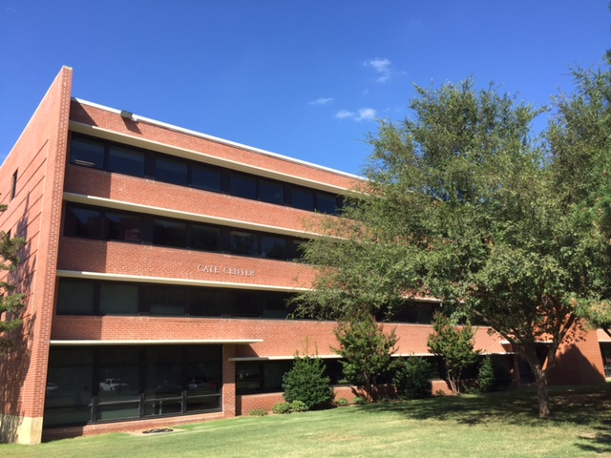
For More Information Contact
James Martin
University of Oklahoma
Zarrow Center for Learning Enrichment
338 Cate Center Dr, Rm 190
Norman, OK 73019
Phone: 405-325-8951
E-mail: jemartin@ou.edu
Zarrowcenter.ou.edu

