Slide 1

HDC PRESENTATION ON THE SDM (CYCLE BEADS)
PRESENTER
ABDIAZIZ

Slide 2
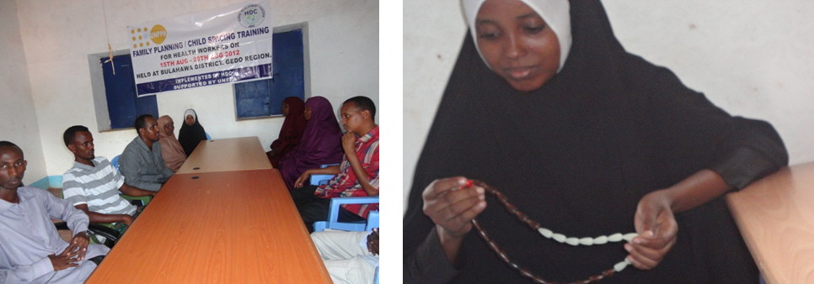
The Standard Days Method and Cycle Beads A Simple Fertility Awareness-based Approach to Birth spacing Program Piloted Gedo region supported UNFPA

Slide 3
Presentation Overview
What is the SDM?
Reason for choosing Cycle beads (SDM)
? achievements short Program of Cycle beads in Gedo region
Lessons Learned
Recommendation
Challenges

Slide 4
What is the Standard Days Method?
Is a method that:
involves both partners
doesn’t require costly imported commodities
offers opportunities

Slide 5

How does the SDM work?
Helps a couple avoid unplanned pregnancy by knowing which days they should not have unprotected intercourse.
Identifies days 8-19 of the cycle as fertile
Is appropriate for women with menstrual cycles 26-32 days long.
Uses a color-coded string of beads–
Cycle Beads® – to help women keep track of their cycle days and know when they are fertile.

Slide 7
Who can use the SDM?
Women who usually have cycles between 26 and 32 days long.
Couples who can avoid unprotected sex during the woman’s fertile day

Slide 8
Reason for choosing SDM
Doesn’t affect health
No side effects
Economical
Easy to learn/use
Acceptable Somalia community

Slide 9
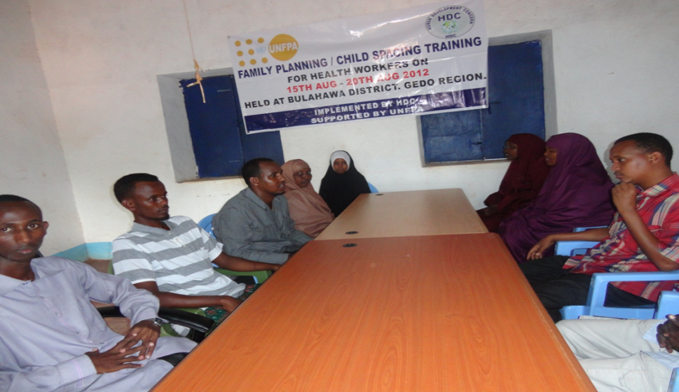
Achievements
10 health staff trained on standard days methods scientifically and practical.
10 trained staff representing 3 districts of Gedo (BULAHAW, BARDERA and Dollow)
All women attended ANC at Bullahawa MCH introduced uses of cycle beads and its’ advantages
Staff trained

Slide 10
Lesson learned short period time
Health provider improved and understood knowledge's of SDM with 5 days.
Cycle beads can even perform by the different provider.
Cycle beads even can be taught in clinic and community setting.
Women learn to use the SDM a 20 minutes session
Women received SDM highly accepted including services provider.
SDM is method accepted religious leaders and entire community.
High demands of Clients introduced before in Bulahwa MCH.

Slide 11
Recommendation
To allocate more resource to Expands coverage area
Empowers more women
Empower men to involves effectiveness of SDM programme
To train more staff and more women to effectively increase coverage of birth spacing
To supply Cycle beads
»

Slide 12
Challenges
Limited fund
Limited commodity

Slide 13
The Standard Days Method does not protect against sexually transmitted infections (STIs) or HIV/AIDS

Slide 14

WAAD MAHADSANTIHIIN

