Slide 1
C# / .NET
Lukáš Kubíček
lukaskubicek@gmail.com
Vakutech.cz

Slide 2
Proč .NET
C# + Visual Studio = produktivní prostředí
Velká komunita (hledání)
Aktivně vyvíjený, moderní trendy
Multiplatformní
Rychlý
https://dot.net
https://docs.microsoft.com

Slide 3
Kde hledat pomoc
Vše se vyvíjí, syntaxe se mění
STACKOVERFLOW
DOCS.MICROSOFT.COM – ASP.NET CORE

Slide 4
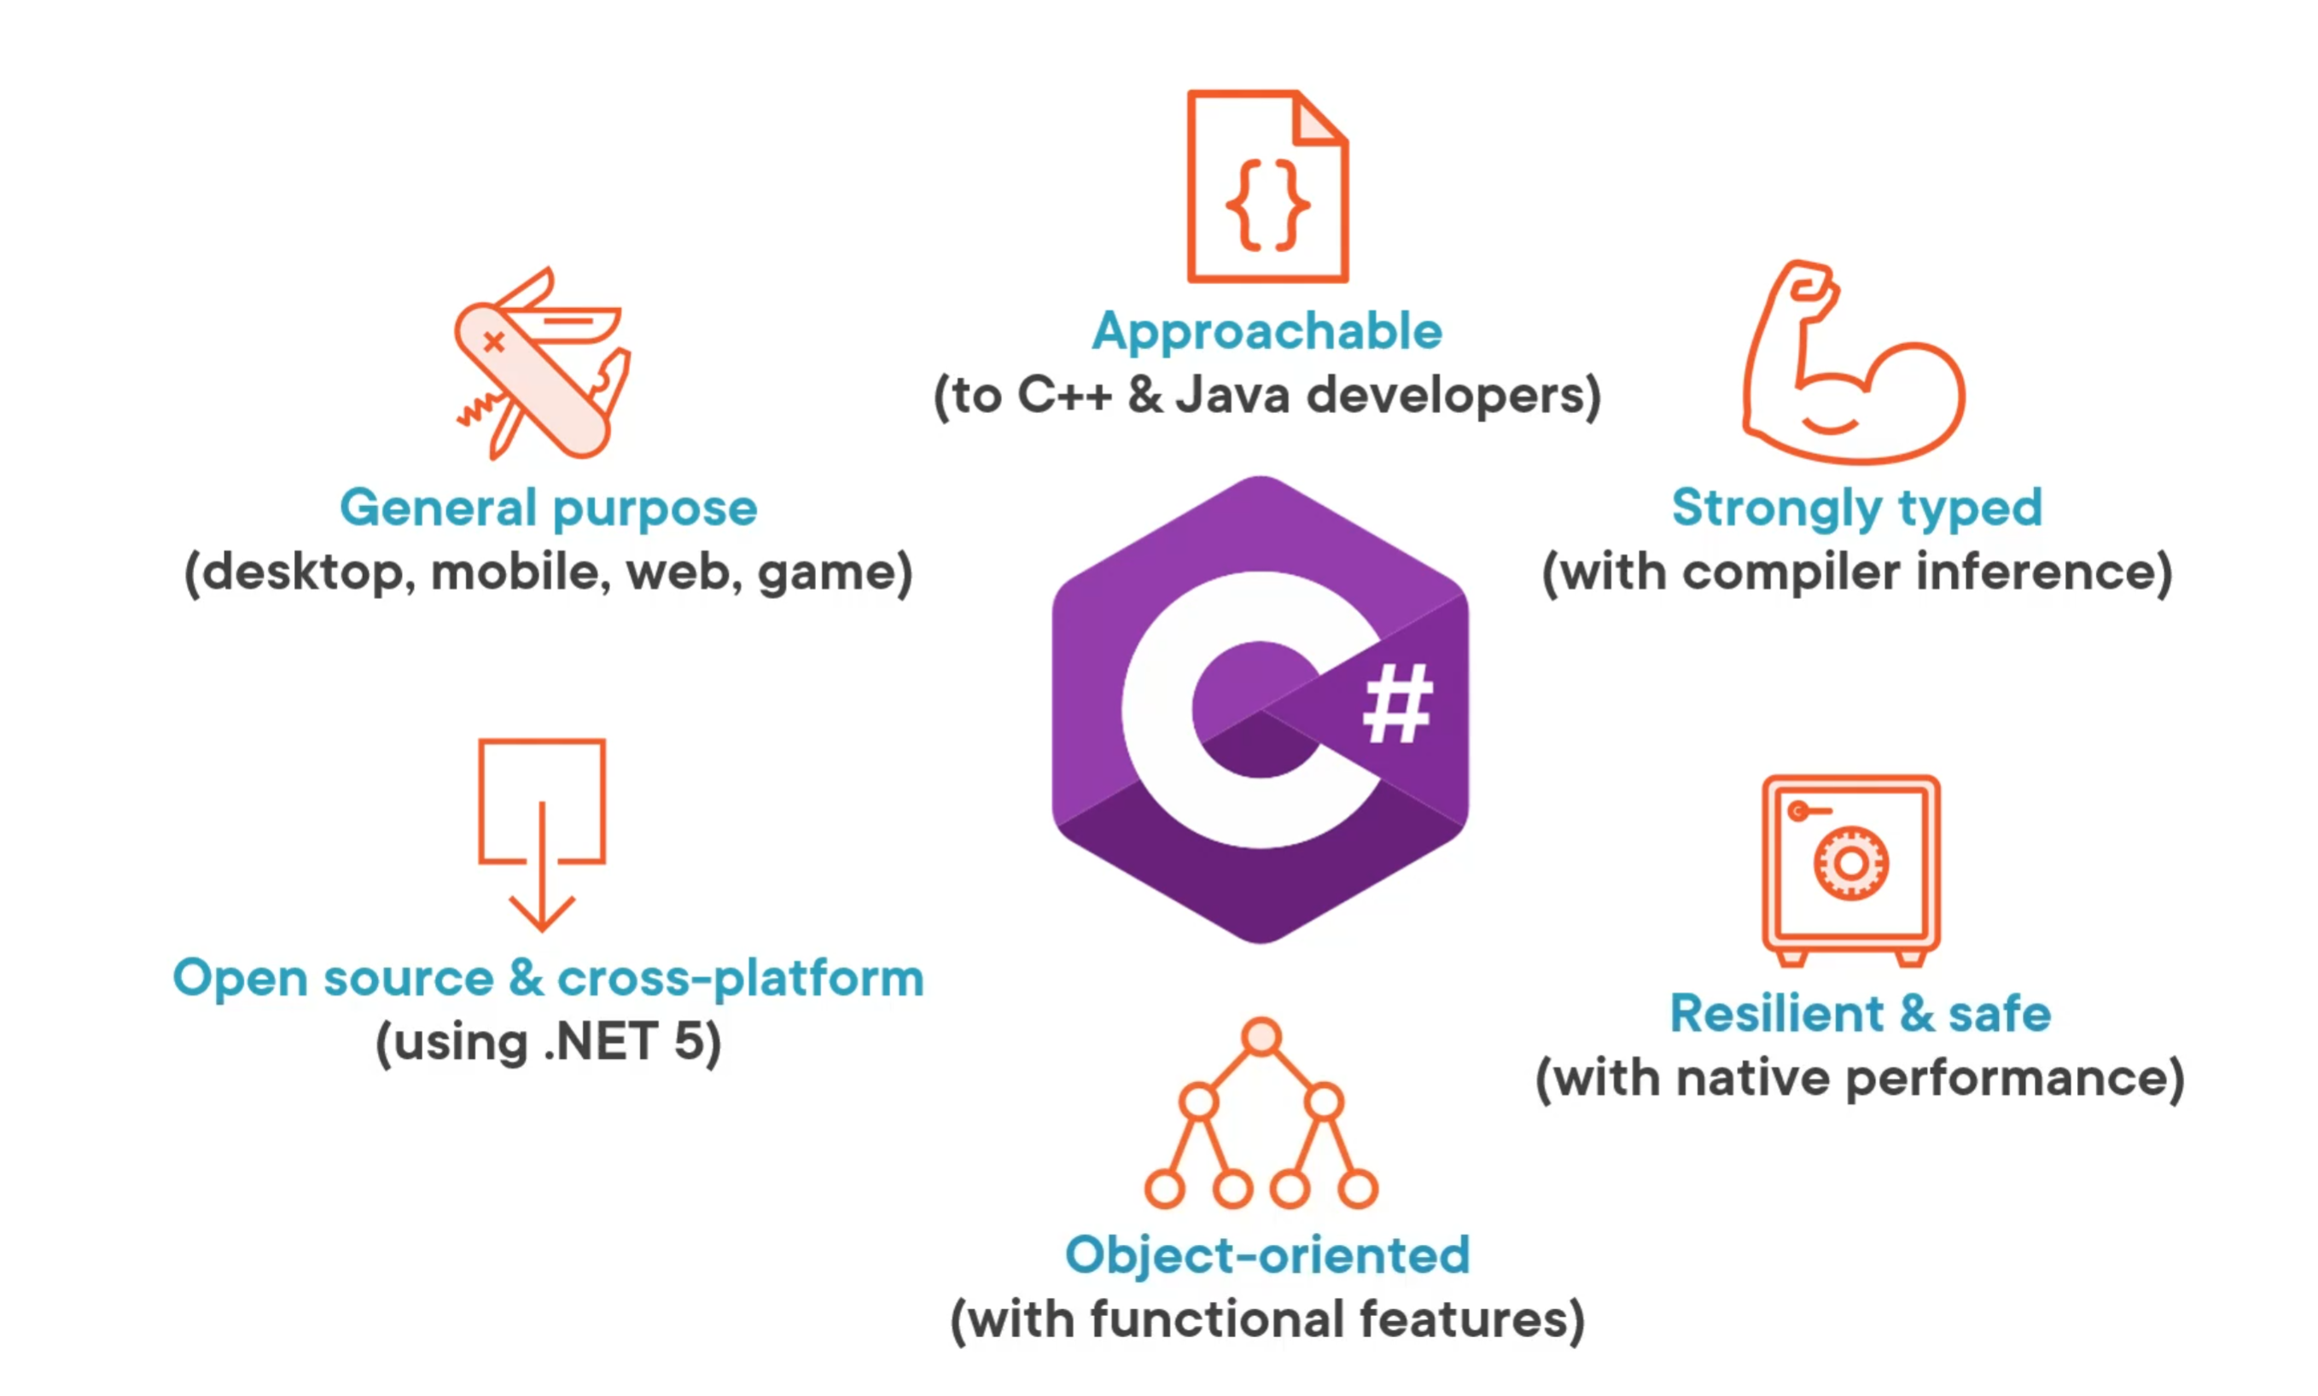
C#

Slide 5
C#
general-purpose
multi-paradigm imperative, declarative, functional
strong typing (explicit, implicit)
generic
object-oriented (class-based)

Slide 6
C#
Desktopové a systémové aplikace (GUI, Console, Služba)
Serverové aplikace (asp.net, MVC, API,..)
Embedded
Cloud – Azure
Scripts (LINQPad)

Slide 7
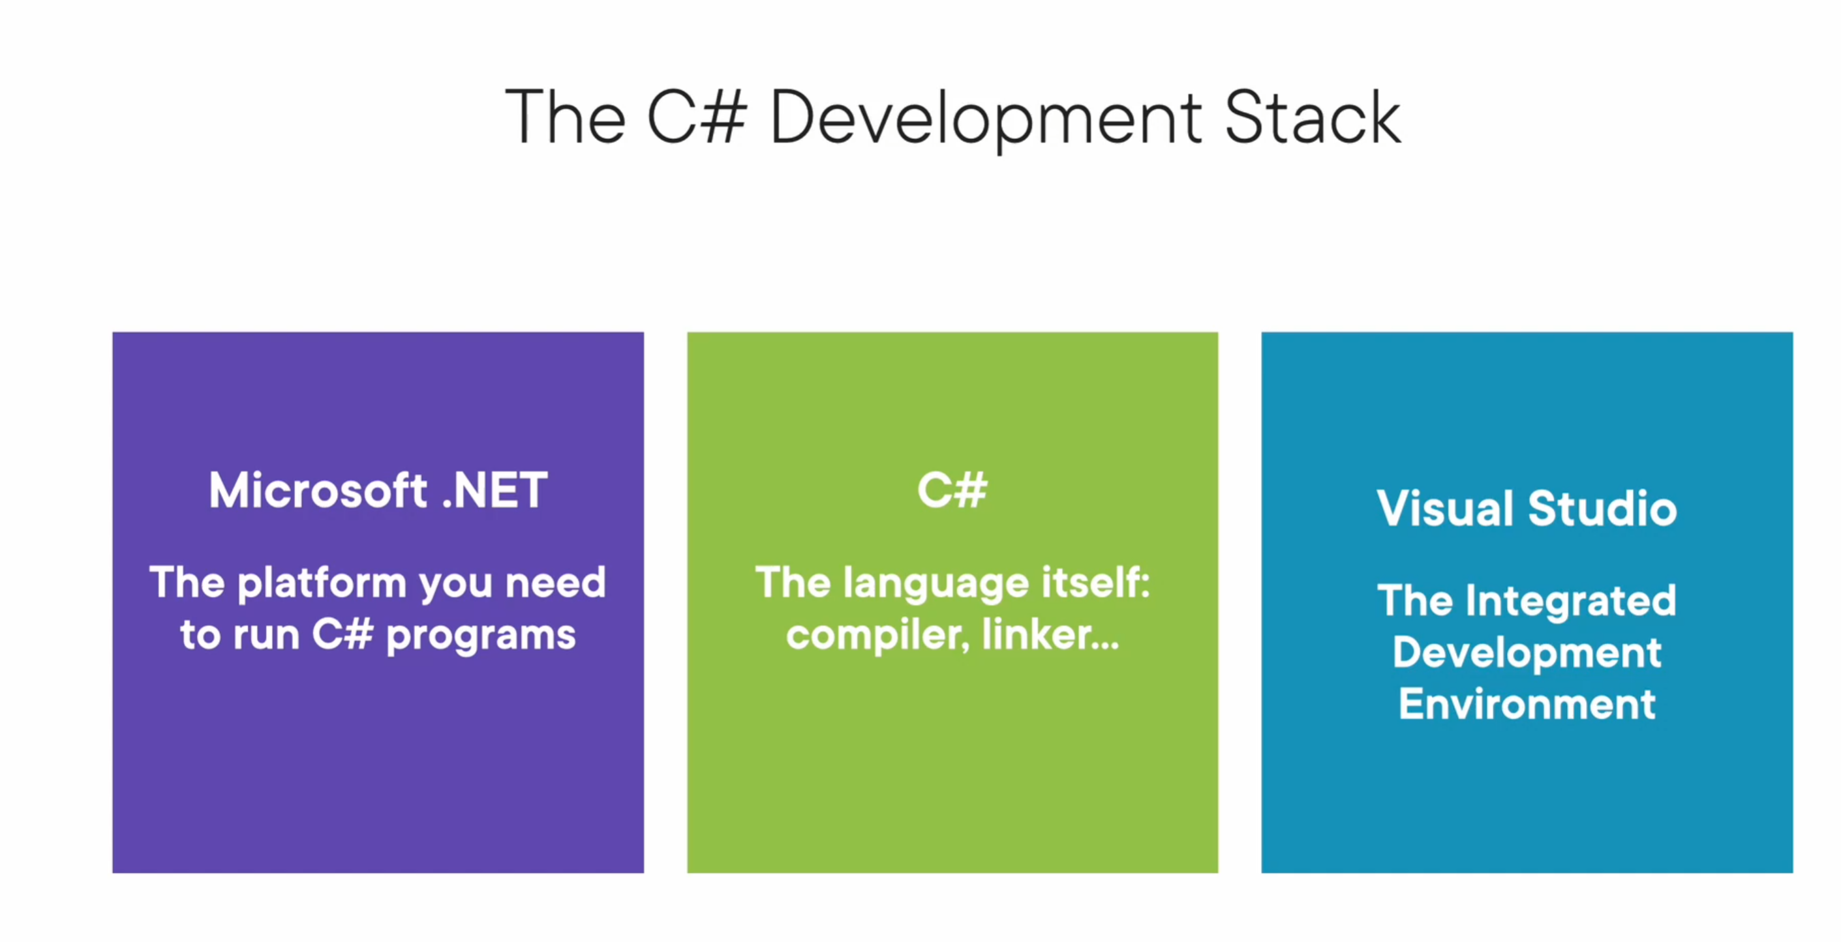
C#

Slide 8
.NET
CLR
Framework Class Library
Languages C# / F# / VB

Slide 9
.NET CLR
.NET Framework includes the Common Language Runtime (CLR). It serves as the execution engine of .NET Framework and offers many services such as memory management, type safety, exception handling, garbage collection, security and thread management. All programs written for .NET Framework are executed by the CLR.

Slide 10
.NET Core
.NET vs .NET Core
.NET 5
multiplatformní

Slide 11
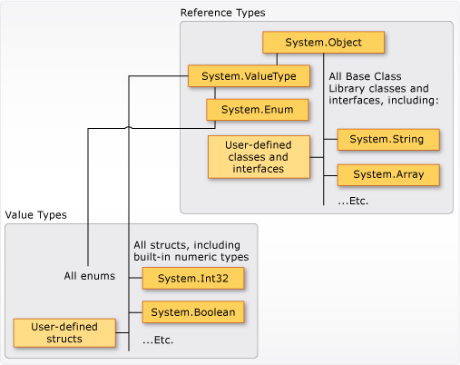
C# - vše je objekt

Slide 12
A tour of the C# language
https://docs.microsoft.com/en-us/dotnet/csharp/tour-of-csharp/
.NET architecture Types and variables
Program structure

Slide 13
C# - Building blocks
https://docs.microsoft.com/en-us/dotnet/csharp/tour-of-csharp/program-building-blocks
Class Members
Accessibility
Fields
Methods
Parameters
Static and instance methods
Virtual, override, and abstract methods
Method overloading
Constructors
Properties
Indexers
Events
Operators
Expressions
Statements

Slide 14
Stataické vs instance
Int, float, double,..
String
DateTime
File
Convert
Console

Slide 15
Kolekce
Arrays
Generics
IEnumerable, Icollection
List
Dictionary
HashSet
ObservableCollection

Slide 16
LINQ
Language Integrated Query
Extension Methods
Lambdas
Anonymous types
SQL, InMemory, XML,..

