Slide 1
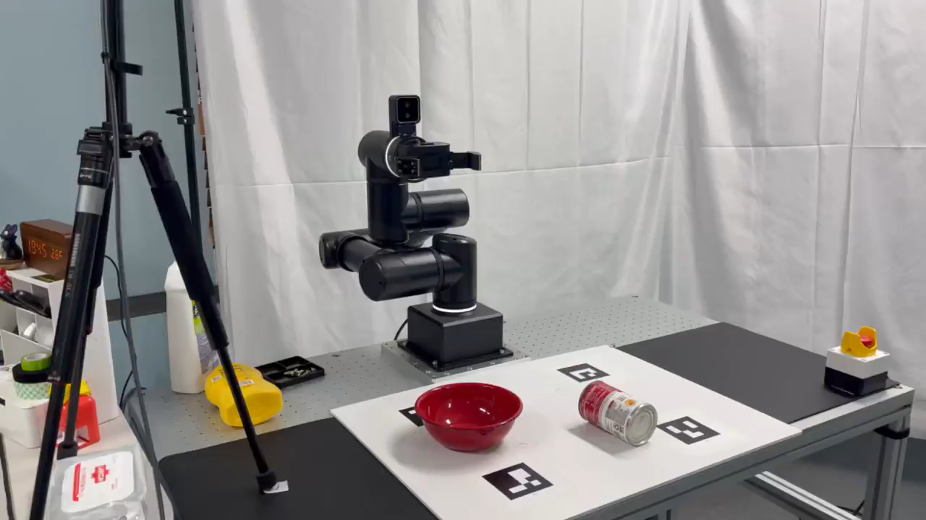
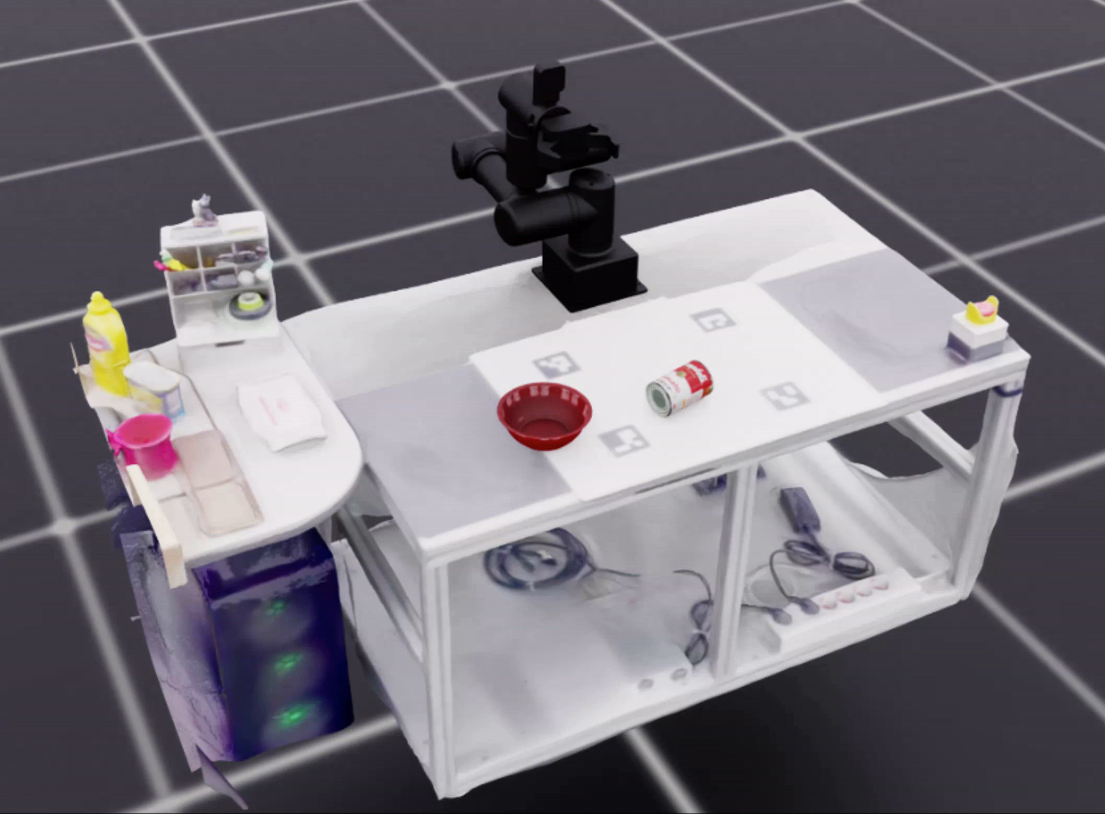

2DGS
Isaac Sim
SmolVLA in Real
Real2Sim
SmolVLA in Sim

