Slide 1
MusiX & LyriX
mobilna aplikacija za slušanje glazbe

Slide 2





jQueryMobile
PhoneGap Desktop
mongoDB
APISeeds Lyrics
jQueryMobile
PhoneGap Desktop
cross-platform mobile application development frameworks
Develop locally then instantly see changes on your connected mobile device

Slide 3
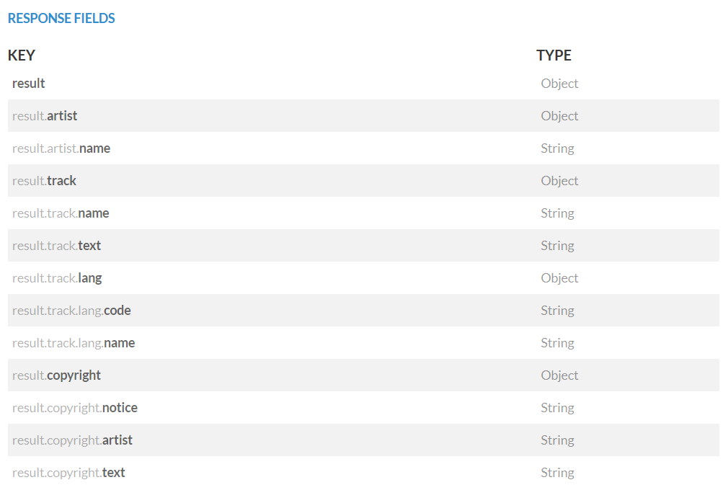
APISeeds Lyrics

Slide 4
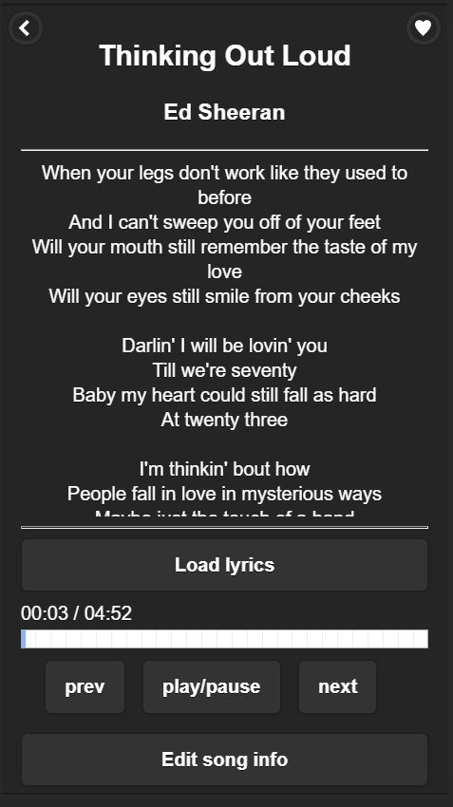
function load_lyrics_from_api() //metoda za dohvacanje teksta trenutno reproducirane pjesme
{
song_artist = document.getElementById('song_artist').innerHTML;
song_title = document.getElementById('song_title').innerHTML;
song_key = ''.concat(song_artist, song_title); if (localStorage.getItem(song_key) == null || localStorage.getItem(song_key) == '')
{
//window.alert('from API');
zahtjev = new XMLHttpRequest();
zahtjev.onreadystatechange = metoda_api;
// GET: 'https://orion.apiseeds.com/api/music/lyric/:artist/:track'
zahtjev.open('GET', ''.concat(api_url, song_artist, '/:', song_title, '?apikey=', api_key), true);
zahtjev.send();
}
else //ako u lokalnom spremniku vec postoji spremljen tekst pjesme
{
//window.alert('from local storage');
document.getElementById("lyrics").innerHTML = localStorage.getItem(song_key);
}
}
JS
function metoda_api()
{
//console.log('metoda');
if (zahtjev.readyState == 4)
{
//console.log('ready state 4');
if (zahtjev.status == 200)
{
//console.log('status 200');
odgovor = JSON.parse(zahtjev.responseText);
var t = odgovor.result.track.text;
t = t.replace(/(\r\n|\n|\r)/gm, "<br>"); //zamjena oznaka za nove redove u oznake <br> za nove redove u Html-u
document.getElementById("lyrics").innerHTML = t;
localStorage.setItem(song_key, t); //spremi u lokalni spremnik tekst na key-u: izvodac+naziv pjesme
}}
}

Slide 5
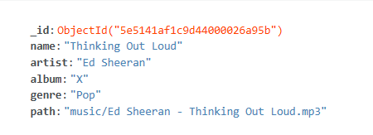
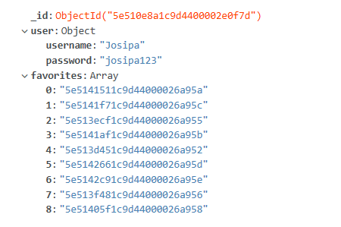
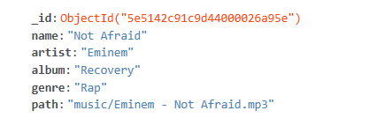
mongoDB
Tracks
Favorites

Slide 6
GET ZAHTJEV - TRACKS
JS
function load_all_from_db()
{
zahtjev_db = new XMLHttpRequest();
zahtjev_db.onreadystatechange = metoda_db;
zahtjev_db.open('GET', ''.concat('http://',IP,':4000/tracks'), true);
zahtjev_db.send();
}
function metoda_db()
{
if (zahtjev_db.readyState == 4)
{
if (zahtjev_db.status == 200)
{
odgovor_db = JSON.parse(zahtjev_db.responseText);
songs_info = odgovor_db;
addToSongsList(songs_info);
addToArtistsList(songs_info);
addToAlbumsList(songs_info);
addToGenresList(songs_info);
_audio.src = songs_info[0]['path'];
_audio.innerText = songs_info[0]['path'];
_audio.load();
}
}
}
globalna varijabla songs_info je JSON objekt sadržaja baze podataka iz tablice Tracks
ove metode prema podacima iz baze generiraju html elemente koji predstavljaju pjesme, izvođače, albume i žanrove
_audio je globalna varijabla koja sadrži audio element, iz popisa pjesama dodaje se prva putanja do audio zapisa

Slide 7
GET ZAHTJEV - FAVORITES
JS
function load_all_from_db_fav()
{
zahtjev_db_fav_get = new XMLHttpRequest();
zahtjev_db_fav_get.onreadystatechange = metoda_db_fav_get;
zahtjev_db_fav_get.open('GET', ''.concat('http://',IP,':4000/favorites'), true);
zahtjev_db_fav_get.send();
}
function metoda_db_fav_get()
{
if (zahtjev_db_fav_get.readyState == 4)
{
if (zahtjev_db_fav_get.status == 200)
{
odgovor_db_fav_get = JSON.parse(zahtjev_db_fav_get.responseText);
username = odgovor_db_fav_get[0]['user']['username'];
password = odgovor_db_fav_get[0]['user']['password'];
favorites = odgovor_db_fav_get[0]['favorites'];
songs_info.forEach(song => {
if( favorites.includes(song['_id']) == false)
{
notfavorites.push(song['_id']);
}
});
addToFavoritesList(songs_info);
addToNotFavoritesList(songs_info);
}
}
}
globalna varijabla favorites sadrži niz id-ova pjesama koje je korisnik dodao u favorite
foreach petljom prolazi se kroz popis svih pjesama i uspoređuju se sa favoritima, a one koje nisu favoriti dodaju se u globalnu varijablu notfavorites
ove metode generiraju elemente za pjesme iz popisa favorita i one koje još nisu dodane u favorite

Slide 8
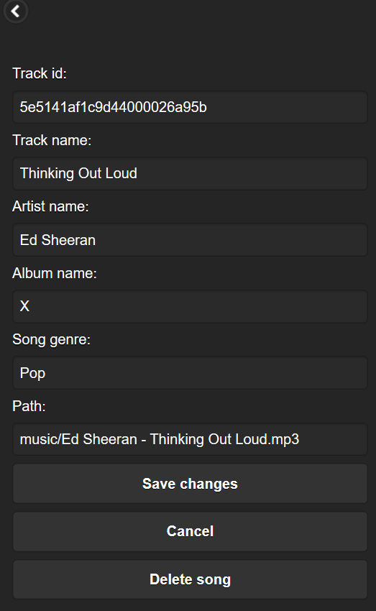
PUT ZAHTJEV - TRACKS
JS
korisnik je ažurirao podatke trenutno reproducirane pjesme čiji se id pronađe tako da se uspoređuje ‘path’ koji je spremljen u .innerText sa svim pjesmama u songs_info
function save_song_info()
{
zahtjev_db_put = new XMLHttpRequest();
for (let i = 0; i < songs_info.length; i++) {
const song = songs_info[i];
if (song['path'] == _audio.innerText) {
zahtjev_db_put.open('PUT',''.concat('http://',IP,':4000/tracks/',song['_id']), true);
}
}
var _object = { name : document.getElementById('edit_song_name').value ,
artist: document.getElementById('edit_song_artist').value,
album: document.getElementById('edit_song_album').value,
genre: document.getElementById('edit_song_genre').value,
path: document.getElementById('edit_song_path').value
};
zahtjev_db_put.onreadystatechange = metoda_db_put;
zahtjev_db_put.setRequestHeader("Content-Type", "application/json;charset=UTF-8");
zahtjev_db_put.send(JSON.stringify(_object));
}
objekt koji se sprema u bazu sadrži ažurirane informcije pjesme iz forme za unos

Slide 9
PUT ZAHTJEV - FAVORITES
JS
function save_to_fav_put()
{
zahtjev_db_fav_put = new XMLHttpRequest();
zahtjev_db_fav_put.open('PUT',''.concat('http://',IP,':4000/favorites/',odgovor_db_fav_get[0]['_id']), true);
var _object = { user : { username:'Josipa', password:'josipa123'},
favorites: favorites};
zahtjev_db_fav_put.onreadystatechange = metoda_db_fav_put;
zahtjev_db_fav_put.setRequestHeader("Content-Type", "application/json;charset=UTF-8");
zahtjev_db_fav_put.send(JSON.stringify(_object));
}
varijabla odgovor_db_fav_get sadrži niz JSON objekata dohvaćenih iz baze iz tablice Favorites, a pošto je u bazi samo jedan JSON objekt(jedan korisnik) dohvaćaju se favoriti objekta na indeksu [0]
function metoda_db_fav_put()
{
if (zahtjev_db_fav_put.readyState == 4)
{
if (zahtjev_db_fav_put.status == 200)
{
favorites = JSON.parse(zahtjev_db_fav_put.responseText)[0]['favorites'];
addToFavoritesList(songs_info);
addToNotFavoritesList(songs_info);
}
else
{
console.log(zahtjev_db_fav_put.status);
}
}
}
globalna varijabla favorites sadrži niz id-ova pjesama koje je korisnik dodao u favorite
ove metode generiraju elemente za pjesme iz popisa favorita i one koje još nisu dodane u favorite

Slide 10
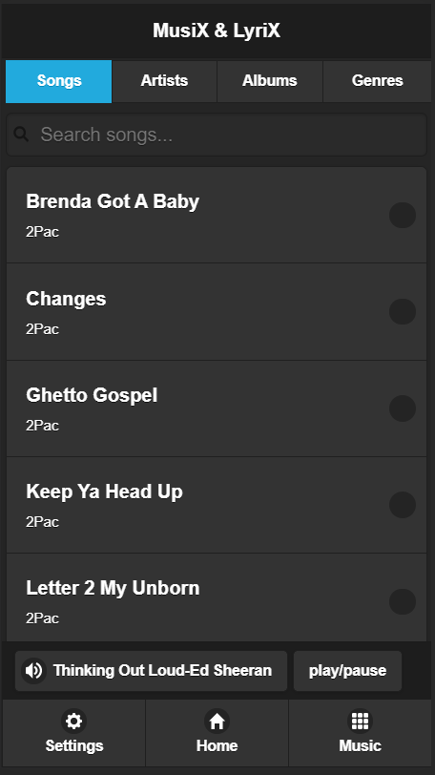
‘#ul_songs’ je id <ul> elementa kojem dodajemo <li> element za svaku pjesmu u varijabli songs_info(parametar songs)
JS
function addToSongsList(songs)
{
document.getElementById('ul_songs').innerHTML = '';
for (let i = 0; i < songs.length; i++) {
const song_info = songs[i];
if (i == 0) {
var element = '<li class="ui-first-child pjesma" data-icon="none" name="_song"><a class="ui-btn ui-btn-icon-right ui-icon-none" href="#" ><h2>' + song_info["name"] + '</h2><p>' + song_info["artist"] + '</p></a></li>';
}
else if (i == (songs.length - 1)) {
var element = '<li class="ui-last-child pjesma" data-icon="none" name="_song"><a class="ui-btn ui-btn-icon-right ui-icon-none" href="#"><h2>' + song_info["name"] + '</h2><p>' + song_info["artist"] + '</p></a></li>';
}
else
{
var element = '<li data-icon="none" class="pjesma" name="_song"><a class="ui-btn ui-btn-icon-right ui-icon-none" href="#"><h2>' + song_info["name"] + '</h2><p>' + song_info["artist"] + '</p></a></li>';
}
$("#ul_songs").append(element);
}
$('.pjesma').off();
koristeći jQuery dodaje se <li> element <ul> elementu
prije dodavanja eventListenera na elemente klase ‘pjesma’ uklanjaju se prethodni da se spriječe višestruki eventListener-i prilikom osvježavanja stranice

Slide 11
dodavanje eventListenera na elemente klase ‘pjesma’
JS
$('.pjesma').on('click', function()
{
for (let i = 0; i < songs_info.length; i++)
{
var el = songs_info[i];
if($(this).find("a").find("h2")[0].innerText == el['name'] && $(this).find("a").find("p")[0].innerText == el['artist'])
{
document.getElementById('song_title').innerHTML = el['name'];
document.getElementById('song_artist').innerHTML = el['artist’];
document.getElementById('btnsong').innerHTML = el['name'] + ' - ' + el['artist'];
_audio.src = el['path'];
_audio.innerText = el['path'];
_audio.load();
_audio.play();
load_lyrics_from_api(); //za odabranu pjesmu dohvatimo tekst
break;
}
}
window.location.href = "#song_page";
});
}
for petljom se prolazi kroz sve pjesme i za dohvaćanje podataka o kliknutoj pjesmi uspoređuju se naziv - <h2> element i izvođač - <p> element
na stranici #song_page se postavlja naziv pjesme i izvođača
postavljanje src atributa audio elementa na putanju odabrane pjesme

Slide 12
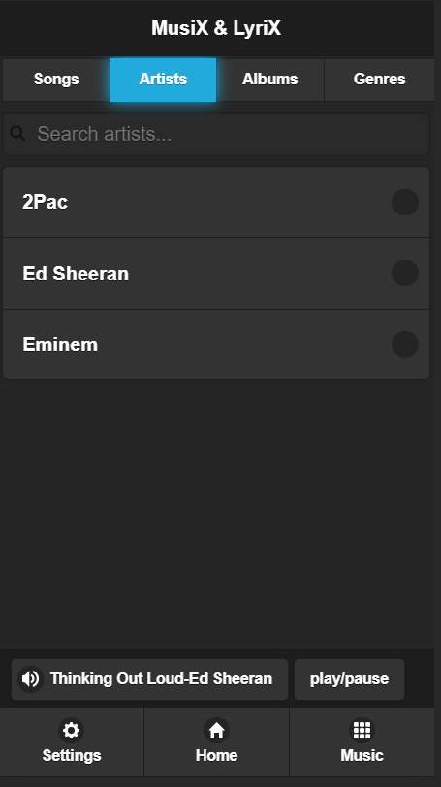
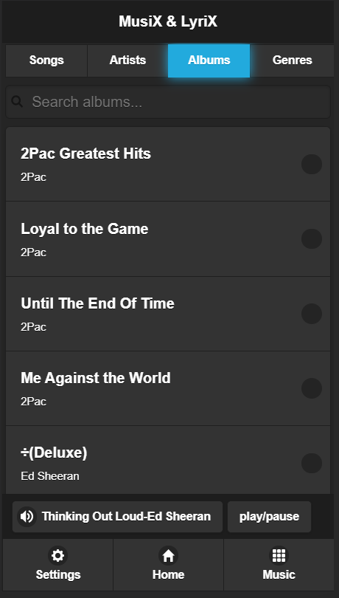
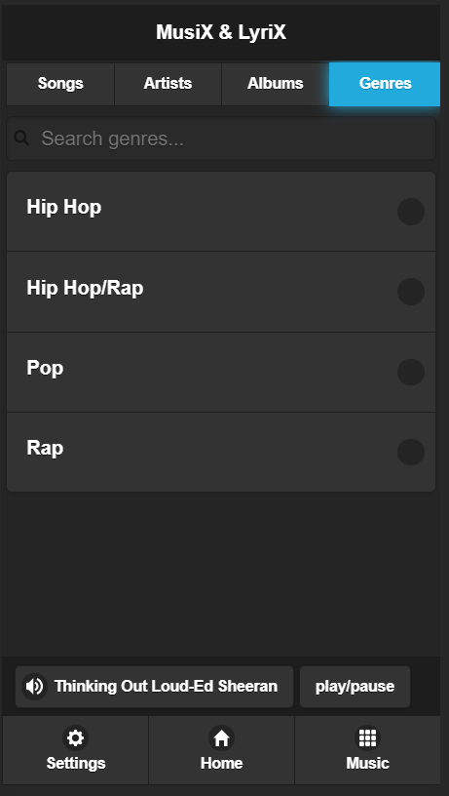
#music_page

Slide 13
<div class="ui-page ui-page-theme-b" data-role="page" id="music_page" data-filter="true" data-input="#search_all">
<div data-role="header" data-position="fixed">
<h1>MusiX & LyriX</h1>
</div> <!--/header-->
<div data-role="tabs">
<div data-role="navbar" data-position="fixed">
<ul>
<li><a href="#songs_list" data-ajax="false" data-theme="b">Songs</a></li>
<li><a href="#artists_list" data-ajax="false" data-theme="b">Artists</a></li>
<li><a href="#albums_list" data-ajax="false" data-theme="b">Albums</a></li>
<li><a href="#genres_list" data-ajax="false" data-theme="b">Genres</a></li>
</ul>
</div><!-- navbar-->
<div id="songs_list">
<ul data-role="listview" data-filter="true" data-filter-placeholder="Search songs..." data-inset="true" id="ul_songs"></ul>
</div><!-- songs_list-->
<div id="albums_list">
<ul data-role="listview" data-filter="true" data-filter-placeholder="Search albums..." data-inset="true" id="ul_albums"></ul>
</div><!-- albums_list-->
<div id="artists_list">
<ul data-role="listview" data-filter="true" data-filter-placeholder="Search artists..." data-inset="true" id="ul_artists"></ul>
</div><!-- artists_list-->
<div id="genres_list">
<ul data-role="listview" data-filter="true" data-filter-placeholder="Search genres..." data-inset="true" id="ul_genres"></ul>
</div><!-- genres_list-->
<audio controls id="_audio" hidden >
<source src="music/Imagine Dragons - Thunder.mp3" type="audio/mpeg">
Your browser does not support the audio element. </audio>
</div><!-- tabs-->
<div class="jqm-footer" data-role="footer" data-position="fixed">
<div style="margin-left: 10px;">
<button type="button" id="btnsong" data-icon="audio"> Song title - Song artist </button>
<button type="button" name="btnplay"> play/pause </button>
</div>
<div data-role="navbar">
<ul>
<li><button type="button" name="btnsettings" data-icon="gear">Settings</button></li>
<li><button type="button" name="btnhome" data-icon="home">Home</button></li>
<li><button type="button" name="btnmusic" data-icon="grid">Music</button></li>
</ul>
</div><!-- /navbar -->
</div><!-- /footer -->
</div><!-- /music_page -->
HTML

Slide 14
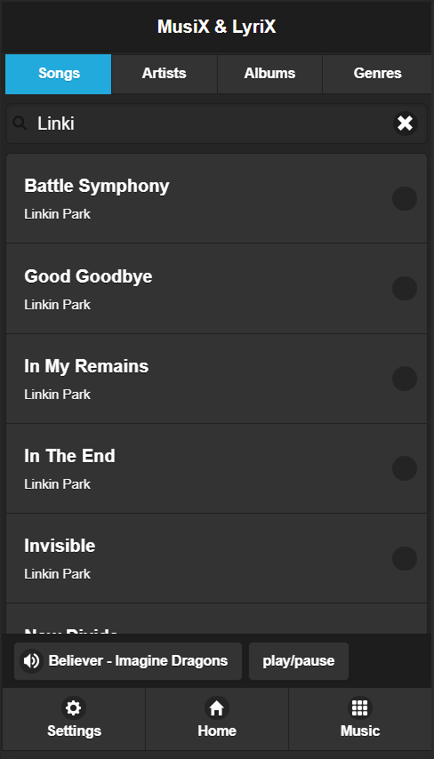
<div id="songs_list">
<ul data-role="listview" data-filter="true" data-filter-placeholder="Search songs..." data-inset="true" id="ul_songs"></ul>
</div><!-- songs_list-->
function play()
{
for (let i = 0; i < songs_info.length; i++)
{
if (songs_info[i]['path'] == _audio.innerText)
{
document.getElementById('song_title').innerHTML = songs_info[i]['name'];
document.getElementById('song_artist').innerHTML = songs_info[i]['artist'];
document.getElementById('btnsong').innerHTML = songs_info[i]['name'] + '-' + songs_info[i]['artist'];
}
}
if (_audio.paused)
{
_audio.play();
}
else
{
_audio.pause();
}
}

Slide 15
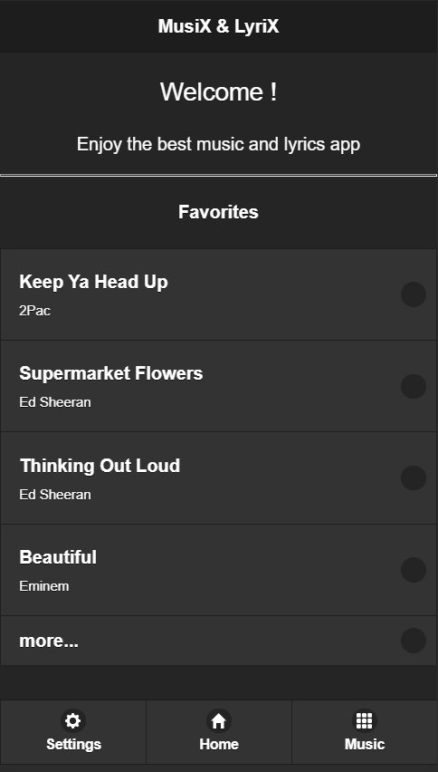
function settings() {
window.location.href = "#settings_page";
}
function music() {
window.location.href = "#music_page";
}
function home() {
window.location.href = "#home_page";
}

Slide 16
#song_page
load_lyrics_from_api()
seektimeupdate()
songprevious()
songnext()

Slide 17
<div class="ui-page ui-page-theme-b" data-role="page" id="song_page">
<div data-role="header" data-position="fixed">
<a href="./" data-shadow="false" data-ajax="false" data-iconpos="notext" data-icon="carat-l" data-rel="back" data-iconshadow="false">Back</a>
<a href="#" data-shadow="false" data-ajax="false" data-icon="heart" data-iconpos="notext" data-iconshadow="false" id="btnlike"></a>
</div> <!--/header-->
<div data-role="content">
<h2 style="text-align: center;" id="song_title">Song title</h2>
<h3 style="text-align: center;" id="song_artist">Song artist</h3>
<hr>
<div id="lyrics" class="lyrics">
.......................................<br>
.......................................<br>
.......................................<br>
.......................................<br>
.......................................<br>
.......................................<br>
.......................................<br>
.......................................<br>
.......................................<br>
.......................................<br>
.......................................<br>
.......................................<br>
.......................................<br>
</div>
<hr>
<button type="button" id="btnloadlyrics">Load lyrics</button>
<div>
<!--<input type="range" id="_range" data-highlight='true' min="0" max="100" step="1" >-->
<div id="timebox">
<span id="curtimetext">00:00</span> / <span id="durtimetext">00:00</span>
</div>
<progress id="progress_bar" max="100" value="0" style="width: 100%;"></progress>
</div>
<div style="margin-left: 20px;">
<a class="ui-btn ui-bnt-a ui-btn-inline ui-shadow ui-corner-all" href="#" id="btnprevious">prev</a>
<a class="ui-btn ui-bnt-a ui-btn-inline ui-shadow ui-corner-all" name="btnplay" href="#">play/pause</a>
<a class="ui-btn ui-bnt-a ui-btn-inline ui-shadow ui-corner-all" href="#" id="btnnext">next</a>
</div>
<a href="#edit_page"><button type="button" id="btnedit">Edit song info</button></a>
</div><!-- /content-->
<div class="jqm-footer" data-role="footer" data-position="fixed">
</div><!-- /footer -->
</div><!-- /song_page -->
HTML

Slide 18
JS
function songnext() //metoda koja se izvrsi klikom na btn next, reproducira sljedecu pjesmu sa popisa pjesama
{
for (let i = 0; i < songs_info.length; i++)
{
if (songs_info[i]['path'] == _audio.innerText) //u popisu pjesama pronadjemo pjesmu koja se trenutno izvodi
{
if ((i+1) == songs_info.length) //ako je trenutna pjesma na kraju popisa pjesama onda se reproducira prva s popisa > songs_info[0]
{
document.getElementById('song_title').innerHTML = songs_info[0]['name'];
document.getElementById('song_artist').innerHTML = songs_info[0]['artist'];
document.getElementById('btnsong').innerHTML = songs_info[0]['name'] + ' - ' + songs_info[0]['artist'];
_audio.src = songs_info[0]['path'];
_audio.innerText = songs_info[0]['path'];
_audio.load();
_audio.play();
load_lyrics_from_api();
break;
}
else if ((i+1) < songs_info.length) //ako je indeks sljedece pjesme unutar duljine popisa pjesama, reproducira se pjesma na songs_info[i+1]
{
document.getElementById('song_title').innerHTML = songs_info[i+1]['name'];
document.getElementById('song_artist').innerHTML = songs_info[i+1]['artist'];
document.getElementById('btnsong').innerHTML = songs_info[i+1]['name'] + ' - ' + songs_info[i+1]['artist'];
_audio.src = songs_info[i+1]['path'];
_audio.innerText = songs_info[i+1]['path'];
_audio.load();
_audio.play();
load_lyrics_from_api();
break;
}
}}}

Slide 19
JS
function songprevious() //metoda koja se izvrsi klikom na btn previous, reproducira prethodnu pjesmu sa popisa pjesama
{
for (let i = 0; i < songs_info.length; i++)
{
if (songs_info[i]['path'] == _audio.innerText) //u popisu pjesama pronadjemo koja se trenutno izvodi
{
if ((i-1) == -1) //ako indeks sljedece pjesme izlazi iz granica niza onda se reproducira pjesma s kraja niza > songs_info[songs_info.length - 1]
{
document.getElementById('song_title').innerHTML = songs_info[songs_info.length - 1]['name'];
document.getElementById('song_artist').innerHTML = songs_info[songs_info.length - 1]['artist'];
document.getElementById('btnsong').innerHTML = songs_info[songs_info.length - 1]['name'] + ' - ' + songs_info[songs_info.length - 1]['artist'];
_audio.src = songs_info[songs_info.length - 1]['path'];
_audio.innerText = songs_info[songs_info.length - 1]['path'];
_audio.load();
_audio.play();
load_lyrics_from_api();
break;
}
else if ((i-1) >= 0 ) //ako u popisu pjesama postoji ona manjeg indeksa onda se ona reproducira > songs_info[i-1]
{
document.getElementById('song_title').innerHTML = songs_info[i-1]['name'];
document.getElementById('song_artist').innerHTML = songs_info[i-1]['artist'];
document.getElementById('btnsong').innerHTML = songs_info[i-1]['name'] + ' - ' + songs_info[i-1]['artist'];
_audio.src = songs_info[i-1]['path'];
_audio.innerText = songs_info[i-1]['path'];
_audio.load();
_audio.play();
load_lyrics_from_api();
break;
}
}
}
}

Slide 20
JS
_audio.addEventListener("timeupdate", function(){ seektimeupdate(); });
unutar setUp metode
function seektimeupdate()
{
var nt = _audio.currentTime * (100 / _audio.duration);
try {
progress.value = nt.toPrecision(3);
} catch (error) {
progress.value = 0;
}
var curmins = Math.floor(_audio.currentTime / 60);
var cursecs = Math.floor(_audio.currentTime - curmins * 60);
var durmins = Math.floor(_audio.duration / 60);
var dursecs = Math.floor(_audio.duration - durmins * 60);
if(cursecs < 10){ cursecs = "0"+cursecs; }
if(dursecs < 10){ dursecs = "0"+dursecs; }
if(curmins < 10){ curmins = "0"+curmins; }
if(durmins < 10){ durmins = "0"+durmins; }
curtimetext.innerHTML = curmins+":"+cursecs;
durtimetext.innerHTML = durmins+":"+dursecs;
}
pretvaranje vremena koje je u audio elementu u milisekundama u sekunde i minute

Slide 21
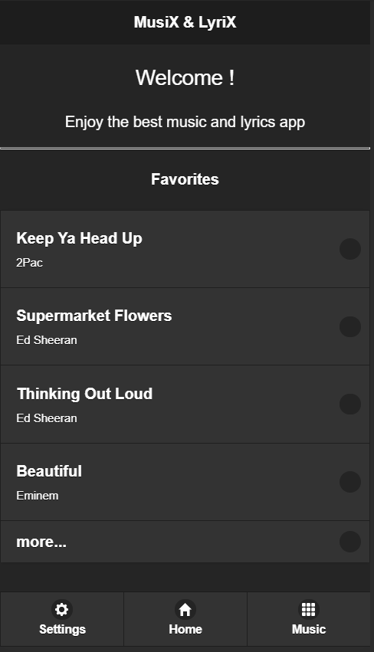
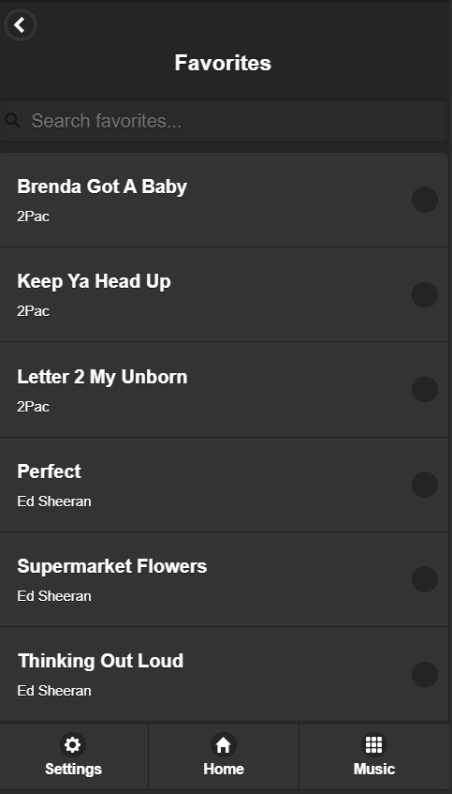
#favorite_page

Slide 22
HTML
<div class="ui-page ui-page-theme-b" data-role="page" id="favorite_page">
<div data-role="header" data-position="fixed">
<a href="./" data-shadow="false" data-ajax="false" data-iconpos="notext" data-icon="carat-l" data-rel="back" data-iconshadow="false">Back</a>
</div> <!--/header--><br>
<h3 style="text-align: center;">Favorites</h3>
<ul data-role="listview" data-inset="true" id="favorites" data-filter="true" data-filter-placeholder="Search favorites..."></ul>
<div class="jqm-footer" data-role="footer" data-position="fixed">
<div data-role="navbar">
<ul>
<li><button type="button" name="btnsettings" data-icon="gear">Settings</button></li>
<li><button type="button" name="btnhome" data-icon="home">Home</button></li>
<li><button type="button" name="btnmusic" data-icon="grid">Music</button></li>
</ul>
</div><!-- /navbar -->
</div><!-- /footer -->
</div><!-- /favorite_page -->

Slide 23
function addToFavoritesList(songs)
{
document.getElementById('ul_favorites').innerHTML = '';
document.getElementById('favorites').innerHTML = '';
for (let i = 0; i < songs.length; i++) {
const song_info = songs[i];
var br = 0;
favorites.forEach(fav =>
{
if (fav == song_info['_id'])
{
if (i == 0)
{
var element = '<li class="ui-first-child fpjesma" data-icon="none" name="_song" id="'+ song_info['path'] + '"' +'><a class="ui-btn ui-btn-icon-right ui-icon-none" href="#" ><h2>' + song_info["name"] + '</h2><p>' + song_info["artist"] + '</p></a></li>';
}
else if (i == (songs.length - 1))
{
var element = '<li class="ui-last-child fpjesma" data-icon="none" name="_song" id="'+ song_info['path'] + '"' +'><a class="ui-btn ui-btn-icon-right ui-icon-none" href="#"><h2>' + song_info["name"] + '</h2><p>' + song_info["artist"] + '</p></a></li>';
}
else
{
var element = '<li data-icon="none" class="fpjesma" name="_song" id="'+ song_info['path'] + '"' +'><a class="ui-btn ui-btn-icon-right ui-icon-none" href="#"><h2>' + song_info["name"] + '</h2><p>' + song_info["artist"] + '</p></a></li>';
}
}
if (br <= 3)
{
$("#ul_favorites").append(element);
br = br + 1;
}
$('#favorites').append(element);
});
}
$('#ul_favorites').append('<li><a class="ui-btn ui-btn-icon-right ui-icon-none" href="#favorite_page">more...</a></li>');
JS

Slide 24
JS
$('.fpjesma').off();
$('.fpjesma').on('click', function()
{
for (let i = 0; i < songs_info.length; i++) //prolazeci kroz popis detalja svih pjesama iz baze podataka trazimo podatke o pjesmi na koju je kliknuto
{
var el = songs_info[i];
if($(this).find("a").find("h2")[0].innerText == el['name'] && $(this).find("a").find("p")[0].innerText == el['artist'])
{
document.getElementById('song_title').innerHTML = el['name']; //na stranici #song_page se postavlja naziv pjesme i ime izvodaca
document.getElementById('song_artist').innerHTML = el['artist'];
document.getElementById('btnsong').innerHTML = el['name'] + ' - ' + el['artist'];
_audio.src = el['path']; //postavljanje src atributa audio elementa na putanju odabrane pjesme koja je i id kliknutog elementa
_audio.innerText = el['path'];
_audio.load();
_audio.play();
load_lyrics_from_api(); //za odabranu pjesmu dohvatimo tekst
break;
}
}
window.location.href = "#song_page";
});
}

Slide 25
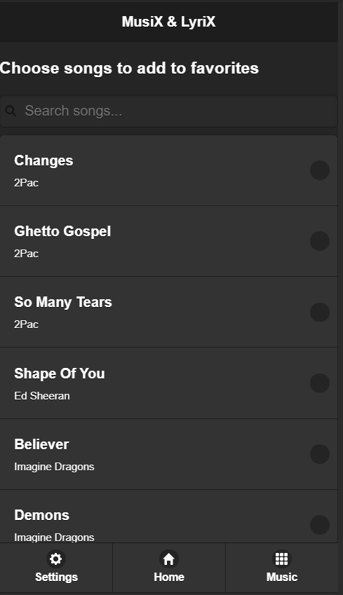
#settings_page

Slide 26
HTML
<div class="ui-page ui-page-theme-b" data-role="page" id="settings_page">
<div data-role="header" data-position="fixed" >
<h1>MusiX & LyriX</h1>
</div> <!--header-->
<h3>Choose songs to add to favorites</h3>
<div id="song_to_fav_list">
<ul data-role="listview" data-filter="true" data-filter-placeholder="Search songs..." data-inset="true" id="ul_song_to_fav"></ul>
</div><!-- song_to_fav_list-->
<div class="jqm-footer" data-role="footer" data-position="fixed">
<div data-role="navbar">
<ul>
<li><button type="button" name="btnsettings" data-icon="gear">Settings</button></li>
<li><button type="button" name="btnhome" data-icon="home">Home</button></li>
<li><button type="button" name="btnmusic" data-icon="grid">Music</button></li>
</ul>
</div><!-- /navbar -->
</div><!-- /footer -->
</div><!-- /settings_page -->

Slide 27
JS
function addToNotFavoritesList(songs)
{
document.getElementById('ul_song_to_fav').innerHTML = '';
for (let i = 0; i < songs.length; i++) {
const song_info = songs[i];
notfavorites.forEach(fav =>
{
if (fav == song_info['_id'])
{
if (i == 0)
{
var element = '<li class="ui-first-child nfpjesma" data-icon="none" name="_song"><a class="ui-btn ui-btn-icon-right ui-icon-none" href="#" ><h2>' + song_info["name"] + '</h2><p>' + song_info["artist"] + '</p></a></li>';
}
else if (i == (songs.length - 1))
{
var element = '<li class="ui-last-child nfpjesma" data-icon="none" name="_song"><a class="ui-btn ui-btn-icon-right ui-icon-none" href="#"><h2>' + song_info["name"] + '</h2><p>' + song_info["artist"] + '</p></a></li>';
}
else
{
var element = '<li data-icon="none" class="nfpjesma" name="_song"><a class="ui-btn ui-btn-icon-right ui-icon-none" href="#"><h2>' + song_info["name"] + '</h2><p>' + song_info["artist"] + '</p></a></li>';
}
}
$("#ul_song_to_fav").append(element);
});
}
$('.nfpjesma').off();

Slide 28
JS
$('.nfpjesma').on('click', function()
{
for (let i = 0; i < songs_info.length; i++) {
var el = songs_info[i];
if($(this).find("a").find("h2")[0].innerText == el['name'] && $(this).find("a").find("p")[0].innerText == el['artist'])
{
favorites.push(el['_id']);
var arr = [];
notfavorites.forEach(element =>
{
if (element != el['_id'])
{
arr.push(element);
}
});
notfavorites = arr;
save_to_fav_put();
break;
}
}
})
}

