Slide 1
Prediction of Making The NCAA Tournament
By: Jaxon Hicks, Joseph Joswiak, Levi Sneller

Slide 2
Agenda
Model Specification
Complete Separation
Interpretations and Confidence Intervals
Hypothesis Testing
Meaningful Insights

Slide 3
Model Specification

Slide 4
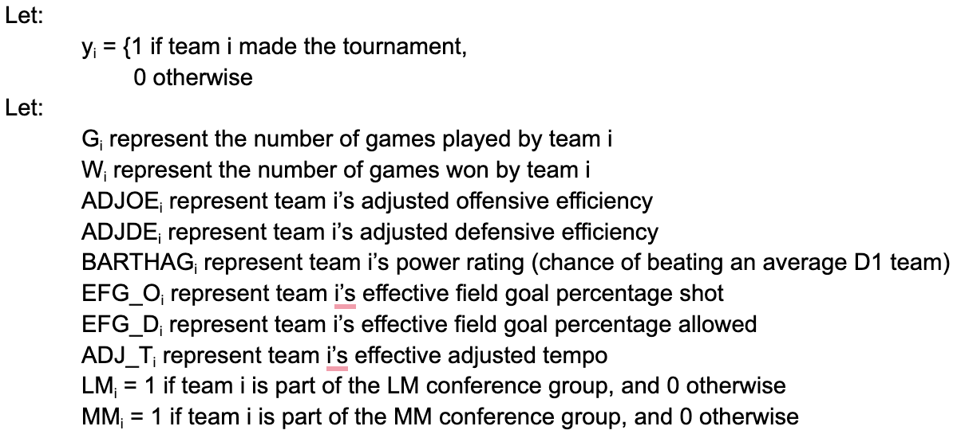
Model Specification:

Slide 5
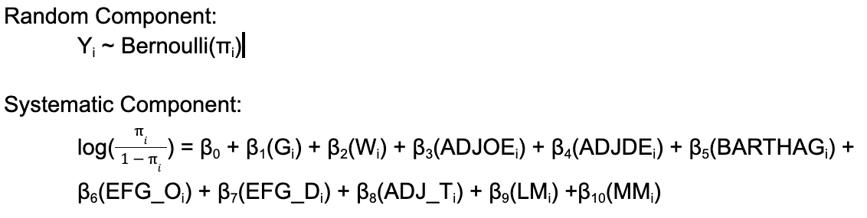
Model Specification
Bernoulli random component for binary data
Logit link for interpretable results (odds ratios)

Slide 6
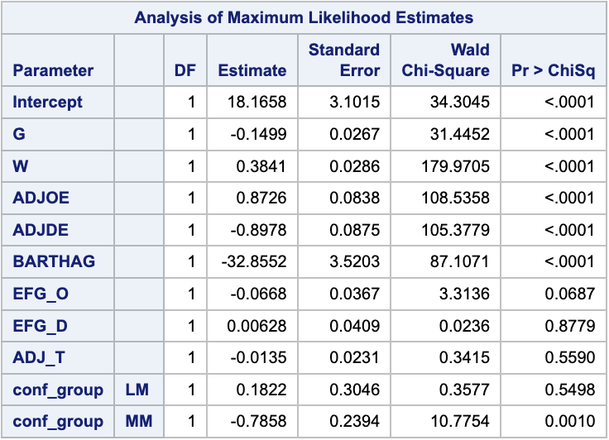
Model Results:
log(π/(1-π)) = 18.1658 – 0.1499(G_{i}) + 0.3841(W_{i}) + 0.8726(ADJOE_{i}) - 0.8978(ADJDE_{i}) – 32.8552(BARTHAG_{i}) – 0.0668(EFG_O_{i}) + 0.00628(EFG_D_{i}) – 0.0135(ADJ_T_{i}) + 0.1822(LM_{i}) – 0.7858(MM_{i})
Note: This model suffers from multicollinearity with BARTHAG

Slide 7
Complete Separation

Slide 8
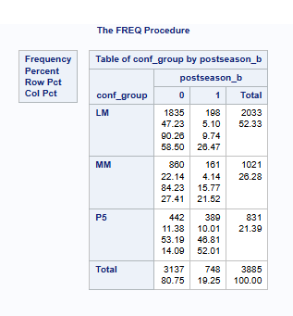
Complete Separation Investigation
Pre Analysis: No zeros in the frequency table indicates lack of complete separation
Post Analysis: No standard errors are greater than 5, indicate no complete separation

Slide 9
Interpretations and Confidence Intervals

Slide 10
ADJOE:
Description:
ADJOE represents the adjusted offensive efficiency. This coefficient is measured by points scored per 100 possessions.
β3 coefficient corresponding to ADJOE.
The predicted β3-hat = .8726.

Slide 11
ADJOE:
Odds:
Holding all other factors constant, the odds of making the tournament increase by a factor of e^.8726=2.393 for each additional point scored in ADJOE. This means that for each additional point in a team's adjusted offensive efficiency, the odds of making the tournament more than doubles, suggesting that stronger offensive performance significantly boosts a team's chances of making the tournament.
Odds Ratio:
Holding all else constant, the odds of making the NCAA tournament increase by a factor of e^5*.8726=78.49 times with every increase of 5 in points scored per 100 possessions in adjusted offensive efficiency.

Slide 12
ADJOE:
Confidence Interval:
Holding all else constant, we are 95% confident that the odds of a team making the NCAA Tournament increase by a factor of e^{.7135}=2.04112 and e^{1.042}=2.83488 for each additional point scored per 100 possessions. Between (104.112% to 183.488%)
Holding all else constant, we are 95% confident that the odds of a team making the NCAA Tournament increase by a factor of e^{5*.7135}=32.4279 and e^{5*1.042}=183.094 for an increase of 5 points scored per 100 possessions. Between (3142.79% to 18209.4%)

Slide 13
Conf_Group:
Description
Conf_group represents the classification of the conference team i is in (either P5, MM, or LM). With the initial observation of P5 being accounted for in the intercept estimate, the predicted low major β9-hat is 0.1822. The predicted mid major β10-hat is -0.7858.

Slide 14
Conf_Group:
This means that in comparison to the Power 5 conference teams, a team in a low major conference has roughly 20% greater odds to make the NCAA Tournament given they have the same resume (holding all other variables constant).
A team in a mid major conference has only 0.45 odds to make the NCAA Tournament relative to a team in a Power 5 conference given they have resume.
Odds of Making NCAA Tournament:
Low Major: e^{0.1822} = 1.1999
Mid Major: e^{-0.7858} = 0.4558

Slide 15
Conf_Group:
Confidence Intervals
Given e^{-0.4140} = 0.660 and e^{0.7806} = 2.180 we are 95% confident that given a team is in a Low major conference, the odds of them making the NCAA Tournament compared to a team in a Power 5 conference is between (0.660,2.180) given they have the same resume
And given e^{-1.2553} = 0.285 and e^{-0.3161} = 0.729 we are 95% confident that given a team is in a mid major conference, the true odds of them making the NCAA Tournament compared to a team in a Power 5 Conference is between (0.285,0.729). This means I can say with 95% confidence that a team in a Power 5 conference has better odds to make the NCAA Tournament than a mid major team given they have the same resume.

Slide 16
Wins Variable:
W_{i} → represents the number of games won by team i.
β2 → coefficient corresponding to W_{i}
β2-hat = 0.3841.

Slide 17
Wins Interpretation:
Holding all other factors constant, the odds of a team making the NCAA tournament increase by a factor of e^{0.3841} = 1.4682922 for each one additional win a team has. In other words, the odds of making the tournament increase by about 46.83%.
Holding all other factors constant, the odds of a team making the NCAA tournament increase by a factor of e^{(2*0.3841)} = 2.155882 for every two additional wins a team has. In other words, the odds of making the tournament increase by about 115.59%.

Slide 18
Wins Confidence Interval:
We are 95% confident that the odds of a team making the NCAA tournament increase by a factor between e^{0.3288} = 1.389300 and e^{0.4411} = 1.554416 for each additional win a team has, holding all other factors constant. (between 38.93% and 55.44%)
We are 95% confident that the odds of a team making the NCAA tournament increase by a factor between e^{(2*0.3288)} = 1.930154 and e^{(2*0.4411)} = 2.416210 for every two additional wins a team has, holding all other factors constant. (between 93.02% to 141.62%)

Slide 19
Hypothesis Testing

Slide 20
Hypothesis Testing:
Test of Model:
H₀: β1 = β2 = β3 = … = β10 = 0
H_{a}: At least one β ≠ 0
Test statistic: 34.3045
Null Distribution: 𝝌²(10)
P-Value: <.0001
Conclusion: We reject H₀ in favor of H_{a}at all reasonable levels of alpha

Slide 21
Hypothesis Testing:
Test of Conf_group Variable
H₀: β9 = β10 = 0
H_{a}: At least one β ≠ 0
Test statistic: 30.9934
Null Distribution: 𝝌²(2)
P-Value: <.0001
Conclusion: We reject H₀ in favor of H_{a} at all reasonable levels of alpha.

Slide 22
Hypothesis Testing:
Test of ADJOE Variable:
H₀: β3 = 0
H_{a}: β3 ≠ 0
Test statistic: 108.5358
Null Distribution: 𝝌²(1)
P-Value: <.0001
Conclusion: We reject H₀ in favor of H_{a}.

Slide 23
Meaningful Insights

Slide 24
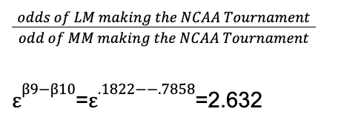
Meaningful Insight 1:
Comparing two non-baseline levels of Conf_group odds of making the NCAA Tournament .
All else constant, the odds that a Low Major makes the NCAA Tournament are 2.632 times that a Mid Major makes the NCAA Tournament. This means the odds of a Low Major team making the NCAA Tournament are about 163.2% higher than the odds of a Mid Major Team making the NCAA Tournament.

Slide 25
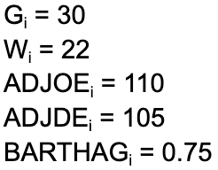
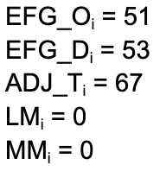
Meaningful Insight 2:
Question: How does a team’s probability of making the NCAA tournament change when adjusting 1 variable, wins?
Consider a team with the following characteristics:

Slide 26
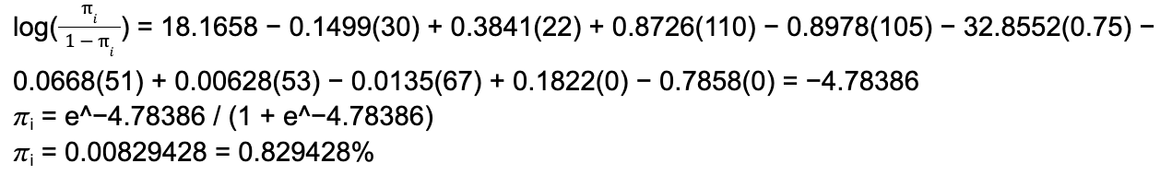
Meaningful Insight 2:
Finding the probability of a team with the initial statistics:
→ Probability of making the NCAA tournament is 0.829428%

Slide 27
Meaningful Insight 2:
What if wins increases by 1, holding all other variables constant?
Original W_{i} = 22, now W_{i} = 23
→ Probability increases from 0.829428% to 1.21313%
Instead, what if wins increases by 5, holding all other variables constant?
Original W_{i} = 22, now W_{i} = 27
→ Probability increases from 0.829428% to 5.39948%

Slide 28
Meaningful Insight 3:
Question: Given a team’s resume, what Adjusted Offensive Efficiency score would give them a 95% probability of making the NCAA Tournament?

Slide 29

Meaningful Insights 3:
G_{i} = 30 Conference: Big 12 (P5)
W_{i} = 23
ADJOE_{i} = x
ADJDE_{i} = 105
BARTHAG_{i} = 0.75
EFG_O_{i} = 51
EFG_D_{i} = 53
ADJ_T_{i} = 67
LM_{i} = 0
MM_{i} = 0

Slide 30
Meaningful Insights 3:
0.95 = e^{z}/1+e^{z}
Where z = 18.1658 − 0.1499(30) + 0.3841(23) + 0.8726(x) − 0.8978(105) − 32.8552(0.75) − 0.0668(51) + 0.00628(53) − 0.0135(67) + 0.1822(0) − 0.7858(0)
0.95 = e^{(-110.39 + 0.8726(x))} / 1+e^{(-110.39 + 0.8726(x)})
x = 118.44
Solving for x, we determine that when a team has the above resume and is in a Power 5 conference, an adjusted offensive efficiency score of 118.44 gives them a 95% probability of making the postseason.

Slide 31
Thank You!
Questions?

