Slide 1
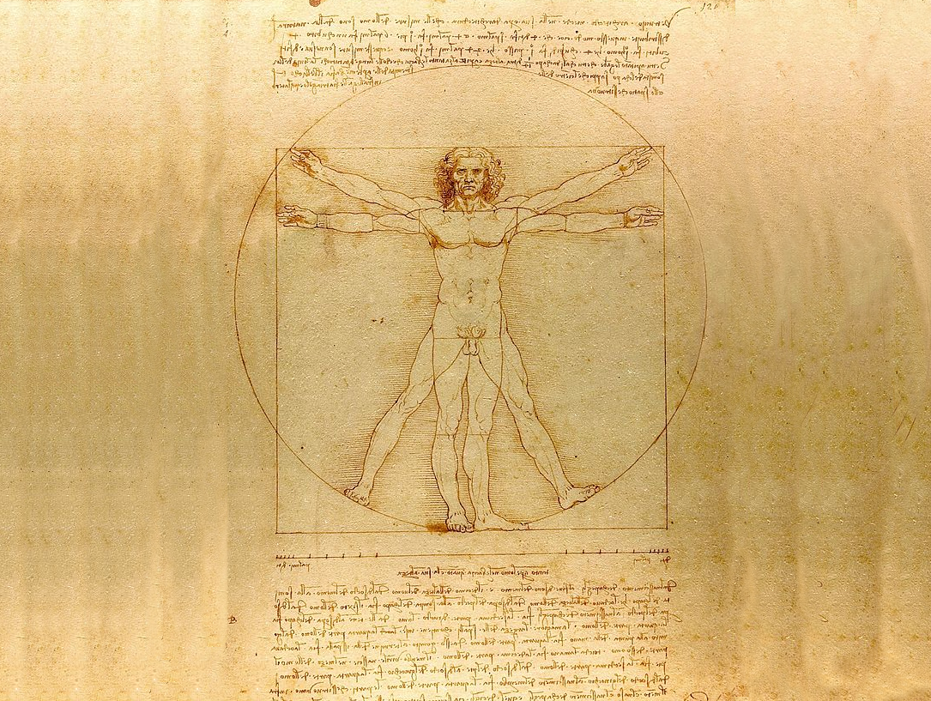
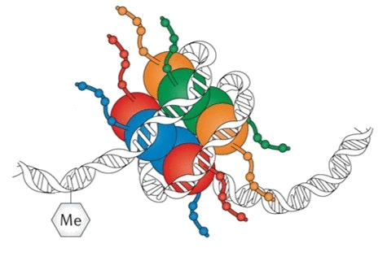
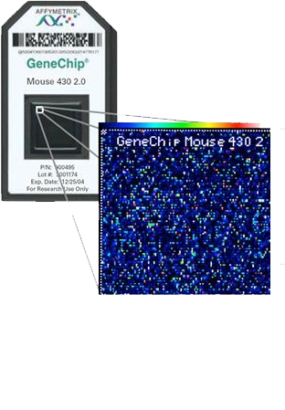
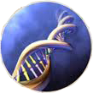
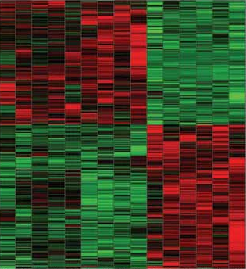
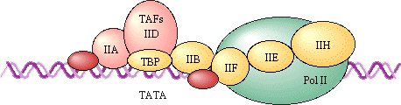
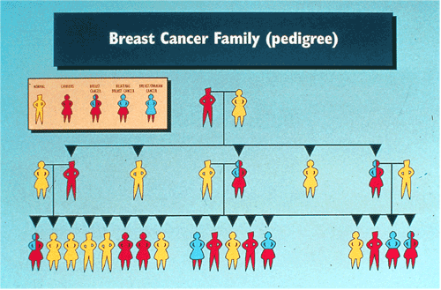
STAT115/215: Computational Biology
Learn. Think. Question. Analyze. Discover.
Module I
Transcriptome Microarray, RNA-seq
Module 2
Gene regulation
ChIP-seq, Epigenetics
Module 3
Human diseases
GWAS, TCGA
T/Th 11:30am-1pm
Science Center 309
Search for Stat 115 on my.Harvard.edu for more info

