Slide 1
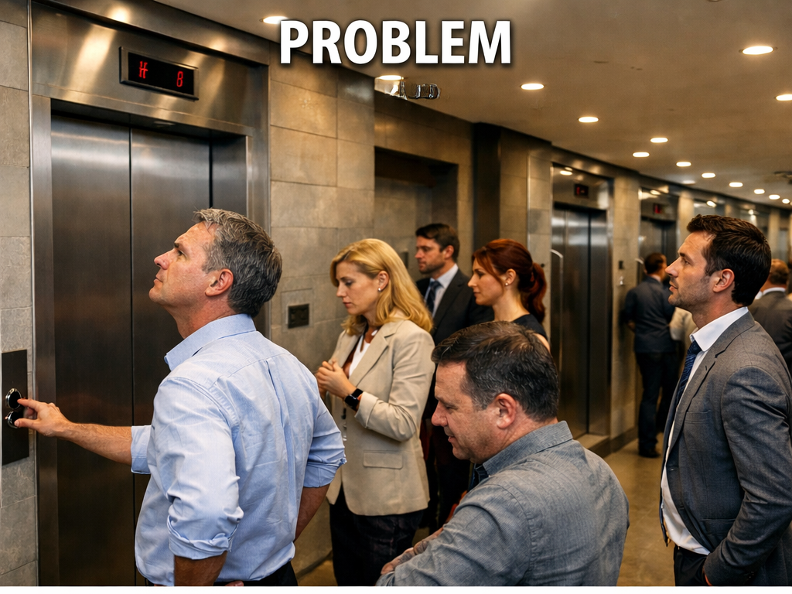
The Problem
Office workers constantly complained that the elevators were too slow.

Slide 2
Observation
Engineers suggested adding more elevators (very expensive).
But a consultant observed something interesting:
People weren't angry about speed — they were bored while waiting.

Slide 3
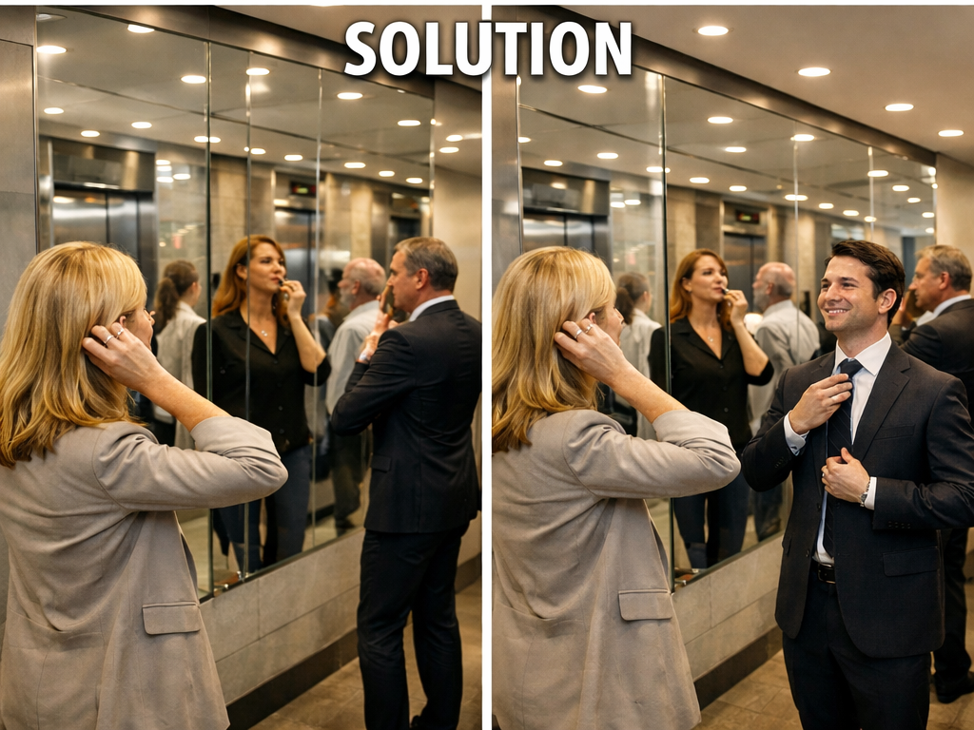
Creative Solution
Instead of building new elevators, the building installed mirrors near the doors.
People began checking their appearance and became engaged while waiting.

Slide 4
Key Lesson for Creative Problem Solving
Don't jump directly to complex solutions.
First understand the real problem.
Sometimes the smartest solution is not faster or bigger — it's simply seeing the problem differently.

