Slide 1
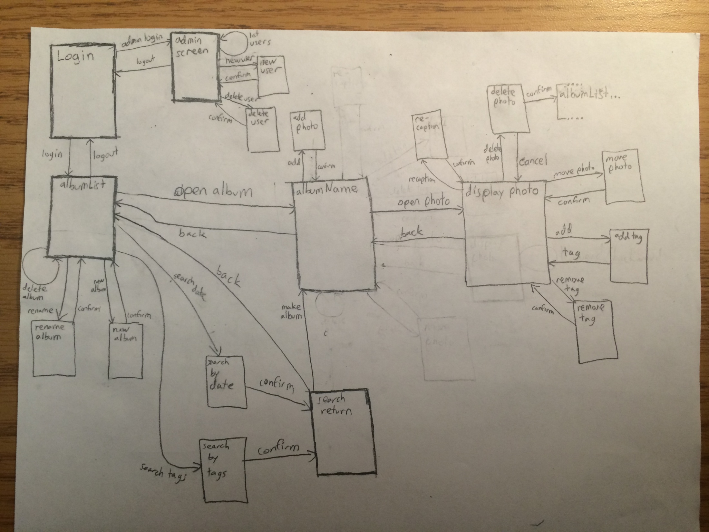

Slide 2
Login (1)
JFrame
JTextField initializes blank
Username:
JTextField
Login
(2) or (3)
JButton

Slide 3
Admin screen (2)
JTextArea initially set blank
JTextArea is updated based on the button pressed (list of users, success message, error message)
Logged in as: admin
JFrame
List Users
JTextArea
Add User
Delete User
JButton
Logout
JPanel
(1)
Notes:
3

Slide 4
Add User Screen (2.1)
JOptionPane
JTextField intializes blank
Create button attempts to add user with UserID in the JTextField
New User
Username
JTextfield
Create
Cancel
JButton
(2)
(2)
JButton

Slide 5
Delete User Screen (2.2)
JOptionPane
JTextField intializes blank
Delete button attempts to delete user with userID in the JTextField
Delete User
Username
JTextfield
Delete
Cancel
JButton
(2)
(2)
JButton

Slide 6
albumList (3)
- JTextArea initializes empty
Gray button are disabled until an album is selected
An album is selected when its corresponding JLabel is clicked
The Jlabel for each album will contain an image with the name of the album over it
A selected album’s photo count and range of dates will display in the JTextArea
JTextArea will also display success/error messages
Logged in as: <userID>
JFrame
(3.3)
Add Album
JTextArea
(4)
Open Album
JLabel
JLabel
JLabel
(3.4)
Rename Album
(3)
Delete Album
JLabel
JLabel
JLabel
(3.1)
Search by Date
JLabel
…
(3.2)
Search by Tags
Logout
(1)
JButton
JPanel

Slide 7
Search by Date (3.1)
- Both JTextFields are initially empty
JOptionPane
From
Search by date
JTextField
To
JTextField
Cancel
Search
(3)
(3.1.1)
JButton
JButton

Slide 8
Search by Tags (3.2)
-JTextArea will be updated with whatever is in the JTextField when Add button is pressed
JFrame
Search by tags
New tag
Tags
JTextField
JTextArea
Add
Cancel
Search
JButton
(3)
(3.1.1)
JButton
JButton
JPanel

Slide 9
Search Return (3.1.1)
Logged in as: <userID>
JFrame
Album Name
(3.3)
Make Album
JLabel
JLabel
JLabel
Caption
Caption
Caption
JLabel
JLabel
JLabel
Caption
Caption
Caption
JLabel
…
Caption
Back
(3)
JButton
JPanel

Slide 10
Create new album (3.3)
JOptionPane
New Album
Name of Album
JTextField
Cancel
Create
(3)
(3)
JButton
JButton

Slide 11
Rename album (3.4)
JOptionPane
Rename Album
Name of Album
JTextField
New Name of Album
JTextField
Cancel
Delete
(3)
(3)
JButton
JButton

Slide 12
Album screen (4)
Logged in as: <userID>
JFrame
Album Name
(4.1)
Add Photo
JLabel
JLabel
JLabel
(5)
Open Photo
Caption
Caption
Caption
JLabel
JLabel
JLabel
Caption
Caption
Caption
JLabel
…
Caption
Back
(3)
JButton
JPanel

Slide 13
Add Photo (4.1)
JOptionPane
Add Photo
Photo Name
JTextField
Cancel
Add
(4)
(4)
JButton
JButton

Slide 14

Display photo (5)
Logged in as: <userID>
JFrame
(5.1)
Add Tags
(5.2)
Remove Tags
JPanel
(5.3)
Re-caption
(5.4)
Move Photo
(5.5)
Delete Photo
Caption
Date
Tags
Back
Previous
Next
(4)
JButton
JPanel
(5)
(5)

Slide 15
Add Tags (5.1)
JOptionPane
Add Tags
Add Tag
JTextField
Current Tags
JTextArea
Cancel
Add
(5)
(5)
JButton
JButton

Slide 16
Remove Tags (5.2)
JOptionPane
Add Tags
Delete Tag
JTextField
Current Tags
JTextArea
Cancel
Delete
(5)
(5)
JButton
JButton

Slide 17
Re-Caption (5.3)
JOptionPane
New Caption
New Caption
JTextField
Current Caption
JTextField
Cancel
Confirm
(5)
(5)
JButton
JButton

Slide 18
Move Photo (5.4)
JOptionPane
Move Photo
Album Name
JTextField
Cancel
Confirm
(5)
(5)
JButton
JButton

Slide 19
Delete Photo (5.5)
JOptionPane
Delete Photo
Delete current Photo?
JTextField
Cancel
Confirm
(5)
(3)
JButton
JButton

