Slide 1

Flight Route Price Prediction and Seasonal Analysis
Khushi Panchal

Slide 2
introduction
This project uses data analytics and machine learning to explore U.S. flight routes and predict airfare.
Through a Streamlit dashboard, it visualizes route patterns, seasonal trends, and provides an interactive fare prediction tool.

Slide 3
01
MOtivation

Slide 4
Why this problem matters
Constant Fluctuations
Flight fares change by the minute, influenced by a myriad of factors beyond a traveler's immediate understanding.
Traveler Frustration
Most travelers struggle to identify optimal booking times, leading to anxiety and potentially higher costs

Slide 5
Why this problem matters
Complex Pricing Dynamics
Airlines leverage sophisticated algorithms that consider season, demand, route traffic, and booking timing to adjust prices dynamically
Lack of Integrated Tools
Existing solutions rarely combine robust machine learning predictions with intuitive route visualization, leaving a gap in comprehensive travel planning

Slide 6
Our solution
ML-Powered Prediction
Develop a robust machine learning model to accurately forecast flight fares based on historical data.
Seasonal & Temporal Patterns
Interactive Dashboard
Incorporate critical temporal features like weekdays, months, and days until departure to enhance prediction accuracy.
Build a user-friendly Streamlit interface for real-time analysis and visualization of flight routes and predictions.

Slide 7
02
DataSet Overview

Slide 8
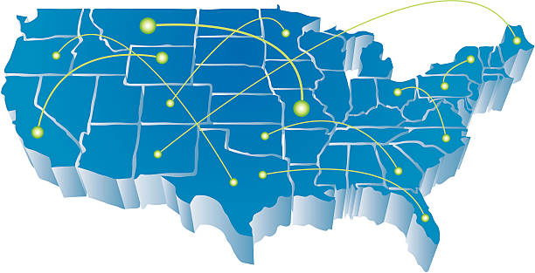
DataSet Overview
Data Volume
Our analysis uses 245,955 rows and 23 columns, spanning 1993-2024
Key Attributes
Geospatial Markers: Origin & Destination Airports
Economic Variables: Flight Fare & Miles Traveled
Operational Identifiers: Airline Carrier
Temporal Dimensions: Quarter & Specific Date

Slide 9
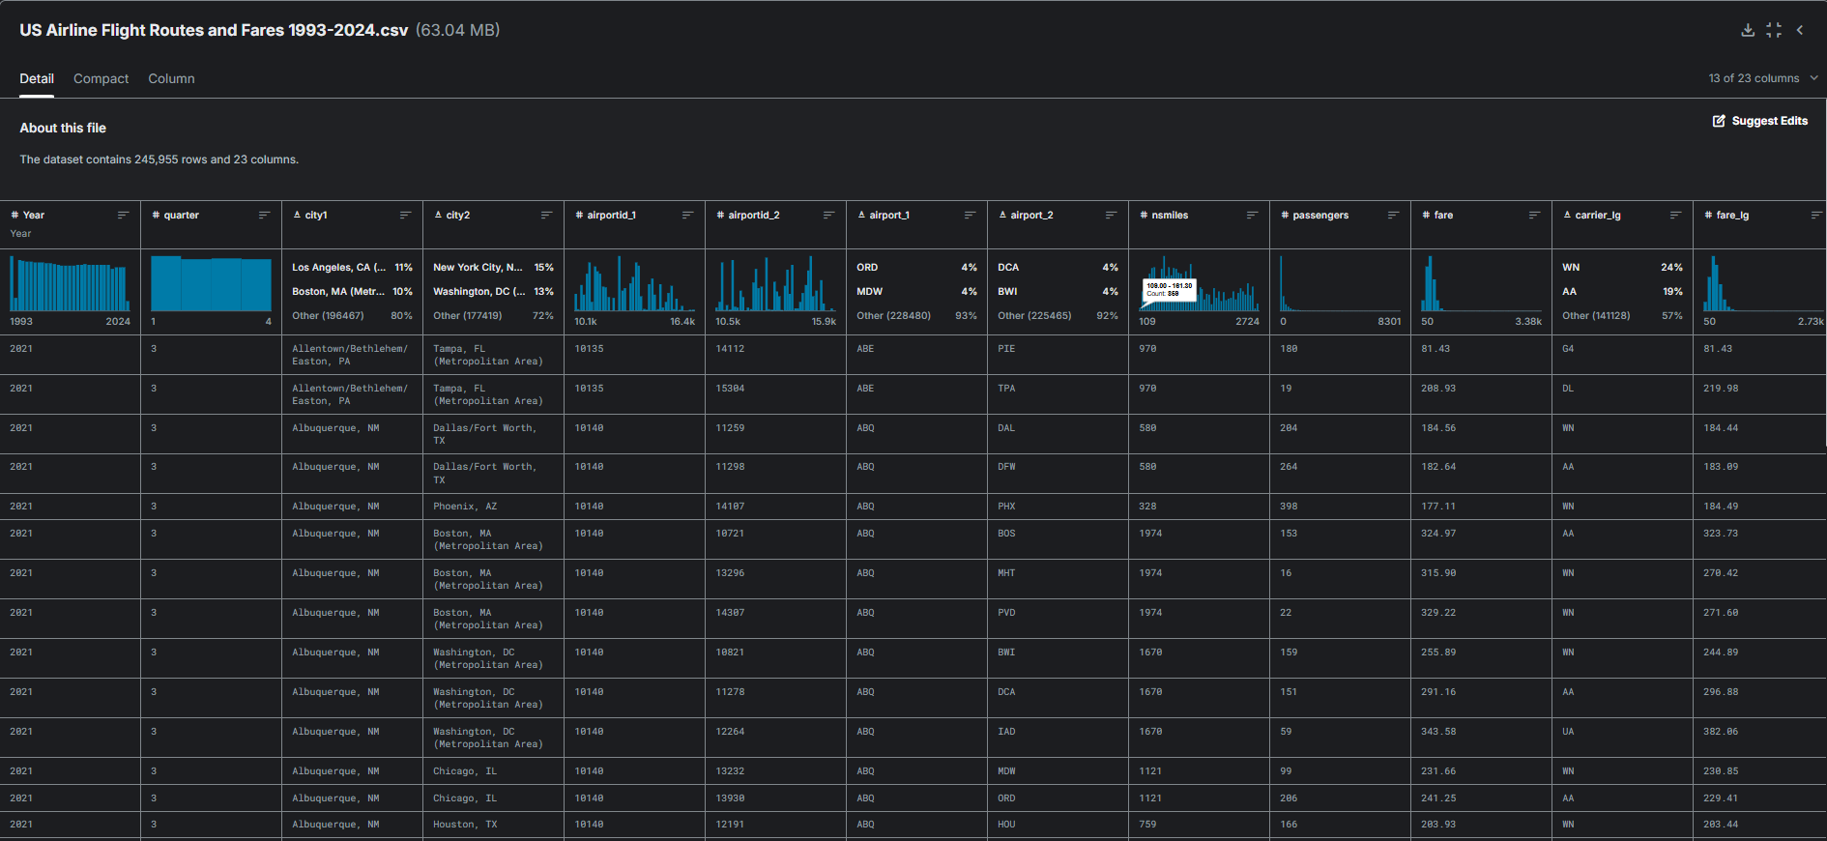


Kaggle Dataset

Slide 10
Our pipeline
EDA
Deployment
Correlation analysis, seasonal patterns
Data Preprocessing
Model Training & Evaluation
Interactive Streamlit dashboard
Clean, encode (target + one-hot), scale
Random Forest with hyperparameter tuning

Slide 11
03
dataprocesSing & feature extraction

Slide 12
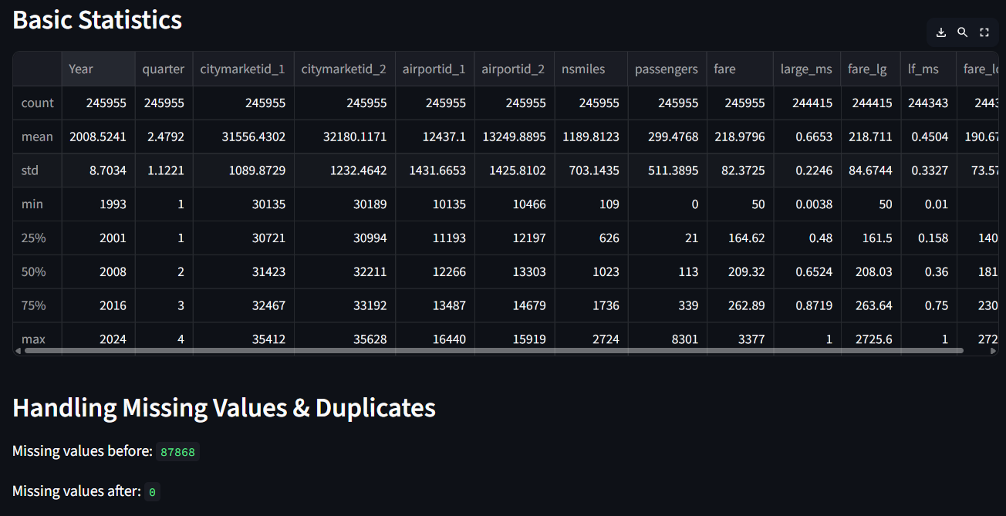
Data Processing
Data Cleaning
Missing Values: Handled via imputation or removal.
Duplicates: Removed to reduce bias.
Outliers: Detected and adjusted to minimize impact.
Data Transformation
Categorical Encoding: Converted non-numeric features (e.g., airlines)
Scaling: Normalized numerical features for uniformity.

Slide 13
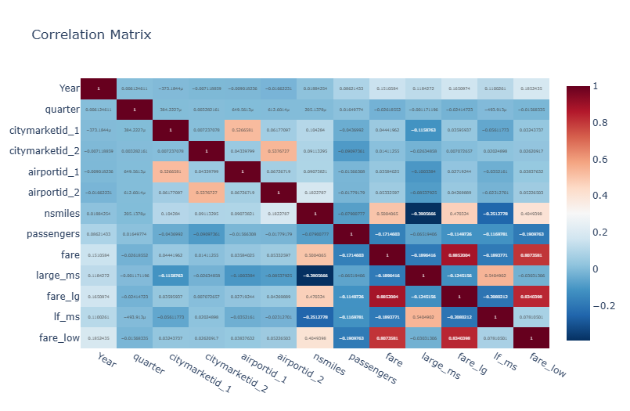
Feature Extraction
Cities: Origin → Destination
Stops: Non-stop or connecting flights
Timing: Days until departure, day of month, month, weekday

Slide 14
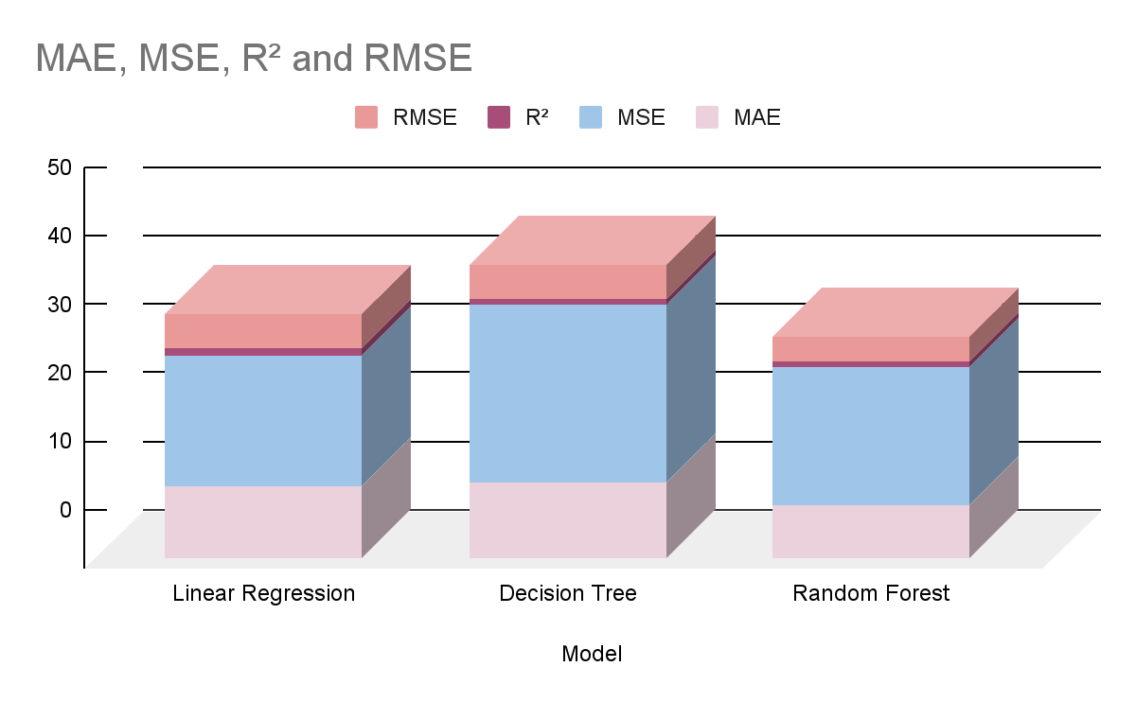
Machine Learning Models
Random Forest
To enhance accuracy and robustness against overfitting, demonstrated the lowest error rates.
Decision Tree
To capture non-linear patterns and interactions through tree-like decision rules
Linear regression
A foundational model, for understanding linear relationships within the data.

Slide 15
Evaluation Metrics
MAE
01
02
RMSE
Mean Absolute Error
Root Mean Squared Error
R²
04
03
MAPE
Coefficient of Determination
Mean Absolute Percentage Error

Slide 16
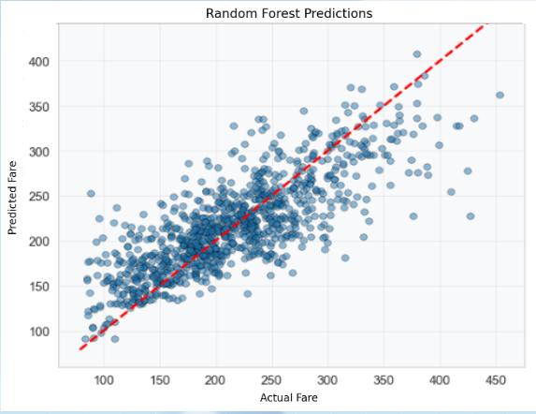
Model Accuracy
This scatterplot visualizes predicted vs. actual flight fares from the Random Forest model. Most predictions cluster around the 'perfect fit' line, indicating strong performance. However, some variance and outliers exist, particularly at higher fare values, suggesting areas for refinement.

Slide 17
04
Flight Route Analysis Dashboard

Slide 18
Streamlit Dashboard Features
02
01
03
Interactive dataset statistics & distributions
Input route/date → Get fare estimate
View cleaning, encoding, and scaling steps
Data Exploration
Price Prediction
Data Preprocessing

Slide 19
Streamlit dashboard features
04
06
05
Visualize price trends over time
Compare multiple routes side-by-side
See algorithm performance & comparisons
Seasonal Analysis
Route Comparison
Model Training

Slide 20
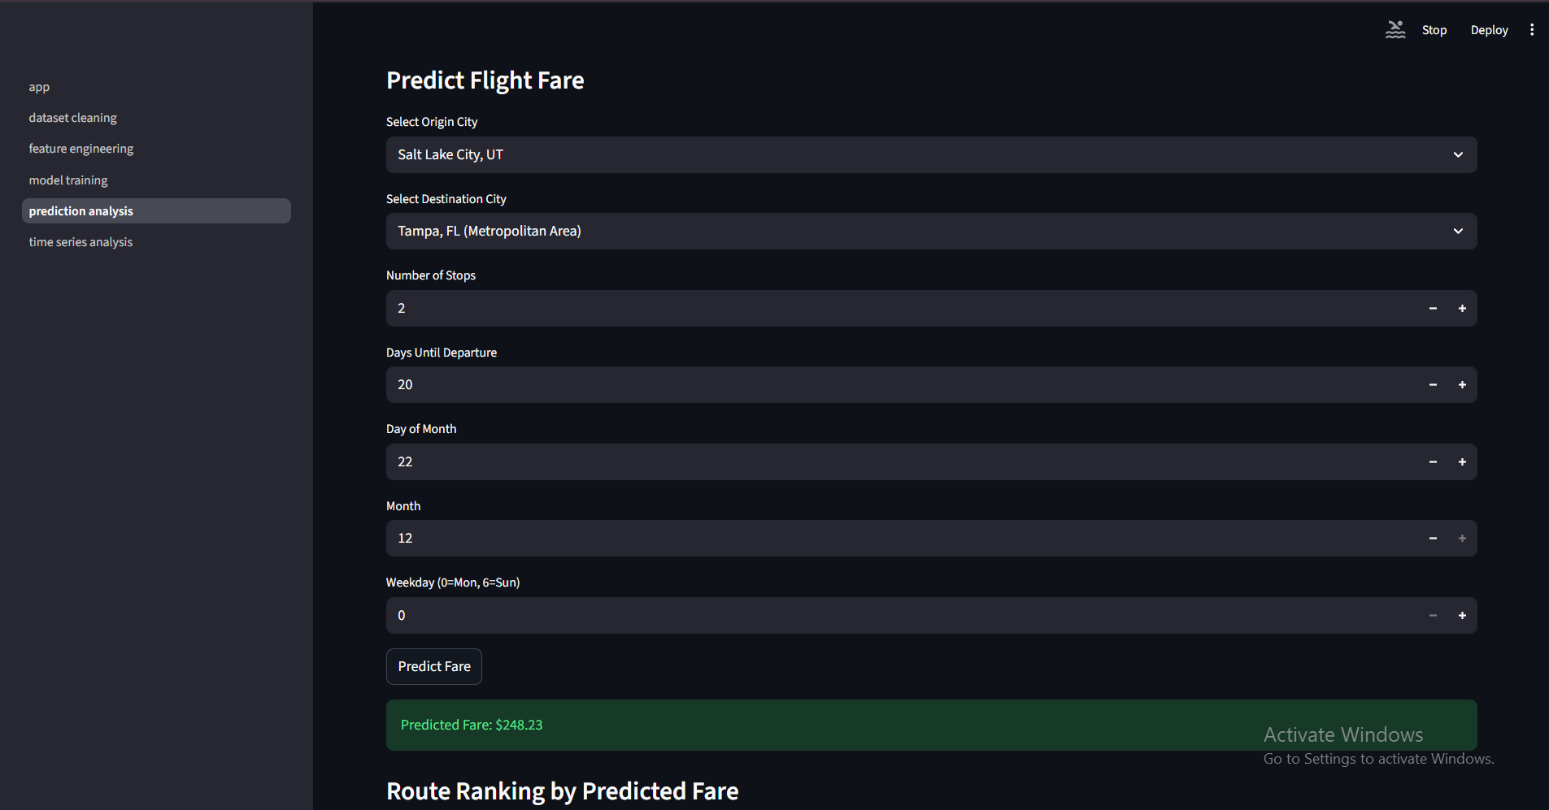

Slide 21
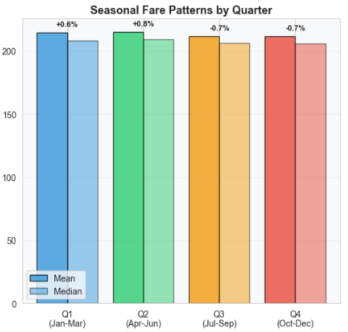
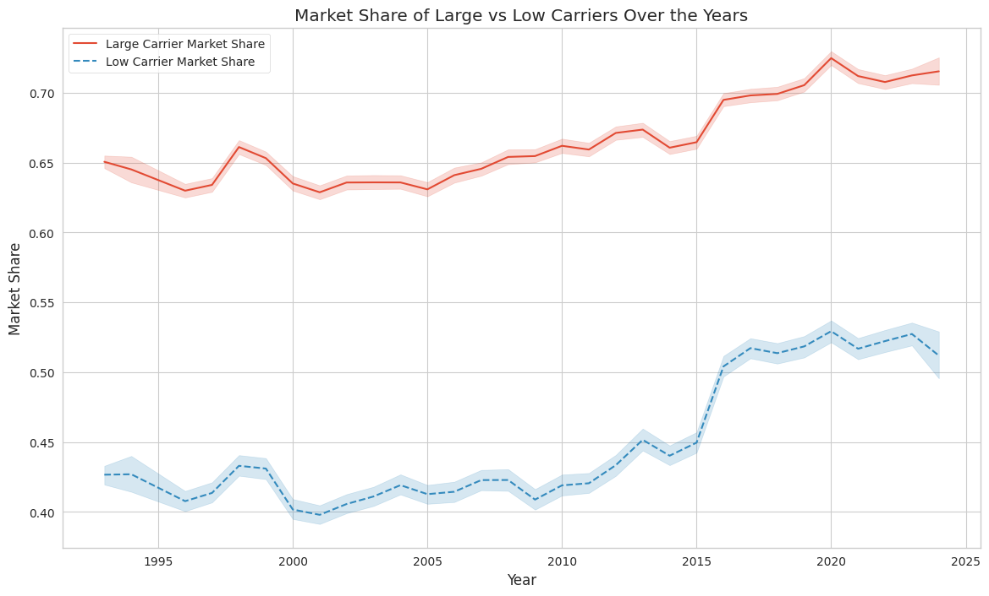
Key Findings
Seasonal Patterns
Q2 (Summer): Highest fares (+0.8%)
Q4 (Winter): Lowest fares (best deals)
Booking sweet spot: 4-8 weeks before departure
Distance drives 35% of price variation
Competition reduces fares by 12-18%
4 distinct route segments identified (clustering)
Market share

Slide 22
Questions?

Slide 23
THANK you!

