Slide 1
International Student Scoring System
Sprint: 1 Demo by Team 25 Washington State University
Presented by: Khushi Panchal, Steven Bennet
Client: International Programs WSU

Slide 2
Introduction
Predict enrollment likelihood of international applicants
Automate scoring and manual review process
Support admission decisions with data-driven insights
Sprint 1 Objectives
Gather requirements
Create documentation (User Stories, Use Cases, UML)
Identify and learn full-stack frameworks

Slide 3
Key Goals for Sprint 1
Conduct client requirement meetings
Develop user stories & UML documentation
Evaluate existing systems (Slate, PeopleSoft)
Identify frameworks: React & Node.js/Express
Begin initial feature development

Slide 4
Requirements Gathering
Process
2 client meetings via Zoom
Requirement Q&A + shared docs
Key Insights
Score applicants by category & overall
Manage multiple document types
Add manual review for flagged cases
Focus on key regions (South Asia, Vietnam, Kenya, Nigeria)
Output: Spreadsheet reports

Slide 5
Documentation Overview
User Stories
Admissions officer → view applicant scores
Admin → flag suspicious documents
System → export results to spreadsheet
Use Case Diagram Highlights
Score Applicant
Upload Documents
Flag for Manual Review
Export Data

Slide 6
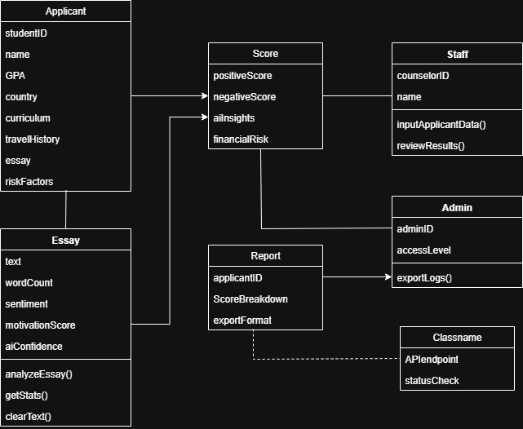
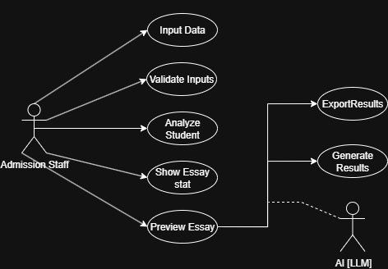
Use case/ UML Diagram

Slide 7
Feature Demonstration
🧮Scoring Algorithm
Calculates category-specific + overall scores
Uses test applicant dataset
📂Document Handling
Accepts file uploads (transcripts, financials, essays)
Stores securely in system database
🚩 Manual Review System
Flags suspicious or incomplete applications
Allows admissions officers to review manually
📊 Data Export
Exports scored applicants to spreadsheet
Easy for client review and decision-making
⚙️ Future Progress (Sprint 2)
Add automated fraud detection
Refine scoring logic + performance

Slide 8
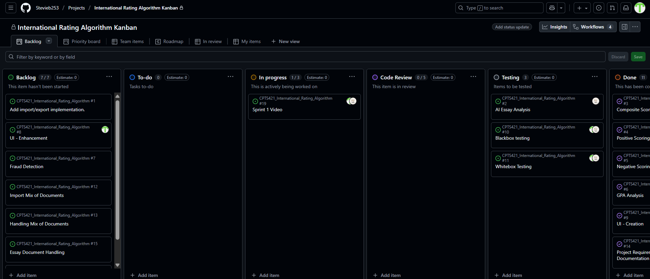
Kanban Board
Requirements gathering, user story creation, UML documentation, skill acquisition.

Slide 9
Skills Identification and Learning Process
Member 1 – Khushi (Front-End Development, Database Management)
Skill: React framework.
Skill: MongoDB (NoSQL).
Member 2 – Steven (Back-End Development)
Skill: Node.js + Express.

Slide 10
Sprint 1 Achievements and Challenges
Achievements:
Gathered requirements from the client and documented them.
Created user stories, use cases, UML diagrams.
Evaluated client systems and identified limitations.
Developed prototype scoring algorithm and document handling system.
Challenges:
Understanding how redacted or blurred documents might affect scoring.
Defining fraud detection rules for multiple document types.
Team addressed challenges by planning test cases and splitting responsibilities for evaluation.

Slide 11
Responsible Use of AI
Disclosure: Used ChatGPT to draft documentation and brainstorm UML diagrams.
Application: AI assisted in creating initial user stories, structuring README, and suggesting UML components.
Limitations: AI outputs required verification and refinement to align with client requirements.
Accountability: All final deliverables and decisions were reviewed and approved by the team.

Slide 12
Next Steps and Retrospective
Next Steps: Begin coding front-end (React) and back-end (Node.js/Express) features based on Sprint 1 documentation. Adding fraud detection and allowing documents to be imported and exported.
Retrospective:
Went well: Team coordination, requirements collection, and initial documentation.
Areas to improve: Better time management for testing datasets and learning new frameworks faster.

Slide 13
Thank you!
Thank you to our stakeholder Trevor Kingsley as this would not be possible without his help! And Thank you our mentor Professor Parteek for the guidance.
We are excited to work on the next tasks to improve the application and will be ready by Sprint 2.

