Slide 1

International Applicant Rating
ALGORITHM
Khushi Panchal & Steven Bennett
12/05/2025

Slide 2
Project Overview
AI-powered system for international student application analysis
Evaluates financial docs, transcripts, essays, and profiles
Calculates risk & potential scores; highlights positive/negative factors
Supports batch processing and CSV/Excel exports
Built with Python, Flask, OpenCV, pdf2image, Tesseract OCR, OpenAI API, MongoDB

Slide 3
Functional Requirements
Student Data Input: Capture applicant information with field validation
Essay Analysis: AI-powered scoring with fallback for accuracy
Scoring Engine: Compute positive, negative, overall composite scores
Financial Risk Assessment: Detect payment issues and financial risks
Fraud & Anomaly Detection: Identify suspicious or unusual documents
Results Presentation: Display clear academic, financial, and behavioral score breakdowns

Slide 4
Non-Functional Requirements
Scalability: Handle multiple users and batch scoring
Accuracy: Match data and flag inconsistencies
Security: WSU keys and role-based access control
Performance: Fast batch scoring with AI fallback
Compliance: Logging, audit trails, and controlled data access
Reliability: 99% uptime and traceable fraud/anomaly flags

Slide 5
System Architecture
Front-End: Collects applicant data and uploads documents
Backend : Coordinates processing and manages workflow
OCR Module: Extracts text from PDFs
AI & Fallback Analysis: Evaluates essays & detects anomalies/fraud
Scoring Engine: Calculates composite scores
Result Delivery: Backend sends structured results back to the UI

Slide 6
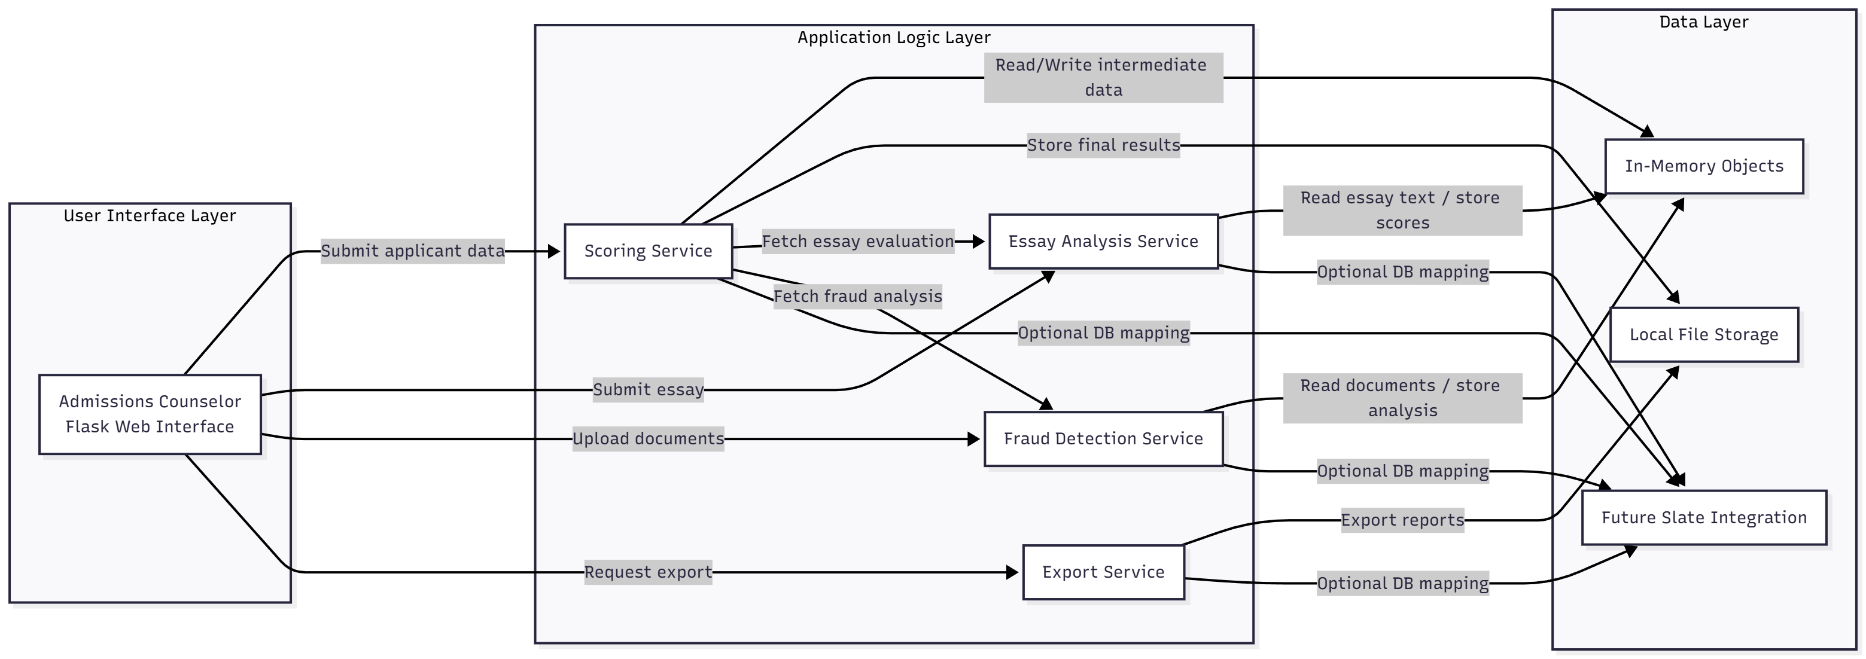
Architecture Diagram

Slide 7
Sprint 3 Achievements
Added multi-PDF batch processing for faster analysis
Implemented financial and transcript document fraud detection
Integrated GPT-based reasoning for explainable risk levels
Added Low / Medium / High fraud classifications
Enhanced OCR previews and AI scoring summaries
Fully integrated fraud checks into the Flask UI workflow
Enabled export of results to CSV/Excel

Slide 8
Sprint 3 Retrospective
What Went Well:
End-to-end financial & transcript fraud detection implemented
Seamless integration into the existing IARA workflow
Clear, explainable risk outputs (Low / Medium / High)
Multi-PDF batch processing added
Challenges:
Limited real sample documents
OCR quality varies with scan resolution
Large PDFs increase processing latency
How We Addressed Them:
Combined heuristics + GPT for reliable analysis
Added input limits and error handling
Logged fraud outcomes for future tuning and improvement

Slide 9
Feature Overview
Student Scoring: AI-powered evaluation of essays, academics, and risk factors
Batch Processing: Multi-PDF support for efficient evaluation of multiple applications
Fraud Detection: Financial and transcript document screening with anomaly detection
Result Presentation: Clear breakdown of positive attributes, risk factors, and final scores

Slide 10
Live Demo
International Application Rating Algorithm

Slide 11
User Interface
Ease of Use: Intuitive interface for admins to input data and upload documents
Actionable Insights: Students’ risk and positive factors clearly displayed
Decision Support: Helps admissions team make informed choices with AI-assisted scoring
Feedback Loop: Results can be exported for reporting or integrated into existing workflows

Slide 12
Testing
Methodology: Manual end-to-end tests for scoring, batch processing, and fraud detection
What We Tested: Student scoring, batch workflows, financial & transcript fraud, AI fallback
Key Observations: Stable flows; fraud labels ~80–85% accurate
Challenges & Future Work: Add unit and integration tests; expand dataset for better accuracy

Slide 13
Responsible Use of AI
Tools: ChatGPT, Claude
Applications:
ChatGPT: Drafted documentation, brainstormed ideas
Claude: Suggested demo code snippets
Benefits: Saved development time, improved clarity, enhanced scoring and risk analysis
Limitations & Verification: Reviewed AI outputs for accuracy; combined with heuristics for reliability

Slide 14
Next Semester Plan & Deliverables
Functional:
Enhanced financial & transcript fraud detectors
Exportable, explainable reports
Improved OCR accuracy
Slate workflow integration
Non-Functional:
Faster processing & better scalability
Higher reliability, fewer false positives
Timeline:
Jan–Feb: Refine detectors, improve OCR
Feb–Mar: Slate integration, export features
Mar–Apr: Performance & scalability tuning
Apr–May: Final testing & user evaluation

Slide 15
Conclusion
Reflection: Strong progress in fraud detection, scoring, and AI-assisted analysis
Lessons Learned: Value of fallback methods, robust error handling, and explainable AI outputs
Overall Achievement: System now delivers reliable, actionable insights for international student applications

Slide 16
Thank you!

