Slide 1

Gotham Keynote
Marceau Cristianini
Jonathan Khalifa
Christophe Tiet
Morgan Druesne

Slide 2


INTRO

Slide 3



Slide 4


TEAM GOTHAM

Slide 5

PLAN
1 - Plannification
2 - Communication
3 - Accompagnement

Slide 6
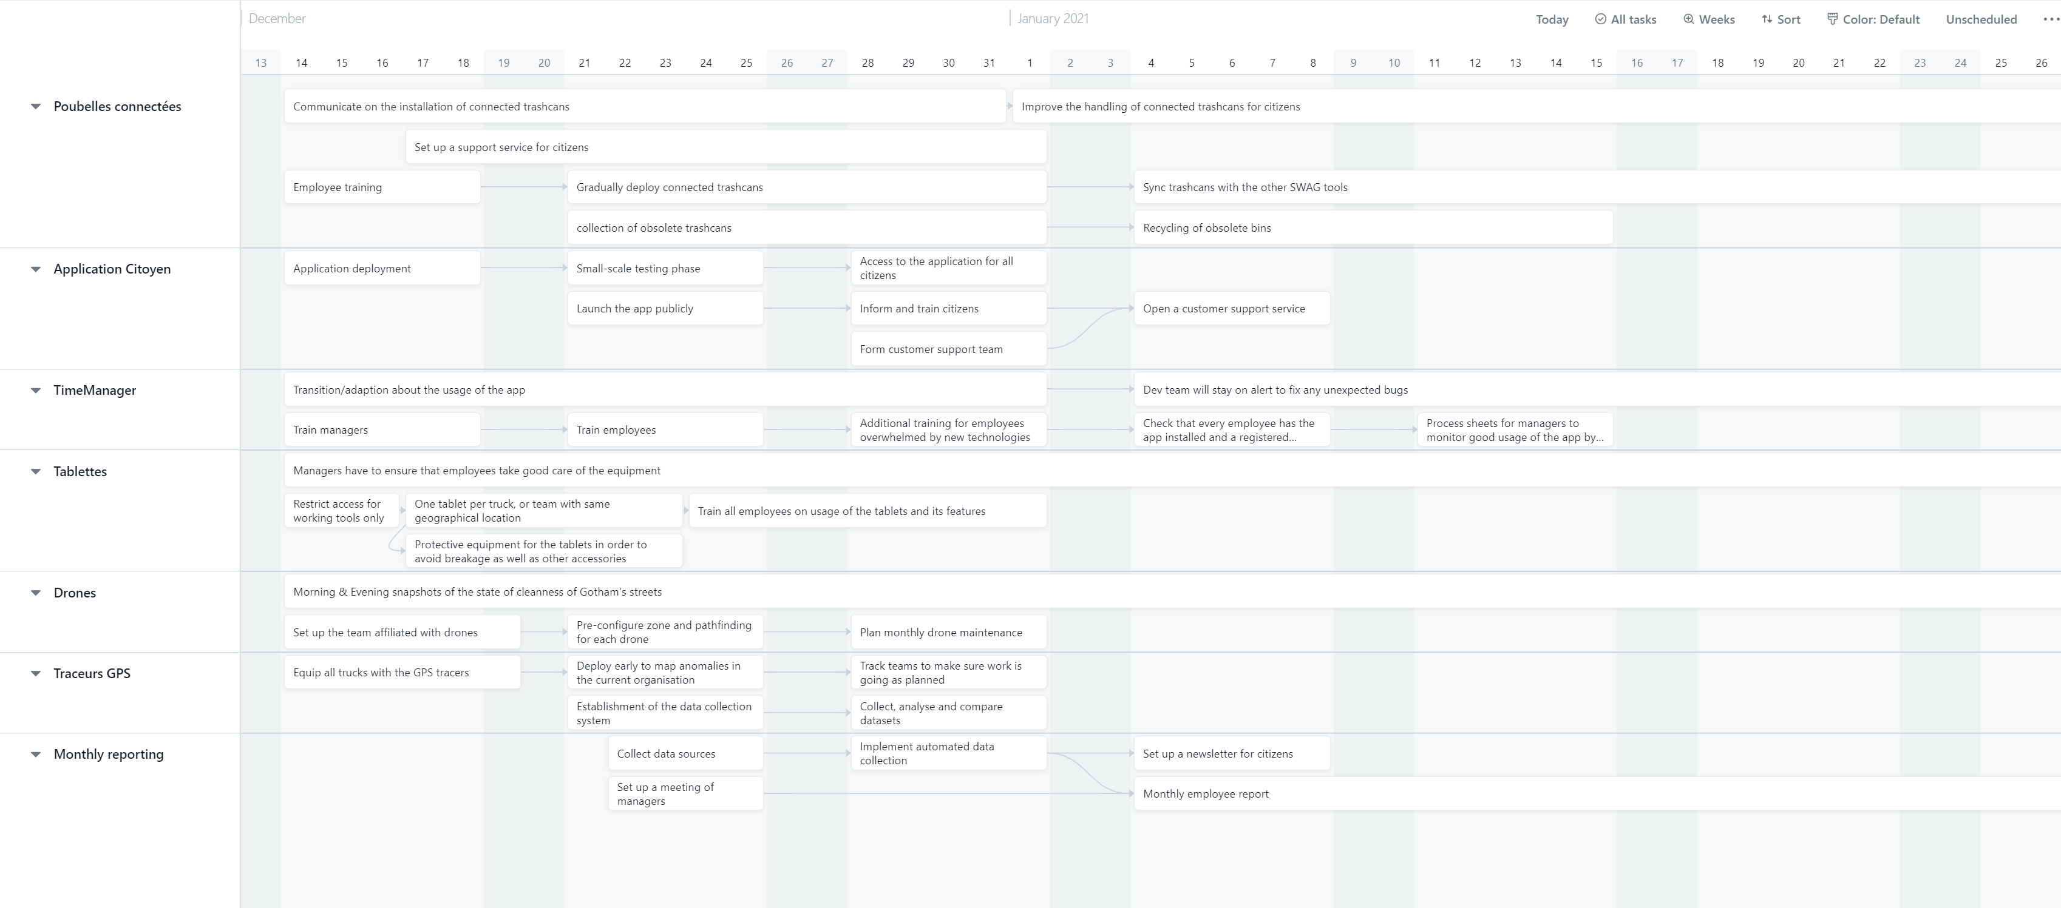
Gantt Diagram

Slide 7
Any Questions ?
Thank you !

