Slide 1
The Technology Value Stream
Jeremiah Kellam
Csd380 Module 1.2 assignment
6/7/2024

Slide 2
What is a value stream
Gartner defines the value stream is defined as, “the sequence of activities necessary to deliver a product, service or experience to a customer, internal or external.” (Attlassian)
Regarding a technology value stream, it “is the process required to convert a business hypothesis into a technology-enabled service that delivers value to the customer.” (N. Brown)

Slide 3
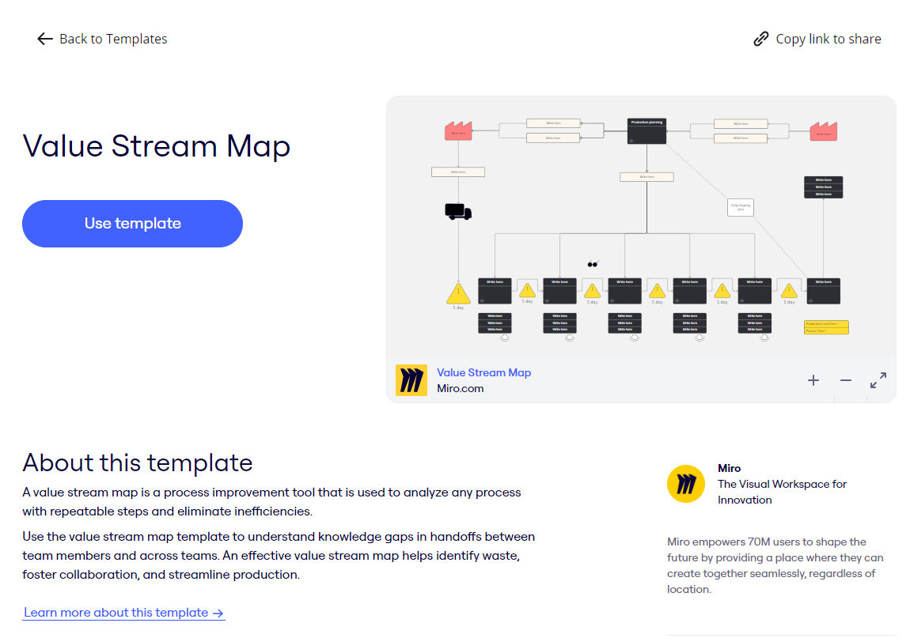
Value Stream Tools – Miro.com
Here is a template that can be used at MIRO.COM to assist in making a value stream map where you indicate process steps and action items throughout the lifecycle.

Slide 4
Lead time Versus processing time (Kim et al., 2015)
Lead time is the total amount of time from initiation of a request, to the start of work, and ending with the completion of the work.
Process time is the exact amount of time needed for work to be done from start to finish.
Process time is included in the total amount of lead time.

Slide 5
The Common Scenario: Deployment Lead Times Requiring Months (Kim et al., 2015)
The book references the challenges before DevOps or Agile or even Lean practices causing delays from lack of progress, long test times with poor integration and remedies for issues.
It simply stated that “heroics” are needed at every stage by individuals to drive change and get results that are needed to meet goals.
Any lack of heroes results in it all crumbling down.

Slide 6
Our DevOps Ideal: Deployment Lead Times of Minutes (Kim et al., 2015)
The book also gave a good visual aide of the process needed to have a lead time of minutes having modular design with many teams able to tackle one item so they are able to:
→ Commit
→ Perform an Automated Test
→ Exploratory Test to validate results
→ Deploy product for usage.

Slide 7
The Third Metric: Percent complete and accurate
One major point I loved reading was about “%C/A” or percent complete and accurate.
Rework is the killer of progress and I’ve dealt with it too often.
The Lead time is the first metric, process time the second, and %C/A is the third to give a solid picture of not only the speed of work but also the quality.

Slide 8
References
Atlassian. (n.d.-e). What is Value Stream Management? | Atlassian. https://www.atlassian.com/agile/value-stream-management
Brown, Nanette (2021, May 24). Taking DevSecOps to the Next Level with Value Stream Mapping. SEI Blog. https://insights.sei.cmu.edu/blog/taking-devsecops-to-the-next-level-with-value-stream-mapping/
Kim, G., Debois, P., Willis, J., & Humble, J. (2015). The DevOps Handbook: How to Create World-Class Speed, Reliability, and Security in Technology Organizations. It Revolution Press.
Sign up | MIRO | The Visual Workspace for Innovation. (n.d.). https://miro.com/. https://miro.com/app/dashboard/?tpTemplate=fb823f2e-9993-4ce7-9dbd-83b947ba00d8&isCustom=false&share_link_id=593925621034

