Slide 1
Establishing a just, learning culture
Jeremiah Kellam
Csd380 Module 9.2 assignment
7/22/2024

Slide 2
What is a Just, Learning Culture (KIM, Et Al. 2014)
A just learning culture is one that responds to incidents in ways that do not impede on investigations and promote fear rather than emphasize the effort to prevent the incident from happening.
An Unjust learning culture will result in more bureaucracy rather then problem resolution and will promote professional secrecy, evasion, and self-protection rather than mindfulness and cohesion to work towards a solution.

Slide 3
Incident occurrence – who’s fault is it?
There is a culture at my current place of employment that when an incident occurs, the first question out of leadership is, “What disciplinary actions have you taken?”
As I started working in my field, I jumped on that bandwagon as that was what I was shown to be successful.
Later I found that all I was seeing was employees that never took a chance because they were afraid to lose what they have.

Slide 4
Bad Apple Theory (kim, et al. 2014)
The bad apple theory is to eliminate the people who cause errors rather than address the issue with the equipment or training that we have provided them.
The belief is that a “bad apple” is the root of all issues and removal will make a process work as intended.

Slide 5
Resolving the issue, not removing the person (Trovas, 2022)
The center for creative leadership requires the establishment of a culture where you foster trust and collaboration in order to build a learning culture.
A psychologically safe workplace contributes to innovation and productivity.
Encouraging questions, transparency in decision making, and an open candor will contribute to learning overall.

Slide 6
Incident resolution and reoccurrence
My position makes me responsible for those I work with.
Overtime, I’ve moved away from disciplinary actions towards process improvement and training requirements.
Engineering a fix is the best mitigation strategy to eliminate risks, but changing a process and rolling out training and documentation has resulted in longer periods between incidents and the requirement for disciplinary action

Slide 7
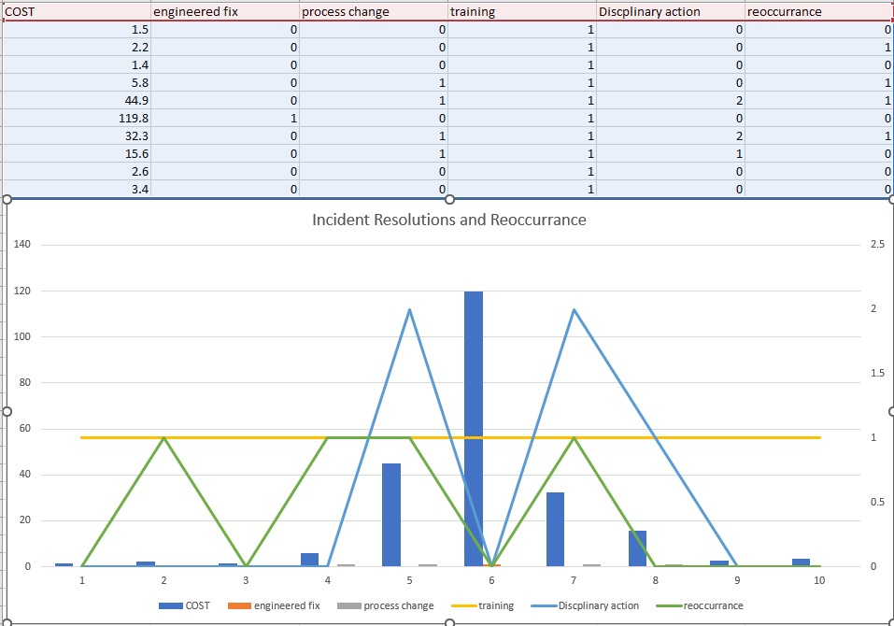

Slide 8
Continuous process improvement and input
Other than one engineering fix that was needed after major loss, all mitigation strategies has been training and process change.
Fiscally, I am required to discipline once the cost reaches a threshold.
I work very hard to find a root cause for blame to be removed so that a solution can be found and a preventative measure can be put in place rather than blame an employee.
Tracking occurrences and who is involved shows what challenges are still prevalent to allow them to occur
I work with those involved to find a way to stop the incident, rather than have them fear to ever make a mistake again.

Slide 9
Results
My efforts have resulted in less disciplinary actions being REQUIRED in the past six months, than there were in the first two months on the job.
Department loss and costs are matching similar locations within the company rather than being the example of what not to do.
Team cohesion is higher with efforts to assist each other rather than watch a person struggle, leading to easier workloads and less incident occurrence.

Slide 10
Conclusion
I agree with the text and the Center for Creative Leadership that a workplace needs to be psychologically safe to promote growth and empowerment of its employees.

Slide 11
References
Kim, G., Debois, P., Willis, J., & Humble, J. (2015). The DevOps Handbook: How to Create World-Class Speed, Reliability, and Security in Technology Organizations. It Revolution Press.
Trovas, S. (2022, May 12). Cultivate a learning culture within your organization. CCL. https://www.ccl.org/articles/leading-effectively-articles/cultivate-and-sustain-a-learning-culture-within-your-organization/

