Slide 1
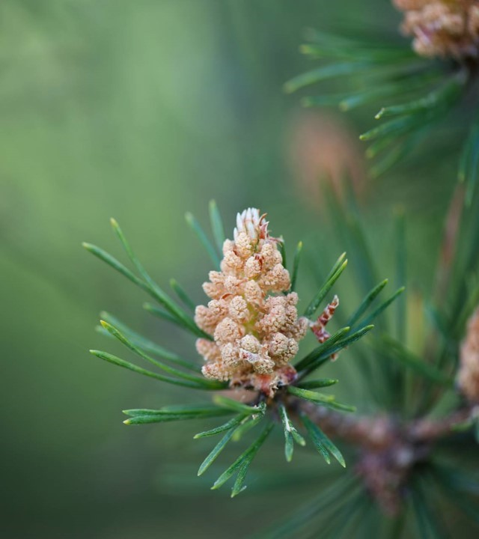
Moffat Bay Lodge
Jaci Brown Austin Moore
Jon Green

Slide 2
About us
Jaci
Jon
Austin
Descriptors: Team leader, Java lover, Organizer, Worry-er
Descriptors:
Location: South Mississippi
Field Preference: Back-end logic, possibly DB, or full start up.
Leader award: Methodical Solver
Location:
Field Preference:
Descriptors: Loves web development, overly analytical, avid movie buff. Location: North Carolina Field Preference: Front-end development and Cybersecurity
Team compliments: Detailed, focused, calm
Team compliments: Methodical problem solver/troubleshooter, patient
Project Requirements:
Presentation with slides for each of the following, at minimum:
Introduction of Team
Sample Prototypes
ERD
Description of at least five (5) tests created, and results of those tests
Lessons Learned as a team.
Screen Capture of live site, depicting the functionality of the following:

Slide 3
Lessons learned by the team:
I have never done well at depending on others, so relying on a group was very difficult at first. I didn't know what to expect but overall, it has turned out well in my opinion. My team excelled at working within the project structure provided by claiming tasks, offering opinions and delivering work on time, and it made the process a lot less stressful in the end due to distribution of work.
Jaci

Slide 4
Lessons learned by the team:
Jon
Working in a team environment is critical as the majority of development careers will involve this business culture. The team experience on this project has allowed me to learn quite a bit in regard to effectively working together, meeting deadlines, overcoming hurdles, as well as the importance foundational leadership in a group setting. Effective communication is key as it maintains the structure of the project and ensures that everyone’s work is consistent and on schedule. Another lesson learned is how effective communication and realistic expectations for the project work in tandem. The output must be obtainable based on a realistic time schedule, otherwise it can create an unpleasant result due to the bar being set too high.

Slide 5
Lessons learned by the team:
Austin:
Nilam:

Slide 6
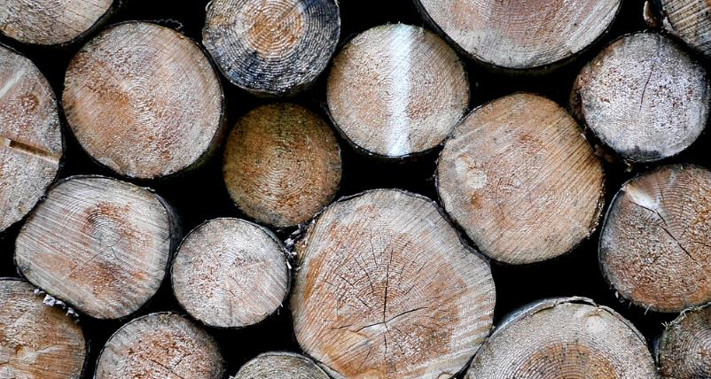
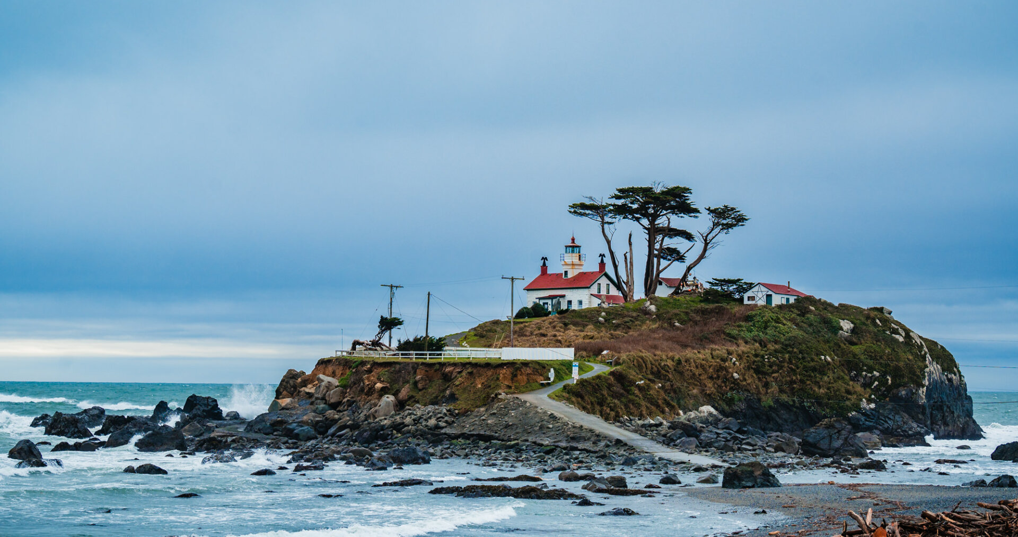
Design process
While building a website to represent Moffat Bay Lodge, we considered the surrounding area carefully. We wanted to bring to life the spirit of the experience here on Joviesda Island.

Slide 7
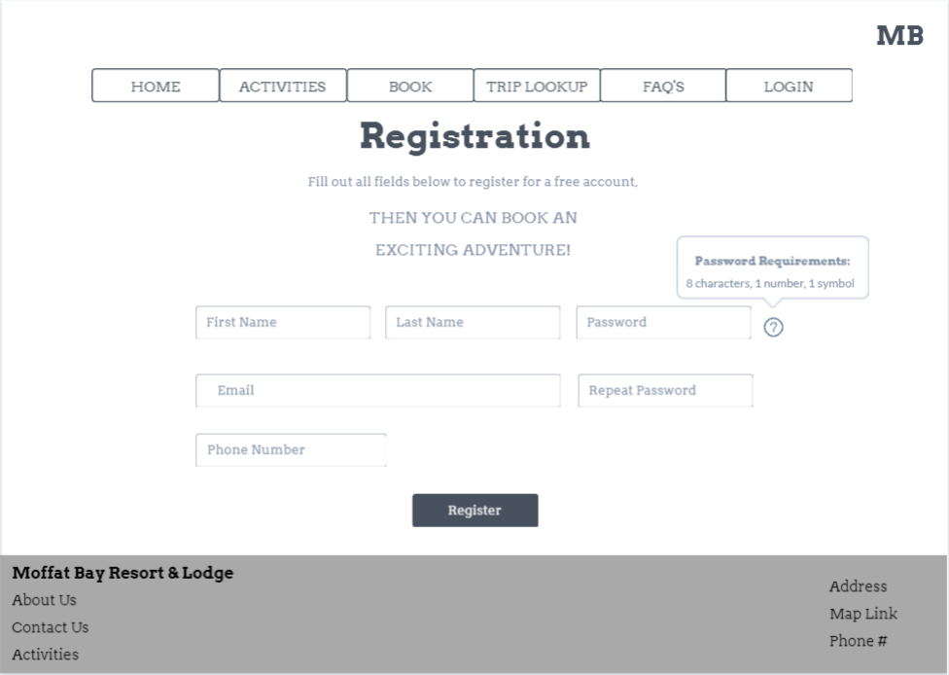
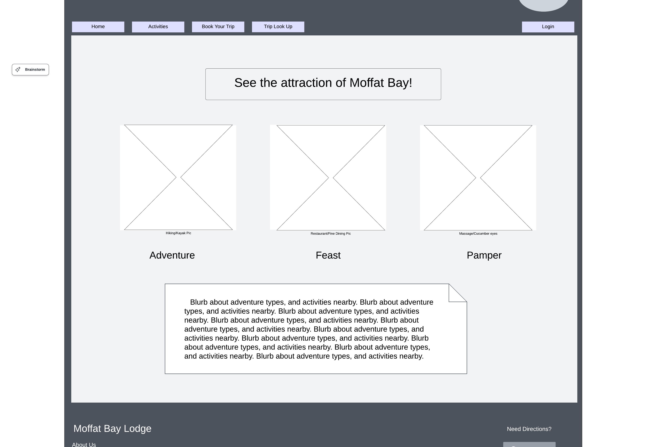
Rough prototypes
Initially, our designs were very basic. We naturally aligned to having contrast for text and menu bars. The goal was to have a mental image to hold while coding, and a way to see the requirements visually.

Slide 8
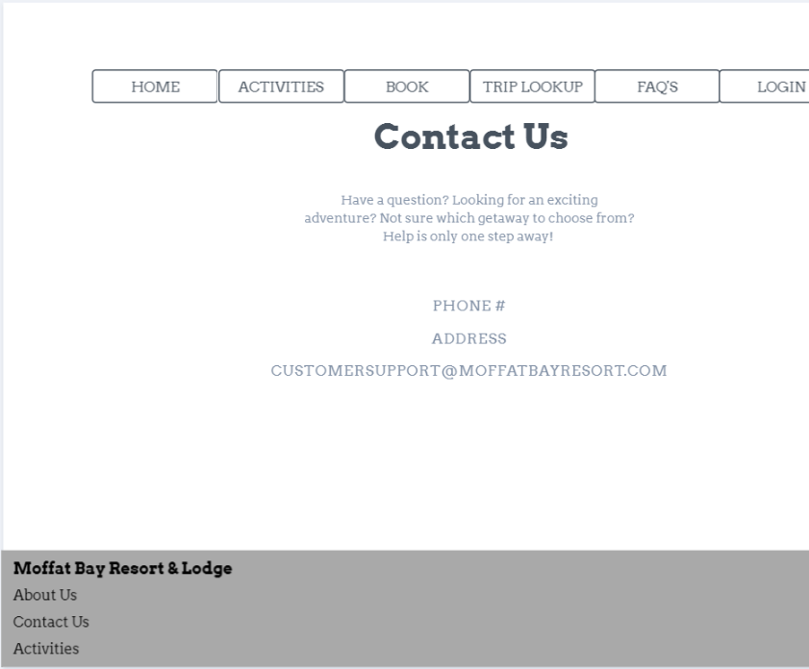
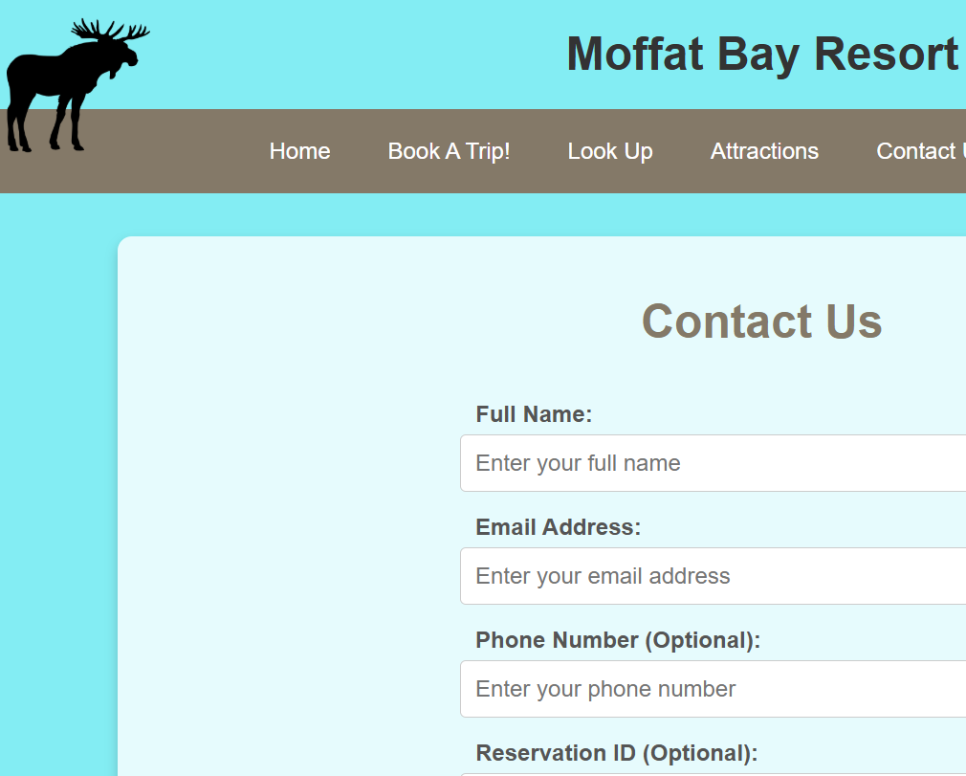
Prototypes in action:
Some of the designs evolved as we settled on a cohesive style. Representing consistency was often highlighted to increase customer trust.

Slide 9
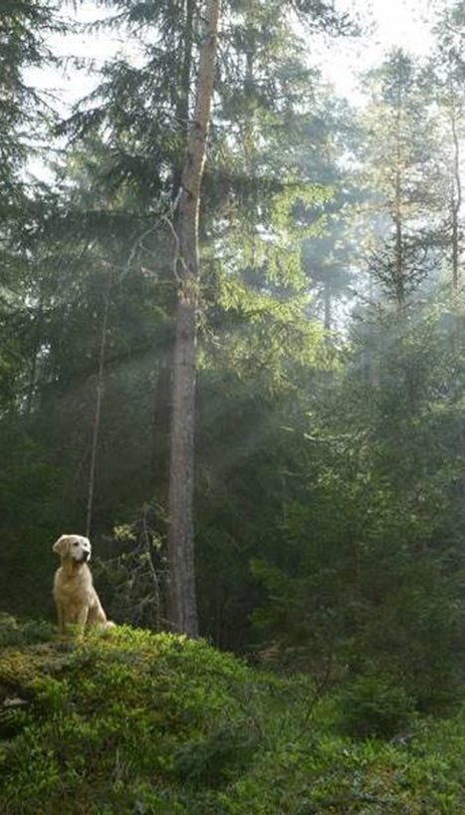
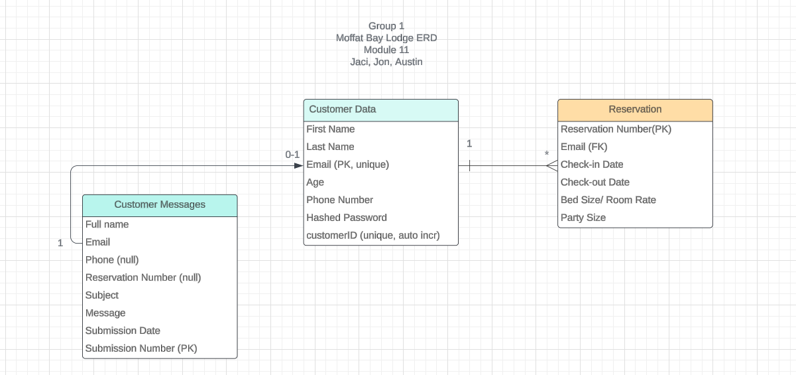
ERD AND TESTING
Our design initially only included customer data and reservations. As we began working, we soon realized we had overlooked storing the messages from the contact page. However,

Slide 10
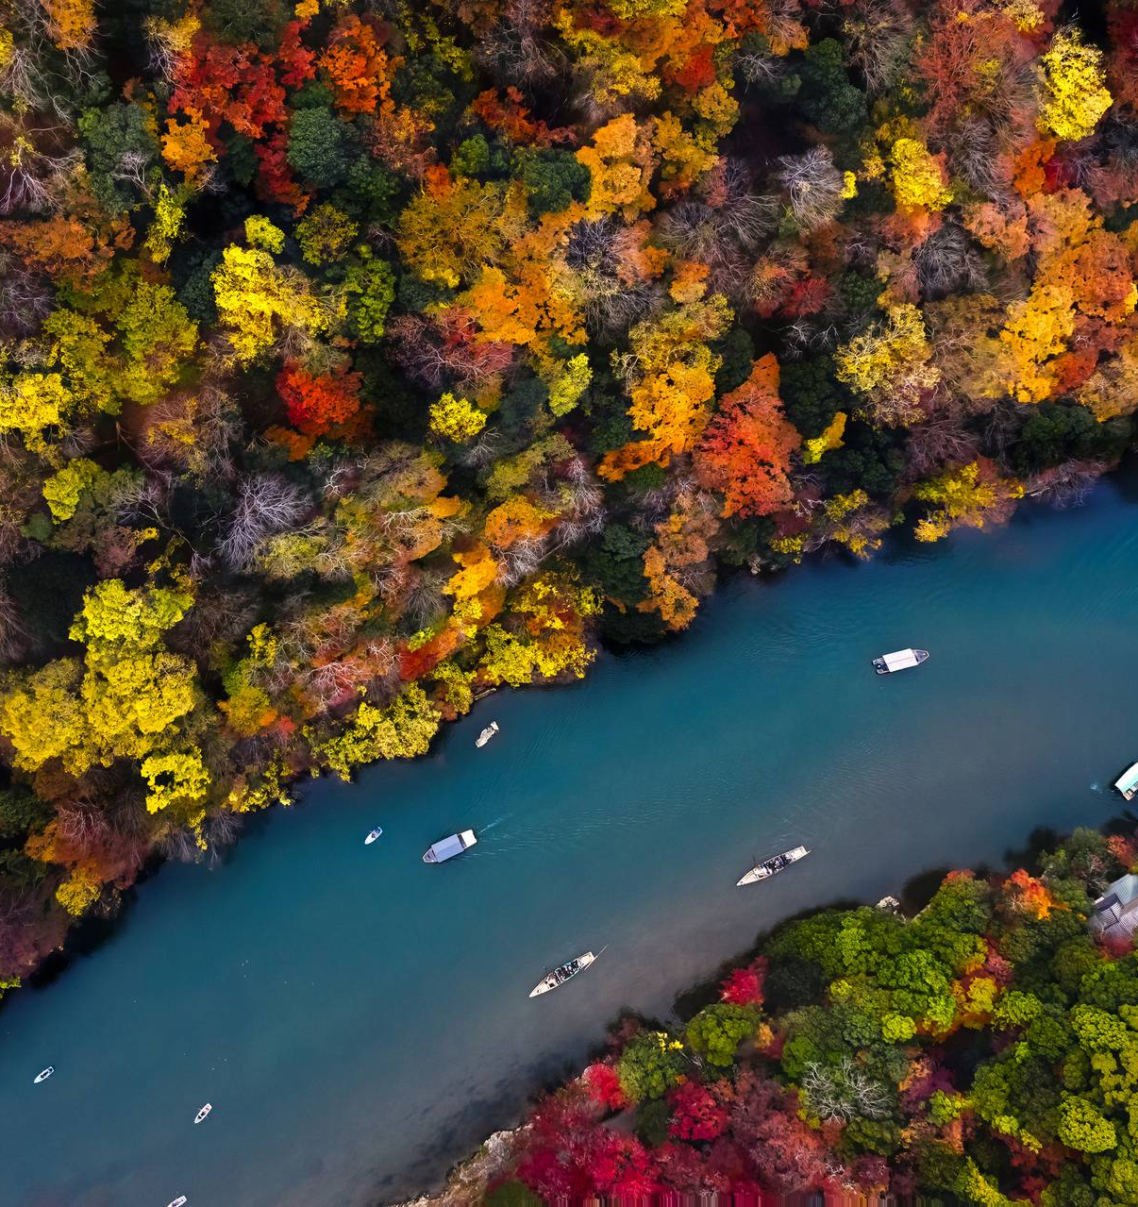
More testing
Highlight feedback/errors
“links to attractions”

Slide 11
Probably more testing
Add images and one – two sentences explaining test thought and outcome
Add pics of success and failure if possible

Slide 12
Favorite features
Cool features
Each devs favorite?
Only product specifically dedicated to this niche market
First beautifully designed product that's both stylish and functional
Conducted testing with college students in the area
Designed with the help and input of experts in the field

Slide 13
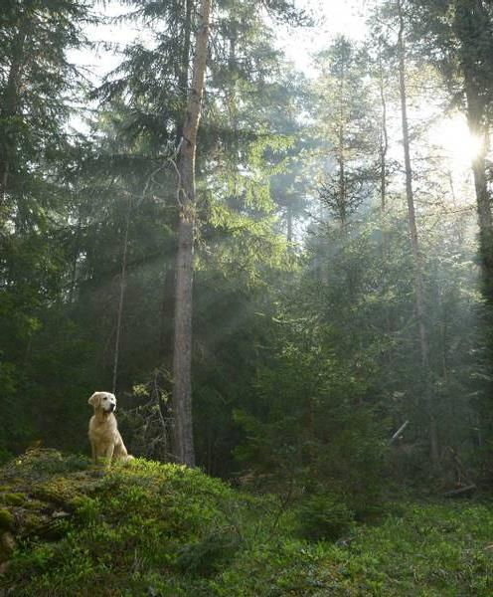
lessons
Team Lessons learned

Slide 14
Probably delete
Opportunity to build
Fully inclusive market
Total addressable market
Freedom to invent
Selectively inclusive market
Serviceable available market
 | Clients | Orders | Gross revenue | Net revenue
20XX | 10 | 100 | $10,000 | $7,000
20XX | 20 | 200 | $20,000 | $16,000
20XX | 30 | 300 | $30,000 | $25,000
20XX | 40 | 400 | $40,000 | $30,000

Slide 15
Probably delete
Our product makes consumer lives easier, and no other product on the market offers the same features
Gen Z (18-25 years old)
Reduce expenses for replacement products
Simple design that gives customers the targeted information they need
Close the gap
Target audience
Cost savings
Easy to use

Slide 16
Probably delte
 | Year 1 | Year 2 | Year 3
Income
Users | 50,000 | 400,000 | 1,600,000
Sales | 500,000 | 4,000,000 | 16,000,000
Average price per sale | 75 | 80 | 90
Revenue @ 15% | 5,625,000 | 48,000,000 | 216,000,000
Gross profit | 5,625,000 | 48,000,000 | 216,000,000

Slide 17
Thank you
Link our git hub? And idk

