Slide 1
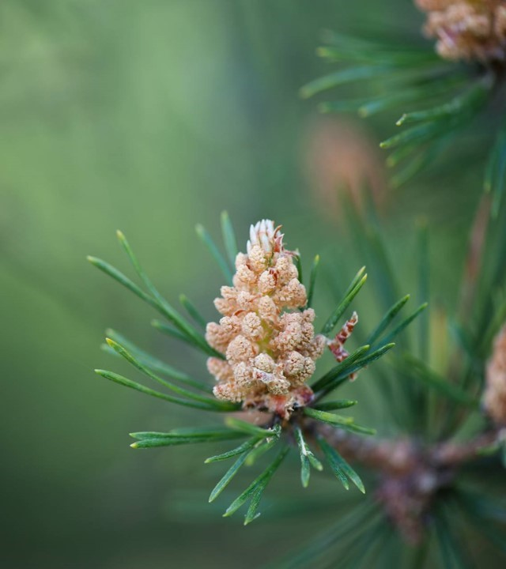
Moffat Bay Lodge
Jaci Brown Austin Moore
Jon Green

Slide 2
About us
Project Requirements:
Presentation with slides for each of the following, at minimum:
Introduction of Team
Sample Prototypes
ERD
Description of at least five (5) tests created, and results of those tests
Lessons Learned as a team.
Screen Capture of live site, depicting the functionality of the following:

Slide 3
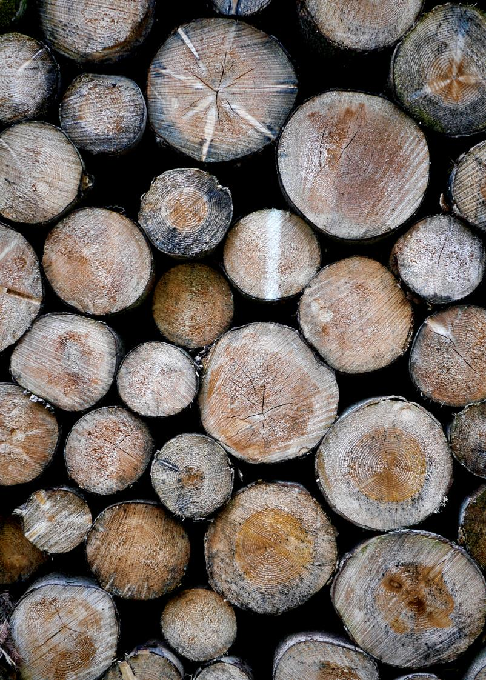
Team overview

Slide 4
Rough prototypes

Slide 5
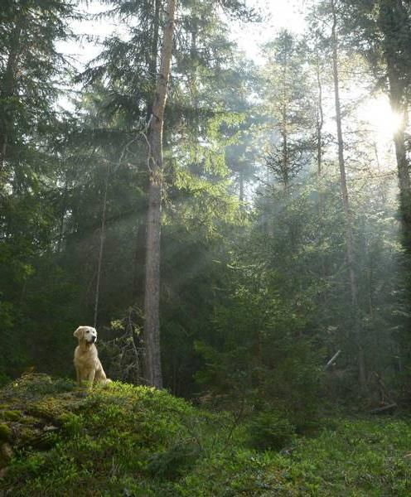
Prototypes in action
More current images of protype meeting real life

Slide 6
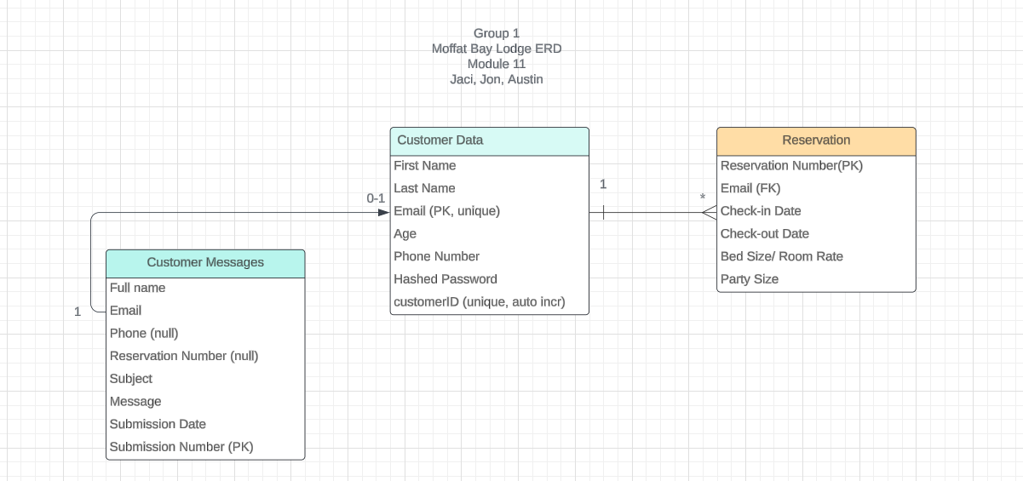
ERD AND TESTING

Slide 7

More testing
Highlight feedback/errors
“links to attractions”

Slide 8
Probably more testing
Add images and one – two sentences explaining test thought and outcome
Add pics of success and failure if possible

Slide 9
Favorite features
Cool features
Each devs favorite?
Only product specifically dedicated to this niche market
First beautifully designed product that's both stylish and functional
Conducted testing with college students in the area
Designed with the help and input of experts in the field

Slide 10
lessons
Team Lessons learned

Slide 11
Probably delete
Opportunity to build
Fully inclusive market
Total addressable market
Freedom to invent
Selectively inclusive market
Serviceable available market
 | Clients | Orders | Gross revenue | Net revenue
20XX | 10 | 100 | $10,000 | $7,000
20XX | 20 | 200 | $20,000 | $16,000
20XX | 30 | 300 | $30,000 | $25,000
20XX | 40 | 400 | $40,000 | $30,000

Slide 12
Probably delete
Our product makes consumer lives easier, and no other product on the market offers the same features
Gen Z (18-25 years old)
Reduce expenses for replacement products
Simple design that gives customers the targeted information they need
Close the gap
Target audience
Cost savings
Easy to use

Slide 13
Probably delte
 | Year 1 | Year 2 | Year 3
Income
Users | 50,000 | 400,000 | 1,600,000
Sales | 500,000 | 4,000,000 | 16,000,000
Average price per sale | 75 | 80 | 90
Revenue @ 15% | 5,625,000 | 48,000,000 | 216,000,000
Gross profit | 5,625,000 | 48,000,000 | 216,000,000

Slide 14
Thank you
Link our git hub? And idk

