Slide 1
Appendix E: Time series prediction using Neural Networks
November 2018

Slide 2
Time Series Prediction
Time series prediction: given an existing time series, we model the time series in order to make accurate forecasts
Example time series
  Financial (e.g., stock price, exchange rates)
  Physically observed (e.g., weather, sunspots, river flow)
Why is it important?
  Preventing undesirable events by forecasting the event, identifying the circumstances preceding the event, and taking corrective action so the event can be avoided.
  Forecasting undesirable, yet unavoidable, events to preemptively lessen their impact e.g., flood prediction
  Profiting from forecasting (e.g., financial markets)

Slide 3
Why is it difficult?
  Limited quantity of data (Observed data series sometimes too short to partition)
  Noise (Erroneous data points, obscuring component)
  Moving Average
  Nonstationarity (Fundamentals change over time, nonstationary)
  Forecasting method selection (Statistics, Artificial intelligence)
Neural networks have been widely used as time series forecasters: most often these are feed-forward networks which employ a sliding window over the input sequence.
The neural network sees the time series X₁,…,X_{n} in the form of many mappings of an input vector to an output value.

Slide 4
Prediction with Neural Networks
A number of adjoining data points of the time series (the input window X_{t-s}, X_{t-s-1},…, X_{t}) are used as activation levels for the input units of the input layer.
The size s of the input window correspondends to the number of input units of the neural network.
In the forward path, these activation levels are propagated over one hidden layer to one output unit. The error used for the backpropagation learning algorithm is now computed by comparing the value of the output unit with the transformed value of the time series at time t+1. This error is propagated back to the connections between output and hidden layer and to those between hidden and output layer. After all weights have been updated accordingly, one presentation has been completed.

Slide 5
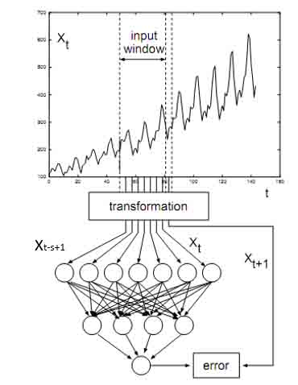
Fig. Learning a time series by a neural network

Slide 6
Prediction with Neural Networks (cont.)
Training a neural network with backpropagation algorithm usually requires that all representations of the samples (called one epoch) are presented many times. For examples, the ANN may use 60 to 138 epoches.
Neural networks can perform time series prediction with high precision since they can capture the non-linear characteristics of time series data.

Slide 7
Evaluating Methods of forecasts
Divide the data into two sections - an initialization part and a test part
  Use the initialization data set to train the neural network
  Use the trained neural network to forecast the test data set and determine the forecast errors to evaluate the predictive effectiveness.
  Evaluate errors (MAD, MPE, MSD, MAPE)

Slide 8
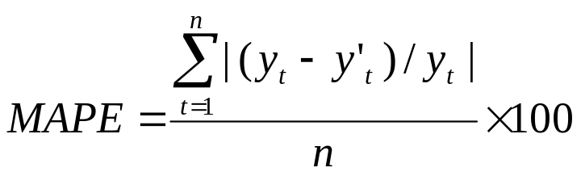
Evaluation Methods of Forecasts
There are three measures of accuracy of the prediction models: MAPE, MAD and MSE.
For all three measures, the smaller the value, the better the fit of the model.
Use these statistics to compare the predictive accuracy of the different methods.
MAPE (Mean Absolute Percentage Error) measure the accuracy of predicted time series values. It expresses accuracy as a percentage.
where y_{t} is the actual value, y’_{t} is the predicted value and n is the number of observations.

Slide 9
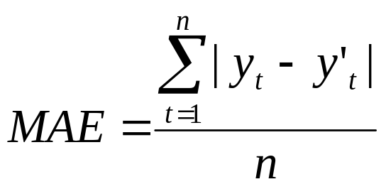
MAPE, MAD, and MSD
MAD (Mean Absolute Deviation) expresses accuracy in the same units as the data, which help conceptualize the amount of error.
where y_{t} is the actual value, y’_{t} is the predicted value and n is the number of observations.

Slide 10
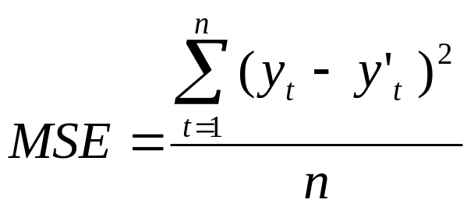
MAPE, MAD, and MSD
MSE(Mean Squared Error) is a more sensitive measure of an unusually large forecast error than MAD.
where y_{t} is the actual value, y’_{t} is the predicted value and n is the number of observations.

