Slide 1
New York City Bike Sharing Demand
Jesse Geman
Sibel Kadıoğlu
Bruce Wang
DATA 1030 Final Project
Supervised by Prof. Dan Potter
Data Science Initiative – Brown University
Notes:
I am Sibel Kadioglu
Today I will talk about

Slide 2
Data
- Citi Bike Data
- Weather Data
- Census Data

Slide 3
Problems to solve from the Data?
How to improve user experience? - Predict outgoing and incoming bikes
Can we provide useful information to prospective business? - Predict certain demographic destinations - Develop trafic based neighborhood

Slide 4
Our Approaches – I
For user experince, - Predicting outgoing/incoming bikes for each stations for a given day and hour - Predicting total outgoing/incoming bikes
for a given day and hour

Slide 5
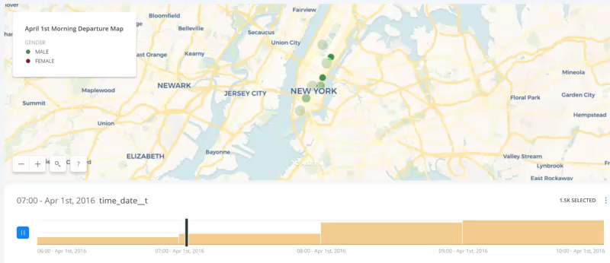
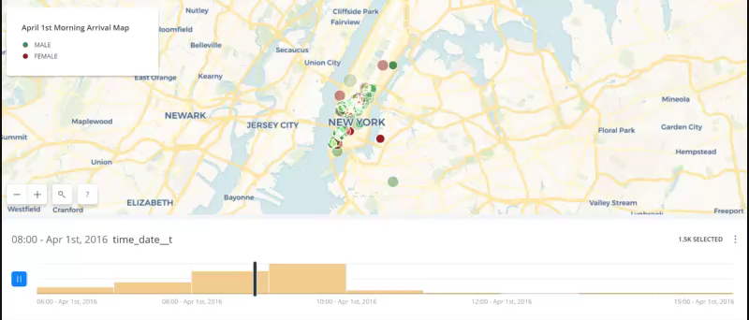
Our Approaches – II
We want to predict destinations of a rider given some initial conditions (weather, age, sex, time of day, etc.)

Slide 6
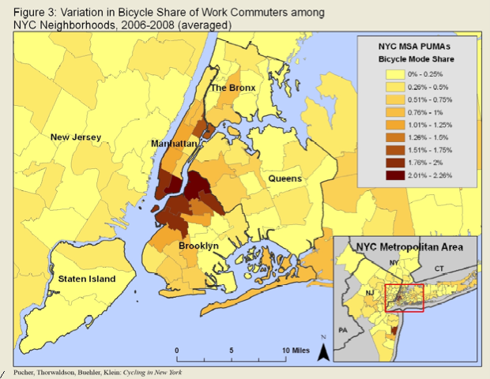
Our Approaches – III
Can we find geographical patterns within the traffic? (Commuter regions, etc.)
https://nyc.streetsblog.org/wp-content/uploads/2010/04/26/Picture_4.png

