Slide 1

AdaBoost Regressor
Meta Estimator.
Fitting the regressor on the original dataset.
Also Fits additional copies of the regressor on the same dataset
Algorithm => AdaBoost.R2

Slide 2
AdaBoost Regressor
Program Procedure:
class sklearn.ensemble.AdaBoostRegressor
regressor = AdaBoostRegressor(random_state=None, n_estimators=50)
Regressor.fit(X, y)

Slide 3
AdaBoost Regressor
Parameters :
1. object, default : None
n_estimators : int, default=50
learning_rate : float, default=1.0
Loss: {‘linear’, ‘square’, ‘exponential’}, default=’linear
random_state : int, RandomState instance or None, default=None
base_estimator : object, default=None

Slide 4
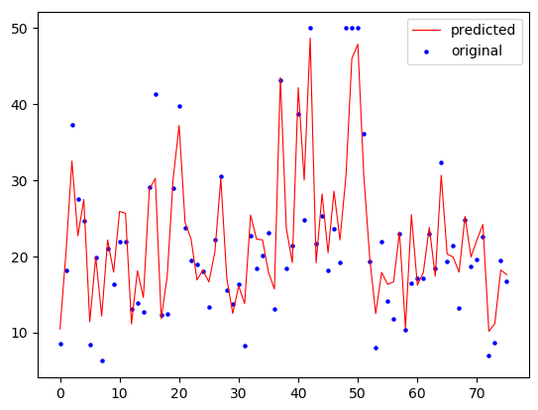
AdaBoost Regressor

