Slide 1
Going from FINN to Galapagos

Slide 2
Objectives
Explore connecting the FINN Quantized-Neural-Network (QNN) compiler with Galapagos, so that the compiled IP cores produced by FINN can be run on multiple devices

Slide 3
Background-FINN
FINN: Open-Source compiler used to compile QNN’s into hardware IP cores that can be run on FPGAs
Each generated IP core generally represents a single node in the QNN (popcount/FIFO, etc), allowing for the possibility of splitting compute across multiple devices
Although QNN’s are supported, main focus is Binary-Neural-Networks (BNN’s)

Slide 4
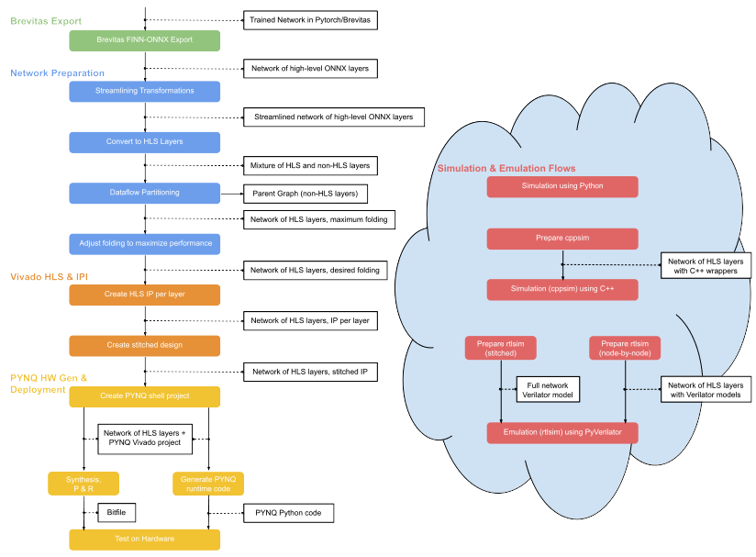
Background-End2End Flow
End-to-End Flow:
Input: Pretrained QNN PyTorch Model
Outputs:
  parent_model: ONNX model of all nodes that can’t be accelerated
  child_model: ONNX model of all nodes that can be accelerated
  Vivado Project of child_model, with Block Design of the nodes converted to IP, stitched together
FINN can also execute the parent_model, running the accelerated child_model on a Xilinx Pynq Board
(Not Pictured) FINN also offers some functional verification tools to verify the outputs of different stages of the flow

Slide 5
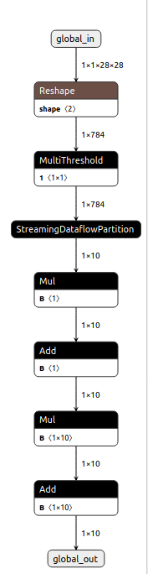
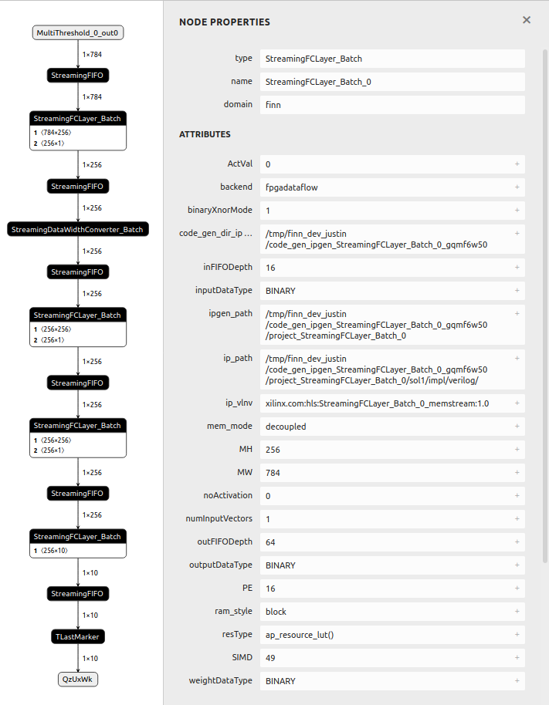
Background-Input/Output Models
Parent Model
(Run in SW)
Child Model
(Run in HW)
Input Model:
Exported as Open-Neural-Network-Exchange (ONNX) format, with modifications
Weights are quantized before export
FINN-specific annotations added to enable binary quantization
Parent/Child Models:
Saved as ONNX format
FINN’s ONNX-Exec functions can deploy the child model to FPGA and run the parent model
ONNX-Exec functions will switch to running child_model automatically when it arrives at the StreamingDataflowPartition
To explore: What if there’s more than one child model?

Slide 6
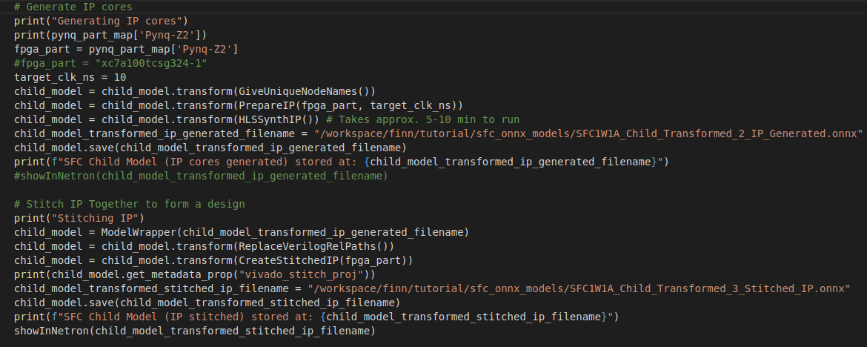
Background-Implementation
FINN functions are called in Python
ONNX model is treated like a class
Steps in Network Preparation, Vivado HLS Generation and Deployment are performed by applying FINN Transform passes on the model
Custom Transform/Analysis passes are supported
Allows users to access the model/flow at any stage

Slide 7
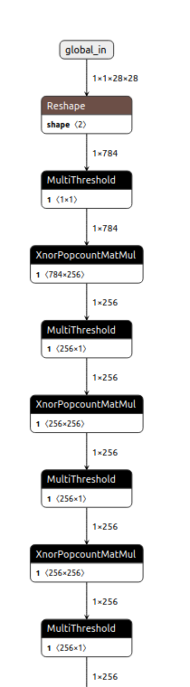
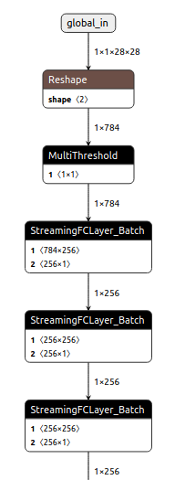
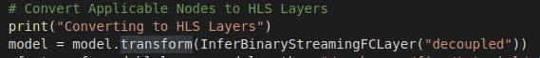
Background-HLS Layers
Transform applied to ONNX Model
FINN goes through the model, and replaces any applicable nodes with nodes indicating they will be run on HLS
Not all nodes can be accelerated
  Each node type that can be converted requires its own transform
  IP cores are synthesized based on a library of HLS primitives

Slide 8
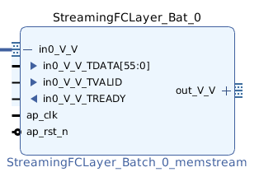
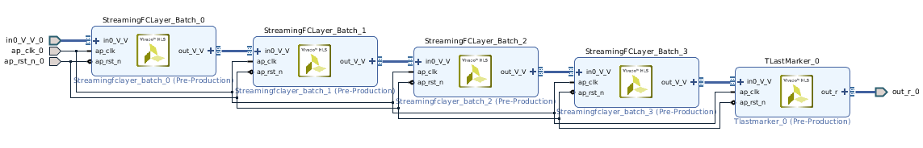
Background-IP Generation
Run on child_model only
Each node in child_model becomes a unique IP Core (images shown are from different models)
ONNX model stores path to IP Core files in ipgen_path attribute
Each IP core that is generated is connected using the AXI-Stream protocol (but no last signal?)

Slide 9
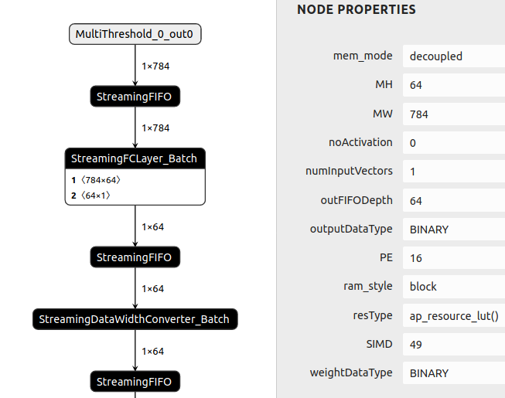
Background – FINN SFCL Cores
StreamingFCLayer (SFCL) Cores perform the computations of one layer in the BNN
Communication: AXI-Stream
Communication Width:
  Communication width is governed by Folding Factors, allows us to trade off between parallelism (performance) and on-chip area
  SIMD: represents number of input lanes inside the core (number of input bits processed in one cycle) -> governs input width
  PE: represents number of processing elements inside the core (number of output bits computed in one cycle) -> governs output width
  Input data width = SIMD * weightDataType, output data width = PE * outputDataType, rounded up to the nearest byte due to AXI-Stream protocol
  Factors are stored and can be found in the ONNX model (see left)
  Bits are populated from LSB, additional bits are padded with 0’s (see example above for 49-bit vector transmitted over 56-bit data bus)
55
55
[55:49]: padded with 0’s
49
48
[48:0]: populated with data
0
0

Slide 10
BG: SFCL Comm Width Cont’d
Communication Width Continued:
Transfers will be evenly populated (eg. Each transfer on the left will contain 49 bits, rather than filling every transfer with 56 bits and having a final transfer of uneven length)
Setting the Folding Factors is done by the user in FINN (Adjusting Folding stage of network prep)
Requirement:
  MW: Matrix Width, represents total width of input vector to this layer (in bits)
  MH: Matrix Width, represents total width of output vector from this layer (in bits)
  MW % SIMD == 0, MH % PE == 0
  SIMD must divide input feature width, PE must divide output feature width with no remainder
Output width of core A and input width of core B do not have to match, FINN will insert data width converters automatically
55
55
[55:49]: padded with 0’s
49
48
[48:0]: populated with data
0
0
More info on Folding Factors:
https://github.com/Xilinx/finn/blob/dev/docs/finn-sheduling-and-folding.pptx
https://arxiv.org/abs/1612.07119

Slide 11
Background - SFCL Num Transfers
Number of AXI-Stream transfers:
Instead of using a TLAST signal, SFCL cores are programmed by FINN to recognize a fixed number of transfers as a single input vector, and will transmit a fixed number of transfers as an output packet
Governed by SIMD, PE, MW, MH
Each input MW is broken up into evenly populated transfers of SIMD bits, same with MH and PE.
Number of input transfers = MW / SIMD
Number of output transfers = MH / PE
Important: Number of input and output transfers depends on SIMD and PE, not on the actual width of the data bus
  Eg. The core on the left has MW of 784 bits, which must be divided by SIMD of 49 (16 transfers), not data width of 56
55
55
[55:49]: padded with 0’s
49
48
[48:0]: populated with data
0
0
More info on Folding Factors:
https://github.com/Xilinx/finn/blob/dev/docs/finn-sheduling-and-folding.pptx
https://arxiv.org/abs/1612.07119

Slide 12
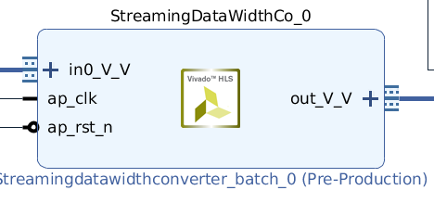
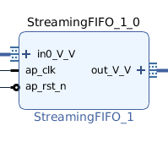
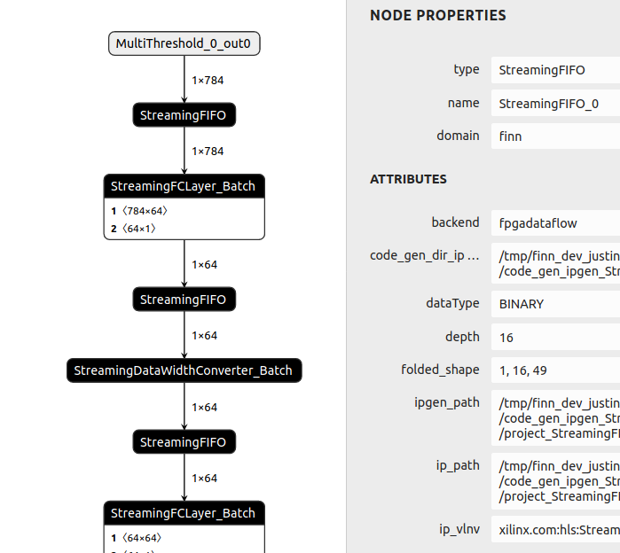
Background – Other FINN Cores
Perform a variety of functions, like FIFO or data width conversion, which support the SFCL cores
Communicate using AXI-Stream
AXI-Stream Data width and number of transfers is determined by preceding/following SFCL cores (eg. This FIFO expects 16 transfers, 49 bits in each transfer, which will be rounded to 56 bits)

Slide 13
Plan P.1
Target connection to occur in the Galapagos Middleware layer
  Middleware allows for specification of individual kernels (IP cores, in FINN’s case), as well as specifying how kernels are connected together
  FINN IP cores match Galapagos kernel I/O
    Contain CLK, ARESETN, IN-stream, and OUT-stream (using AXI-Stream protocol)
  Middleware Layer allows us to connect HW cores with the unaccelerated SW Cores

Slide 14
Plan: What are our Inputs?
Individual IP Cores:
Most flexible (any program that generates IP cores could reuse this bridge, not just FINN)
Would require list of IP cores with details such as project/file location, connections, etc
IP Block Design:
All connections have already been made for us
If we want to split IP cores into kernels, would require us to deconstruct the project
May not be as flexible (deconstructing the project may require project-specific commands)
C++ Kernels
Would allow us to run kernels on both CPU or HW
Would require list of kernels with details such as file location, connections, etc
We would need to perform HLS on all kernels that run on HW
Some kernels might require special files/commands during HLS (haven’t found any so far)
Selected due to flexibility and simplicity

Slide 15
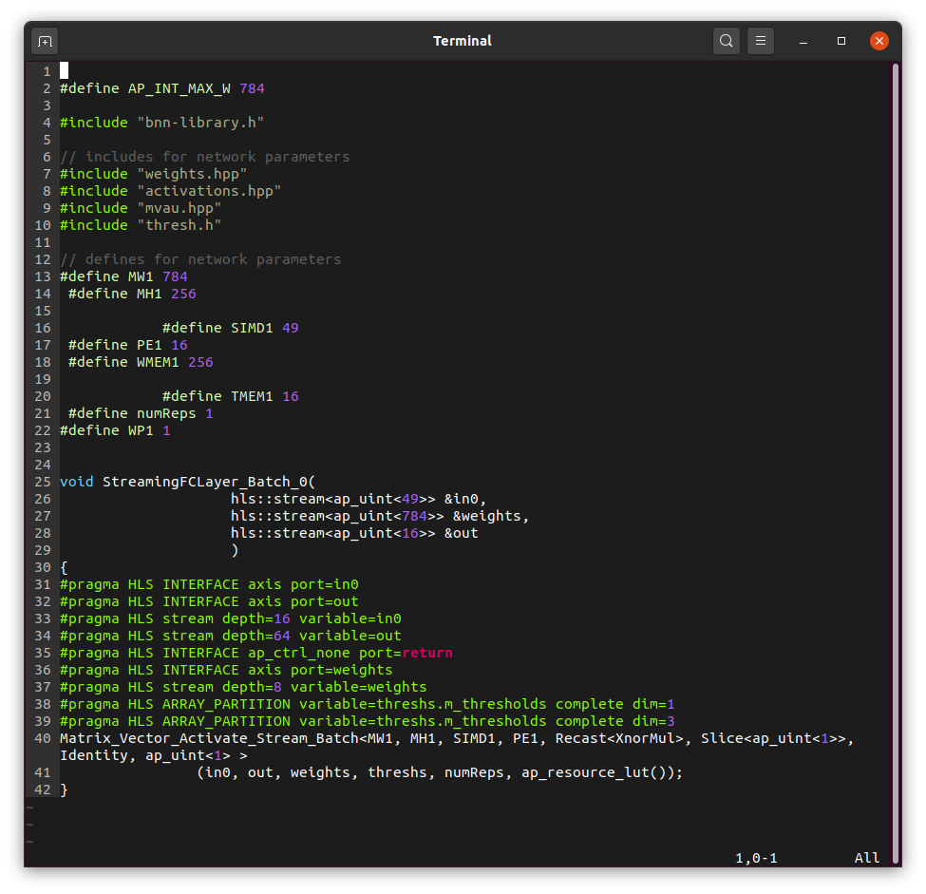
Plan: Inputs
First stage: Connect and deploy IP cores using Galapagos
  Easiest to start with
  IP cores should (if the flow is used correctly) be generated correctly, saves us the trouble of debugging errors due to HLS
Second/Long-term stage: Connect cores modelled by C++ files using Galapagos
  Allows users to easily switch between running cores on CPU and HW
  Would allow users to first test/debug models using software (libGalapagos)

Slide 16
Plan: Full Flow
Generate ONNX model and IP using FINN
Determine the layout and partitioning of IP cores across FPGAs, generating Galapagos Logical and Mapping File
Use Galapagos to stitch together IP and generate multiple bitstreams, connecting cores on different FPGAs together using Galapagos bridges

Slide 17
Full Flow Overview
ONNX Model
Not Started
In progress
Done
User uses FINN End-to-End flow to transform and generate IP for the ONNX model
FINN End-to-End Flow
FINN model + IP
User decides how model will be partitioned across multiple devices, generating Logical file and Mapping file (could be automated)
Partitioning
Mapping File
Logical File
IP Analysis
Galapagos
Galapagos uses FINN model as well as Logical and Mapping file to figure out what bridges must be created, as well as their configuration
Parameters
Bridge Insertion
Galapagos stitches IP cores together and inserts Galapagos bridges, creating block diagrams for each device
Bitstream Generation
And Deployment
Galapagos generates bitstreams and deploys them on each device

Slide 18
Full Flow P1: FINN Flow
User can use Brevitas or Pytorch to produce their BNN’s
User follows FINN’s End-to-End flow, substituting the network that used in the tutorial for their network
End to End Tutorials:
  https://github.com/Xilinx/finn/tree/master/notebooks/end2end_example
  Fully-Connected Networks and CNN examples provided
User should follow the tutorial until IP has been created
STATUS:
  FINN is maintained by Xilinx Research Labs, and is currently released in alpha phase

Slide 19
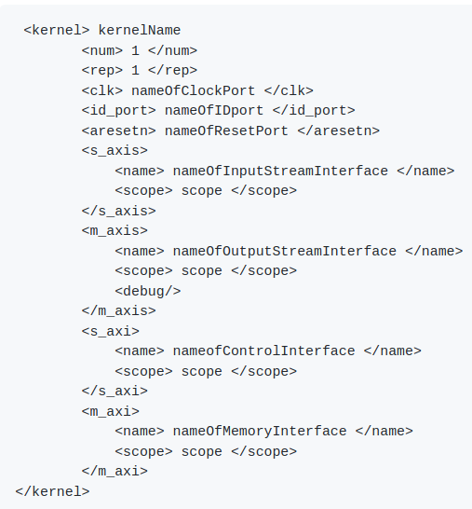
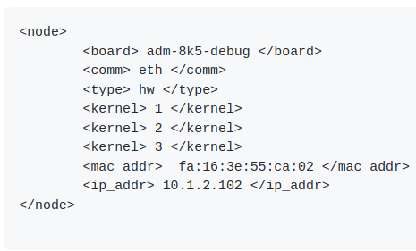
Full Flow P2: Partitioning
User uses their ONNX model to decide which cores should be partitioned onto each device
Output of this stage should be a Galapagos Logical File and Mapping File
Information about the Logical File and Mapping File can be found on the Galapagos repository: https://github.com/UofT-HPRC/galapagos
STATUS:
  Automation of this step has not been started

Slide 20
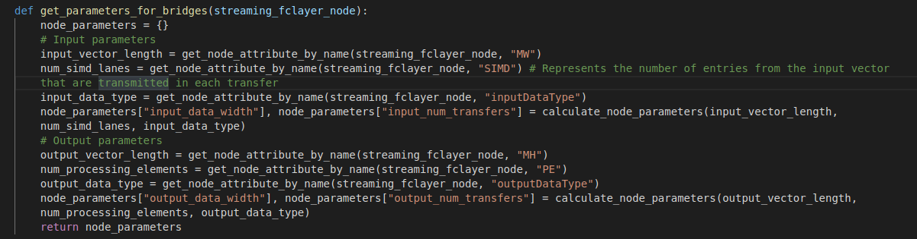
Full Flow P3: IP Analysis
Using python functions, Galapagos determines important parameters for Galapagos bridges
IMPORTANT: These functions will look for IP stored in the “ipgen_path” attribute of each accelerated FINN node. If users copy IP to a different location, they must update these IP paths as well. The paths are absolute.
  The script finn_galapagos_software/finn_helper.py contains functions that can be called inside the FINN docker container, one of which copies an ONNX model and all of its IP to a target location, changing all necessary filepaths automatically.
Currently, the important parameters to gather for Galapagos are:
  AXI-Stream input data width (in bits) (based on SIMD)
  AXI-Stream output data width (in bits) (based on PE)
  Number of input transfers
  Number of output transfers
STATUS:
  Functions for gathering these parameters have been written in finn_galapagos_software/finn_galapagos.py, but a script needs to be created to automate their use. See the documentation in that folder for details.

Slide 21
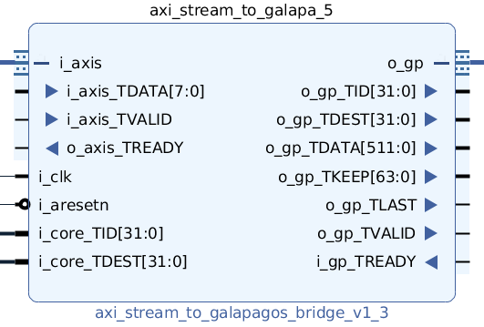
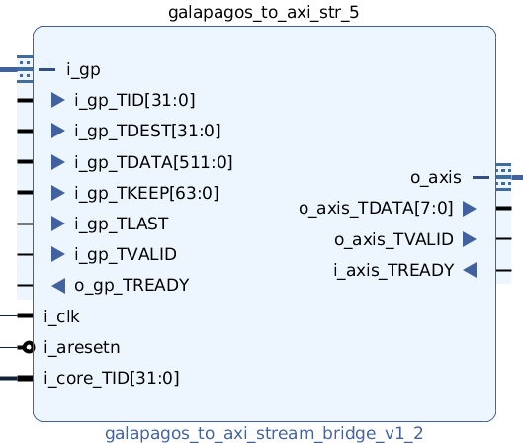
Full Flow P4: Bridge Insertion
Galapagos is used to convert the logical file and mapping file into stitched IP.
Galapagos will use the logical file and mapping file to stitch IP cores together.
Galapagos will also instantiate Galapagos bridges to connect IP cores on different FPGAs together, via a network switch.
STATUS:
  Bridges have been created to convert the AXI-Stream transfers from FINN cores into Galapagos packets, and vice versa.
  These bridges will be attached between FINN cores and existing Galapagos network cores to enable connection between FPGAs.
  Insertion of these bridges and generation of the stitched project have not been started

Slide 22
Full Flow P4: Bridges
2 Bridges: axi_stream_to_galapagos, galapagos_to_axi_stream
Connect FINN cores with Galapagos network bridges
User/Galapagos connects const cores to specify TID and TDEST
AXI-Stream to Galapagos Parameters:
AXI_STREAM_DATA_WIDTH (bits)
NUM_AXI_STREAM_TRANSFERS: number of transfers sent from the FINN core it’s connected to that makes up a single output vector
GALAPAGOS_DATA_WIDTH (bits)
Galapagos to AXI-Stream Parameters:
AXI_STREAM_DATA_WIDTH (bits)
GALAPAGOS_DATA_WIDTH (bits)
NUM_GALAPAGOS_TRANSFERS: number of transfers sent from the AXIS_GP core it’s connected to that makes up a single output vector (calculated by dividing FINN packet width by GALAPAGOS_DATA_WIDTH and rounding up)
AXI_STREAM_DATA_WIDTH and NUM_TRANSFERS are calculated using IP Analysis
STATUS:
Bridges have been simulated and tested on one FPGA, but should be tested on multiple FPGAs
Additionally, the parameter GALAPAGOS_NUM_TRANSFERS should be replaced with AXI_STREAM_NUM_TRANSFERS for consistency

Slide 23
Full Flow P5: Deployment
Galapagos generates bitstreams and deploys bitstreams onto FPGAs
STATUS:
  Galapagos currently builds Vivado projects, but bitstream deployment is not supported.
  A full run needs to be tested, where the full flow is completed
  Also, a process must be derived to connect the FINN cores deployed on FPGAs with unaccelerated FINN cores that must be run on CPU. Galapagos supports running software kernels on CPUs, so utilization of that should be investigated. Additionally, long-term goals of FINN are to increase the number of cores that get accelerated, so hopefully this option will not be necessary.

Slide 24
To do
These are tasks that still need to be completed for the Full Flow to function.
Full Flow P2: Partitioning:
Automation of partitioning task
Full Flow P3: IP Analysis:
Creation of IP Analysis script that uses built functions to automatically output bridge parameters based upon an ONNX model and the partitioning
Full Flow P4: Bridge Insertion:
Test bridges with Galapagos hardware, and send packets across different FPGAs
Modify bridges to not require GALAPAGOS_NUM_TRANSFERS parameter, for consistency
Integrate the bridges into Galapagos so that Galapagos can insert the bridges automatically when it detects FINN cores
Full Flow P5: Deployment:
Test of the full flow (from model generation to bitstream deployment)
Automate deployment of bitstreams
Connect unaccelerated cores of the FINN model to cores deployed on the FPGA.

Slide 25
Future Work
These are optional tasks for extending this flow.
Support for C++ HLS kernels: Instead of taking FINN IP cores as an input, take in FINN C++ kernels which are transformed into FINN IP cores via HLS
  This will allow FINN IP cores to be run on both software and hardware, and for simulations of the entire project to occur using libGalapagos
Perform performance, power and area measurements, comparing deployment using FINN and deployment using Galapagos
Extend these protocols to run other cores that communicate using AXI-Stream

