Slide 1
싸이랭
December 2, 2017
스터디뽀개기

Slide 2

그 시작. 2014
첫 미팅. 2016
현재. 2017
강남역 씨맥스
매주 토요일 오후 2시 - 5시
Natural Language Processing & English Learning

Slide 3
Goal 01
Computational Language Data Analysis & Application
Develop and apply (language/education) research/tools
First
Second
Third
Corpus Development
NLP
Data/Text Analysis
Basics of Python for Text Analysis

Slide 4
Goal 02
English Learning
Learn how to improve English proficiency with a focus on speaking and writing skills
Vocabulary
Writing
Speaking
Learning new words
Email, resume, Q & A
Free conversation, presentation practice

Slide 5
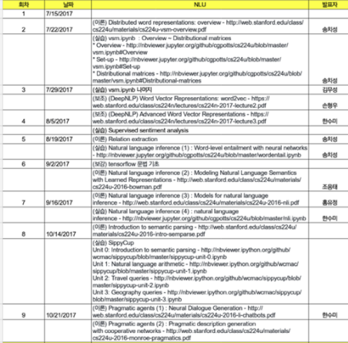
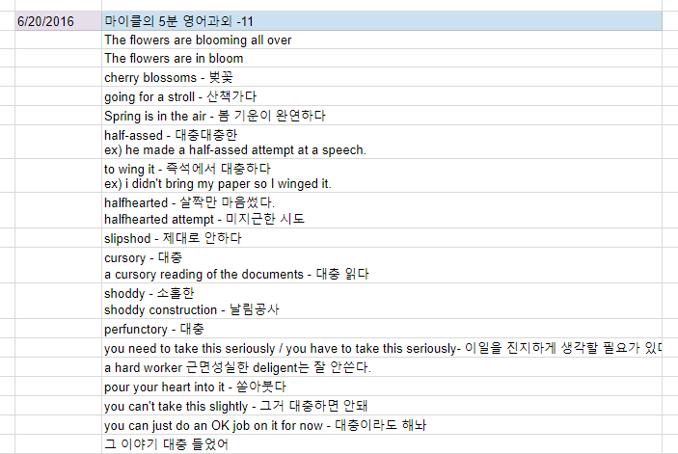
Self-directed learning
SNS Collaboration

Slide 6
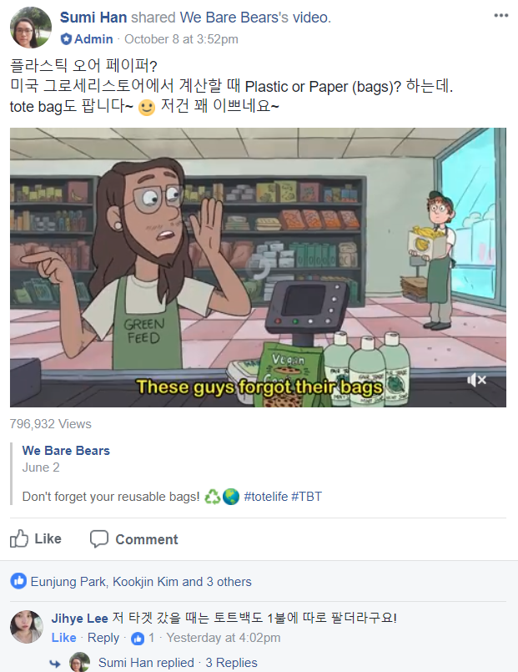
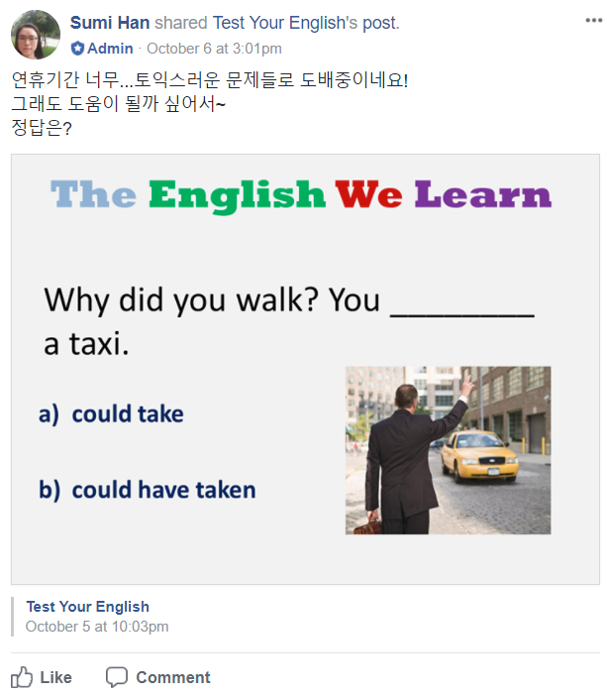
Slow and steady wins the race! Join us now!
Template credit: 페이스북 피도리

