Slide 1
싸이버스
https://www.facebook.com/thepsybus/

Slide 2
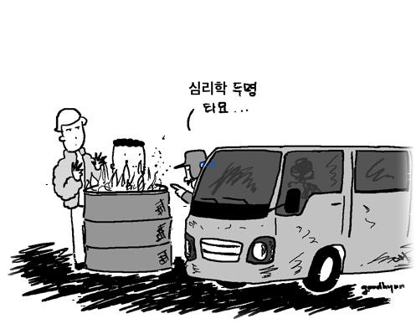
Psy + Bus

Slide 3
Cyber + Earth

Slide 4
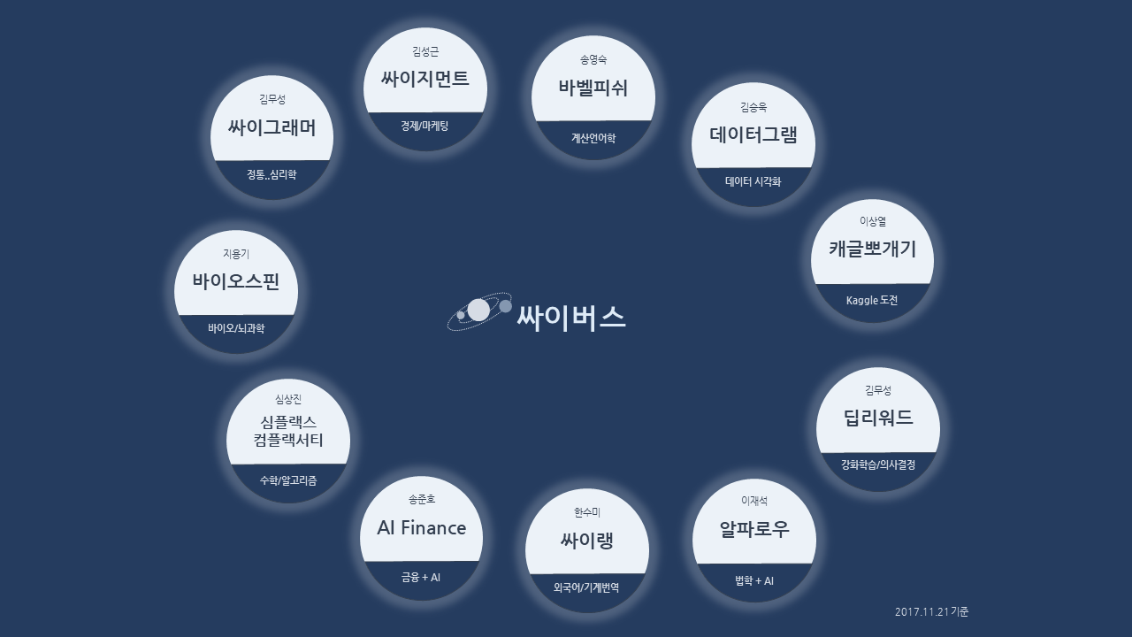
Cyber + Multiverse

