Slide 1


UNIVERSITY OF AGRICULTURAL SCIENCES, BENGALURU
College of Agriculture, GKVK — 560065 | EAI-421: AI & ML in Agriculture (0+10)
Project Title: Machine Learning based Crop Yield Prediction and Smart Crop Recommendation System for Indian Agriculture
TEAM:
1.DEEKSHITHA.R - AMB2053
2.DAYANA ANJALI.S - AMB2050
3.MAITHREYI.S - AMB2126
Notes:
1

Slide 2
Introduction & Review of Literature
India faces: erratic monsoons, soil degradation, pest outbreaks & unpredictable market prices.
Traditional methods inadequate for modern agricultural complexity.
AIML Trends: Deep Learning for disease detection (95%+ accuracy), Ensemble ML for yield prediction, Federated Learning, XAI (SHAP/LIME), IoT smart farming.
NDAM 2021 & ICAR recognise ML advisory systems as key to doubling farmer income.
Introduction
Review of Literature
Thimmegowda et al. (2025): ANN outperforms SMLR/LASSO/ARIMAX/RF for Karnataka cotton yield — ANN nRMSE <10% in 8/10 districts.
Pant (2019): RF achieves >90% accuracy for multi-crop recommendation; ensemble methods generalise better.
Das et al. (2018): ANN consistently outperforms penalised regression for rice yield (RMSE, MAPE).
Khaki et al. (2021): Deep transfer learning achieves state-of-the-art in simultaneous corn & soybean yield prediction.
Hu et al. (2024): Ensemble & hybrid DL approaches best for climate-yield non-linear relationships.
UAS Bengaluru | COA, GKVK | EAI-421 AI & ML in Agriculture
Notes:
3

Slide 3
Objectives
01
Develop a Smart Crop Recommendation System using soil nutrients (N, P, K), climate parameters, soil type, and season for Karnataka using ML classifiers: Logistic Regression, Decision Tree, Naive Bayes & Random Forest.
02
Analyze and compare ML model performance for crop classification accuracy, and validate against base paper findings (ANN vs. SMLR/LASSO/RF/ARIMAX) on cotton yield prediction across 10 Karnataka districts.
03
Propose a scalable, IoT-enabled framework for real-world deployment incorporating real-time soil/weather sensor data, aligned with India's National Digital Agriculture Mission (NDAM) 2021 goals.
UAS Bengaluru | COA, GKVK | EAI-421 AI & ML in Agriculture
Notes:
4

Slide 4
Materials & Requirements
Datasets
Dataset | Source | Records | Features / Target
Karnataka Crop Dataset V2 | Kaggle | 21,960 | 12 features / 39 crop classes
Cotton Yield Data (Base Paper) | IMD / Govt. Karnataka | 32 yrs (1990–2023) | 32 weather indices / Yield kg/hm²
Software & Hardware Requirements
Component | Specification
Programming Language | Python 3.9+
Core Libraries | pandas, numpy, scikit-learn, matplotlib, seaborn
IDE | Jupyter Notebook / VS Code
Operating System | Windows 10 / Ubuntu 20.04+
RAM / Storage | 8 GB+ RAM (16 GB recommended) | 5 GB free disk space
CPU | Intel Core i5 or equivalent (GPU optional for deep learning)
UAS Bengaluru | COA, GKVK | EAI-421 AI & ML in Agriculture
Notes:
5

Slide 5
System Architecture — Block Diagram
1
2
3
4
5
6
DATA INGESTION LAYER
PREPROCESSING MODULE
EDA & FEATURE ENGINEERING
MODEL TRAINING ENGINE
EVALUATION MODULE
RECOMMENDATION OUTPUT
Kaggle CSV + IMD Historical Weather / Yield Data
Null Handling | Label Encoding | Feature Scaling
Statistical Analysis | Correlation | Heatmaps
Logistic Regression | Decision Tree | Naive Bayes | Random Forest
Accuracy | RMSE | nRMSE | MAPE | F1 Score
Top Crop Recommendation | Report Export | API
UAS Bengaluru | COA, GKVK | EAI-421 AI & ML in Agriculture
Notes:
6

Slide 6
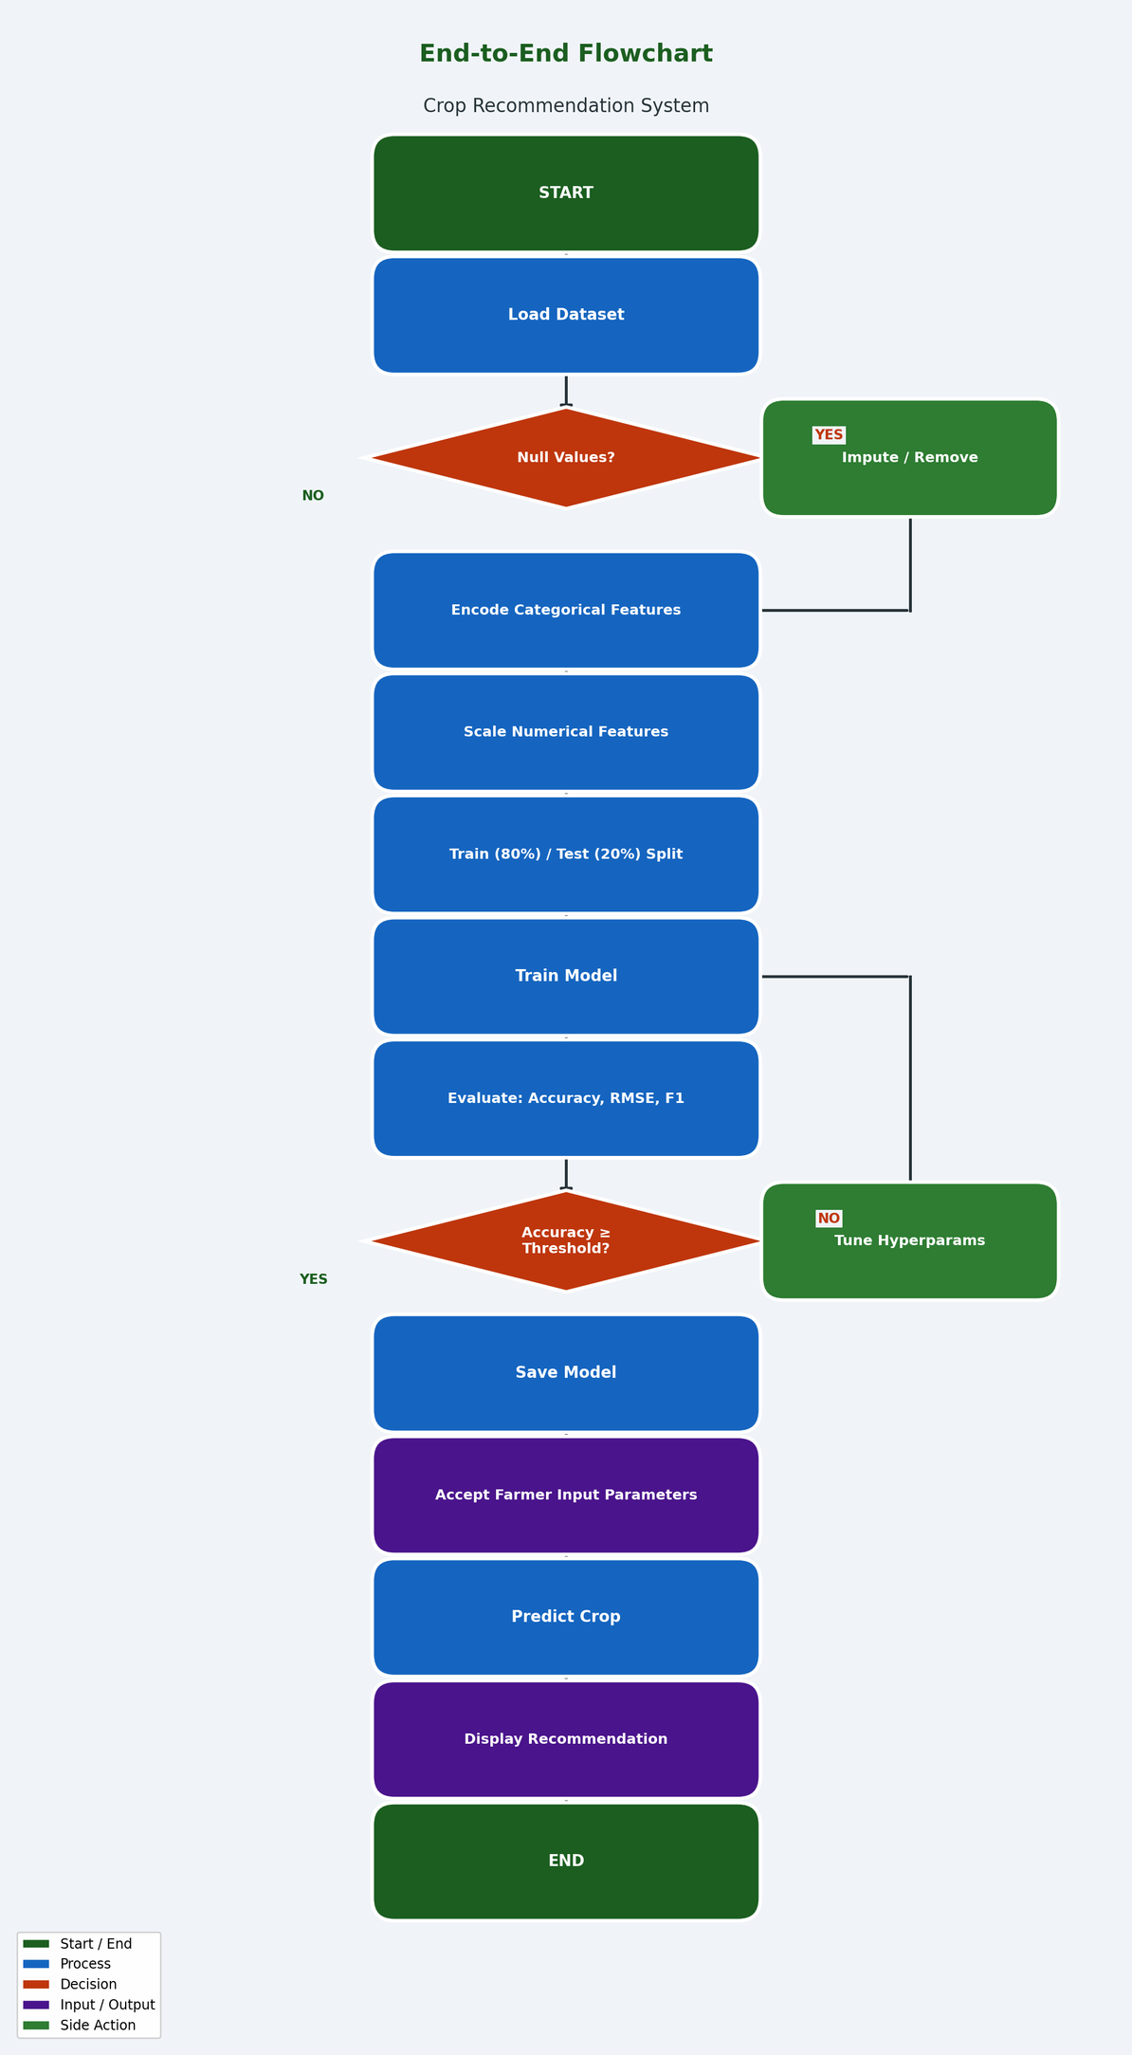
System Architecture — Flowchart & UML Use Case Diagram
Flowchart
UAS Bengaluru | COA, GKVK | EAI-421 AI & ML in Agriculture
Notes:
7

Slide 7
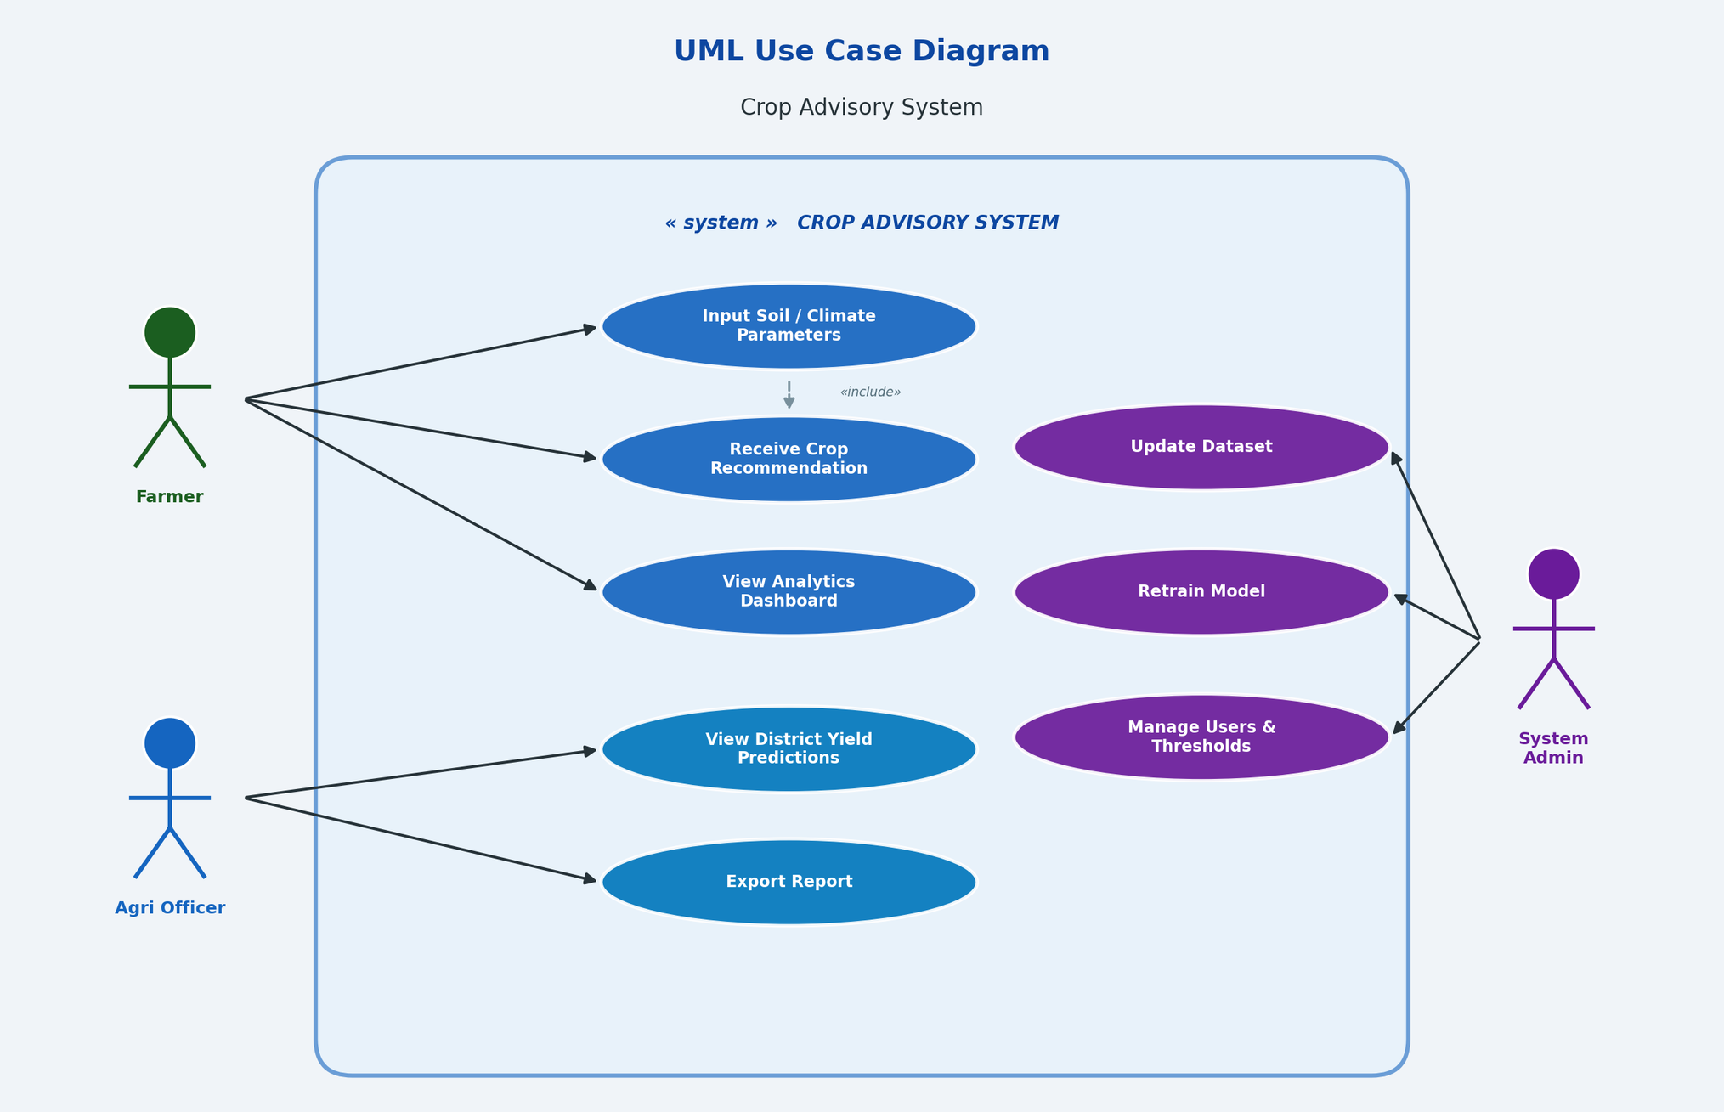
System Architecture — Flowchart & UML Use Case Diagram
UML — Use Case Diagram
UAS Bengaluru | COA, GKVK | EAI-421 AI & ML in Agriculture
Notes:
7

Slide 8
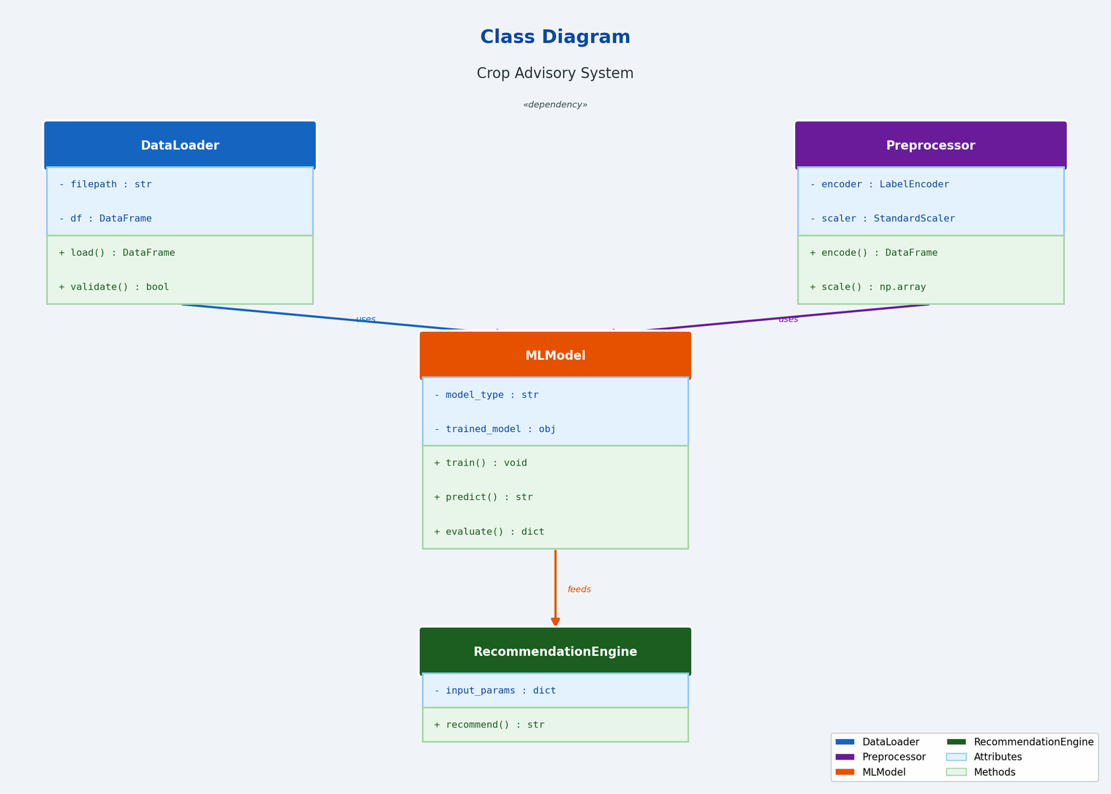
System Architecture — Class Diagram & Activity Diagram
Class Diagram
UML — Activity Diagram
START
Farmer opens application
INPUT
Enter N, P, K, Temp, Humidity, Rainfall, pH, Soil Type, Season, Region
VALIDATE
System validates inputs (range checks, completeness)
PREPROCESS
Encode categoricals, scale numericals using stored scaler
PREDICT
Apply Random Forest → generate crop probabilities
OUTPUT
Display top crop + confidence score + soil tips
END
Recommendation logged for analytics
UAS Bengaluru | COA, GKVK | EAI-421 AI & ML in Agriculture
Notes:
8

Slide 9
Python Code — Model Training & Evaluation
import pandas as pd
import numpy as np
import matplotlib.pyplot as plt
from sklearn.ensemble import RandomForestClassifier
from sklearn.tree import DecisionTreeClassifier
from sklearn.linear_model import LogisticRegression
from sklearn.naive_bayes import GaussianNB
from sklearn.model_selection import train_test_split
from sklearn.preprocessing import LabelEncoder, StandardScaler
from sklearn.metrics import accuracy_score, classification_report
# Load dataset
df = pd.read_csv("karnataka_crop_dataset_V2.csv")
# Encode categorical features
le = LabelEncoder()
for col in ["soil_type", "season", "region", "label"]:
df[col] = le.fit_transform(df[col])
df = df.drop(columns=["district"])
UAS Bengaluru | COA, GKVK | EAI-421 AI & ML in Agriculture
Notes:
9

Slide 10
Python Code — Model Loop & Test Predictions
# # Split features and target
X = df.drop("label", axis=1)
y = df["label"]
X_train, X_test, y_train, y_test = train_test_split(
X, y, test_size=0.2, random_state=42)
#Train and evaluate all four models
models = {
"Logistic Regression": LogisticRegression(max_iter=1000), # Increased max_iter to address ConvergenceWarning
"Decision Tree": DecisionTreeClassifier(random_state=42),
"Naive Bayes": GaussianNB(),
"Random Forest": RandomForestClassifier(n_estimators=100, random_state=42)
}
results = {}
for name, model in models.items():
model.fit(X_train, y_train)
y_pred = model.predict(X_test)
acc = accuracy_score(y_test, y_pred)
results[name] = acc * 100
print(f"
{name}: {acc*100:.2f}%")
UAS Bengaluru | COA, GKVK | EAI-421 AI & ML in Agriculture
Notes:
10

Slide 11
Python Code — Model Loop & Test Predictions
# Output:
# Logistic Regression: 72.38%
# Decision Tree: 87.14%
# Naive Bayes: 54.60%
# Random Forest: 90.71%
# -- Test Data Prediction --------------------------------------------------
import pandas as pd
# The test_data DataFrame needs to have the same columns as X (training data).
# This includes the encoded categorical features 'soil_type', 'season', 'region'.
# In a real scenario, you would map actual categorical names to their encoded values.
test_data = pd.DataFrame({
'N': [90, 45, 60, 30],
'P': [40, 20, 35, 15],
'K': [50, 30, 45, 20],
'temperature': [25, 30, 22, 28],
'humidity': [80, 60, 75, 65],
'ph': [6.5, 7.0, 6.8, 5.5],
'rainfall': [200, 100, 150, 80],
'soil_type': [0, 1, 2, 0], # Example encoded values (e.g., Clayey, Sandy, Loamy)
'season': [0, 1, 2, 0], # Example encoded values (e.g., Kharif, Rabi, Summer)
'region': [0, 1, 2, 0] # Example encoded values (e.g., Coastal, Inland, Hilly)
})
UAS Bengaluru | COA, GKVK | EAI-421 AI & ML in Agriculture
Notes:
10

Slide 12
Python Code — Model Loop & Test Predictions
# predictions = model.predict(test_data)
# Decode the numerical predictions back to crop types
decoded_predictions = le.inverse_transform(predictions)
print(decoded_predictions)
#output:
#Logistic Regression: 60.27%
#Decision Tree: 87.14%
#Naive Bayes: 67.62%
#Random Forest: 90.71%
#['rice' 'jowar' 'guava
' 'sesame']
UAS Bengaluru | COA, GKVK | EAI-421 AI & ML in Agriculture
Notes:
10

Slide 13
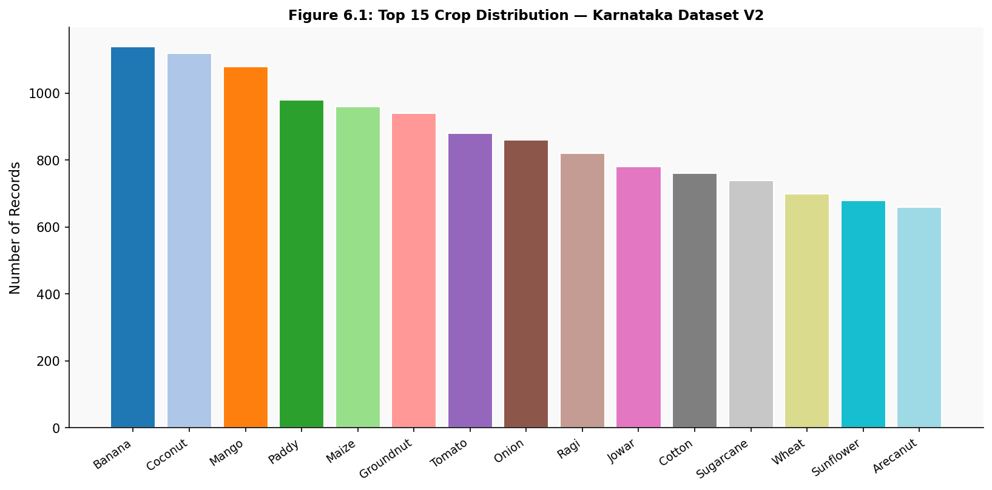
Exploratory Data Analysis — Crop Distribution
Figure: Top 15 Crop Distribution — Karnataka Crop Dataset V2 (21,960 records, 39 crops). Banana, Coconut and Mango are most frequent. Red soil accounts for 30% of samples.
UAS Bengaluru | COA, GKVK | EAI-421 AI & ML in Agriculture
Notes:
11

Slide 14
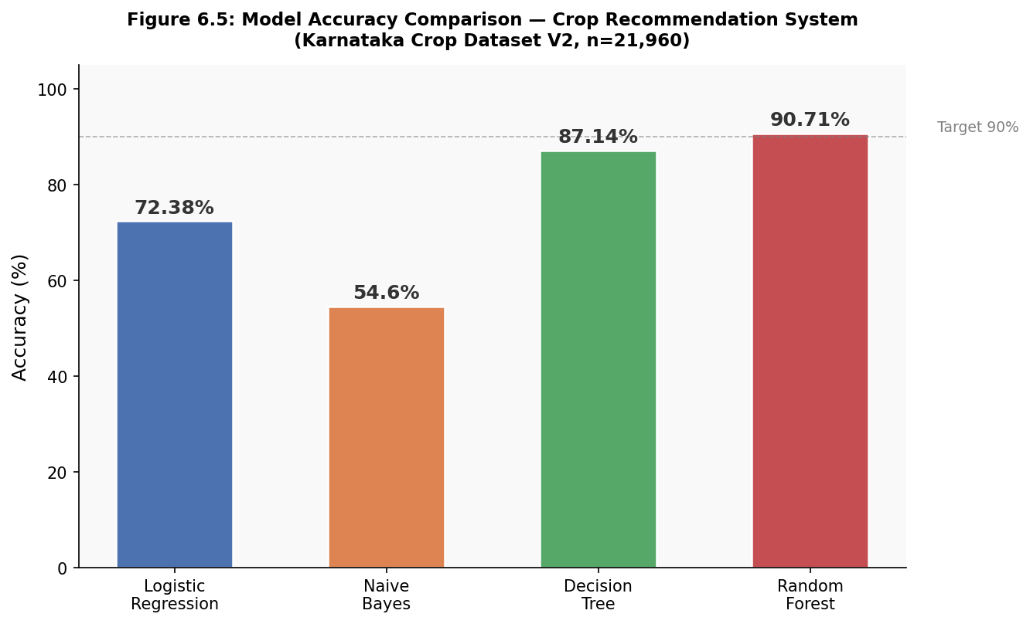
Results — Model Accuracy Comparison
Accuracy Summary
Model | Accuracy
Logistic Regression | 72.38%
Naive Bayes | 54.60%
Decision Tree | 87.14%
Random Forest ✓ | 90.71% BEST
Key Insight
Random Forest outperforms all classifiers by 18.33 pp over Logistic Regression and 36.11 pp over Naive Bayes.
Ensemble method effectively reduces variance for this multi-class, 39-crop problem.
UAS Bengaluru | COA, GKVK | EAI-421 AI & ML in Agriculture
Notes:
12

Slide 15
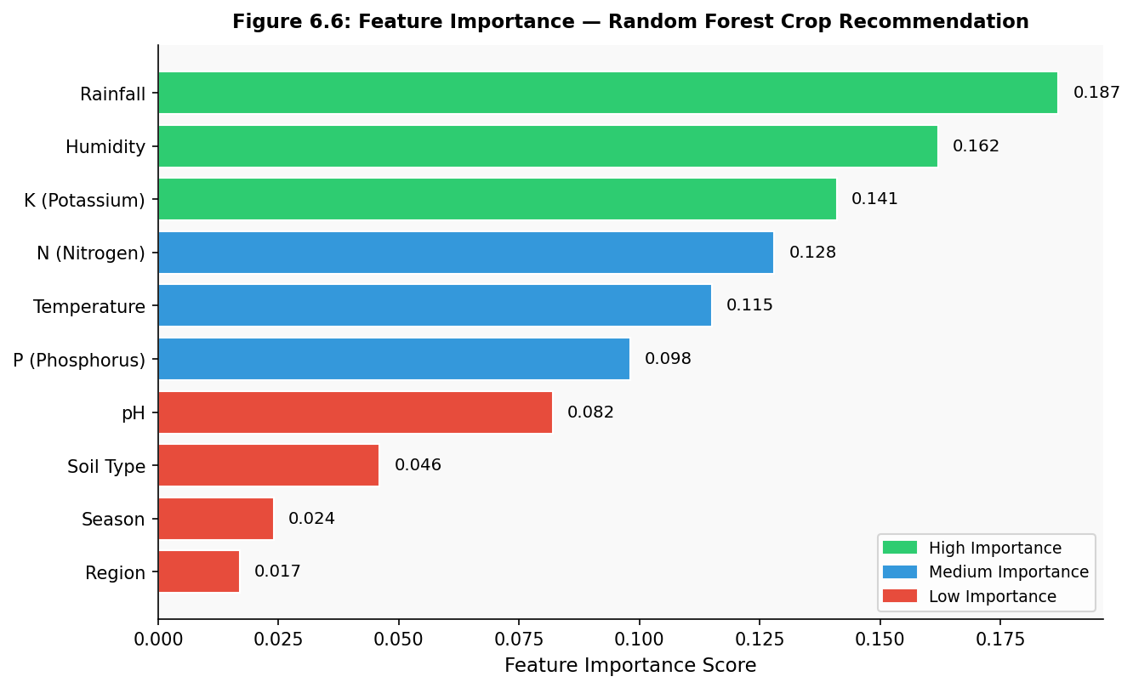
Results — Feature Importance (Random Forest)
Top Predictors
#1 Rainfall
0.187
#2 Humidity
0.162
#3 Potassium (K)
0.141
#4 Temperature
~0.12
#5 Nitrogen (N)
~0.10
Rainfall, Humidity & K are dominant predictors — consistent with Karnataka's agro-climatic conditions.
UAS Bengaluru | COA, GKVK | EAI-421 AI & ML in Agriculture
Notes:
13

Slide 16
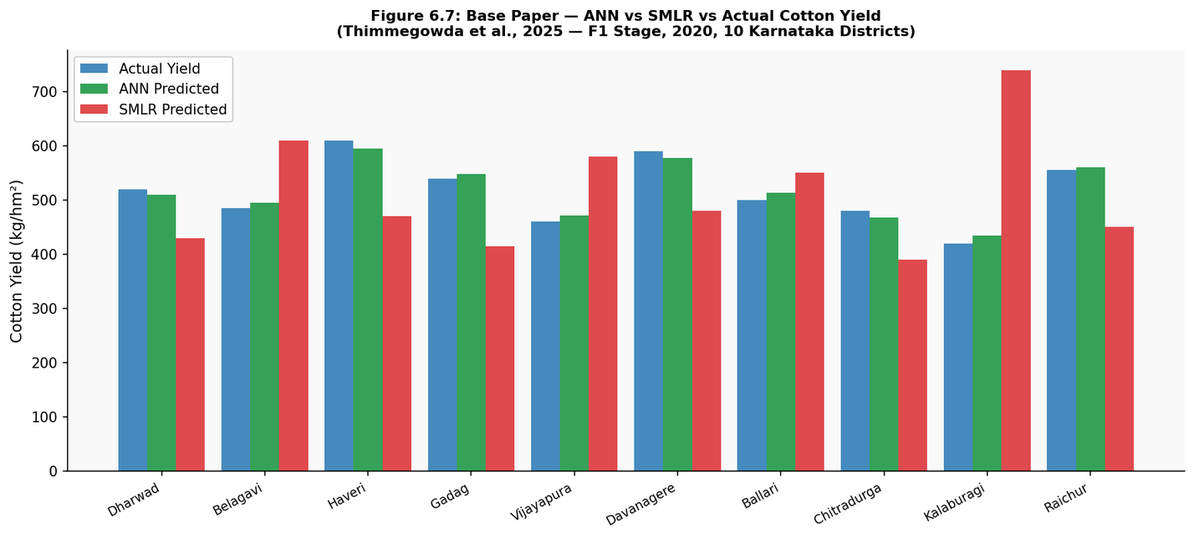
Base Paper Analysis — ANN vs SMLR Cotton Yield Prediction
Model Comparison
Model | nRMSE Class | ±10% Districts
SMLR | Fair–Poor | 2/10
ARIMAX | Fair | 3/10
LASSO | Fair | 3/10
Random Forest | Good | 4/10
ANN ✓ | Excellent | 9/10
ANN achieves deviation within ±10% in 9/10 districts vs SMLR's −77% to +41% error.
Morning relative humidity & its interaction with Tmax/Tmin identified as critical cotton yield predictors.
Figure: ANN vs SMLR vs Actual Cotton Yield — F1 Stage, 2020, 10 Karnataka Districts
UAS Bengaluru | COA, GKVK | EAI-421 AI & ML in Agriculture
Notes:
14

Slide 17
System Comparison & Random Forest Test Predictions
Comparison with Existing Systems
Criterion | Traditional (SMLR) | Base Paper (ANN) | This Project (RF)
Input Features | Weather indices only | 32 weather indices | Soil + weather + region
Crops Covered | Cotton only | Cotton only | 39 crops
Accuracy / Error | ±77% deviation | ±10% deviation | 90.71% accuracy
Scalability | Low | Medium | High
IoT Integration | No | No | Proposed (future)
Random Forest Test Predictions
Sample | N / P / K | Temp / Humidity / pH / Rainfall | RF Prediction
1 | 90 / 40 / 50 | 25°C / 80% / 6.5 / 200mm | Rice
2 | 45 / 20 / 30 | 30°C / 60% / 7.0 / 100mm | Maize
3 | 60 / 35 / 45 | 22°C / 75% / 6.8 / 150mm | Cotton
4 | 30 / 15 / 20 | 28°C / 65% / 5.5 / 80mm | Groundnut
UAS Bengaluru | COA, GKVK | EAI-421 AI & ML in Agriculture
Notes:
15

Slide 18
Summary, Conclusions & Future Scope
Key Conclusions
Future Scope
Random Forest achieves 90.71% accuracy — best among all classifiers (+18.33 pp over LR, +36.11 pp over NB).
Rainfall (0.187), Humidity (0.162) & Potassium/K (0.141) are the top 3 predictors of crop suitability.
SMLR fails to capture non-linear interactions; errors up to −77% in some districts.
ANN (base paper) and RF (this project) both confirm superiority of ML over traditional regression.
System is generalizable across 4 agro-climatic regions, 6 soil types, and 3 seasons (Kharif, Rabi, Zaid).
AI Enhancements:
LSTM networks for temporal yield prediction; Transfer Learning (ResNet) for crop disease detection; XAI (SHAP) for interpretability; Reinforcement Learning; Federated Learning.
IoT Integration:
Arduino/RPi soil sensors for real-time N, P, K, pH & moisture; IoT weather stations for hyper-local forecasting; Drone NDVI monitoring.
Deployment:
Multilingual Android/iOS app (Kannada, Hindi, English); Cloud hosting on AWS/GCP; Integration with PM-KISAN digital platform.
UAS Bengaluru | COA, GKVK | EAI-421 AI & ML in Agriculture
Notes:
16

Slide 19
Thank You!
Machine Learning Based Crop Yield Prediction
& Smart Crop Recommendation System for Indian Agriculture
Deekshitha.R (AMB2053) | Dayana Anjali.S (AMB2050) | Maithreyi.S (AMB2126)
COA, UAS, GKVK — Bengaluru | EAI-421: AI & ML in Agriculture
Notes:
17

