Slide 1

IT3081 STATISTICAL MODELLING
EMPLOYEE
ABSENTEEISM
ANALYSIS AND
PREDICTION
Evidence for workforce planning,
wellbeing support, and ethical
decision-making
DS.WE.2.1 Group 10
1
Notes:
Original source: uploaded SM FINAL -Employee_Absenteeism_Analysis(1).pptx, slide 1. Member details retained for the forthcoming new Slide 2: Lakshitha Dilshan J K P, IT24102621; Nirmani K.H.D.T, IT24103380; Palliyaguruge C.T, IT24103655; Senaratne P.A.R.T, IT24103526. Workplace illustration is AI-generated conceptual imagery.

Slide 2

GROUP MEMBERS
DS.WE.2.1 Group 10
GROUP MEMBER | STUDENT ID
Lakshitha Dilshan J K P | IT24102621
Nirmani K.H.D.T | IT24103380
Palliyaguruge C.T | IT24103655
Senaratne P.A.R.T | IT24103526
2
Notes:
Group member names and student IDs transcribed exactly from the original cover slide. Background is an AI-generated decorative asset.

Slide 3
PRESENTATION ROADMAP
01
Problem and evidence base
Industry problem, consultancy objectives, research landscape, and the gap addressed by this study
02
Data and statistical evidence
Dataset audit, descriptive analysis, visual evidence, and robust group comparisons
03
Models and advanced methods
Predictive models, experimental-design options, PCA, Bayesian methods, and the time-series limitation
04
Decision support
Industry innovation proposal, expert-validation status, recommendations, and safeguards
3
Notes:
Roadmap content preserved verbatim from original slide 2 of the supplied Employee Absenteeism presentation. It is now slide 3 after inserting the new group members slide.

Slide 4

INDUSTRY PROBLEM &
CONSULTANCY OBJECTIVES
Industry problem
Management decision
Employee absence affects staffing continuity, workload distribution, productivity, wellbeing, and replacement cost. Management needs evidence about where pressure is concentrated.
Use aggregated patterns to guide staffing, scheduling, workload reviews, and wellbeing support. Do not use model output as automatic evidence for discipline, dismissal, promotion, or denial of opportunity.
Consultancy objectives
01
Audit data quality and define the outcome
04
Compare interpretable and regularised models
02
Describe distribution and relationships
05
Evaluate advanced methods and propose ethical decision support
03
Test group differences with robust methods
4
Notes:
Original content preserved from source slide 3, now slide 4 after insertion of group members. Office photo is AI-generated conceptual imagery and does not depict the study workplace.

Slide 5

RESEARCH LANDSCAPE &
RESEARCH GAP
Evidence reviewed
What research supports
The supplied literature set contains 18 papers covering absenteeism determinants, occupational health, manufacturing, prediction, decision support, and workplace interventions.
Absence reflects worker, workplace, health, psychosocial, and non-work factors. Large, longitudinal, prospective, and multilevel studies strengthen the evidence base.
Remaining gap
Definitions vary across studies. Classification can discard information from continuous hours, prediction may lack explanation, and cross-sectional records cannot establish causality. Individual scoring also creates privacy and fairness risks.
THIS PROJECT
Continuous AbsentHours
Robust tests
Interpretable models
Explicit limitations
Aggregate use
5
Notes:
All content preserved from original source slide 4, now slide 5 after insertion of group members. Literature workspace imagery is AI-generated conceptual decoration; it does not depict actual supplied research papers.

Slide 6

DATASET SELECTION &
UNDERSTANDING
Dataset | MFGEmployees4.csv
Dimensions | 8,336 employees × 13 variables
Outcome | AbsentHours, continuous
Numeric predictors | Age; LengthService
Categorical predictors | Gender, City, JobTitle, DepartmentName, StoreLocation, Division, BusinessUnit
Audit-only fields | EmployeeNumber; Surname; GivenName
Time field | None. Trend and forecasting claims are not supported
Quality audit
0
missing values
0
duplicate rows or employee IDs
0
negative numeric values
34
implausible ages
1
service-age inconsistency
1,320
zero-absence records
44
high IQR outliers
The dataset is suitable for comparison and prediction, but flagged records require sensitivity analysis.
6
Notes:
Dataset metadata table and all audit findings preserved exactly from original source slide 5, now slide 6 after insertion of group members. Dataset illustration is generated conceptual imagery and does not depict the actual data file.

Slide 7

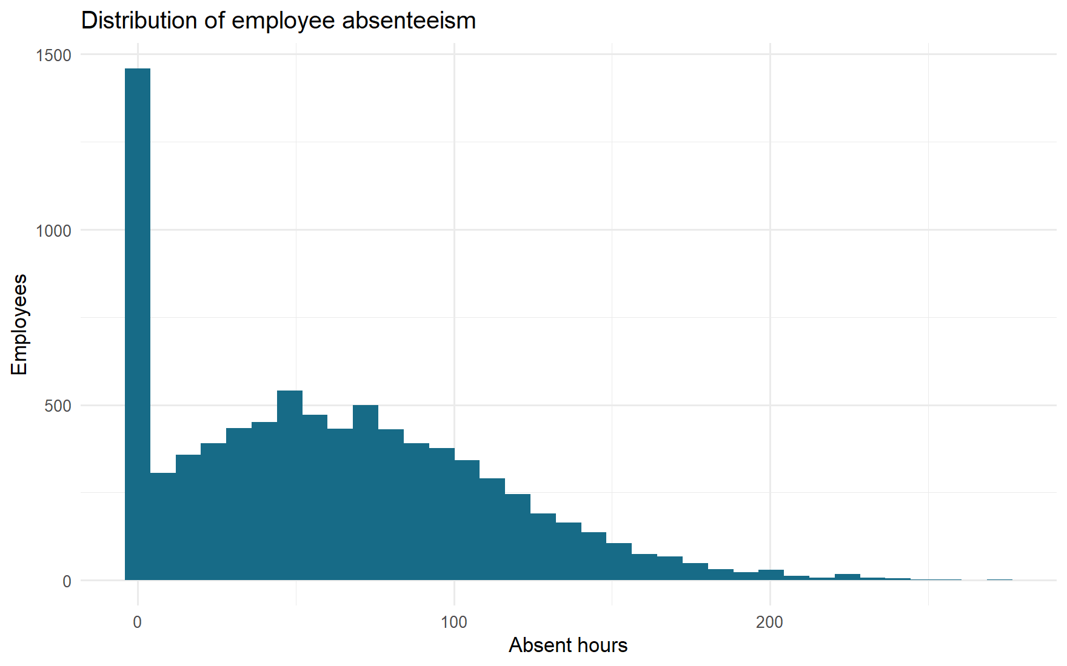
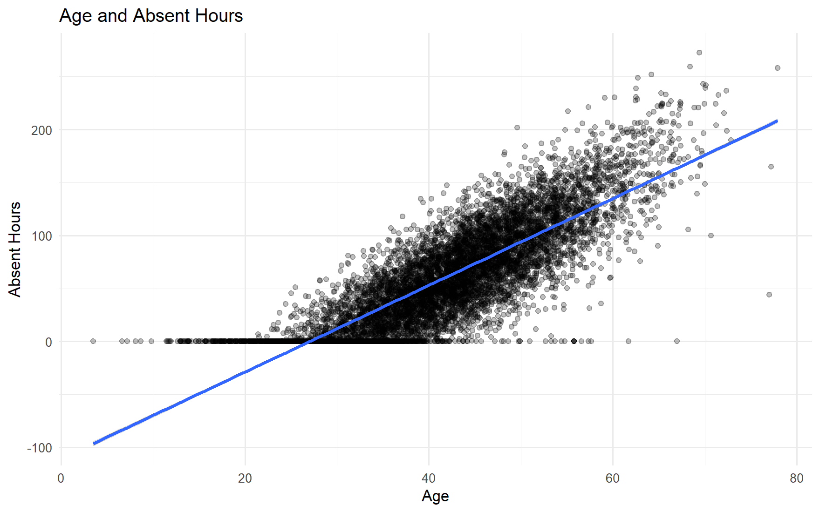
DESCRIPTIVE ANALYSIS &
INITIAL INSIGHTS
Mean 61.284 h Median 56.006 h SD 49.038 h IQR 64 h Range 0–240 h Skewness 0.642
Zero absence: 1,320 employees (15.83%)
Age: Pearson r = 0.8302; Spearman ρ = 0.8419; both p < 0.001
LengthService has negligible practical association: Pearson r = −0.0442; Spearman ρ = −0.0141.
7
Notes:
Original histogram and age scatterplot images retained unchanged from original slide 6, now slide 7. All descriptive statistics and correlation results preserved exactly. Underlying chart data were not supplied separately; these evidence charts remain source images.

Slide 8

STATISTICAL INFERENCE
EVIDENCE
Welch ANOVA and Kruskal-Wallis at α = 0.05; Holm adjustment for pairwise tests
Variable | Groups | Welch F | Welch p | η² | Decision
Gender | 2 | 99.7853 | < 0.001 | 0.01187 | Reject equal means
DepartmentName | 18 | 2.8381 | 0.000493 | 0.00376 | Reject equal means
Division | 5 | 6.6809 | 0.000448 | 0.00219 | Reject equal means
BusinessUnit | 2 | 21.8396 | < 0.001 | 0.00178 | Reject equal means
All four differences are statistically detectable, but every effect size is small (η² < 0.012).
Management decisions should combine adjusted p-values, effect sizes, uncertainty, sample size, and operational relevance.
8
Notes:
All test names, significance threshold, adjustment method, native table values, and conclusions preserved exactly from original source slide 7, now slide 8. Background is conceptual generated illustration and does not represent an empirical statistical result.

Slide 9
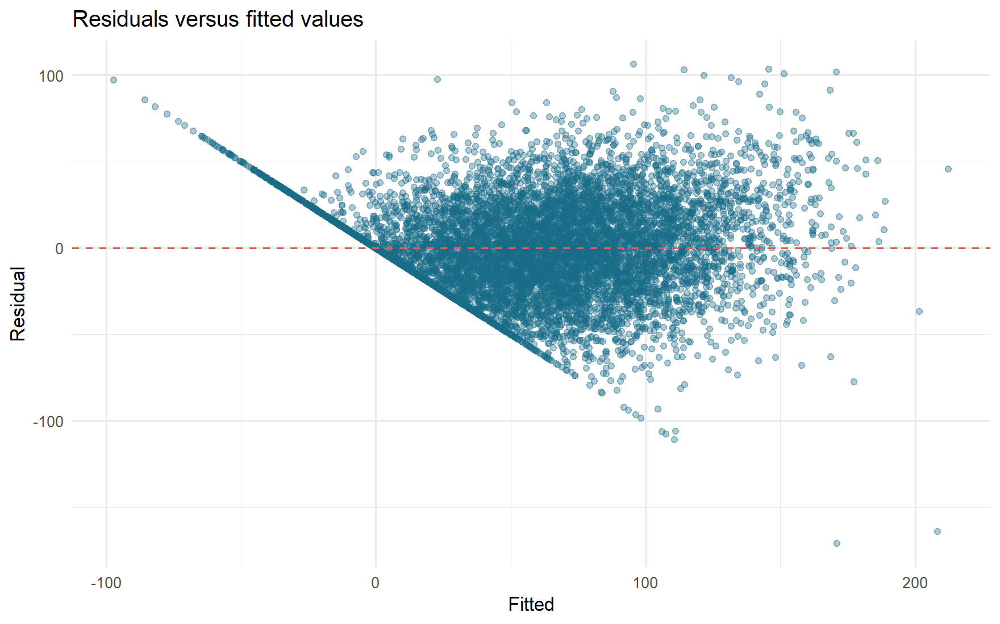
PREDICTIVE STATISTICAL
MODELLING
Design: 80/20 split, seed 42, five-fold cross-validation, leakage-safe preprocessing
Model | Test MAE | Test RMSE | Test R² | Interpretability
LASSO | 20.446 | 26.215 | 0.7074 | Moderate
Elastic Net | 20.489 | 26.264 | 0.7063 | Moderate
Multiple linear regression | 20.553 | 26.320 | 0.7050 | High
Ridge | 21.569 | 27.499 | 0.6780 | Moderate
SENSITIVITY ANALYSIS
Excluding 34 flagged records: Elastic Net RMSE 25.219; LASSO 25.252; MLR 25.310; Ridge 27.054.
OLS DIAGNOSTICS
R² 0.6971; Breusch-Pagan 266.90 (p < 0.001); Jarque-Bera 116.36 (p < 0.001);
Durbin-Watson 1.991; max Cook's D 0.0804; 427 high-leverage cases.
9
Notes:
All model comparison values, experimental design, sensitivity results, OLS diagnostic statistics, and original residuals chart retained from source slide 8, now slide 9. Chart is the supplied source image; all table values and text remain editable.

Slide 10
EXPERIMENTAL DESIGN
EVALUATION
EVIDENCE BOUNDARY
No experiment was conducted. The current cross-sectional records support association and prediction, not causal claims about interventions.
01
COMPLETELY RANDOMISED
DESIGN (CRD)
02
RANDOMISED COMPLETE
BLOCK DESIGN (RCBD)
Randomly assign eligible employees or operational units to a supportive intervention or standard practice. Analyse a treatment indicator with a t-test, ANOVA, or regression.
Block by department, division, job category, or location, then randomise within blocks. Blocking can reduce organisational variation and improve precision.
OUTCOMES AND SAFEGUARDS
Measure AbsentHours, the zero-absence proportion, employee feedback, and programme cost. Require ethical approval, pre-registration, privacy safeguards, contamination control, and monitoring of non-compliance and attrition.
10
Notes:
All evidence boundary, CRD, RCBD, outcomes, and safeguards content preserved from original source slide 9, now slide 10 after insertion of the group members slide. Background photo is conceptual and does not show an actual experiment.

Slide 11
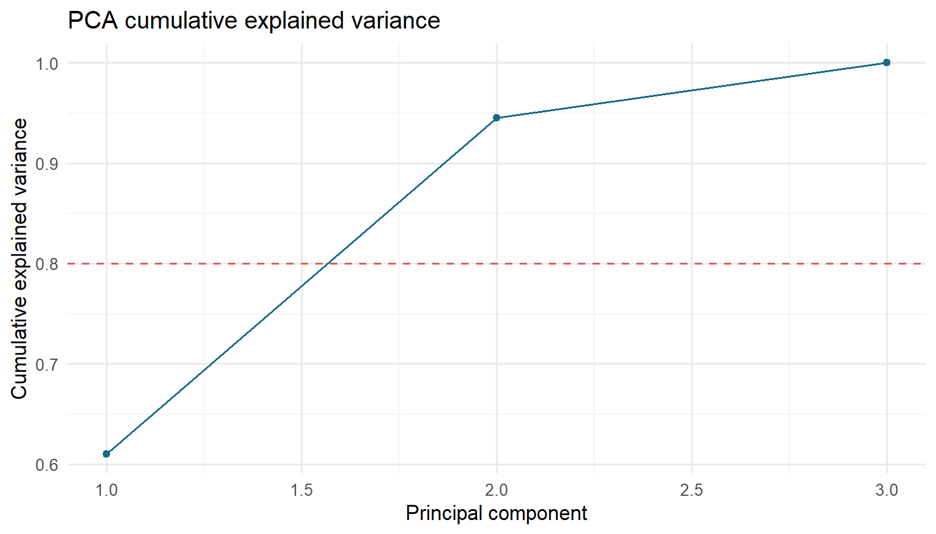
PCA EVALUATION
EXPLAINED VARIANCE
PC1
PC2
PC3
61.01%
33.52%
5.47%
PC1 + PC2: 94.53%
REPORTED COMPARISON
Age + service baseline R² = 0.6971
PCA regression with PC1 and PC2 reports R² = 0.9186
CRITICAL LIMITATION
PCA included AbsentHours, so outcome information entered the components. The higher R² is target leakage and does not prove better prediction.
11
Notes:
Original source slide 10, now slide 11. All explained variance figures, reported regression comparisons, and target-leakage limitation preserved. Source PCA chart retained as an image. Text is editable.

Slide 12
BAYESIAN STATISTICAL
METHODS
01
STATUS
02
SUITABLE EXTENSION
Bayesian methods were evaluated conceptually, but no Bayesian model was fitted. The current outputs contain no posterior estimates or credible intervals.
A hierarchical Bayesian regression can model AbsentHours with partial pooling across departments, divisions, or locations. Weakly informative priors can stabilise small groups.
03
DECISION VALUE
04
REQUIRED REPORTING
Posterior distributions answer practical probability questions, such as the chance that a group effect exceeds a meaningful threshold. Posterior predictive checks evaluate model fit.
Report priors, posterior means or medians, 95% credible intervals, convergence diagnostics, sensitivity to priors, and posterior predictive checks. Maintain the same privacy and fairness safeguards.
12
Notes:
All status, suitable extension, decision value and required reporting content preserved from source slide 11, now slide 12. Background is conceptual generated imagery and does not represent a fitted Bayesian posterior.

Slide 13
TIME SERIES EXTENSION
CURRENT DATASET LIMIT
NO VALID DATE OR TIME FIELD
The present data cannot support trend, seasonality, forecasting, or time-based intervention claims.
01
DATA NEEDED
02
FUTURE ANALYSIS
03
POSSIBLE CAUSAL
EXTENSION
Absence date, duration, employee or unit identifier, exposure hours, work schedule, department, and policy or intervention dates.
Aggregate to weekly or monthly unit-level rates. Inspect trend and seasonality, use a time-based holdout, and compare seasonal-naive, ETS, or ARIMA models.
An interrupted time-series design could evaluate a policy change when timing, implementation, and a credible pre-intervention period are available.
13
Notes:
All current dataset limitations, required future data, analysis options, and possible causal extension preserved from original source slide 12, now slide 13. Background photo is conceptual and does not depict a measured time series.

Slide 14
INDUSTRY INNOVATION
PROPOSAL
AGGREGATE ABSENTEEISM DECISION-SUPPORT FRAMEWORK
Aggregate signal | Management response | Safeguard
Rising unit absence hours | Review staffing, workload, schedules, and wellbeing support | Minimum group-size rules; no employee ranking
Persistent subgroup difference | Check policy, job design, and local working conditions | Use effect size and uncertainty, not p-values alone
Model error or drift | Recalibrate, retrain, or suspend use | Monitor RMSE, bias, data quality, and subgroup performance
High-risk interpretation | Human review before any action | Document purpose, access, retention, appeals, and prohibited uses
Refresh monthly or quarterly. Publish an aggregate dashboard and model card.
Keep identity fields outside the modelling pipeline.
14
Notes:
Original source slide 13, now slide 14. All framework signals, management responses, safeguards, and refresh/reporting requirements preserved. Table and text are native editable PowerPoint elements. Background is conceptual generated imagery.

Slide 15
INDUSTRY EXPERT VALIDATION
STATUS: PENDING
No interview, survey, approval, or written expert feedback was supplied.
The presentation does not invent validation evidence.
01
EXPERTS TO
CONSULT
02
VALIDATION
QUESTIONS
03
EVIDENCE TO
RETAIN
HR manager, operations or production manager, occupational-health or wellbeing lead, data-protection or governance representative, and employee representative.
Are the findings plausible? Are recommended actions feasible? Could any metric create unfair or punitive outcomes? What minimum group size and access rules are acceptable?
Role and sector, date, method, anonymised feedback, decisions made, requested revisions, and sign-off status. Add this evidence before claiming industry validation.
15
Notes:
All pending status, evidence boundary, experts to consult, validation questions and evidence requirements preserved from source slide 14, now slide 15. Workplace background is conceptual generated imagery, not expert-validation evidence.

Slide 16
FINAL CONSULTANCY
RECOMMENDATIONS
IMMEDIATE ACTIONS
MODELLING AND GOVERNANCE
01
Repair or quarantine the 34 implausible ages and one service-age inconsistency
Use robust OLS for explanation and LASSO or Elastic Net as predictive benchmarks. Repeat sensitivity checks, monitor drift and subgroup error, document purpose and access, and prohibit punitive individual use.
02
Keep identity fields audit-only
03
Monitor absence at department or unit level
04
Pair statistical significance with effect size and uncertainty
NEXT EVIDENCE
BOTTOM LINE
Collect valid dates for time-series analysis. Conduct an ethically approved supportive trial where feasible. Fit a hierarchical Bayesian model only when it adds decision value. Complete and document expert validation.
The evidence supports aggregate workforce planning and targeted support. It does not support causal claims or automatic decisions about individual employees.
16
Notes:
All immediate actions, modelling and governance recommendations, next evidence, and bottom-line conclusions preserved from original source slide 15, now slide 16. Workplace imagery is conceptual. All content text remains editable.

Slide 17
THANK
YOU
17
Notes:
Original THANK YOU closing content retained from source slide 16, now slide 17 after insertion of the group members slide. Background is conceptual generated workplace imagery matching the redesigned cover.

