Slide 1



CERES Portal | Business Insights
Presented by: Brandon Harley

Slide 2

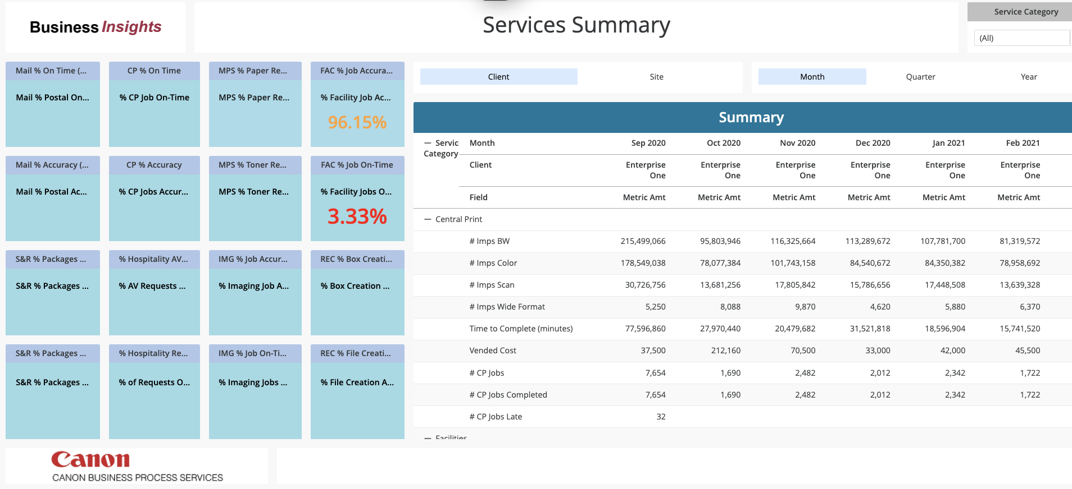
Stats and Trends (Automated Reports)
…

Slide 3
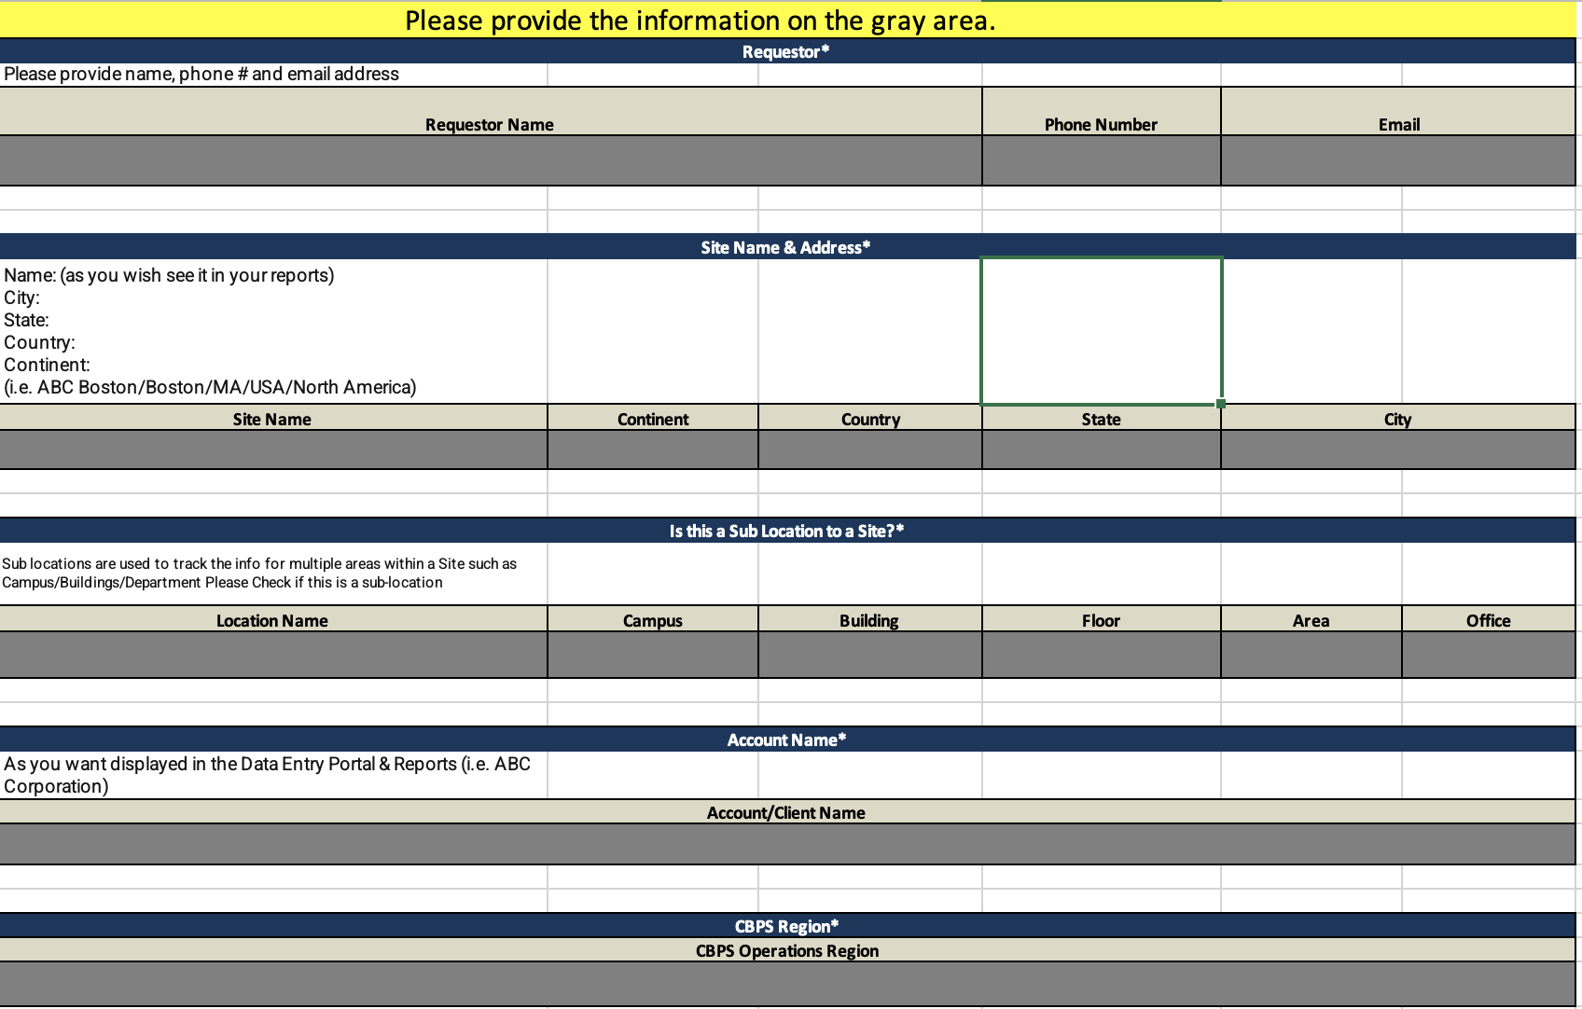
Configuration Worksheet
CERES Initialization Form
Requestor’s Name / Contact info
Site Name and Address
Sub Location details
Account Name
CBPS Region

Slide 4
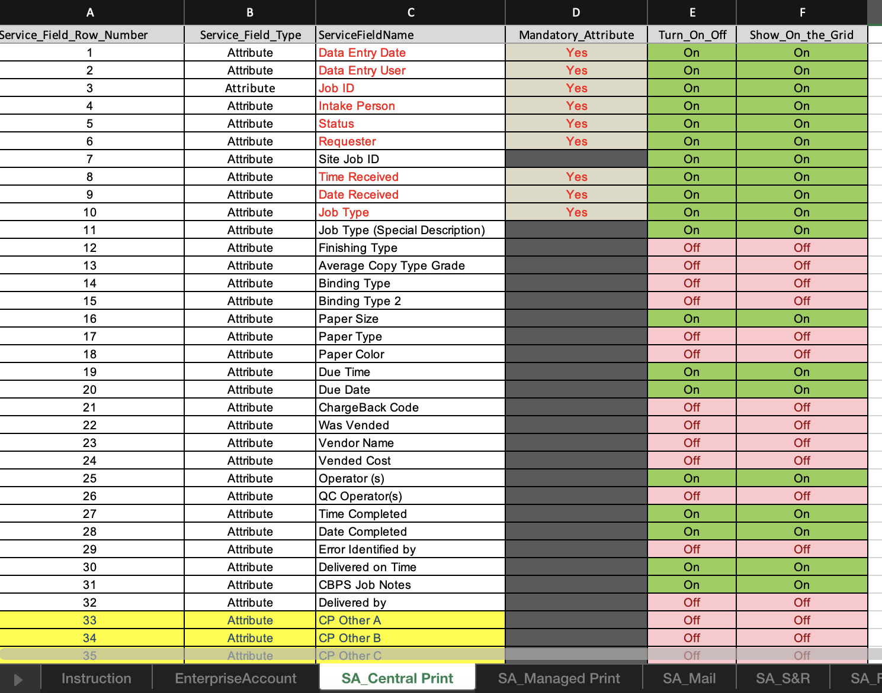
Configuration Worksheet
CERES Initialization Form
Central Print
Managed Print
Mail
Shipping & Receiving
Facilities
Hospitality
Commentary
Required fields
Turn Off Attributes and Metrics that do not provide value or are outside the SOW

Slide 5
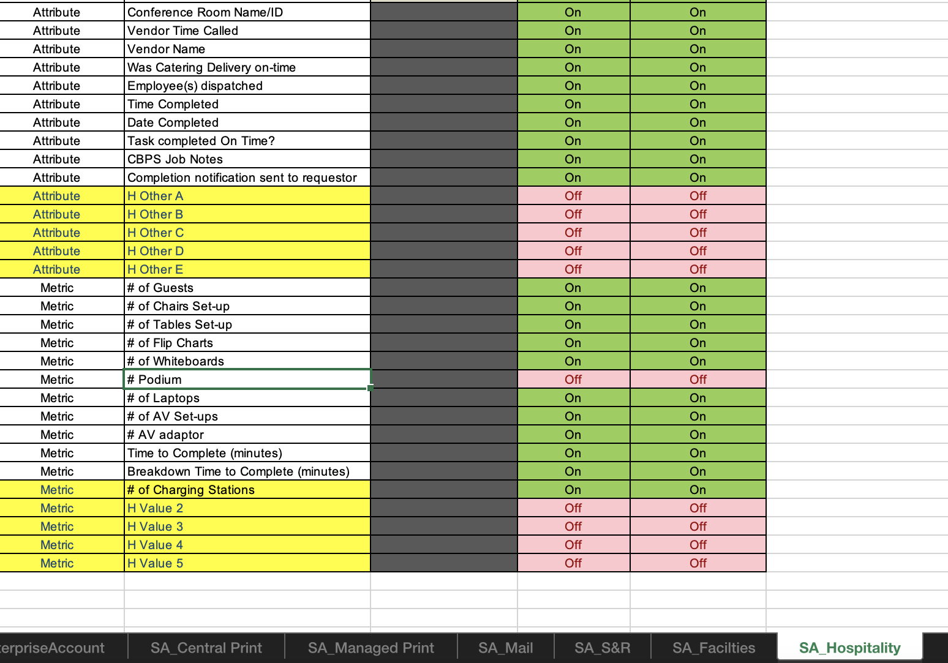
Configuration Worksheet
Additional Attribute fields
Trackable information or details
Ex:
Additional Metric fields
Trackable data
Ex: # of Mobile charging stations

Slide 6
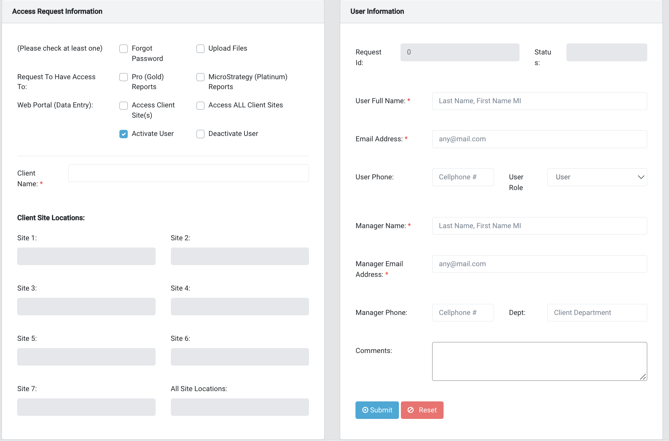
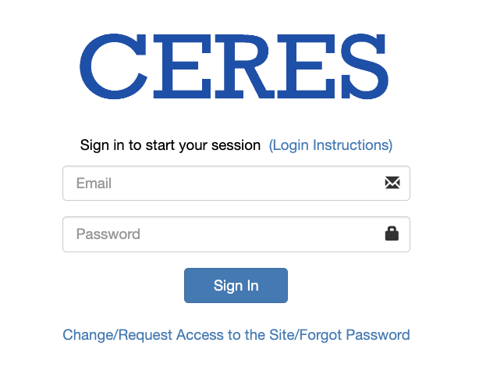

Assigning Access
Website: microstrategy.cbpsportal.com
Request access on login screen
Activate User
Client Name (Account)
User Full Name
Email
Manager’s name
Manager’s email address
Credentials provided after manager’s approval

Slide 7
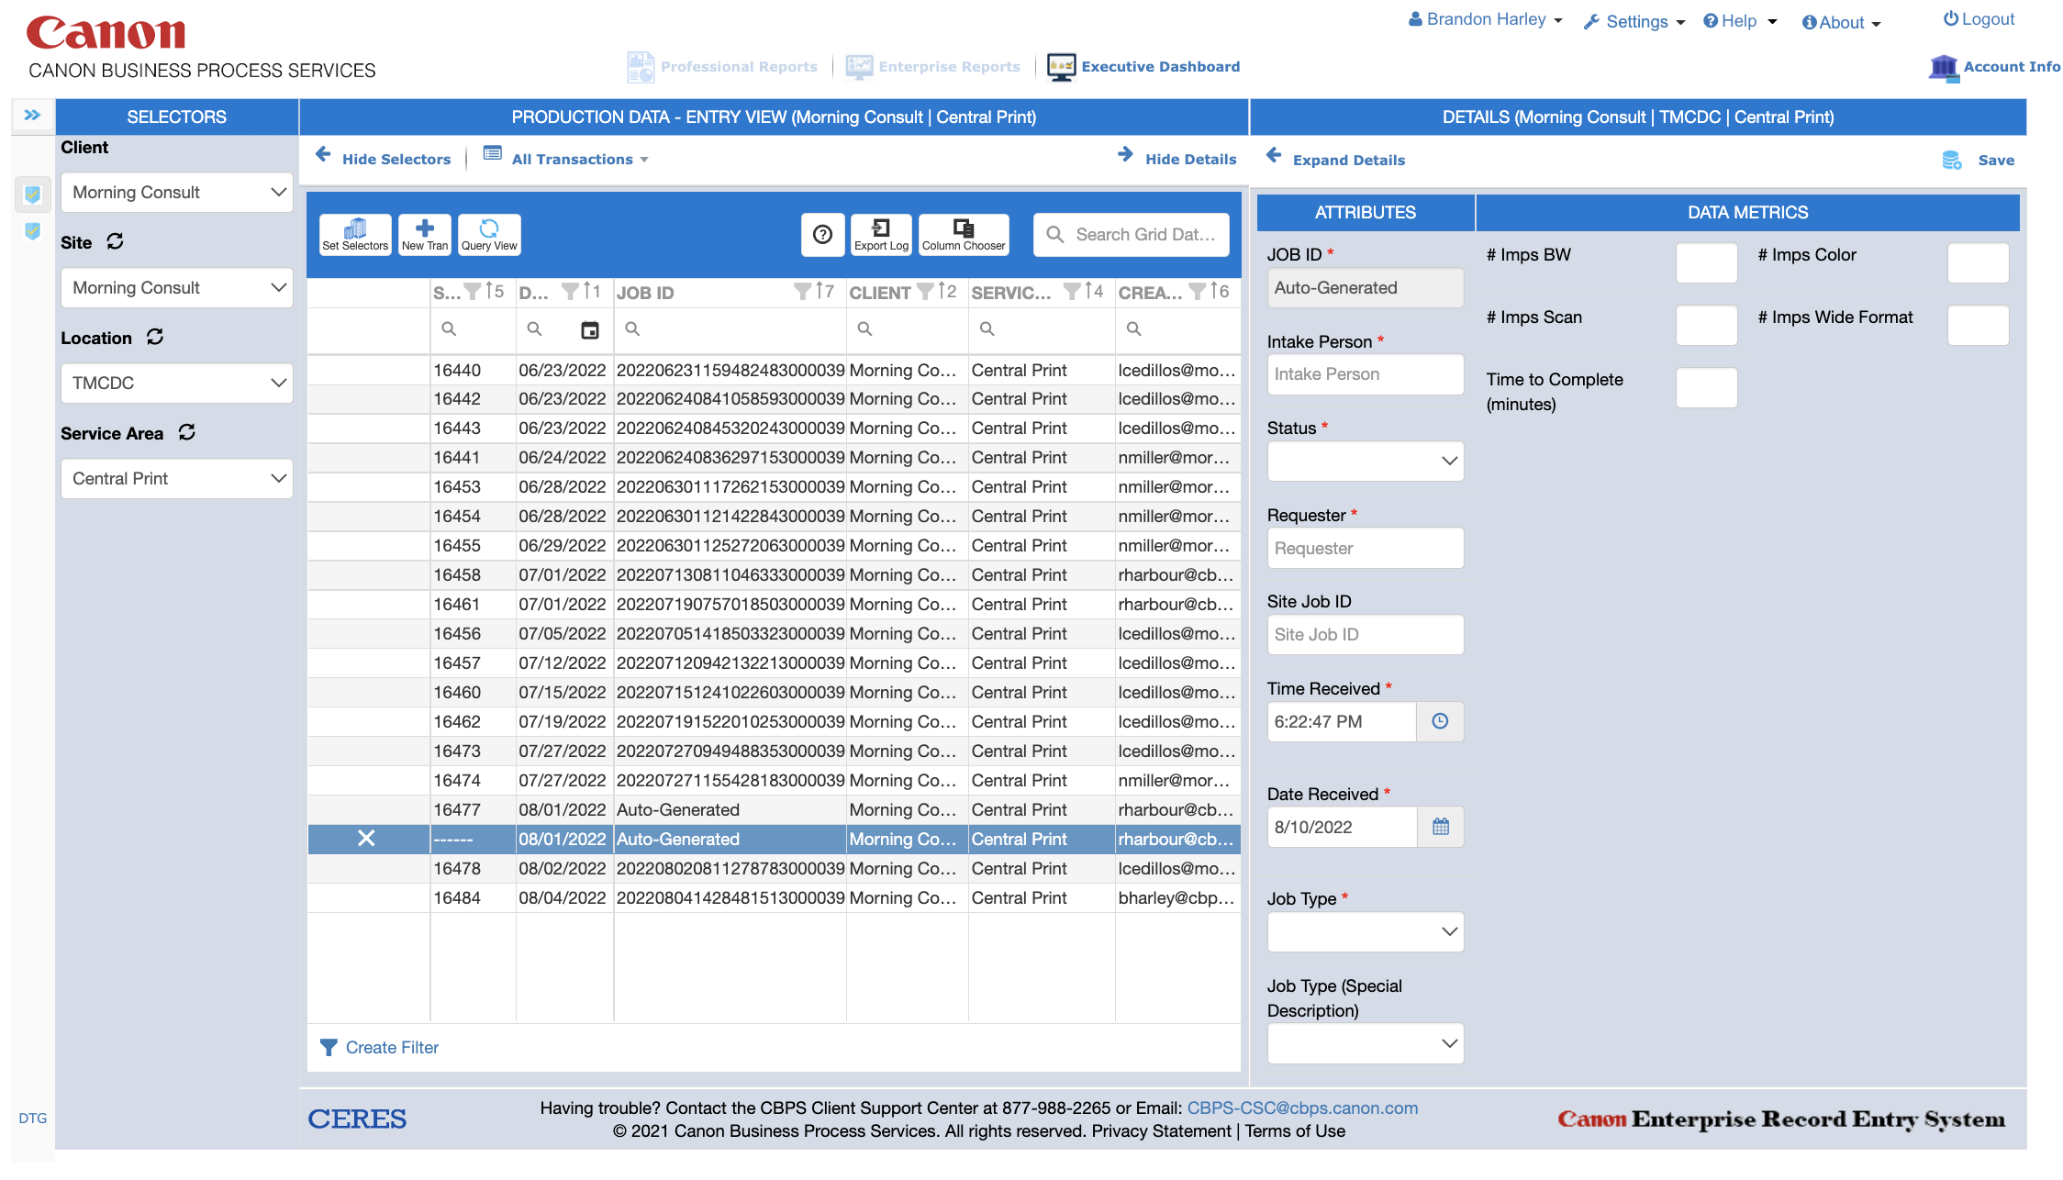





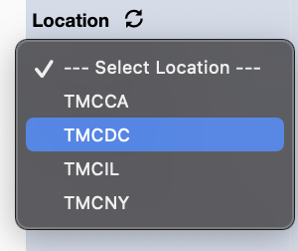


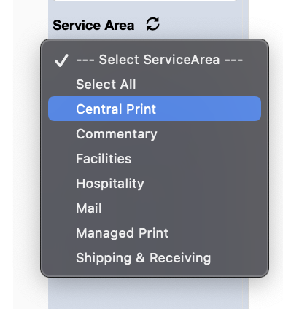
Production Data – Entry View

