Slide 1
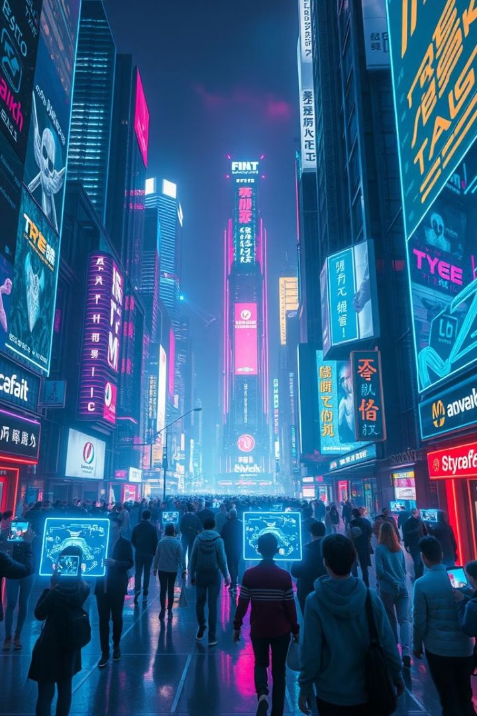
Mixed Reality Bridging the Real & Virtual Worlds
By
Harikishore .G [24071A6793]
Harshini .E [24071A6794]
Janaki Ram .K [24071A6795]
Nikhil .J [24071A6796]

Slide 2
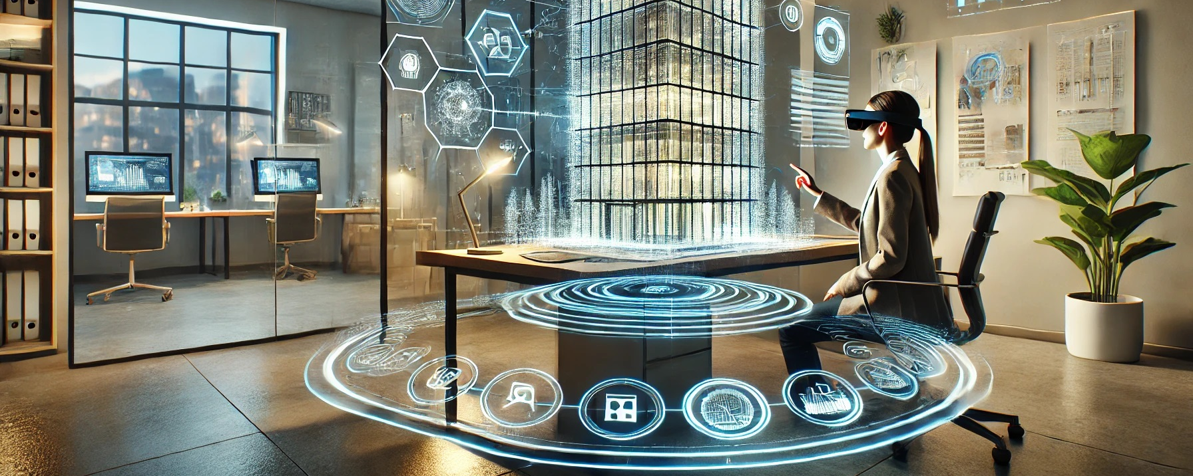
What is Mixed Reality?
Mixed Reality (MR) merges real and virtual environments, allowing users to interact with both physical and digital objects in real-time.
Combines Augmented Reality (AR) and Virtual Reality (VR), seamlessly blending virtual elements with reality.

Slide 3
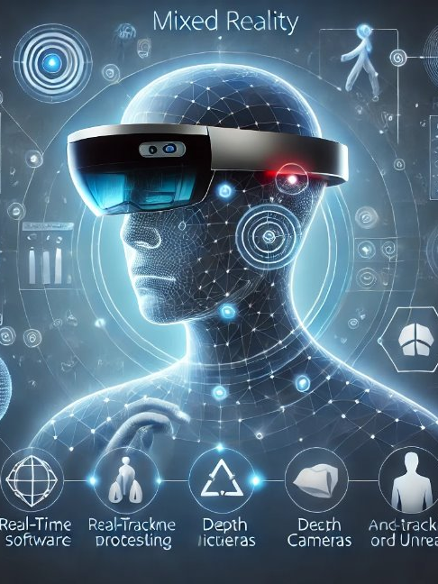
How Mixed Reality Works
Hardware: Sensors (depth cameras, accelerometers) and displays like Microsoft HoloLens.
Software: Real-time data processing and graphics rendering engines (Unity, Unreal Engine).
Interaction Mechanisms: Voice, gestures, and eye tracking enable interaction.

Slide 4
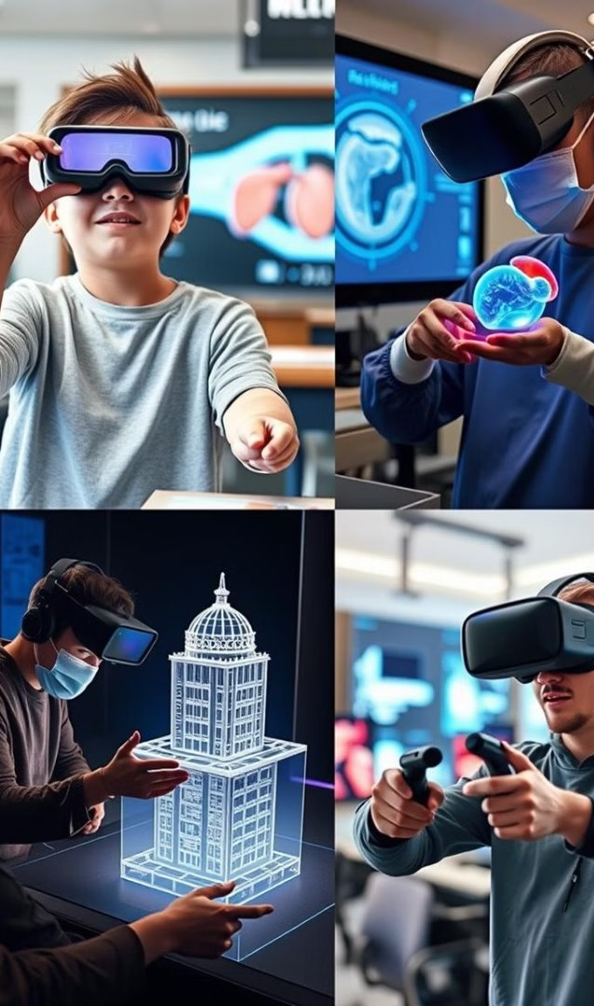
Applications of Mixed Reality
Education: Virtual labs for safe experiments and immersive historical recreations.
Healthcare: Surgical planning, real-time guidance, and mental health therapies.
Engineering and Design: 3D prototyping and machinery operation simulations.
Gaming and Entertainment: Holographic interactions and immersive experiences.

Slide 5
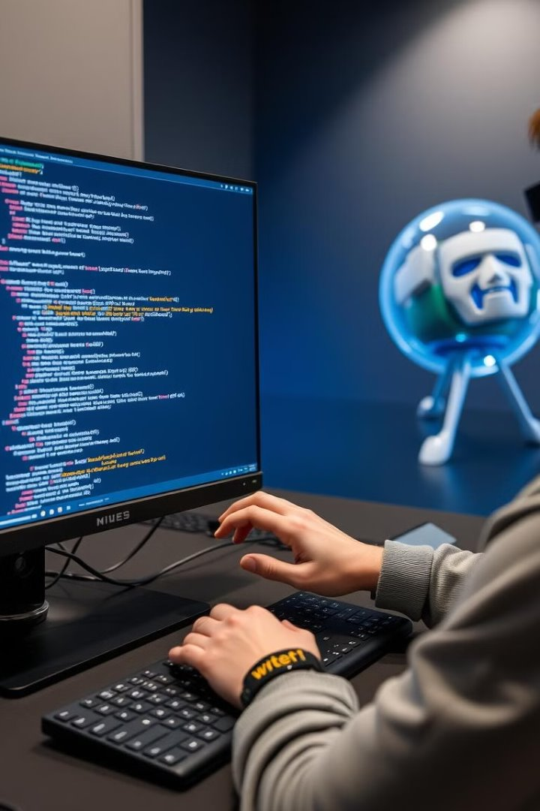
Role of C Programming in Mixed Reality
High Performance: Ideal for real-time data processing in MR.
Hardware Compatibility: Integrates seamlessly with device drivers and APIs.
Algorithm Implementation: Enables tracking, image recognition, and motion sensing.

Slide 6
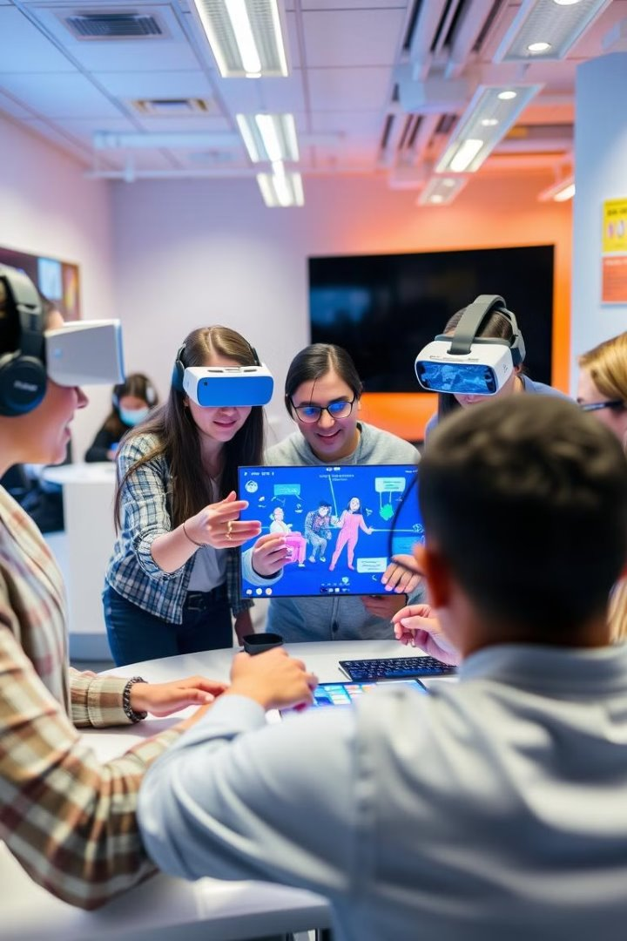
Advantages of Mixed Reality
Enhanced Productivity: Streamlined workflows in manufacturing.
Improved Learning: Immersive training environments.
Realistic Simulations: Cost-effective replicas of risky scenarios.
Collaboration: Shared virtual-physical environments foster innovation.

Slide 7
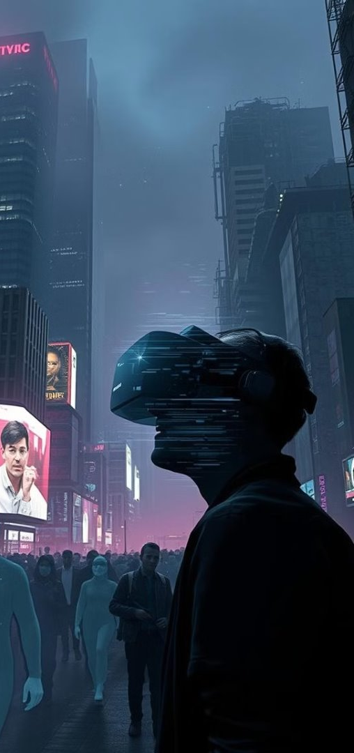
Challenges in Mixed Reality
Technical Limitations: High computational demands and power consumption.
Economic Barriers: Expensive hardware limits accessibility.
Social Concerns: Privacy and potential over-reliance on technology.

Slide 8
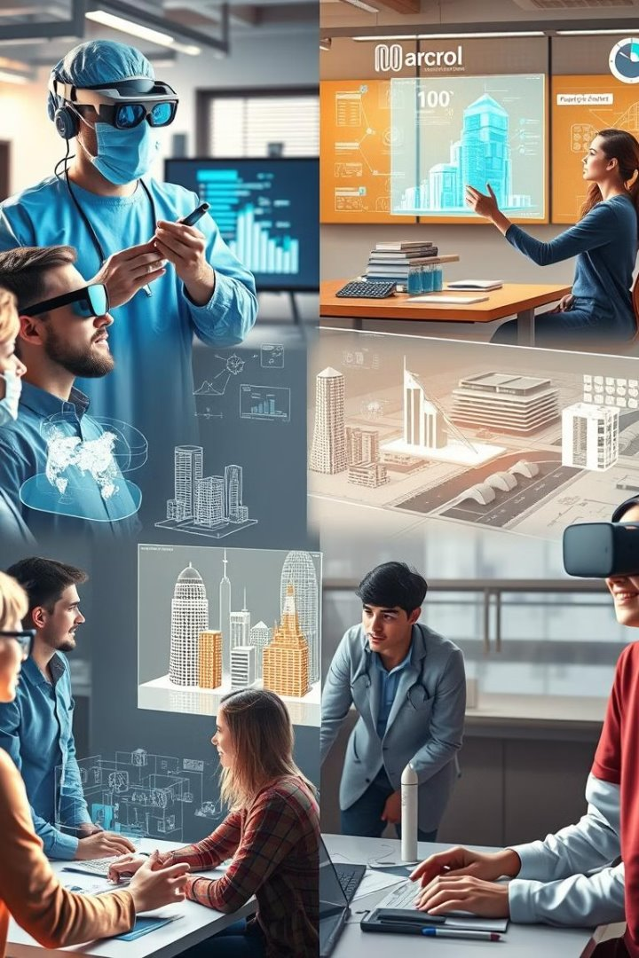
Future of Mixed Reality
AI Integration: Smarter systems powered by Artificial Intelligence.
5G Connectivity: Low-latency interactions enabled by advanced networks.
Wearable Devices: Compact, affordable devices increase accessibility.

Slide 9
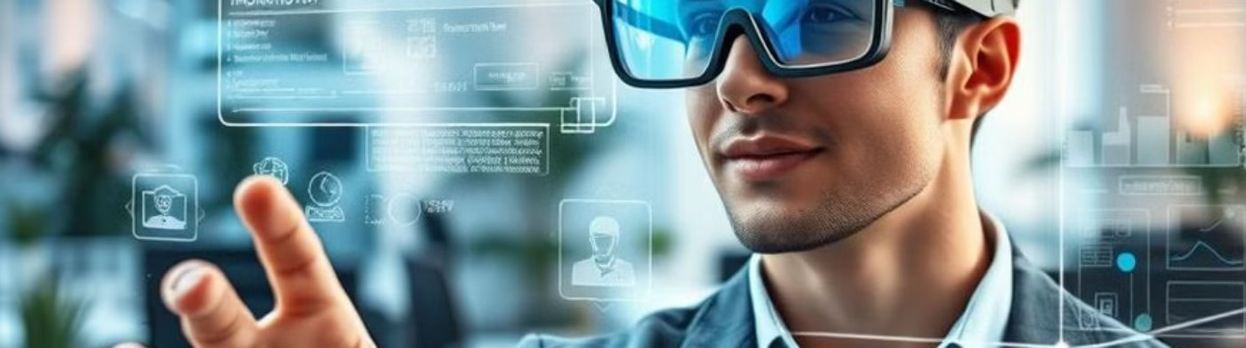
Conclusion
Transformation: MR reshapes interaction by merging real and virtual worlds.
Impact: Broad applications in education, healthcare, gaming, and more.
Vision: MR redefines our relationship with technology and reality.

Slide 10
Thank You

